Slide 1
Human Computer Interaction
Lecture 01
Mr. Umar Khayyam

Slide 2
Introduction
HCI
Human Computer Interaction
It is a field of study that refers to communication between the human (the users) & computer system.
HCI is multidisciplinary field of study focusing on design of computer technology and, in particular, the interaction of between humans(the users) and computers.

Slide 3
Importance
In a world dominated by technology, seamless interaction with computers is essential for productivity, & satisfaction.
HCI has several benefits, both for users and designers.
Understanding users’ needs
Creating meaningful interactions
Contributing to UX design and research
Making technology accessible
1. Ubiquity of Technology
Computers & devices are integral to daily life.
Poor HCI design can lead to frustration, reduce productivity, & even safety risks.
2. Business Success
Users-friendly products have a competitive edge in the market.
HCI contributes directly to customer satisfaction & loyalty.

Slide 4
Importance
3. Social & Ethical Responsibility
Ensures equitable access to technology
Reduces barriers for undeserved populations.

Slide 5
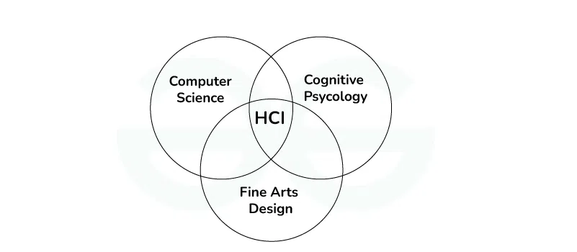
Objective
Human uses digital devices to perform various activities.
HCI is to design a system in such a way that make them efficient, stable, usable.
Lack of communication can result in poor designed user interfaces.
There are some disciplines contributing to HCI.

Slide 6
Different Design Needs
1. User Diversity
Age Groups
Young users require visually engaging interactions.
Elderly users need larger fonts, simple, & readable.
Cultural Differences
Language, Layout, Symbols.
2. Context Of Use
Workplace
Task-specific, efficient designs (e.g. Dashboards for data analysis).
Entertainment
Visually appealing interface (e.g. Gaming UI, streaming platform).
Health Care
Accuracy-focused systems for monitoring, diagnosis, & patient management.

Slide 7
Different Design Needs
3. Technological Variability
Desktop
Comprehensive, multi-tasking interface.
Mobile
User-friendly mobile layouts.
Wearables
Context-aware designs.

Slide 8
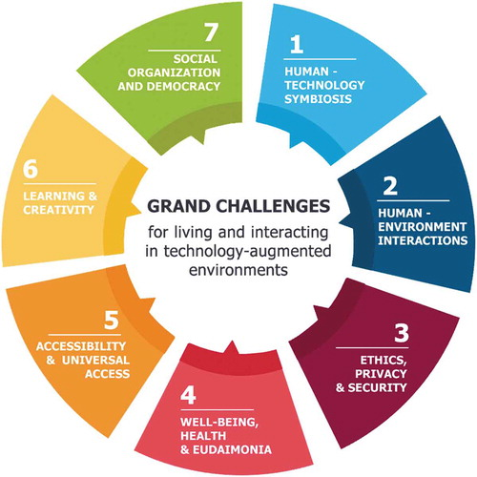
Challenges in HCI

Slide 9
Challenges in HCI
1. Human Technology Symbiosis
Creating systems that seamlessly integrate with human thought and actions.
2. Human Environment Interactions
Examines how social and environmental change over time.
3. Ethics, Privacy, & Security
Addressing ethical concerns, ensuring user privacy, and securing data.
4. Well-Being Health & Eudaimonia
Design technologies in that manner to promote mental health, prevent addiction, and enhance quality of life.
5. Accessibility & Universal Access
Ensuring technology is usable by all individuals, and easily available to all users.

Slide 10
Challenges in HCI
6. Social Organization & Democracy
Design systems that support social collaboration, community building.
With the appropriate technological support, people will be able to better address contemporary fundamental problems such as energy use, pollution, climate change, immigration, and poverty.
7. Learning & Creativity
Using technology to foster education, skill development.
People with diverse backgrounds, skills, and interests will be able to collaborate to solve challenging problems, by cooperatively learning and creating knowledge together.
In this new era, technology will support and promote new learning styles, multimodal learning affordances, as well as lifelong learning.

Slide 11
Goals of HCI
1. USABILITY
One of the key concept in HCI.
It is concerned with making systems easy to learn and use.
A Usable System is:
Easy to learn.
Easy to remember how to use.
Effective to use.
Efficient to use.
Safe to use.
Enjoyable to use.

Slide 12
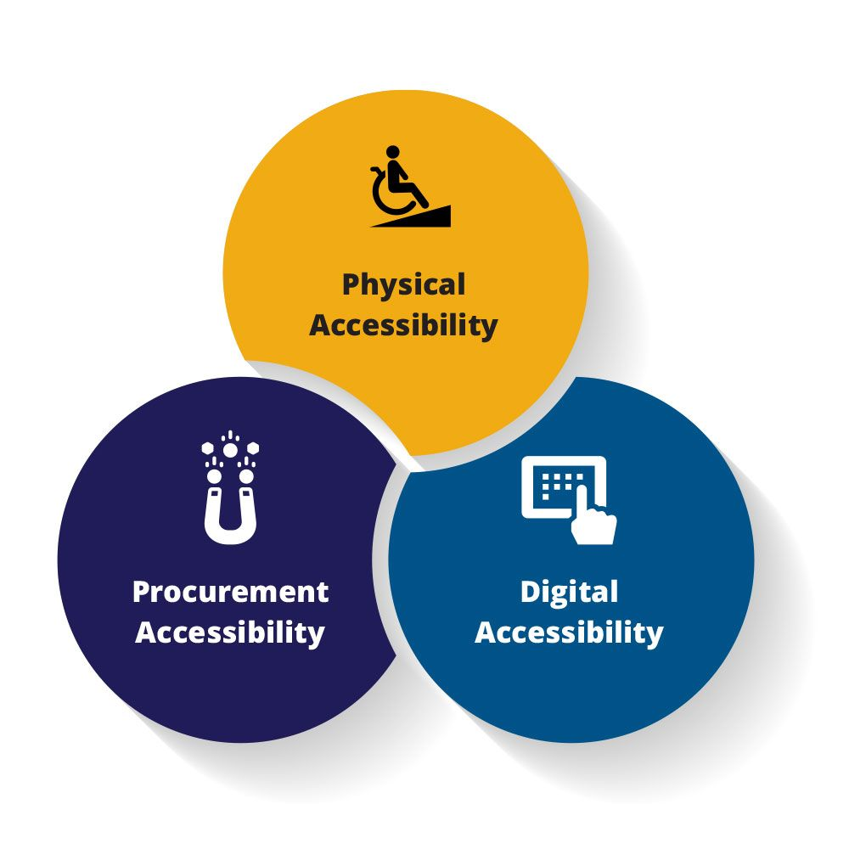
Goals of HCI
2. Accessibility
Ensuring that all the users have equal access to digital platforms.

Slide 13
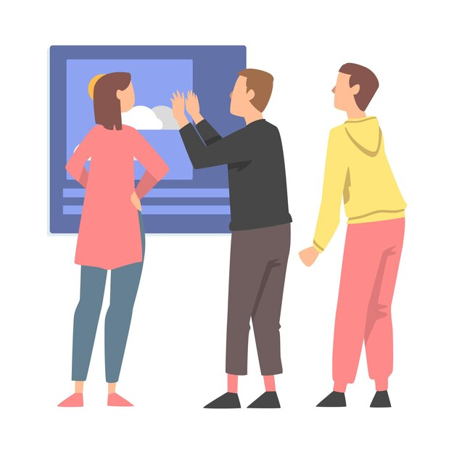
Goals of HCI
3. Understanding User Characteristics
Understanding how users behave, think, & what their preferences are.

Slide 14
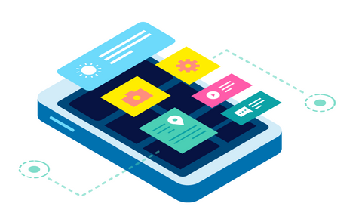
Goals of HCI
4. Learnability
Provide clear instructions, tutorials, & help documentation to guide users.
5. User Interface
Designing the user interface to ensure the user’s satisfaction & perception of technology.

Slide 15
Lecture Completed!
Thank You

