Slide 1
Human Computer Interaction
Lecture 04
Mr. Umar Khayyam

Slide 2
Cognition
Introduction:
We take an example like I suggest you to drive a car with your Computer Keyboard.
How your mind will think to drive that car with keyboards.
What is Cognition?
Cognition is what goes in our mind when carry out our every day's activities.
It involves cognitive processes, like thinking, learning, remembering, decision making, seeing, reading, writing, daydreaming, and talking.
It is important to note that many of these cognitive processes are independent.

Slide 3
Cognition
Cognition has also been described in terms of specific kinds of processes.
Attention
Perception & Recognition
Memory
Learning
Reading, Speaking, and Listening
Problem Solving, Planning, Reasoning, Decision Making

Slide 4
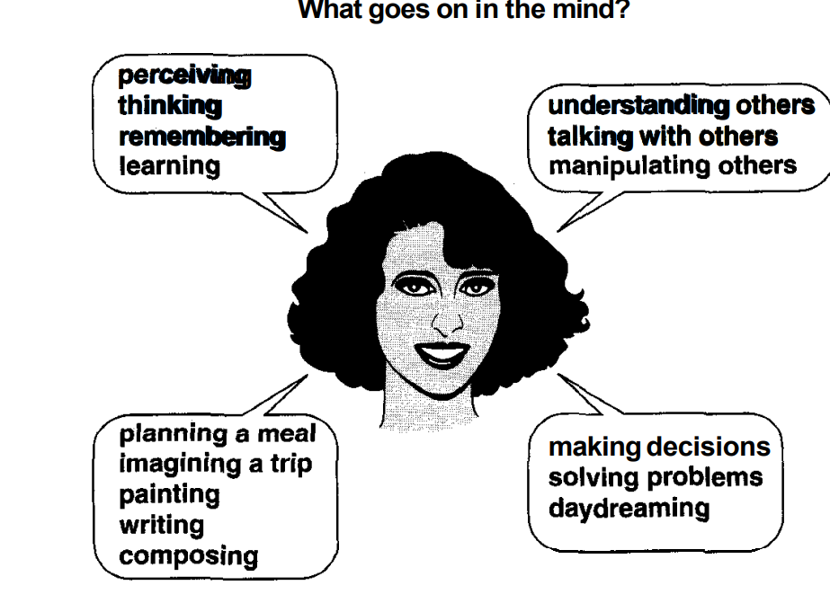
Cognition

Slide 5
Cognitive Framework
In this section we will discuss THREE approaches, which have a different perspective on cognition.
Mental Models
Information Processing
External Cognition
Mental Models
A mental model is a user’s internal representation of how a system works, based on their understanding and experiences.
It guides their interactions & expectations when using the system.
Significance
Helps users to predict and interact with the system.
Aligning design with user mental models improves usability.
Example: A folder icon on desktop reflects the mental model of physical file.

Slide 6
Cognitive Framework
Information Processing
Information Processing refers to the cognitive processes users engage in while interacting with systems, modeled similarly to how computers handle information.
Understanding these stages enables designing systems that reduce cognitive load improve efficiency.
External Cognition
Use of external artifacts to augment or reduce cognitive efforts.
External visuals, tools, or interfaces,
How user manipulate these tools to offload memory or computation.

Slide 7
Cognitive Framework
Information Processing
Information Processing refers to the cognitive processes users engage in while interacting with systems, modeled similarly to how computers handle information.
Understanding these stages enables designing systems that reduce cognitive load improve efficiency.
External Cognition
Use of external artifacts to augment or reduce cognitive efforts.
External visuals, tools, or interfaces,
How user manipulate these tools to offload memory or computation.

Slide 8
Lecture Completed!
Thank You

