Slide 1

Grab mart
UX report
By Umar Kasan

Slide 2
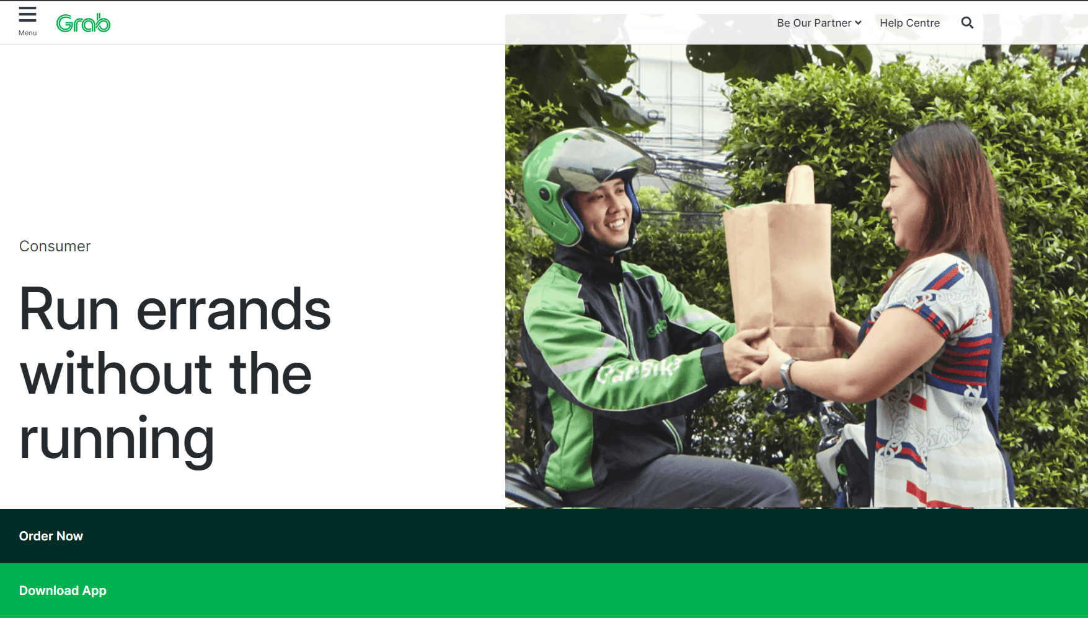
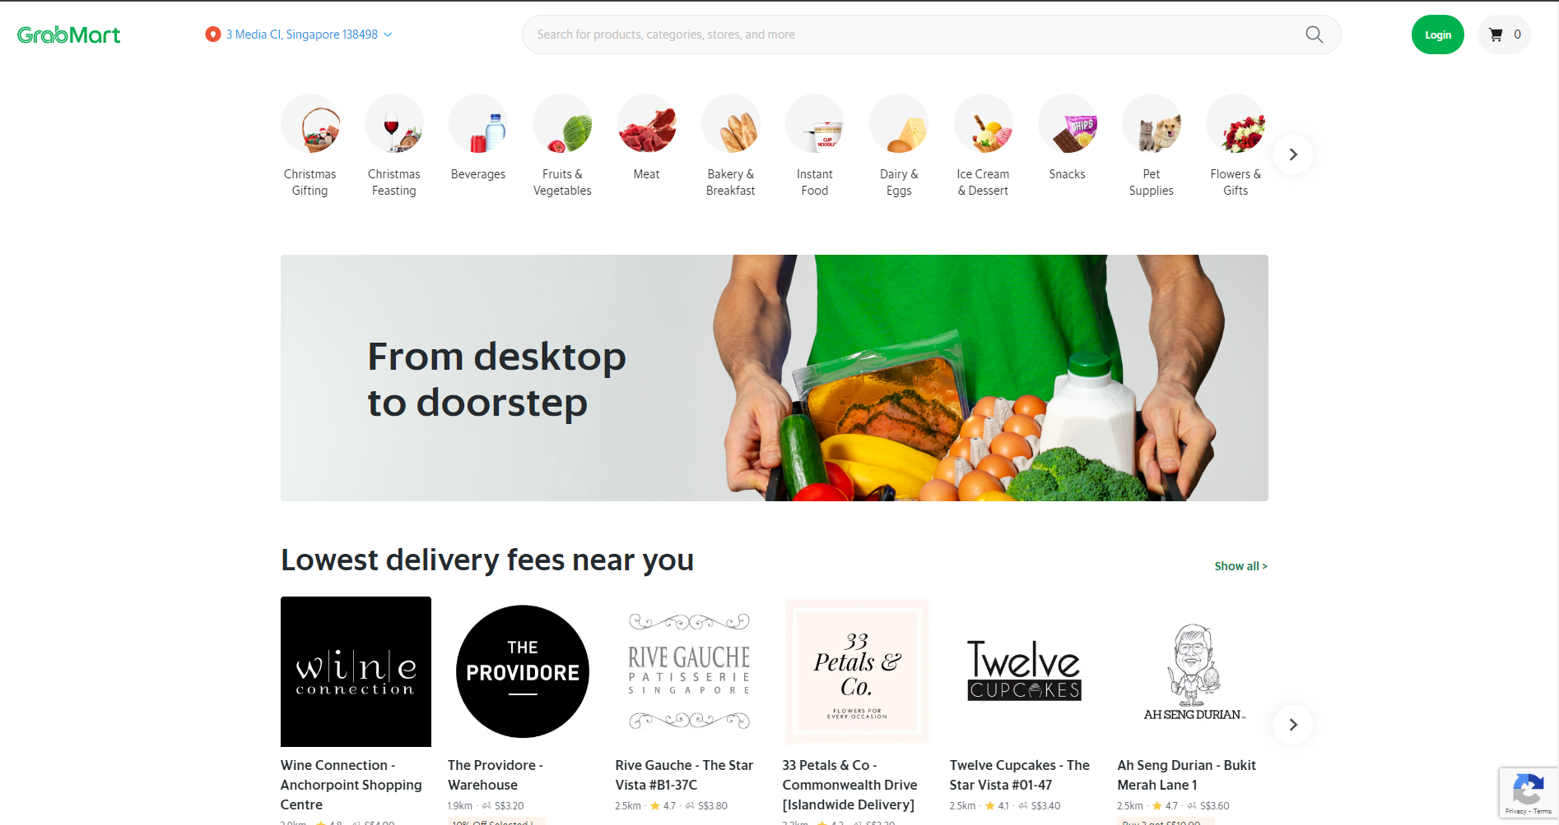
Current site
Landing Page
Second Page

Slide 3
Experience Map (Empathise)
Inconvenient way to access the website, too many layers to go through
Not enough description of items
Need to download app
Takes too long to navigate
Too many words that is not meant for consumer
Item do not show details of ingredients
Unable to select schedule to deliver items
Some pictures not shown

Slide 4
Survey
What is your expected time of use in any e-commerce?
Response: About 15 minutes.
Do you prefer to search in the search bar or click on the categories when looking for your items?
Response: Categories
Would you like recommended bundle deals that have a slight discount?
Response: Yes
Would you prefer to scroll or select the pages
Response: scroll

Slide 5

Persona A
Name: Rick
Occupation: culinary student
Marital status: Single
Reason for accessing site:
Looking for specific ingredient and nutritional value for her school report
Need to replicate experiment in school kitchen for examination
Has to buy a large variety of ingredients
Unable to carry the ingredients to school and will not look cool in front of his female classmates

Slide 6

Persona b
Name: Mellissa
Occupation: Full time Graphic Designer
Marital status: Single Mother of 2 kids
Reason for accessing site:
Easy to cook nutritious meals for her kids
Has no time to buy groceries at a cheap price
Only available to collect at certain time
Has to pick up kids at pre-school

Slide 7
Ideation
Common pain point:
Process from web page to grab mart page takes too long
Schedule delivery is difficult to find as well
Address is identified as current location and not where it will be delivered to which may cause issues if the delivery is too far
Cannot use social media to log in
Lack of better categories that suit niche needs of users

Slide 8
Scenario A
Allow the user to go to Grab Mart website directly, instead of the download the app page.
The user is allowed to change the address at any moment of his order instead of prior need to input the address before making an order
Additional description is shown in the items tag such as weight to compare similar items
Search for the order
Checks out

Slide 9
Scenario b
Purpose: More specific item categorising
After log in, user can select over a myriad of preselectors that will show case below the header
Below the header will include categories for promotions and deals that was selected
Category such as:
Easy to cook meals, differ from instant food
Promos
BBQ

Slide 10
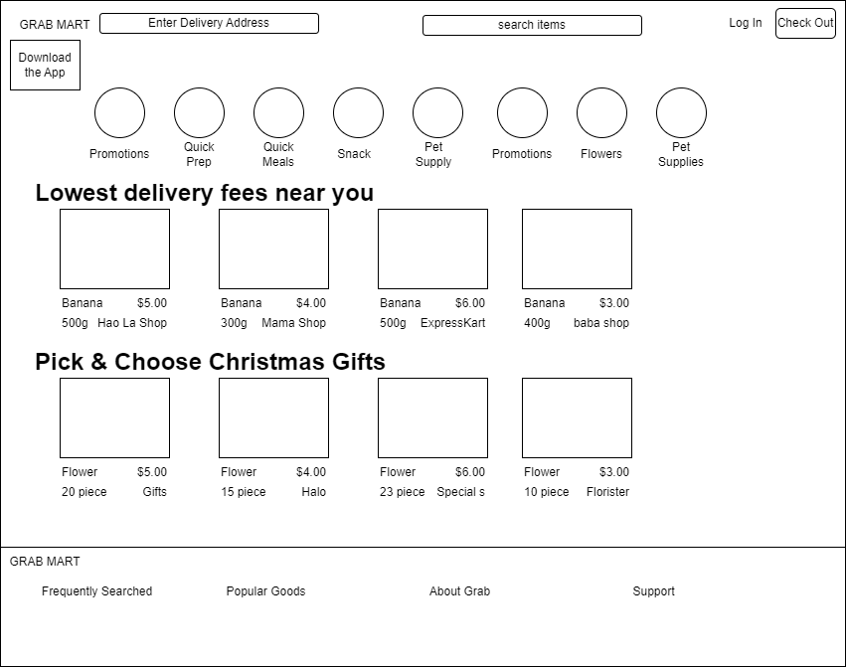
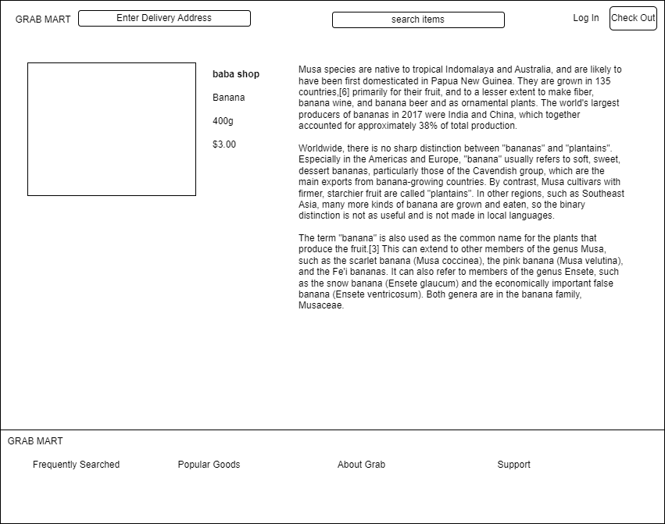
Wireframe
For scenario A
Download app option
When clicked will go to a detail page of the product
More information of product

Slide 11

Thank You

