Slide 1


Design & Develop Front End Community Portal
Module Project
Module: NICF-UI Frameworks
Course: NICF-Advanced Certificate in Web Development
Start Date : 5 Dec 2022
End Date : 14 Jan 2023
Submission Date : 12 Jan 2023
Learner Name : Umar Bin Kasan
Enrollment ID : 9022A
Presentation Date : 14 Jan 2022

Slide 2
Document History
Version Number | Effective Date of release | Summary of Included Changes | Author
1 | 4th March 2016 | First Edition | Satya CVS
2 | 7th April 2017 | Changed for Module 2 | Shrinivas K R
3 | 14th May 2017 | Changed for Module 3 | Shrinivas K R
4 | 03rd May 2018 | Changed for RQF | Shrinivas K R
5 | 16th Sep 2018 | Change for Java Track | Shrinivas K R

Slide 3
Contents
S. No. | Description
01 | Development Tools
02 | Feedback Techniques
03 | Pages Inventory
04 | Forms & Pages Design
05 | Forms & Pages Feedback
06 | HTML Pages
07 | Usability Metrics
08 | User Interaction Steps
09 | User Interaction Flowchart
10 | Current & Desired Usability
11 | Prototype Screen
12 | Prototype Feedback
13 | Usability Test
14 | Project Milestones & Tasks
15 | Milestone Feedback & Action taken
16 | Project Results
17 | Proposed Improvements

Slide 4

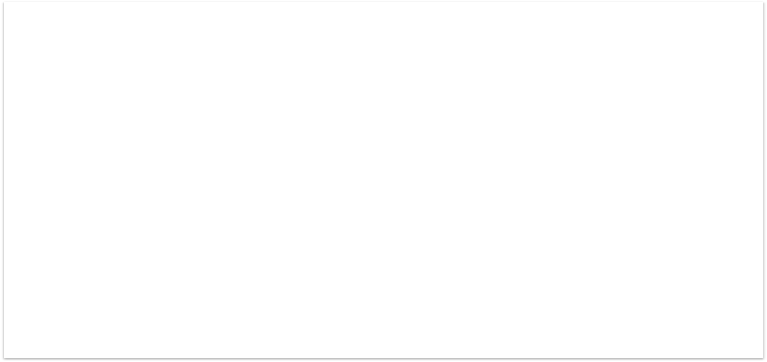
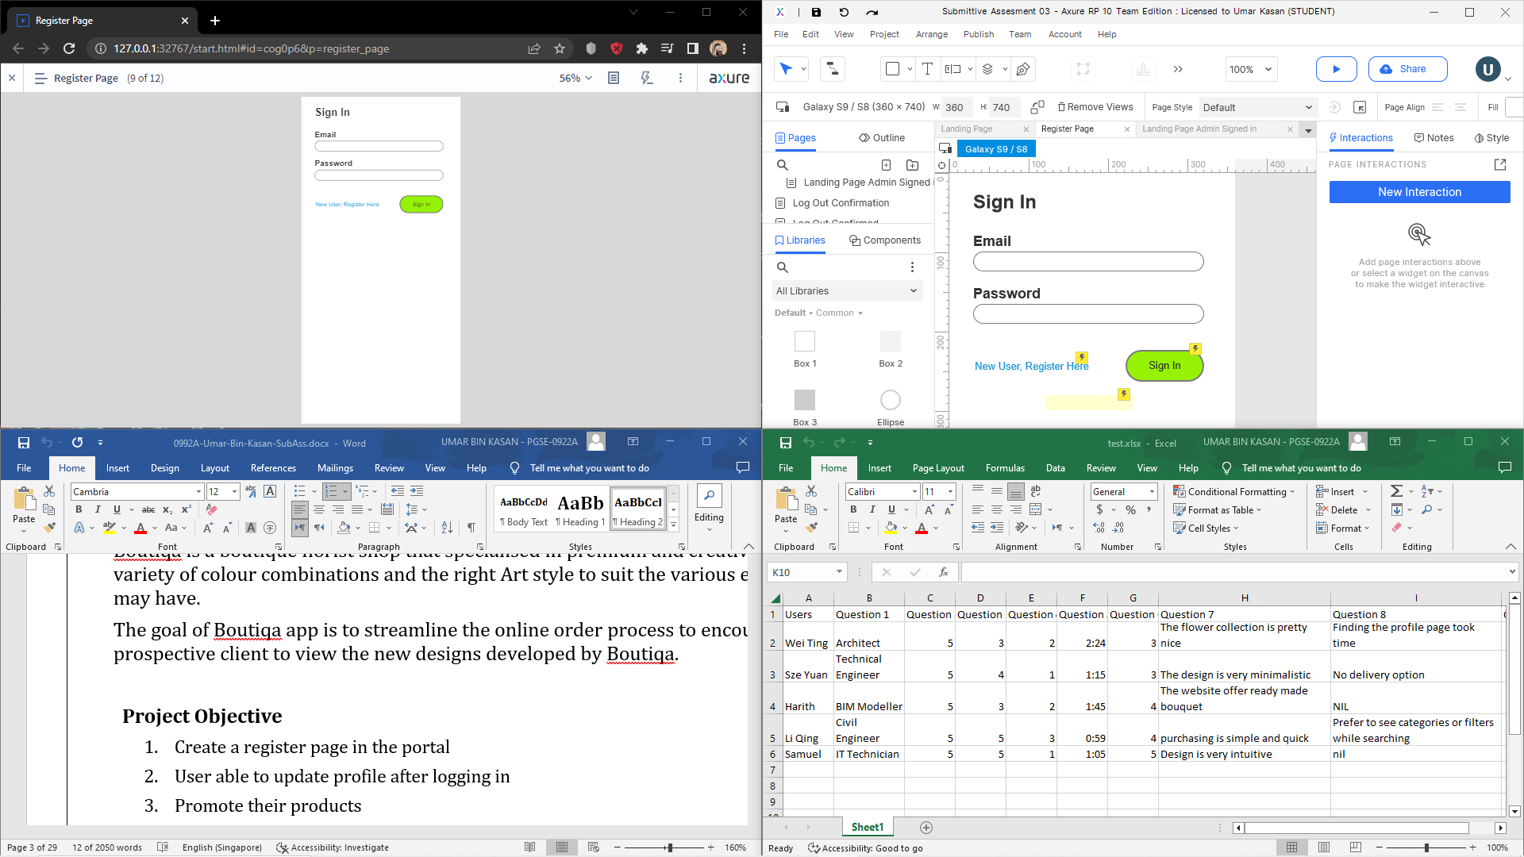
1. Development Tools
Development Tools Screen captures
Axure RP tool
Word
Microsoft Excel
Google Chrome

Slide 5

2. Feedback Techniques
Feedback gathering techniques
1 on 1 interview questions
consisting of pre test questions
followed by a trial run and post test question

Slide 6
3. Pages Inventory
List of Pages for which UI need to be developed
S. No. | Page Name
1 | Landing Page
2 | Register + Forget Password + Reset Password Page
3 | Item page
4 | Log Out Confirmation
5 | Log out confirmed
6 | Profile page
7 | Check out page

Slide 7
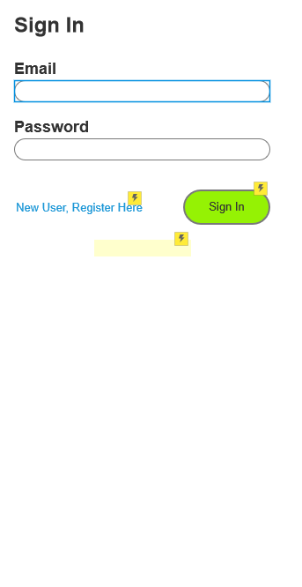
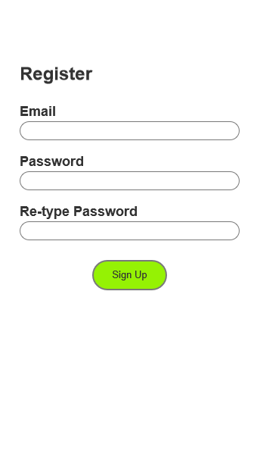
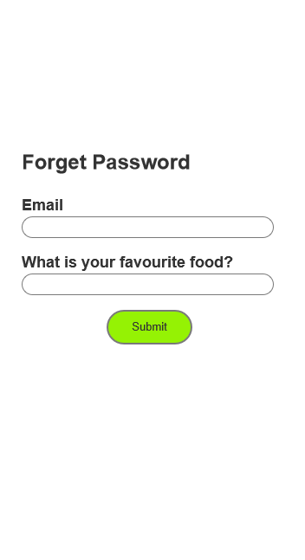
4. Forms & Pages Design

Slide 8
5. Forms & Pages Feedback
Users | Question 1 | Question 2 | Question 3 | Question 4 | Question 5 | Question 6 | Question 7 | Question 8 | Question 9
Wei Ting | Architect | 5 | 3 | 2 | 2:24 | 3 | The flower collection is pretty nice | Finding the profile page took time | 3
Sze Yuan | Technical Engineer | 5 | 4 | 1 | 1:15 | 3 | The design is very minimalistic | No delivery option | 4
Harith | BIM Modeller | 5 | 3 | 2 | 1:45 | 4 | The website offer ready made bouquet | NIL | 3
Li Qing | Civil Engineer | 5 | 5 | 3 | 0:59 | 4 | purchasing is simple and quick | Prefer to see categories or filters while searching | 5
Samuel | IT Technician | 5 | 5 | 1 | 1:05 | 5 | Design is very intuitive | nil | 4

Slide 9

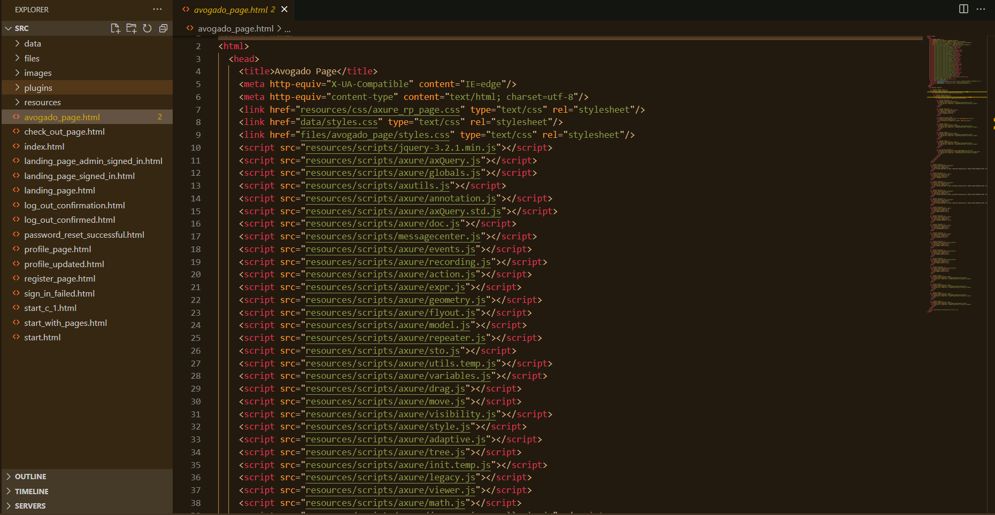
6. HTML Pages
Screen capture of Pages

Slide 10
7. Usability Metrics

Slide 11
8. User Interaction Steps
The questionnaire consists of 3 parts; Pre-Test, trial Test & Post test. The Pre-test checks on the user demography The trial test observes the user time to use the website without the questioner interfering the test. Expectations and goals are explained prior the trial test. Tester are given the following information: Email: user1 Password:123 Goal: Login -> Key in email and password -> profile page -> edit username ->go main page->

Slide 12
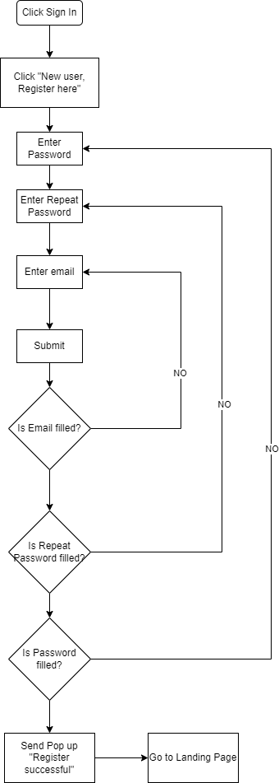
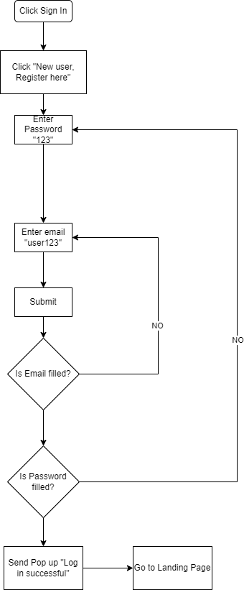
9. User Interaction Flowchart

Slide 13
10. Current & Desired Usability
1. TSR: Task Success Rate
User 1 User 2 User 3 User 4 User 5
144sec 75sec 105sec 59sec 65sec
Time on task is : 89.6 sec
2. UER
A possible of 3 errors
User 1 User 2 User 3 User 4 User 5
0 0 0 0 0
Error rate is : 0% error rate
3. NPS
From a survey done (1 ~ 3 : detractors, 4: Passive, 5 Promoter)
User 1 User 2 User 3 User 4 User 5
3 4 3 5 4
Net Promoter score is : -20% score

Slide 14
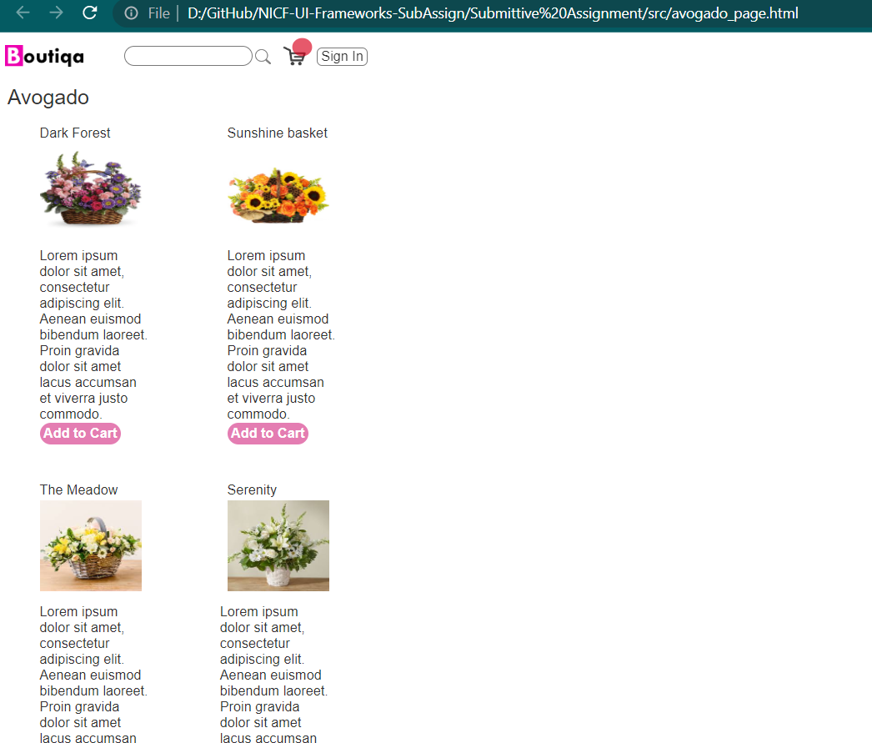
11. Prototype Screen

Slide 15
12. Prototype Feedback
Users | Question 1 | Question 2 | Question 3 | Question 4 | Question 5 | Question 6 | Question 7 | Question 8 | Question 9
Wei Ting | Architect | 5 | 3 | 2 | 2:24 | 3 | The flower collection is pretty nice | Finding the profile page took time | 3
Sze Yuan | Technical Engineer | 5 | 4 | 1 | 1:15 | 3 | The design is very minimalistic | No delivery option | 4
Harith | BIM Modeller | 5 | 3 | 2 | 1:45 | 4 | The website offer ready made bouquet | NIL | 3
Li Qing | Civil Engineer | 5 | 5 | 3 | 0:59 | 4 | purchasing is simple and quick | Prefer to see categories or filters while searching | 5
Samuel | IT Technician | 5 | 5 | 1 | 1:05 | 5 | Design is very intuitive | nil | 4

Slide 16
13. Usability Test
Log in
S/N | Participants | TOT | UER | TSR | Feedback
1 | Wei Ting | 15s | 0 | Success
2 | Sze Yuan | 10 | 0 | Success
3 | Harith | 15 | 0 | Success
4 | Li Qing | 15 | 0 | Success
5 | Samuel | 20 | 0 | Success
Total or Average |  | 15s | 100% | 100% | Password validations helps user to enter correct data
Register
S/N | Participants | TOT | UER | TSR | Feedback
1 | Wei Ting | 35s | 0 | Success
2 | Sze Yuan | 20 | 0 | Success
3 | Harith | 35 | 0 | Success
4 | Li Qing | 30 | 0 | Success
5 | Samuel | 25 | 0 | Success
Total or Average |  | 30s | 100% | 100% | Password validations helps user to enter correct data
Check Out
S/N | Participants | TOT | UER | TSR | Feedback
1 | Peter | 35s | 0 | Success
2 | Bonnie | 20 | 0 | Success
3 | Aaron | 35 | 0 | Success
4 | Fanny | 30 | 0 | Success
5 | Mike | 25 | 0 | Success
Total or Average |  | 30s | 100% | 100% | Information of delivery price and information helps manage expectations

Slide 17
14. Project Milestones & Tasks
Project Task ID | Project Task Description | Project Milestone ID
1 | Gather user feedback and information | 1
2 | Wireframe designs | 1
3 | Present wireframe design to user | 1
4 | Design Mockups | 2
5 | Develop Prototype | 2
6 | Conduct usability tests | 2
7 | Gather feedback and prototype accordingly | 3
8 | Present final prototype for feedback | 3

Slide 18
15. Milestone Feedback & Action taken
Project Milestone ID | Milestone Feedback received from Tutor / Learning Facilitator | Action Taken (Yes / No)
1 | Gather user feedback and information | 1
2 | Wireframe designs | 1
3 | Present wireframe design to user | 1
4 | Design Mockups | 2
5 | Develop Prototype | 2
6 | Conduct usability tests | 2
7 | Gather feedback and prototype accordingly | 3
8 | Present final prototype for feedback | 3
1 | Gather user feedback and information | 1
2 | Wireframe designs | 1
3 | Present wireframe design to user | 1
4 | Design Mockups | 2
5 | Develop Prototype | 2

Slide 19

16. Project Results (1/2)
List of HTML Pages being Produced
avogado_page.html
check_out_page.html
index.html
landing_page.html
landing_page_admin_signed_in.html
landing_page_signed_in.html
log_out_confirmation.html

Slide 20
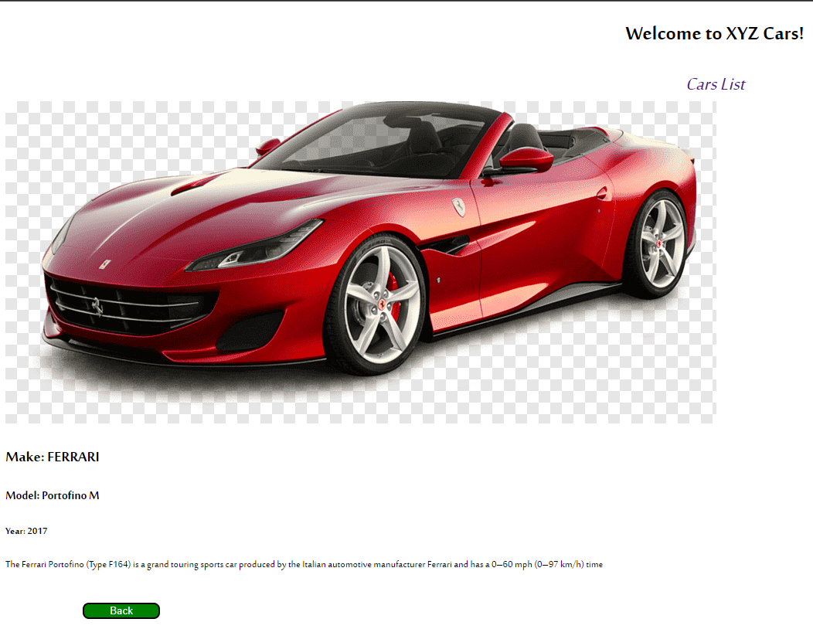
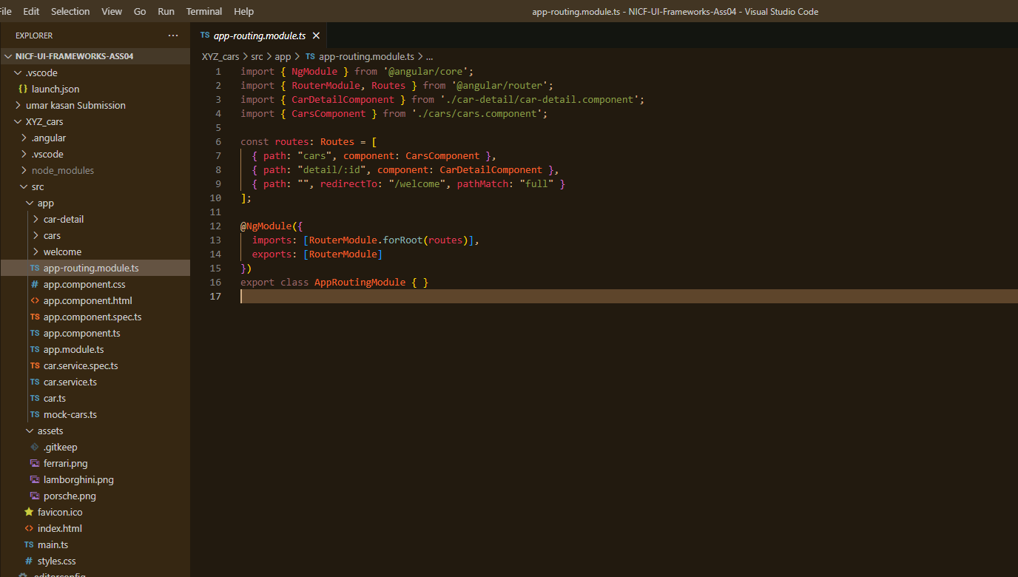
16. Project Results (2/2)
Angular js and app

Slide 21

17. Proposed Improvements
List of Improvements
Create a search bar that works and can be used to search items in the website
Admin have dynamic database

