Slide 1
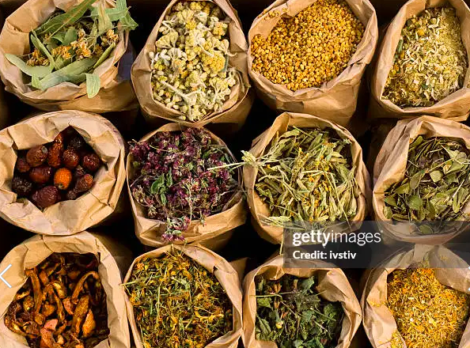
Use of Herbal Remedies
Field Survey Report
Program:
Data Analytics Bootcamp
Presented by:
UMAR MUSA ISAH
Date:
May 2026

Slide 2

INTRODUCTION
Herbal remedies have been used for generations across many communities.
Traditional medicine remains an important source of treatment for common illnesses, particularly where affordability, availability, and cultural beliefs influence healthcare choices.
This survey was conducted to understand patterns of herbal remedy use and respondents’ perceptions of their effectiveness.

Slide 3

ABOUT THE SURVEY
Topic:
Use of Herbal Remedies
Aim: To assess traditional medicine use among respondents.
Objectives:
Identify commonly used herbs
Determine reasons for use
Assess perceived effectiveness
Total Respondents in Final Analytical Dataset: 60
Tools Used for Data Collection:
KoboToolbox
CommCare
Google Forms

Slide 4
RESPONDENT PROFILE
Demographic Overview
Profile Variables
The survey captured respondent demographic characteristics to support analysis of herbal remedy use across different respondent groups.
The demographic variables included gender and age group.
• Gender
• Age Group
FINAL ANALYTICAL DATASET
60 Respondents

Slide 5
HERBAL REMEDY USAGE
HERBAL REMEDY USERS
95.00%
KEY USAGE DIMENSIONS
• Herbal remedy usage
• Commonly used herbs
• Frequency of use
• Reasons for use
• Perceived effectiveness
The survey findings indicates a high level of herbal remedy use among the respondents.
This suggests that herbal remedies represent a significant reported healthcare practices.
ANALYTICAL FOCUS
Understanding why respondents use herbal remedies and how they perceive their effectiveness.

Slide 6
KEY ANALYTICAL FINDINGS
HERBAL USAGE RATE
95%
EFFECTIVENESS RATE
92%
RECOMMENDATION RATE
78%
SIDE EFFECTS RATE
37%
KEY INSIGHTS
• Herbal remedies were widely used among the surveyed respondents.
• Most respondents perceived herbal remedies as effective.
• A substantial proportion of respondents indicated willingness to recommend herbal remedies.
• More than one-third of respondents reported experiencing side effects.
ANALYTICAL NOTE
The findings highlight both the continued use of herbal remedies and the importance of safe-use awareness, appropriate guidance, and further public health education.

Slide 7
LESSONS LEARNED & CHALLENGES
LESSONS LEARNED
CHALLENGES
• Respondent availability and engagement
• Data collection across different platforms
• Maintaining consistency during data preparation
• Ensuring data quality before analysis
• Digital data collection improves data organization.
• Data cleaning is essential before analysis.
• Cross-tool validation strengthens confidence in results.
• Data visualization makes findings easier to communicate.
PROJECT TAKEAWAY
Structured data collection, careful data preparation, and cross-tool validation are critical to producing reliable analytical results.

Slide 8
RECOMMENDATIONS & CONCLUSION
RECOMMENDATIONS
• Promote safe and informed use of herbal remedies.
• Strengthen public awareness on potential side effects and appropriate use.
• Encourage consultation with qualified healthcare or traditional medicine practitioners.
• Improve documentation and monitoring of herbal remedy use.
CONCLUSION
The survey shows that herbal remedies remain widely used among the respondents.
The findings also indicate a strong perception of effectiveness and willingness to recommend herbal remedies, while reported side effects highlight the importance of safe-use awareness.
Overall, the project demonstrates how structured digital data collection, data preparation, analysis, and visualization can support evidence-based understanding of herbal remedy use.
KEY MESSAGE
Evidence-based analysis can help translate community survey data into practical insights for safer and more informed decision-making.

Slide 9
PROJECT METHODOLOGY
01
DATA COLLECTION
KoboToolbox
CommCare
Google Forms
02
DATA PREPARATION
Review
Cleaning
Standardization
03
DATA ANALYSIS
Excel
SQL
Power BI
04
VALIDATION
Cross-tool
Result Checking
QA
05
REPORTING
Dashboard
Presentation
Documentation
The project followed a structured workflow from digital data collection through data preparation, analysis, validation, and final reporting.
FINAL ANALYTICAL DATASET
60 Respondents

Slide 10
DATA ANALYSIS & TOOLS
EXCEL
Data Cleaning
Data Preparation
Initial Analysis
SQL
Data Integration
Querying
Analytical Validation
POWER BI
Dashboard Development
KPI Visualization
Data Storytelling
ANALYTICAL WORKFLOW
Data Cleaning → Data Integration → Analysis → Visualization → Reporting
FINAL OUTPUT
Validated analytical findings
and professional visual reporting

Slide 11
PROJECT DELIVERABLES
01
CLEANED DATASET
Prepared and standardized
survey data for analysis.
02
DATA ANALYSIS
Excel and SQL-based
analytical outputs..
03
POWER BI DASHBOARD
Interactive visual analysis
and KPI reporting.
04
SURVEY REPORT
Structured presentation of
key findings and insights.
05
DOCUMENTATION
Supporting documentation
for project reproducibility.
06
PORTFOLIO ASSET
Professional project package
for portfolio presentation.

Slide 12
THANK YOU
Use of Herbal Remedies
Field Survey Report
Data-driven insights from community survey data
Presented by
UMAR MUSA ISAH

