Slide 1






TVET Programme Impact Assessment
Prepared by
Umar Musa Isah
Data Analytics Bootcamp
August 2026
Excel | SQL | Power BI | KoboToolBox | CommCare | Google Forms

Slide 2

Background
• TVET programmes equip individuals with practical and employable skills.
• Measuring programme outcomes helps determine whether training achieves its intended objectives.
• This assessment evaluates participant experiences, employment outcomes, and programme satisfaction using survey data.

Slide 3

Problem Statement
• Limited evidence is often available on the long-term impact of TVET programmes.
• Programme managers require reliable data to support planning and decision-making.
• This project applies data analytics to evaluate programme performance and identify areas for improvement.

Slide 4

Project Aim
To assess the impact of the TVET programme by collecting, analysing, and visualising participant data to generate evidence that supports programme evaluation and informed decision-making.
Collect reliable survey data
Prepare and clean the dataset
Analyse responses using Excel and SQL Server
Build an interactive Power BI dashboard
Provide evidence-based recommendations

Slide 5
Project Methodology
Questionnaire developed with validation rules and skip logic.
Responses collected through KoboToolbox, CommCare, and Google Forms.
Dataset validated, cleaned, and prepared for analysis.
Descriptive statistics, Pivot Tables, Pivot Charts, and dashboard.
Queries used to retrieve, summarise, and validate analytical results.
Interactive dashboard developed using DAX measures and visualisations.
Findings documented with recommendations and presentation.
📋 Survey
Design
📱 Data
Collection
🧹 Data
Cleaning
📊 Excel
Analysis
🗄 SQL
Analysis
📈 Power BI
Dashboard
📄 Reporting

Slide 6
Data Collection & Management
KoboToolbox
↓
CommCare
↓
Google Form
↓
Exported Data
↓
Microsoft Excel
↓
Cleaned Dataset
Final Dataset Used for Analysis: 54 Valid Responses

Slide 7
Data Analysis Workflow
Data Analysis Workflow
• 54 validated responses
• Duplicate-free
• Ready for analysis
🗂 Cleaned Dataset
• Data validation
• Frequency analysis
• Pivot Tables
• Pivot Charts
📊 Microsoft Excel
The cleaned dataset was analysed using Microsoft Excel, SQL Server, and Power BI to generate reliable insights for programme evaluation.
• Data querying
• Aggregation
• Trend analysis
• Query validation
🗄 SQL Server
• Data modelling
• DAX measures
• Interactive dashboard
• KPI visualization
📈 Power BI
• Key findings
• Recommendations
• Decision support
💡 Insights

Slide 8
Key Findings
👥
✓ A total of 54 valid responses were analysed.
✓ Male respondents accounted for 55.6%, while females represented 44.4%.
✓ Self-employment was the most common employment outcome (70.4%).
✓ Participants reported high overall satisfaction with the TVET programme.
✓ Most respondents indicated they would recommend the programme to others.
⚥
💼
😊
👍
👥 54
Respondents
💼 70.4% Self-employed
😊 High Satisfaction
Key Insight
The findings suggest that the TVET programme has contributed positively to participants' employment outcomes and overall satisfaction, with self-employment emerging as the dominant outcome among respondents.

Slide 9
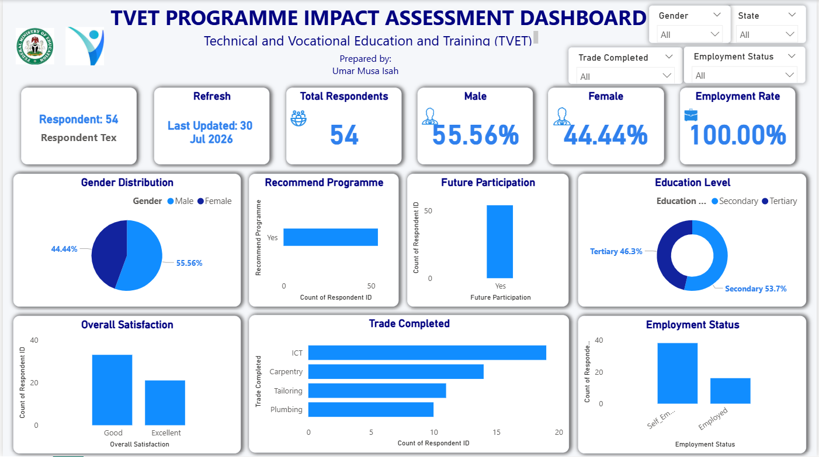
Interactive Dashboard Highlights
👥 54
Respondents
💼 70.4% Self-employed
😊 High Satisfaction
👍 Strong Recommendation Rate
The Power BI dashboard provides an interactive view of the survey results, enabling users to monitor:
• Gender Distribution
• Employment Status
• Training Outcomes
• Income Improvement
• Participant Satisfaction
• Programme Recommendations
Interactive dashboards transform survey data into clear, actionable insights that support evidence-based programme monitoring and decision-making.

Slide 10

Recommendations
Expand access to vocational training so that more individuals can benefit from practical skills development.
Strengthen entrepreneurship support programmes to help graduates grow and sustain self-employment opportunities.
Maintain the current quality of training while continuously improving learning facilities and practical resources.
Conduct regular monitoring and evaluation to measure long-term employment and income outcomes.
These recommendations are based on the survey findings and are intended to support continuous improvement of future TVET programmes.
Use participant feedback to guide future programme planning and continuous improvement.

Slide 11

Conclusion
This assessment demonstrates how digital data collection and data analytics can be used to evaluate the impact of TVET programmes.
The analysis indicates positive participant outcomes, particularly in employment and programme satisfaction. By integrating KoboToolbox, CommCare, Google Forms, Microsoft Excel, SQL Server, and Power BI, the project produced reliable insights that can support evidence-based planning, monitoring, and decision-making.
Overall, the project achieved its objectives and provides a practical framework for evaluating similar development programmes.
✔ Complete End-to-End Workflow
✔ Data-Driven
Insights
✔ Evidence-Based
Recommendations
"Reliable data becomes valuable only when it is transformed into meaningful insights that support better decisions."

Slide 12

Thank You & Questions
THANK YOU
Questions & Discussion
Thank you for your time and attention.
I welcome your questions, comments, and feedback.
Prepared by:
Umar Musa Isah
Data Analytics Bootcamp Capstone Project August 2026
"Turning data into meaningful insights for better decisions."

