Slide 1
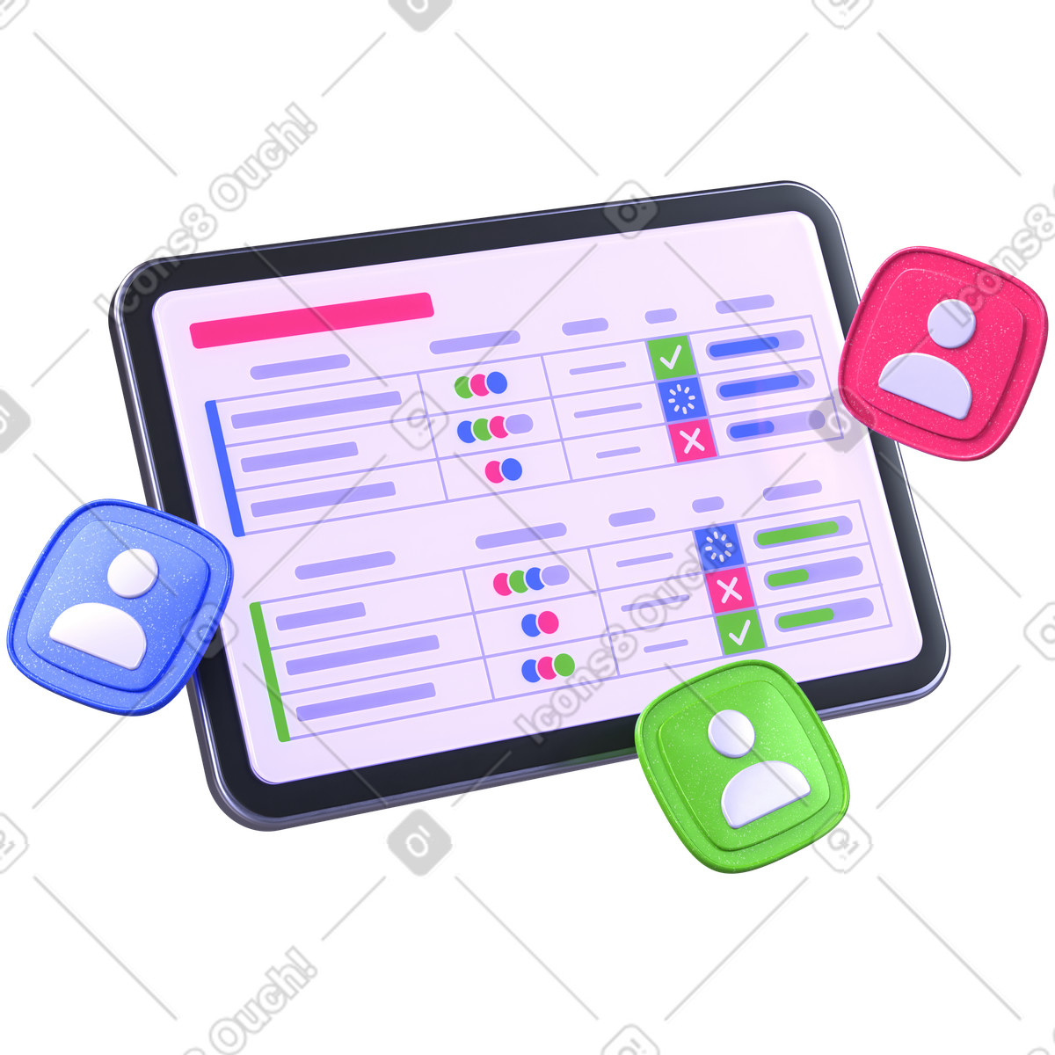

UNDP M&E Indicator Tracker
Kano Youth Livelihood & Empowerment Programme Dashboard
Prepared by: Umar Musa Isah
Data Analyst | Excel | SQL | Power BI | Python
2026

Slide 2



Project Overview
Sector
International Development / NGO
Kano State, Nigeria
12 LGAs Covered
Python, Excel, Power BI, DAX
This project simulates a UNDP Monitoring & Evaluation reporting system designed to track programme implementation, performance indicators, budget utilization, and operational risks across Kano State.

Slide 3




Business Problem
Large-scale development programmes generate substantial operational data from field teams, implementing partners, and beneficiaries.
Without centralized reporting, programme managers struggle with delayed reporting, weak KPI visibility, poor budget monitoring, and slow risk escalation.

Slide 4




Project Objectives
Track beneficiaries across LGAs
Monitor KPI performance
Analyze budget utilization
Identify operational risks

Slide 5

Dataset Overview
Dataset | Records
Beneficiaries | 1500+
KPI Tracker | 7
Budget Tracker | 12
Risk Register | 25
The dataset was synthetically generated using Python to simulate realistic UNDP programme operations.

Slide 6




Data Pipeline
Raw Data → Cleaning → Modeling → DAX → Dashboard
Raw Data
Data Cleaning
Data Modeling
DAX Measures
Power BI Dashboard

Slide 7
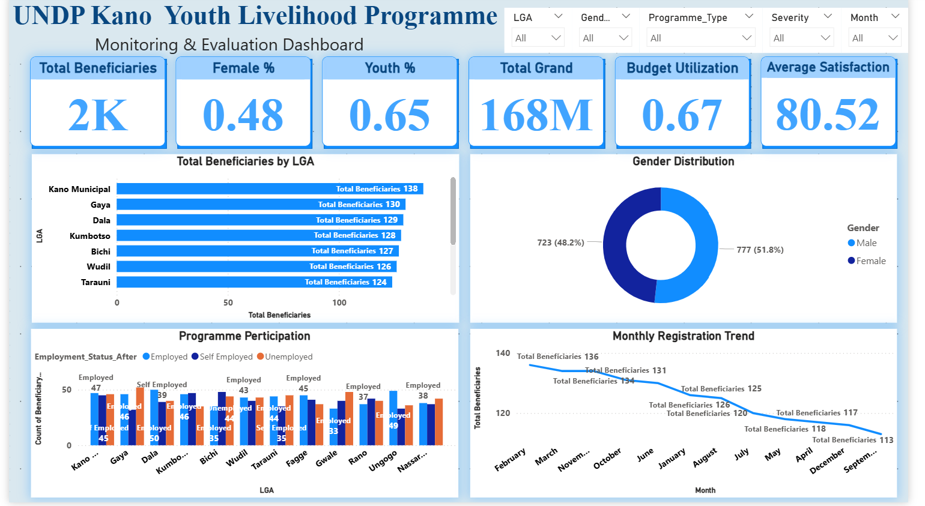
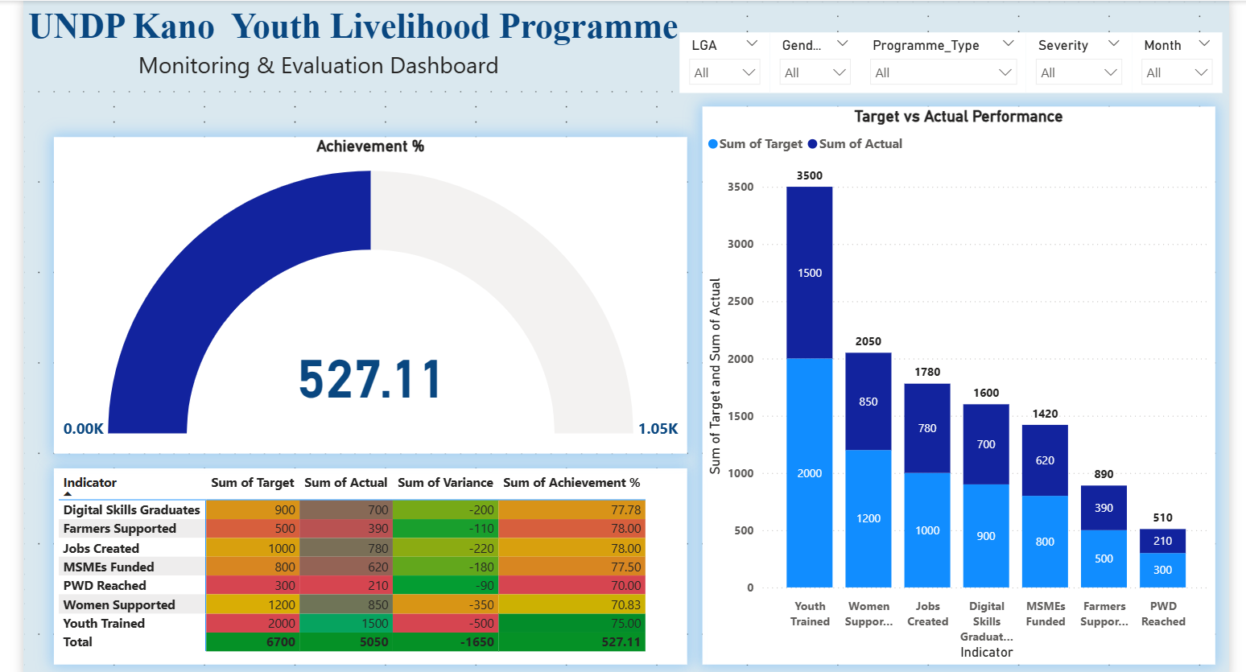
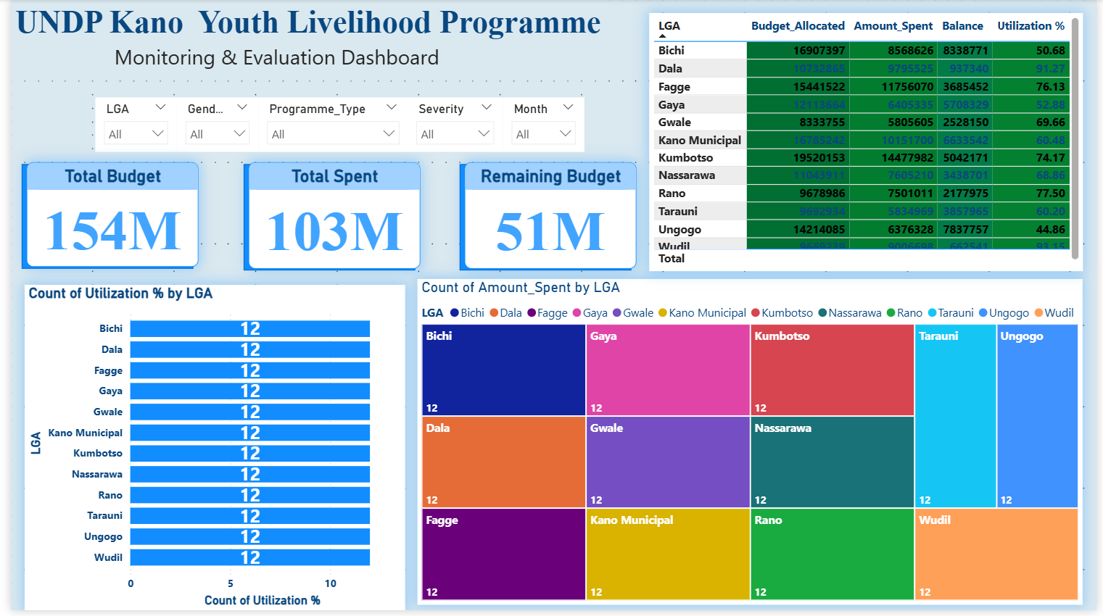
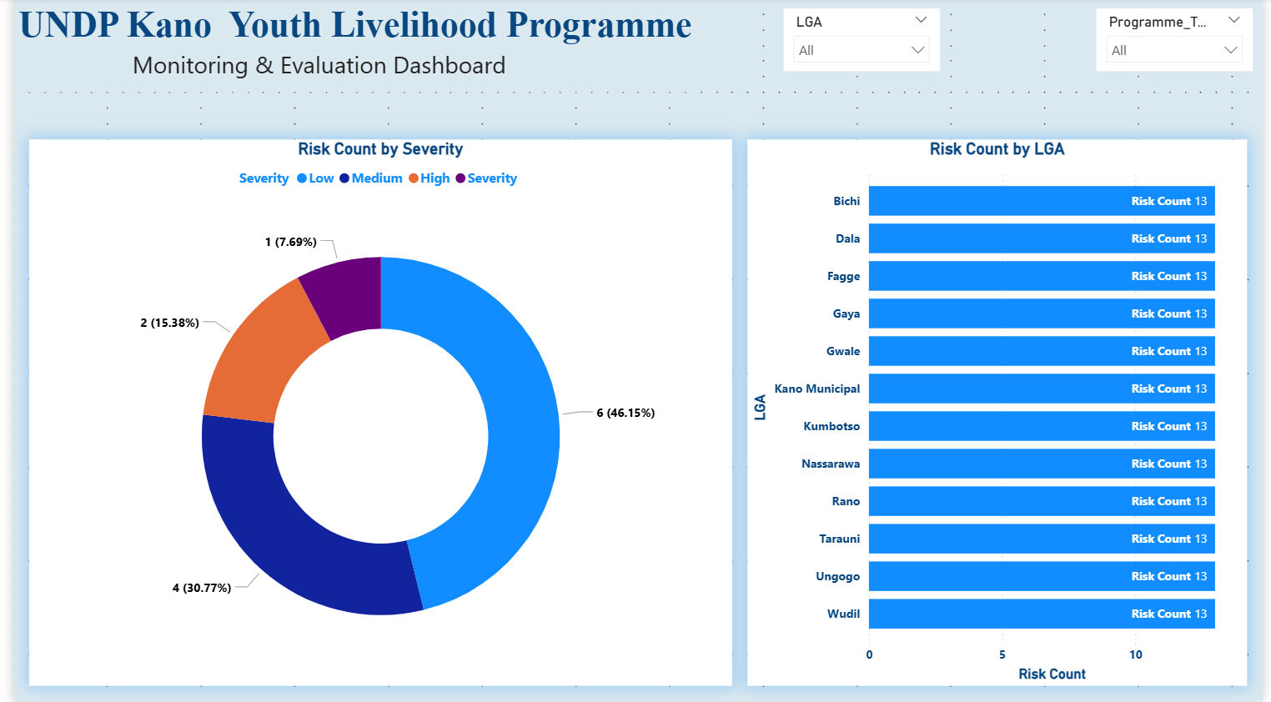
Dashboard Overview
Executive Overview
Programme Performance
Budget Monitoring
Risk Dashboard

Slide 8




Key Insights
1,500+
Beneficiaries
54%
Female Participation
83%
Budget Utilization
76%
Income Growth
Top Programme:
ICT Training
Most Risks:
Medium Severity

Slide 9

Recommendations
Increase support for low-performing LGAs
Strengthen field data validation
Improve grant monitoring process
Expand female outreach in underrepresented LGAs
Enhance risk escalation mechanisms

Slide 10





Skills Demonstrated
Data Cleaning
Python
Excel
Power BI
M&E Reporting
Dashboard Design
DAX
KPI Analytics

Slide 11
Business Impact
The dashboard transformed fragmented programme data into actionable insights, enabling faster reporting, stronger accountability, better risk management, and improved strategic decision-making.
Faster Reporting
Better Governance
Improved Planning
Early Risk Detection

Slide 12

Thank You
Questions?
Umar Musa Isah Data Analyst

