Slide 1

UNICEF Education Monitoring Dashboard
Kano State Education Analysis (2024–2025)
Prepared by Umar Musa Isah
Power BI | Excel | Data Analytics Portfolio
UNICEF Dashboard Portfolio | 2026

Slide 2
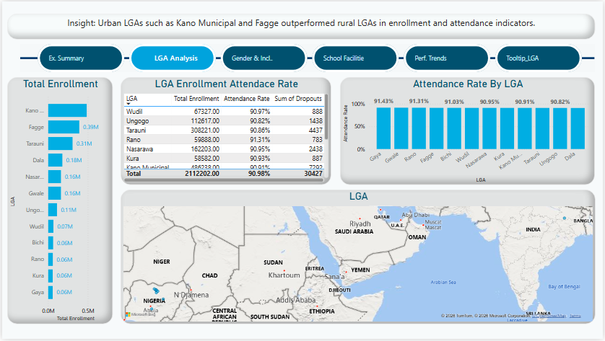
Project Overview
This project simulates a UNICEF-style education monitoring system for Kano State using synthetic data generated with Python and analyzed in Power BI. The dashboard supports data-driven monitoring of enrollment, attendance, gender inclusion, WASH indicators and school infrastructure performance across multiple LGAs.
UNICEF Dashboard Portfolio | 2026

Slide 3


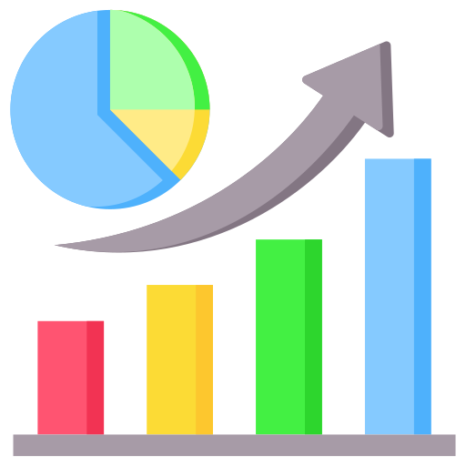



Project Objectives
Monitor school enrollment
Track WASH access
Analyze attendance patterns
Identify infrastructure gaps
Evaluate gender inclusion
Support decision-making
UNICEF Dashboard Portfolio | 2026

Slide 4
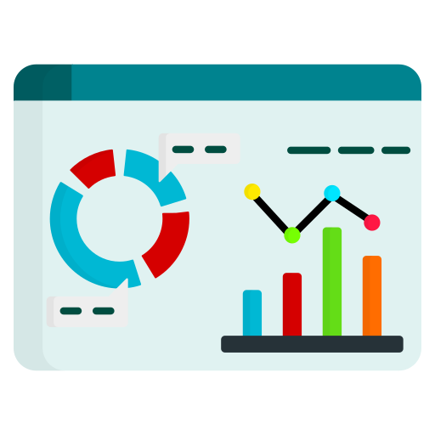


Dataset & Methodology
Table
Python → Excel → Power BI
Metric | Value
Records | 7,500+
LGAs | 12
Time Period | 2024–2025
Tool Used | Python
UNICEF Dashboard Portfolio | 2026

Slide 5
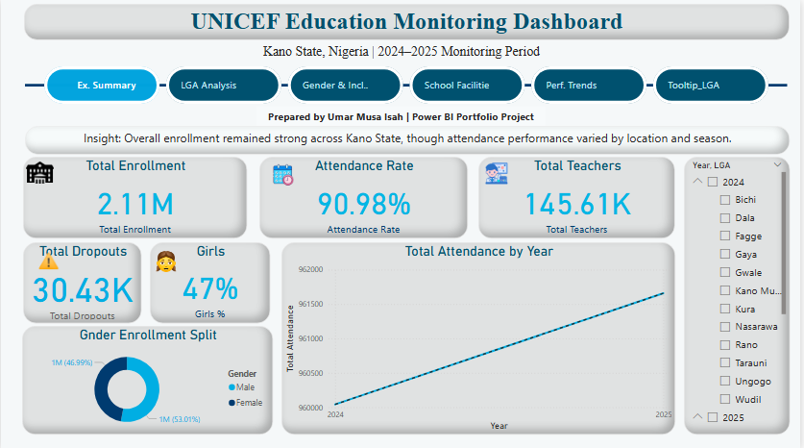
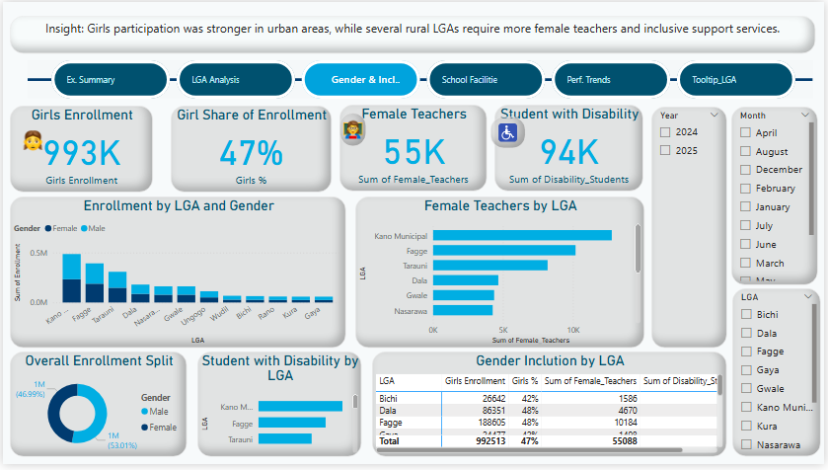
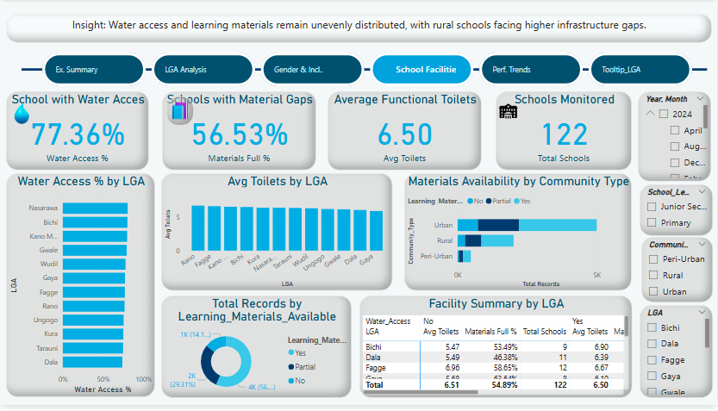
Dashboard Overview
Executive Summary
Gender & Inclusion
WASH & Facilities
UNICEF Dashboard Portfolio | 2026

Slide 6
Key Insights
Urban LGAs demonstrated stronger attendance and enrollment performance than rural LGAs.
Girls participation improved in several communities but rural areas still showed lower inclusion rates.
Water access and learning materials remain inconsistent across schools in rural communities.
UNICEF Dashboard Portfolio | 2026

Slide 7
Tools & Skills Applied
Tools Icons:
Skills
Data Cleaning
Data Modeling
DAX
Dashboard Design
Data Storytelling
KPI Reporting
UNICEF Dashboard Portfolio | 2026

Slide 8


Challenges & Solutions
| Challenge | Solution |
Relationship errors
Created lookup tables
Large dataset handling
Used optimized DAX
Dashboard organization
Implemented page navigation
Realistic simulation
Used Python synthetic data
UNICEF Dashboard Portfolio | 2026

Slide 9
Project Impact
7,500+
Records Analyzed
7,500+
Records Analyzed
This dashboard demonstrates the ability to transform raw education monitoring data into actionable insights for decision-making. The project reflects practical skills relevant to NGO, UN and data analyst roles.
7,500+
Records Analyzed
12
LGAs Covered
7,500+
Records Analyzed
5
Dashboard Pages
UNICEF Dashboard Portfolio | 2026

Slide 10

For Portfolio & Learning Purposes
Umar Musa Isah
UNICEF Dashboard Portfolio | 2026

