Slide 1
Paper Presentation
Group - 04
CSE 712 – Symbolic Machine Learning II
Presented By -
Abdullah Umar Nasib - 19166009
Ashik Adnan - 22166003
Nazifa Khanom - 22166009
Fahim Hasnat - 22166016
Md Mazidul Hasan - 22166018
S M Mahsanul Islam Nirjhor - 22166037
Presented to -
Annajiat Alim Rasel
Senior Lecturer,
Dept of Computer Science and ENgineering, BRAC University.

Slide 2
A Web Scale Entity Extraction System
Paper Title

Slide 3
Abstract and Introduction
Nazifa Khanom - 22166009

Slide 4
Introduction
Demonstrate the effectiveness of multi- lingual, multi-task and cross-document type learning
Discussion of the label collection schemes that help to minimize the amount of noise in the collected data

Slide 5
Content understanding finds myriad applications in large scale recommendation system. For example:
1. Ranking content with sparse data.
2. Explaining the working theory of the recommendation system to users and regulators.
This paper presents an overview of the entity extraction platform build for the recommendation system.

Slide 6
Challenges:
Multiple Languages
Multiple Entity Types
Multiple Document Types

Slide 7
Notation and Setup
Abdullah Umar Nasib - 19166009

Slide 8
Notation and Setup
Entity
A human interpretable concept that is grounded in a real world notion.
Mention
A word or a phrase in the text that refers to an entity.
Entity Extraction
The task of extracting mentions from a given text and linking them to entities.
Structured Document
Each instance of this problem consists of a structured document with text attributes.
Closed-Word Task
Open-Word Task

Slide 9
Open - Word Entity Extraction
The Data Labeling
The Model Architecture

Slide 10
Data Labeling
→ Collecting data for the open-world entity extraction presents unique challenges since it entails collecting free-form inputs from raters.
→ Designs a widget to let raters highlight spans of text, generating a set of positive mentions per example.
→ Each example is rated by multiple raters and there are different ways to combine mentions from all raters.
And - Select tokens highlighted by all raters
Or - Select tokens highlighted by any rater
Majority - Select tokens highlighted by the majority of raters.

Slide 11
Data Labeling
Table 1: Exact Match F1 is the F1 score of the aggregated rater labels of extract match compared with the expert labels
Evaluating these methods by comparing to inhouse experts, the Majority method is chosen, which provides the best label quality, for the label generating.
Method | Exact Match F1
And | 0.775
Or | 0.706
Majority | 0.794

Slide 12
Modeling
S M Mahsanul Islam Nirjhor - 22166037

Slide 13
Modeling
Extraction Stage
Clustering stage

Slide 14
Extraction Stage
Tried to find all mentions in a text using a sequence to sequence model.
Extraction model is based on a pre-trained cross-lingual language model

Slide 15
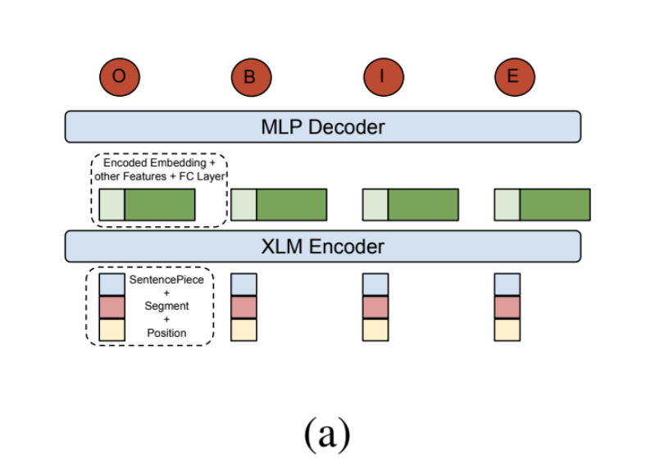
Extraction Stage
Figure 1: (a) The open-world extraction model, where each sentence piece is classified as B/I/O/E;
For computation efficiency, we choose a multiple layer perception on top of XLM instead of conditional random field layer

Slide 16
K-Means Algorithm
Performance was unacceptable.
Embeddings do not follow uniform distribution
Embeddings fail to align with human interpretation.

Slide 17
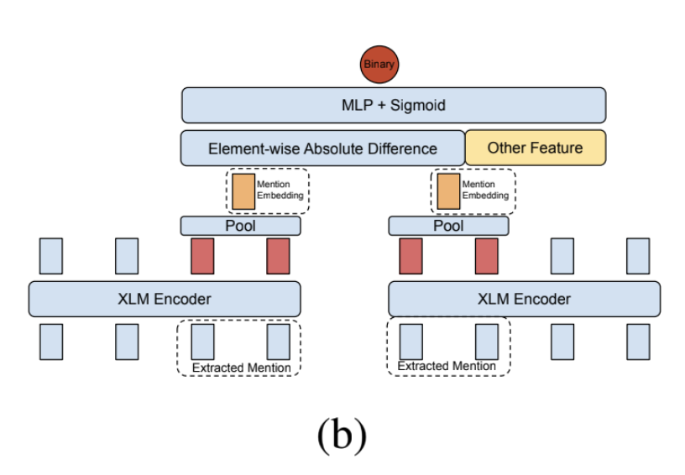
Semi-Supervised Clustering Stage
Figure 1: The open world link prediction model, which predicts if two mentions refer to the same entity.
To predict links between mentions if they represent the same underlying entity.
Siamese neural network to scale for processing .
Louvain community detection algorithm
Finally, result significantly improved.

Slide 18
Closed-World Entity Extraction
Fahim Hasnat - 22166016

Slide 19
Data Labeling
Open World Extraction model
Open world link prediction model
Closed World linking model

Slide 20
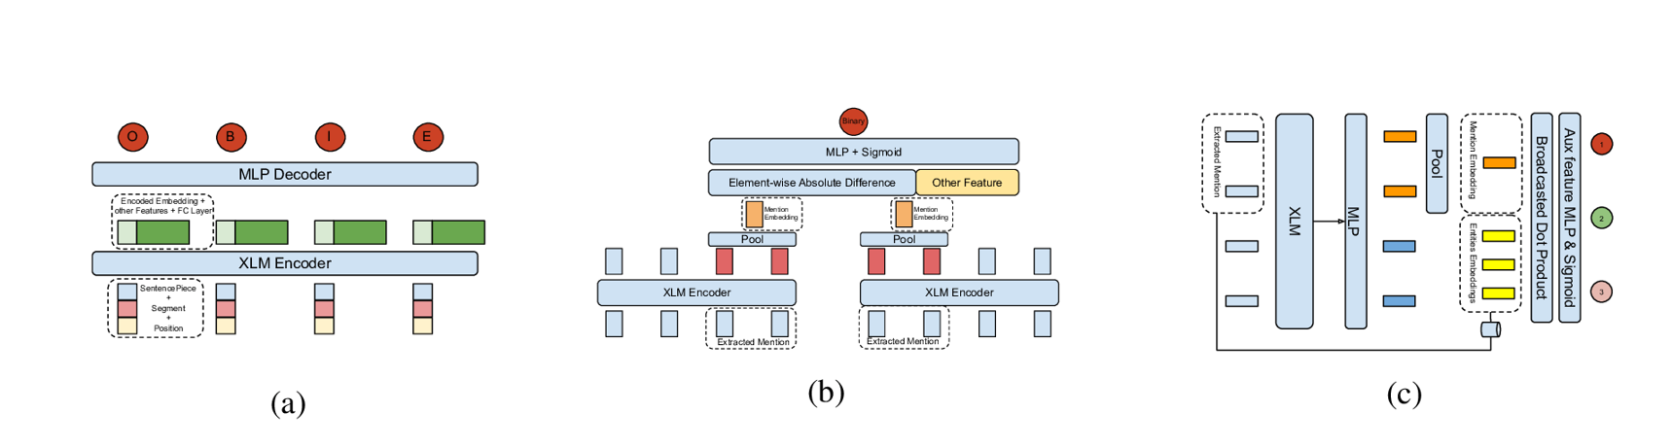

Slide 21
Modeling
Extraction Stage
Linking Stage

Slide 22
Extraction Stage
Fuzzy string matching
Rule based clean up

Slide 23
Linking Stage
Computes similarity between mention and its candidate entities
On the entity side, its Wikipedia texts are summarized offline into embeddings.
Relevance score is generated through a linear projection of embeddings

Slide 24
Scaling Challenges
Md Mazidul Hasan - 22166018

Slide 25
Cross Language Model and Fine-Tuning
Transformer based pretrained language model
Cross-lingual pretraining
XLM

Slide 26
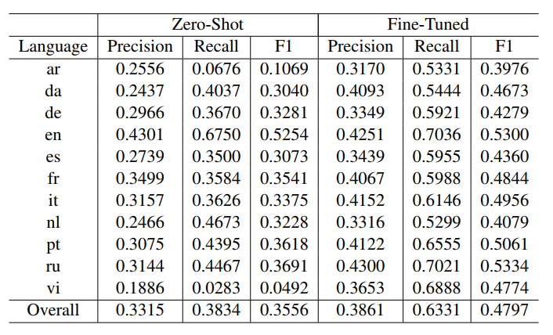
Zero-shot (English only)
Fine-tuned(All languages)
Table 2: Multilingual fine-tuning of product name extraction model. Zero-shot model is trained on English only

Slide 27
Multi-Task Learning For Extraction, Clustering, and Linking
Subfield of machine learning
Improved data efficiency
Reduced overfitting
Reduced overfitting
Train a model for a new entity type
Update the model for an existing entity type
Increases inference costs

Slide 28
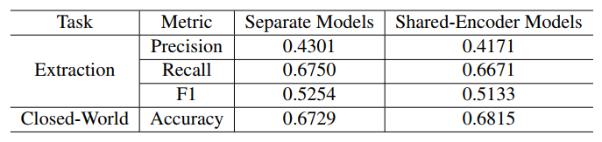
Shared XLM Encoder
inference time is reduced to 1/7 of before
Table 3: Co-train product name extraction and closed world linking models with a shared XLM encoder

Slide 29
Cross Document Transfer Learning, Conclusion and Future work
Ashik Adnan - 22166003

Slide 30
Cross Document Transfer Learning
Transfer learning aims at improving the performance of target models on target domains by transferring the knowledge contained in different but related source domains
Incorporate the transfer learning framework in their system to solve cross document types challenge

Slide 31
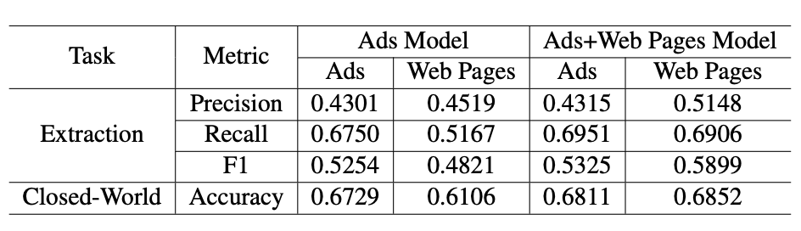
They run experiments on zero-shot transfer learning and few-shot transfer learning
Transfer learning between product name extraction and closed-world linking models between ads and web pages data. The first model is trained on ads only; the second is trained on both ads and web pages. The sample sizes of ads and web pages are the same.

Slide 32
Conclusion And Future Work
They presented the platform of the entity extraction at giant internet company’s scale
In the future, they want to improve the efficiency of Transformer related language model.

Slide 33
Thank You !

