Slide 1
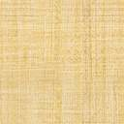
Paper Review Presentation Group No: 08
CSE 713 :: ADVANCED SYNTACTIC PATTERN RECOGNITION
Submitted By-
19166009 ABDULLAH UMAR NASIB
21266007 SAMIHA KHAN
22166007 SUMAIYA MIM
22166016 FAHIM HASNAT
22166018 MD MAZIDUL HASAN
22166037 S M MAHSANUL ISLAM
21341025 JAWAD BIN SAYED
Submitted To-
Annajiat Alim Rasel
Senior Lecturer
Department of Computer Science and Engineering
BRAC University
Dhaka, Bangladesh

Slide 2
A Comparative Study on Handwritten Digit
Recognizer using Machine Learning Technique

Slide 3
Outline
ABSTRACT
INTRODUCTION
RELATED WORK
PROPOSED WORK
EXPERIMENTAL RESULTS
DATASET DESCRIPTION
PERFORMANCE METRICS
CONCLUDING REMARKS
FUTURE WORK SCOPES

Slide 4
Abstract
The main purpose of this experiment in this paper is rapid assessment of multiple types of classification models on digit recognition problem.
The work offers an environment for comparing four types of classification models in a unified experiment:
Multiclass decision forest
Multiclass decision jungle
Multiclass Neural Network &
Multiclass Logistic Regression

Slide 5
Abstract
The work presents assessment results using 6 performance metrics:
Overall accuracy
Average accuracy,
Micro-averaged precision,
Macro-averaged precision,
Micro-averaged recall &
Macro-averaged recall
The experimental results showed that the highest accuracy was obtained by Multiclass Neural Network with the value of 97.14%.

Slide 6
Introduction
Digit recognition problem is one of the challenging problem in computer vision and machine learning as developing an accurate automated recognition of handwritten digits is difficult.
Examples of Applications:
Processing bank check
Online form data input by users using digital device

Slide 7
Introduction
The variation in handwriting among people makes it difficult to train the computers to recognize handwritten digits.
In the paper researchers using machine learning techniques to address the digit recognition problem. The work focuses on utilizing a tool that would embrace multiple types of classification models with diverse performance metrics to analyze various classification techniques and finding the best technique for digit recognition.

Slide 8
RELATED WORK (1)
Hayder Naser Khraibet AL-Behadili’s work on Classification algorithms for determining handwritten digit
K-Nearest Neighbor
Neural Networks
Decision Tree
Artificial Neural Network

Slide 9
RELATED WORK (2)
Meiyin Wu and Li Chen applied Deep Belief NetWork (DBN) and Convolutional Neural Network (CNN) in their research Image recognition based on deep learning which are deep learning techniques to the handwritten character recognition problem.
This work considered both the real world handwritten character database and MNIST database and the results showed that the accuracy obtained by CNN was greater than DBN.

Slide 10
RELATED WORK (3)
In A Comparative Study on Handwriting Digit Recognition Classifier Using Neural Network, Support Vector Machine and K-Nearest Neighbor, Chayaporn Kaensar conducted a study on digit recognition using different classifiers.
The work considered dataset from UCI repository and used WEKA tool kit to train and test the dataset. The results showed that Support Vector Machine (SVM) classified accurately than other classifiers, but SVM consumed lot of training time.

Slide 11
RELATED WORK (4)
Faizan Farooq, Siddhant Tandon, Pankaj Parashar and Prateek Sengar applied artificial neural networks and logistic regression to recognize handwritten digits from 0 to 9.
To perform multiclass classification, they used artificial neural networks and One-vs-All logistic regression. This work applied vectorization which is an advanced optimization algorithm to make the performance faster.
They considered a database of five thousand handwritten digits and reported that the system is very effective in recognizing the digit.

Slide 12
PROPOSED WORK
In order to accurately recognize digits from handwritten images algorithms like:
Multiclass decision forest,
Multiclass decision jungle,
Multiclass Neural Network and
Multiclass Logistic Regression.
Then, tried to identify the model with highest accuracy.

Slide 13
PROPOSED WORK
A. Classification algorithms description:
Multiclass Decision Forest: Multiclass Decision Forest uses the decision forest algorithm to build multiple decision trees and applies voting approach to identify the most accepted output class.
Multiclass Decision Jungle: Multiclass Decision Jungle is the extension to decision forest which uses a decision jungle algorithm to create a Directed Acyclic Graphs (DAGs)-based multiclass classification model.

Slide 14
PROPOSED WORK
A. Classification algorithms description:
Multiclass Neural Network: Multiclass Neural Network uses neural network algorithm to create a multiclass classification model which predicts a target with multiple values.
Multiclass Logistic Regression: Multiclass Logistic Regression fits data to a logistic function and predicts target with multiple values.

Slide 15
PROPOSED WORK
B. Experimental Platform
Microsoft Azure Machine Learning Studio (MLS)
Cloud-based machine learning as a service
By default built-in classification models

Slide 16
PROPOSED WORK
Confusion Matrix was used to evaluate the models.
Accuracy: It is the ratio of correct results to total cases.
Precision: It is the ratio of correct results over all positive results.
Recall is the part of all true results returned.

Slide 17
PROPOSED WORK
Micro-average on precision and recall.
Micro-average of precision =(TP)/(TP + FP)
Micro-average of recall = (TP)/(TP + FN)
Here, TP = True Positive, FP = False Positive, FN = False Negative

Slide 18
Dataset Description
The dataset is considered from MNIST
It contains digit from zero to nine
Each image is of size 28*28 pixels
Each pixel value indicates the lightness or darkness
Total 785 columns
Total number of rows is 4,200
Dataset is divide into two part
60% for training
40% for testing

Slide 19
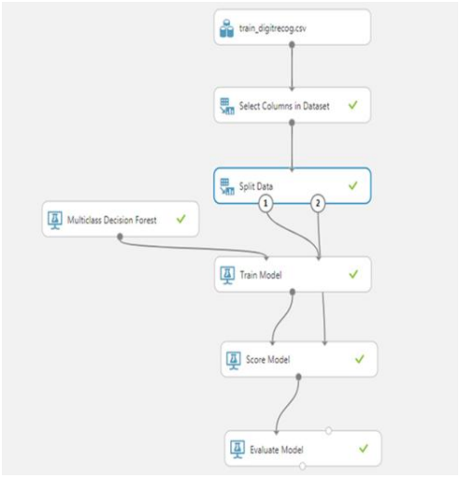
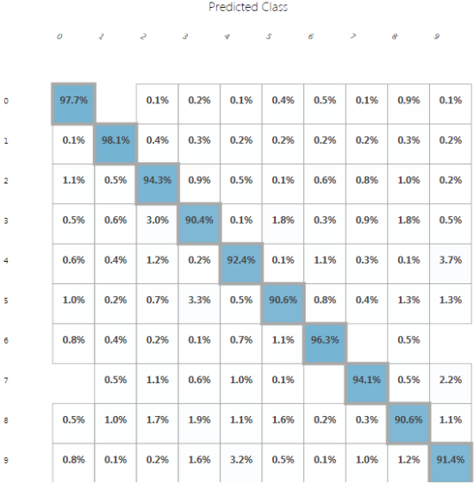
Experiment-1: Multi Class Decision Forest
Fig 1 Visual interface for multiclass decision forest experiment
Fig 2 Confusion matrix for multiclass decision forest

Slide 20
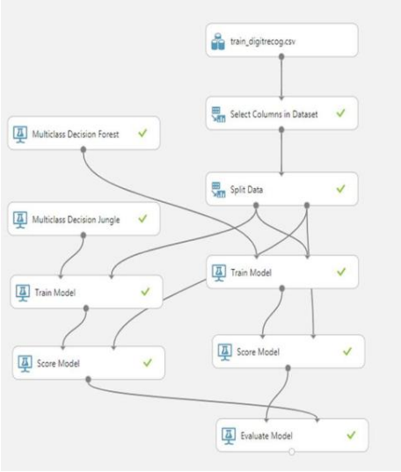
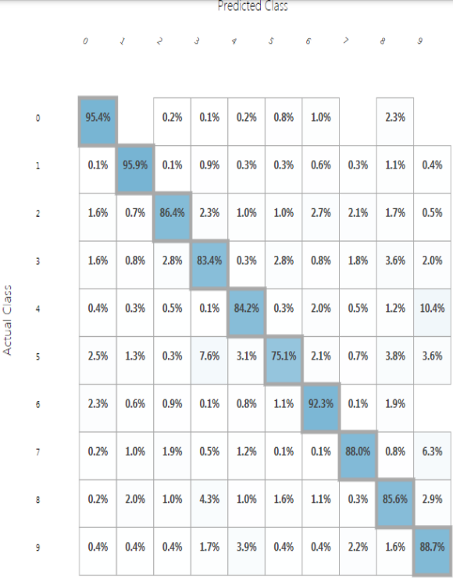
Experiment-2: Multi Class Decision Jungle
Fig 3 Visual interface for multiclass decision jungle experiment
Fig 4 Confusion matrix for multiclass decision jungle

Slide 21
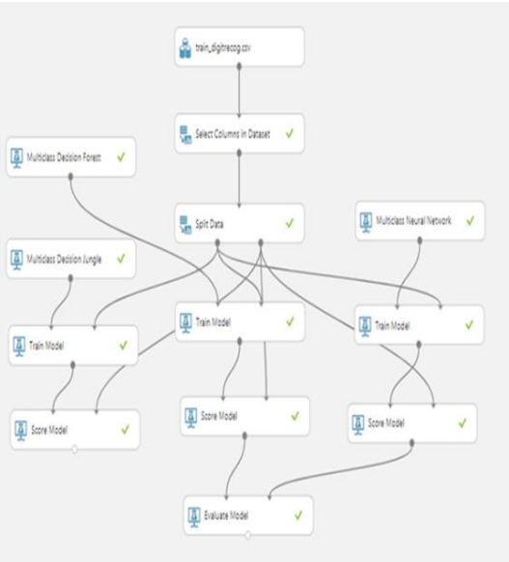
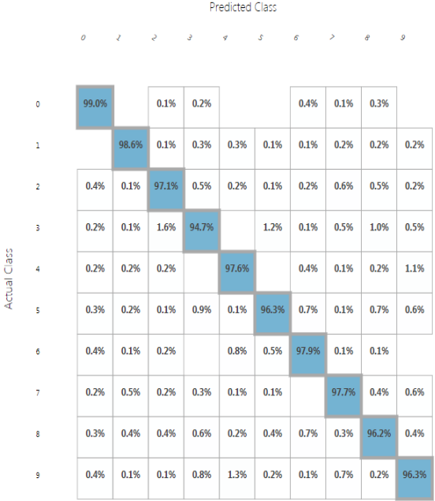
Experiment-3: Multi Class Neural Network
Fig 5 Visual interface for multiclass neural network experiment
Fig 6 Confusion matrix for multiclass neural network

Slide 22
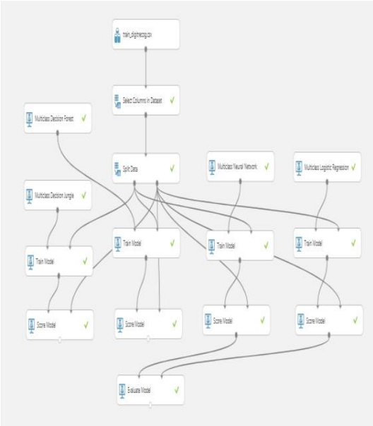
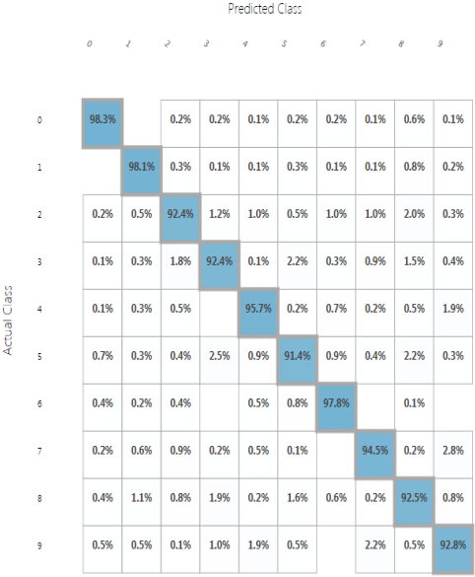
Experiment-4: Multi Class Logistic Regression
Fig 7. Visual interface for multiclass logistic regression experiment
Fig 8 Confusion matrix for multiclass logistic regression

Slide 23
Performance Metrics
Macro-averaged Precision and Recall:
Average of the precision and recall of the model on different sets.
Average Accuracy:
Average of each accuracy per class
Overall Accuracy:
Ratio of correctly predicted items and total items

Slide 24
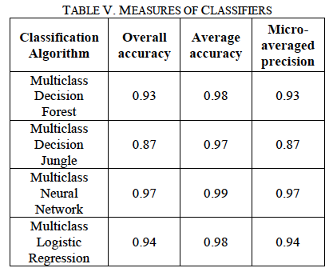


Performance Metrics

Slide 25
Concluding Remarks
Multiclass neural network gives best results
Web based Service on Azure.
It can be used by Reasearchers to conduct experiments
Can add classification models to webservice

Slide 26
Future Work and Scope
In Future the model can be optimised to give 100% accurate results. For this it needs more data and more variations in data. The model need to be trained with more time. Then comes execution. We need to find better ways of using this model. We can use check it for checking exam scripts. We can use to identify hard to understand handwritings. It can be used to read prescriptions given by doctors. It will be a huge help for people if we can solve such huge problems using this approach to understand handwriting using machine learning techniques.

Slide 27
Thank You

