Slide 1
PROJECT TITLE
CAPSTONE PROJECT
Presented By:
Junaid Umar
Channabasaveshwara Institute of Technology
Department of Computer Science

Slide 2
OUTLINE
Problem Statement
System Development Approach
Algorithm & Deployment (Step by Step Procedure)
Result
Conclusion
Future Scope(Optional)
References

Slide 3
Problem Statement
Users often need quick, accurate, and location-specific weather information without navigating complex menus. This project solves that problem by creating a simple, intuitive dashboard that provides immediate access to real-time weather conditions and forecasts, simplifying daily planning and travel preparation.️️

Slide 4
System Approach
The system is a client-side web application built with a modern, straightforward technology stack.
Structure: HTML is used to create the semantic layout of the dashboard, including containers for the search bar, current weather, and the forecast.
Styling: CSS provides a clean, responsive design. It uses Flexbox to center the main container and arrange forecast cards, ensuring the interface works well on both desktop and mobile devices.
Dynamic Logic: JavaScript drives the core functionality.
Geolocation API: The navigator.geolocation object is used to automatically detect the user's location on page load for immediate, relevant data.
OpenWeatherMap API: Asynchronous fetch calls are made to this API to retrieve current weather data and 5-day forecasts based on either coordinates or a manually entered city name.

Slide 5
Algorithm & Deployment
The application's logic is event-driven and follows a clear sequence.
Initialization: On page load, the script immediately calls the getWeatherByLocation function to fetch data for the user's current location.
Location Fetch: The browser's Geolocation API is prompted for the user's coordinates. If permission is denied or the API is unavailable, the application defaults to a preset city ('London').
API Request: An async request is sent to the OpenWeatherMap API with either the user's coordinates or a city name from the search input.
Data Processing: The returned JSON data is parsed to extract key information for both current conditions and the 5-day forecast. The forecast data is filtered to show one result per day.
UI Rendering: The innerHTML of the #current-weather and #forecast divs is dynamically updated with the fetched weather data, displaying it to the user.
Deployment: The project is deployed as a static website on a service like GitHub Pages, accessible via a public URL.

Slide 6
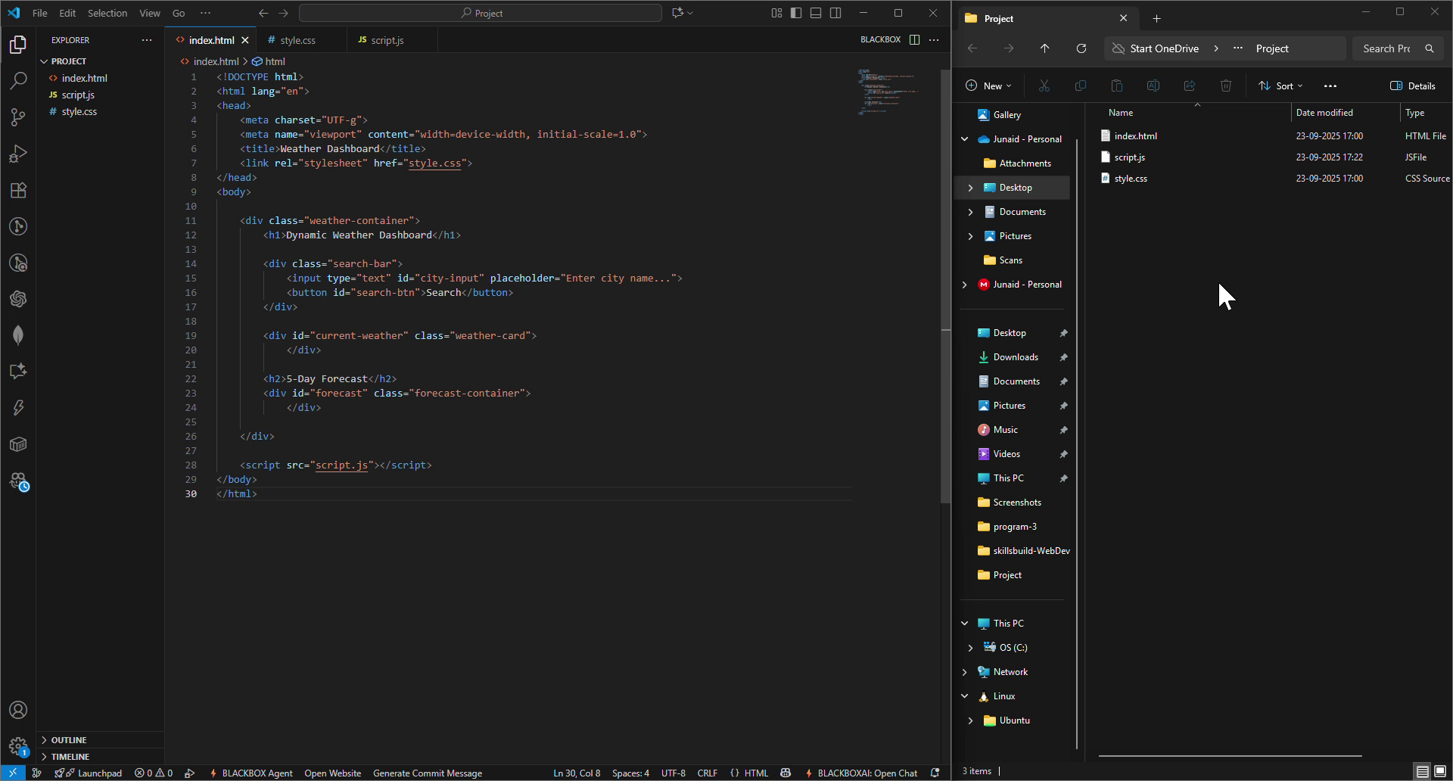
Result

Slide 7
GITHUB LINK
Github Link :
https://github.com/Umaralp/MyWeatherDashboard

Slide 8
Conclusion
This project successfully demonstrates the effective integration of fundamental web technologies (HTML, CSS, JavaScript) with powerful third-party APIs to build a practical and data-driven application. It solves the core problem by delivering a responsive, user-friendly, and efficient solution for accessing weather information.

Slide 9
Future scope(Optional)
Enhanced Error Handling: Replace browser alert() pop-ups with on-screen error messages for a smoother user experience.
Loading Indicators: Implement a visual loader to give feedback to the user while the API data is being fetched.
API Key Security: Move the API key from the client-side JavaScript to a backend proxy or serverless function to prevent misuse.
UI Polish: Add CSS transitions for smoother updates and animations when weather data loads.

Slide 10
References
OpenWeatherMap API: The primary source for all weather and geolocation data. Retrieved from https://openweathermap.org/api.
MDN Web Docs - Geolocation API: Documentation for the navigator.geolocation interface used for location detection. Retrieved from https://developer.mozilla.org/en-US/docs/Web/API/Geolocation_API.
MDN Web Docs - Fetch API: Documentation for the fetch() method used to make network requests. Retrieved from https://developer.mozilla.org/en-US/docs/Web/API/Fetch_API.

Slide 11
THANK YOU

