Slide 1
secure data hiding in images using steganography
CAPSTONE PROJECT
Presented By:
Student Name : Junaid Umar
College Name & Department : Channabasaveshwara Institute of Technology, Department of Computer Science

Slide 2
OUTLINE
Problem Statement
Technology used
Wow factor
End users
Result
Conclusion
Git-hub Link
Future scope

Slide 3
Problem Statement
In today's digital world, secure communication is crucial to protect sensitive information from unauthorized access. Traditional encryption methods can raise suspicion, making it necessary to hide messages discreetly. This project uses image steganography to embed secret messages within an image, ensuring confidentiality while maintaining the image’s original appearance. A passcode adds an extra layer of security, allowing only authorized users to decrypt and retrieve the hidden message.

Slide 4
Technology used
Python - Primary programming language for the encryption and decryption process.
OpenCV (cv2) - Used for image processing (loading, modifying, and saving images).
File Handling - To store and retrieve the passcode from a text file.
NumPy (implicitly used by OpenCV) - Handles image arrays for encoding and decoding messages.
Operating System (os module) - Used to open the encrypted image file automatically.
Supported devices - Windows

Slide 5
Wow factors
Simple Yet Effective Encryption – Hides a secret message inside an image using pixel manipulation.
Password Protection – Adds an extra security layer by requiring a passcode for decryption.
No External Dependencies (Except OpenCV) – Uses only OpenCV and Python’s built-in modules.
Stealthy Data Hiding – The encrypted image looks visually identical to the original, making it hard to detect.
Customizable & Expandable – Can be modified to support larger messages, different encryption techniques, or more secure hashing..
Offline & Secure – No internet is required, reducing risks of data leakage.
Automated Image Opening – Opens the encrypted image automatically for user convenience.

Slide 6
End users
Cybersecurity Enthusiasts – Individuals learning about encryption and secure communication.
Forensic Investigators – Can use steganography for covert communication in investigations.
Ethical Hackers & Penetration Testers – To test data-hiding techniques and security vulnerabilities.
Journalists & Whistleblowers – To securely hide sensitive messages from unauthorized access.
Students & Researchers – For academic projects, cryptography research, and learning purposes.
Data Security Professionals – Can integrate or analyze steganography techniques in real-world applications.
Spy Agencies & Intelligence Organizations – May use similar techniques for secure, covert communication.
Privacy-Conscious Users – Anyone who wants to securely send hidden messages without detection.

Slide 7
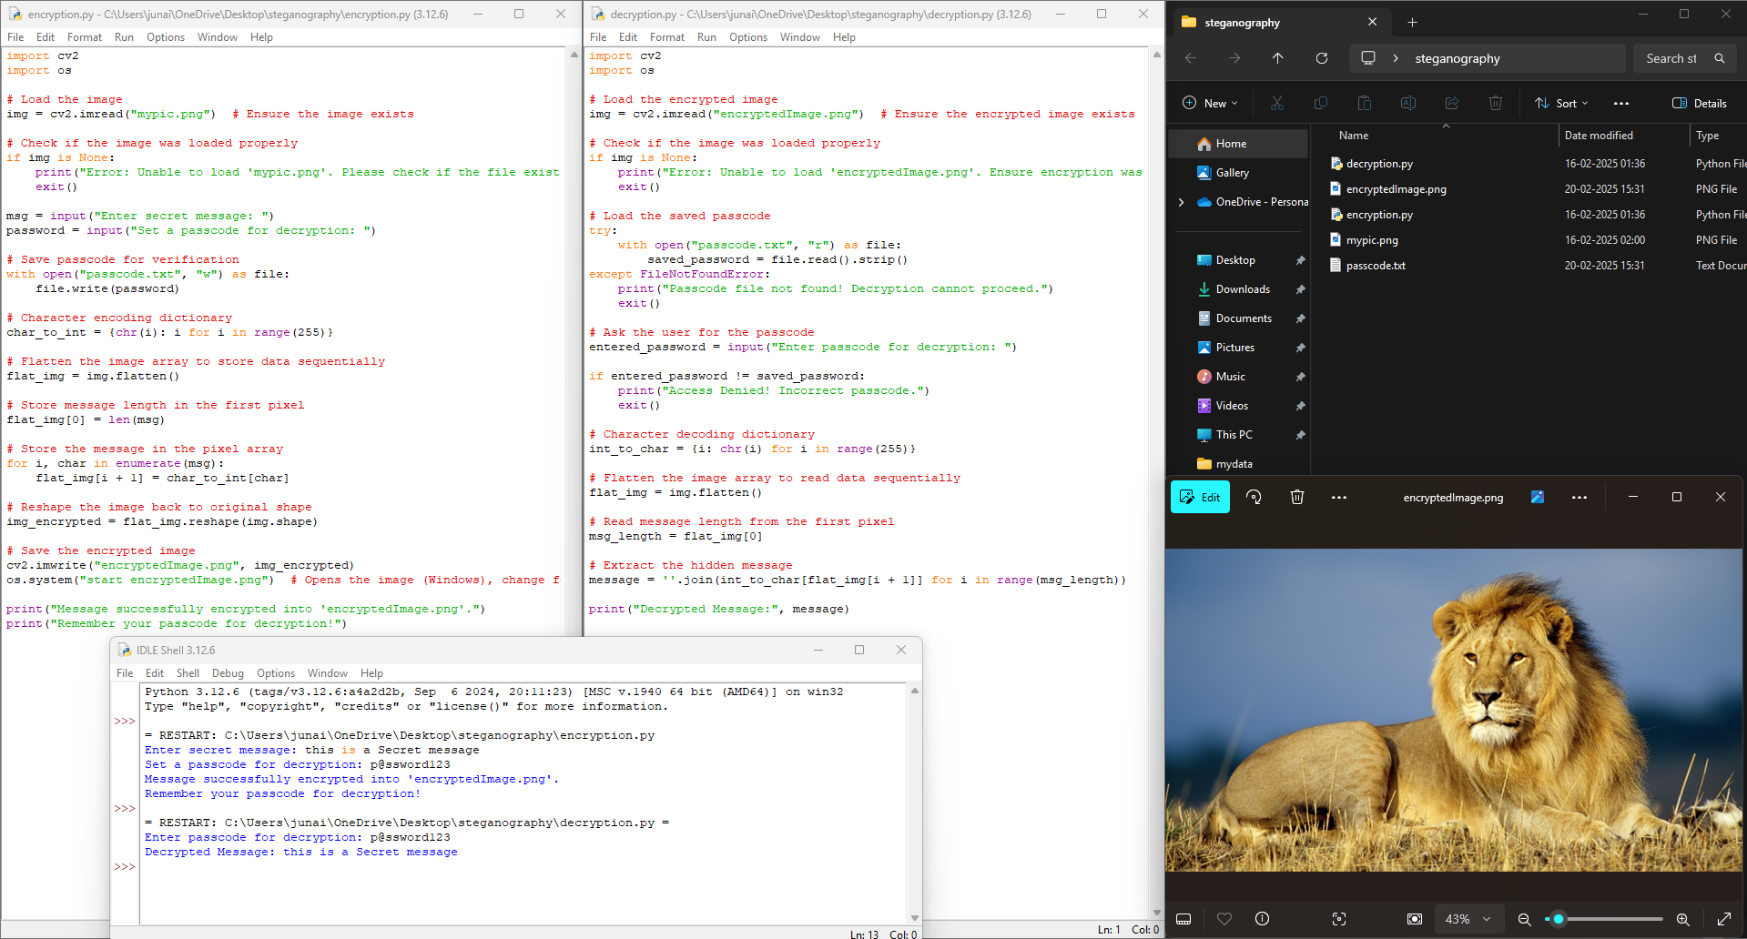
Result 1

Slide 8
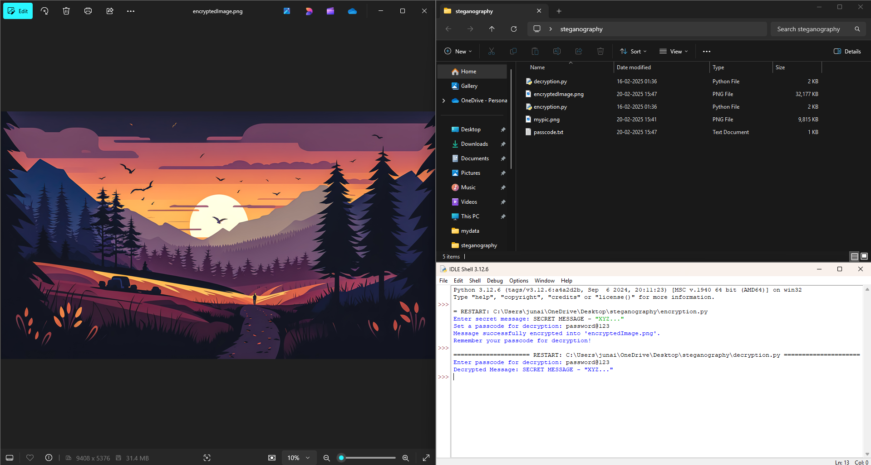
Result 2

Slide 9
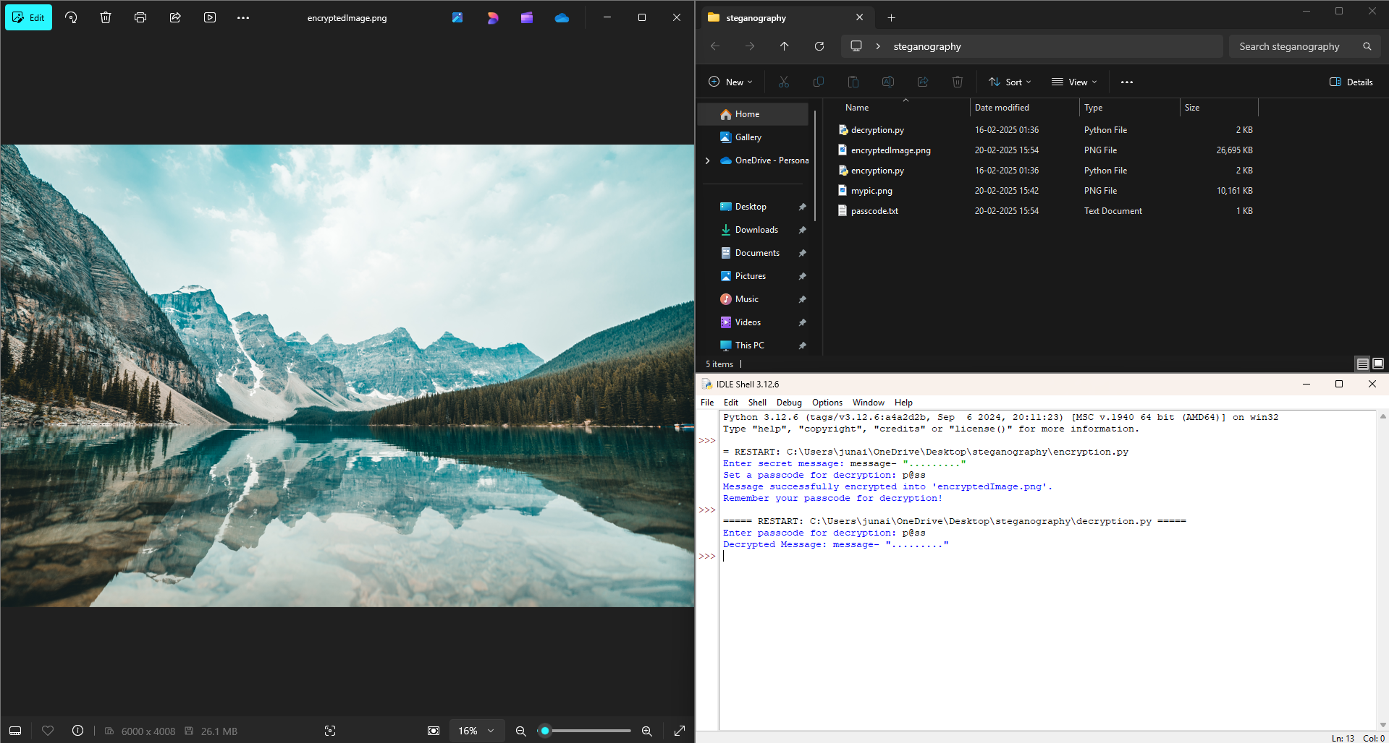
Result 3

Slide 10
Conclusion
This steganography project successfully demonstrates how secure communication can be achieved by embedding hidden messages within an image. By combining image processing with encryption, the project ensures that sensitive information remains concealed from unauthorized users. The added passcode protection enhances security, allowing only intended recipients to access the message. This approach is a lightweight, effective, and discreet method of data hiding, making it useful for cybersecurity, forensic investigations, and personal privacy.

Slide 11
GitHub Link
https://github.com/Umaralp/Steganography

Slide 12
Future scope
1. Advanced Encryption – Integrate AES or RSA encryption for stronger security before embedding the message.
2. Support for Different Image Formats – Expand compatibility to formats like JPEG, BMP, and GIF while minimizing data loss.
3. Increased Storage Capacity – Optimize pixel usage to store longer messages without significantly altering the image.
4. Multi-Level Authentication – Implement biometric or two-factor authentication (2FA) for enhanced security. .
5. Mobile and Web Integration – Develop a web app or mobile app for easier access and usability.
6. Audio & Video Steganography – Extend the concept to hide messages in audio files or video frames for more versatility.

Slide 13
THANK YOU

