Slide 1

Business Performance Dashboard – 2024
Sales, Region, Delivery Analysis
Umasankar G
25/09/2025

Slide 2

Table of Contents
1.Task Objective
2.Data & Tools used
3.Methodology
4.Dashboard Overview
5.Key Insights
6.Conclusion

Slide 3
Objective :
The primary objective of this project is to design a business-focused, interactive dashboard that provides actionable insights into sales performance, regional contribution, and delivery efficiency for the year 2024. Using Tableau, the dashboard integrates multiple KPIs and visualizations to support strategic decision-making across marketing, operations, and customer service functions.

Slide 4

Data & Tools used
DATA : Excel file,Cleaned_Csv file
TOOLS : Jupyter-Notebook , Python ,Tableau,Copilot

Slide 5
Methodology:
1.Data Preparation
Cleaned and standardized fields (e.g., Delivery Time)
Created calculated fields for analysis
2. KPI Identification
Selected Total Price, Profit Margin (%), and Delivery Time
Built KPI cards for quick business insights
3. Chart Design
Monthly Sales Trends and Region Performance
Delivery Time Distribution using bins
4. Dashboard Assembly
Used layout containers and filters (Region, Product, Year)
Added annotations and labels for clarity
5.Insight Generation
Identified peak sales and top-performing regions.Assessed delivery speed
and operational delays

Slide 6
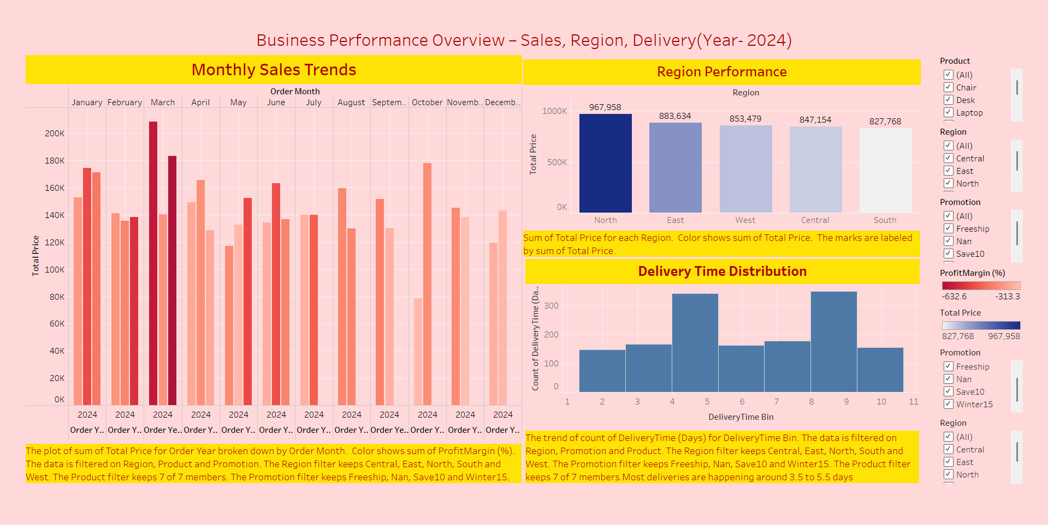
Dashboard Overview :

Slide 7
Key Insights
1. Monthly Sales Trends
Sales peaked in Q2 (April–June), indicating strong seasonal demand or successful promotions during this period.
Technology category consistently outperformed Furniture and Office Supplies in terms of revenue and profit
2. Region Performance
North and East regions generated the highest total profit, making them strategic zones for future investment or marketing focus.
South region showed relatively lower performance, which may require targeted campaigns or operational review.
3. Delivery Time Distribution
Majority of deliveries occurred within 3–6 days, reflecting efficient logistics and fulfillment.
Outliers beyond 8 days were minimal, but may signal isolated delays or product-specific bottlenecks.
4. Filter-Based Observations
When filtered by Furniture category and East region, profit performance remained strong, but delivery times slightly increased—possibly due to bulkier shipments.
Promotion filters revealed that “Freeship” campaigns correlated with higher order volumes but slightly lower profit margins.

Slide 8
Workflow:
Phase 1
Phase 3
Get resource files(csv,excel files)
Dashboard Overview
Phase 2
Phase 4
Data Cleaning and preprocessing
Insights for Business Decisions

Slide 9
Conclusion
The dashboard successfully delivers a comprehensive view of business performance for the year 2024, integrating sales trends, regional profitability, and delivery efficiency into a single interactive platform. Through strategic visualizations and dynamic filters, it enables stakeholders to explore key metrics, identify growth opportunities, and address operational challenges with clarity and confidence

Slide 10
Thank You
Umasankar G
25/09/2025

