Slide 1

Secure Login Form with GOOGLE reCAPTCHA
-Uma Sree
-12303980
-LPU

Slide 2

INTRODUCTION
• CAPTCHA stands for 'Completely Automated Public Turing test to tell Computers and Humans Apart'.
• It helps to protect websites from bots and automated abuse.
• This project implements a login form integrated with Google reCAPTCHA v2.
• Purpose: To prevent bots from submitting the login form.

Slide 3

TECHNOLOGIES USED
• HTML5 – For form structure.
• CSS3 – For styling.
• PHP – Backend logic and CAPTCHA verification.
• Google reCAPTCHA – For user verification.
• XAMPP – For local server execution.

Slide 4

SYSTEM ARCHITECTURE
1. User opens the login form.
2. Enters credentials and solves CAPTCHA.
3. PHP sends CAPTCHA response to Google API.
4. Google verifies and returns result.
5. System grants/denies access.

Slide 5

IMPLEMENTATION AND OUTPUT
IMPLEMENTATION:
• Form includes username, password, and reCAPTCHA.
• CAPTCHA key used: Google test key.
• PHP verifies CAPTCHA server-side.
• Feedback shown: 'CAPTCHA Verified' or 'Failed'.
OUTPUT:
• Successful login shows verification success message.
• Wrong or no CAPTCHA shows error.
• Runs locally using XAMPP or online with free hosting.

Slide 6

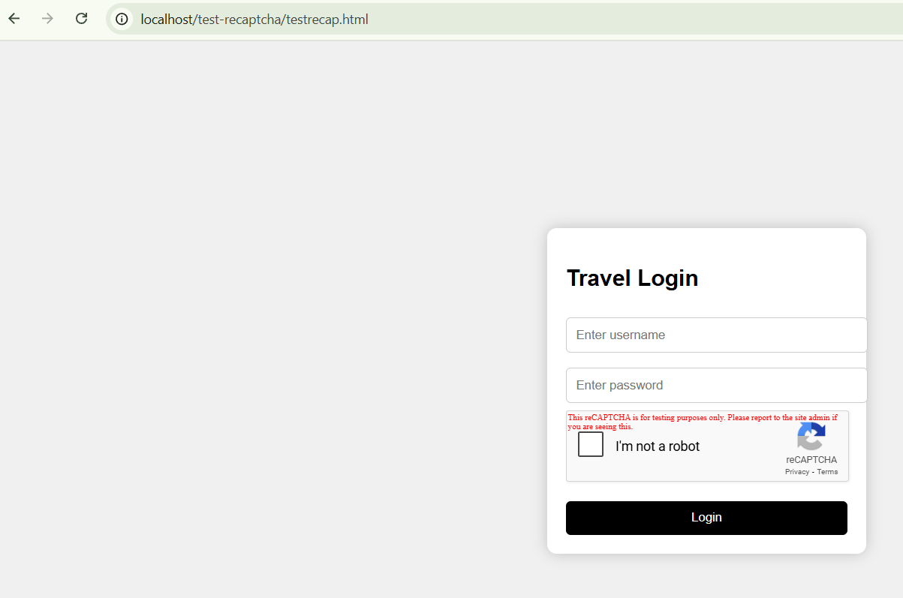
1. HTML page where login form will open
2. This is the Test reCAPTCHA

Slide 7
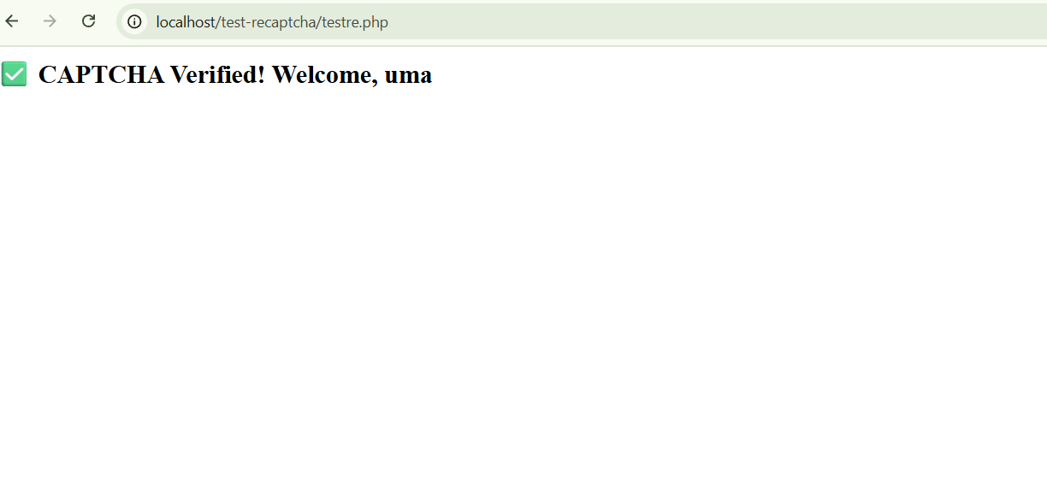
1. After Login If its Successfully verified.
2. If not then we get Error

Slide 8

CONCLUSION:
• CAPTCHA secures login from bots.
• Easy to implement with test keys.
• Portable and sharable project.
• Useful for real-world secure form designs.

