Slide 1
Cryptography & Network Security
Ms. Regina Esi Turkson (Mrs Regina Esi Segbefia)
Department of Computer Science and Information Technology University of Cape Coast

Slide 2
Disclaimer!
The lecture slides are partially collected from the Internet for educational purpose only. The lecturer does not claim any credit for them and the copyrights belong to the original authors.

Slide 3
Cryptography and Network Security
Chapter 2
Foundations of Cryptography

Slide 4

Secure Communication Model
Oscar
Alice
Bob
x
y
Encrypt
Decrypt
K
K
Secret Key
Secret Channel
K

Slide 5
The Strength of the Cryptosystem
The strength of an encryption method comes from the algorithm, the secrecy of the key, the length of the key, the initialization vectors and how they all work together in the cryptosystem.
If a key can be broken by a Pentium IV processor in 3 hours, then the cipher is not strong at all. If they however be broken by multiprocessor system over 1.2 million years, then its pretty darn strong.

Slide 6
Cyptosystem Services
Confidentiality – Only authorized entities are allowed to view
Integrity – Ensures the message was not altered by unauthorized individuals
Authenticity – Validates the source of a message, to ensure the sender is properly identified

Slide 7
Cyptosystem Services
Nonrepudiation – Establishes sender identity so that the entity cannot deny having sent the message
Access Control – Access to an object requires access to the associated crypto keys in many systems (e.g. login)

Slide 8
Cyptosystem Services
Suppose your boss sends you a message telling you will be receiving a raise that doubles your salary.
The message is encrypted , so you will be sure it really came from your boss(authenticity).
So you will be sure that someone did not alter it before it arrived at your computer (integrity).
So you will be sure that no one read it as it travelled over the network (confidentiality).

Slide 9
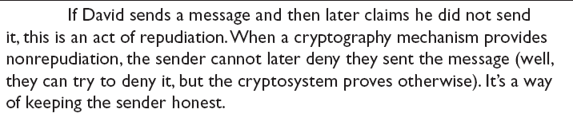
Cyptosystem Services
So that your boss cannot deny that he sent it when he comes to his senses (nonrepudiation).

Slide 10
Methods of Encryption
Symmetric/private/secret/single key
Same key for encryption and decryption
Key distribution problem
Asymmetric / Public key
Mathematically related key pairs for encryption and decryption
Public and private keys

Slide 11
Symmetric Cryptography: Examples.
Shift
Data Encryption Standard (DES)
Triple-DES (3DES)
Blowfish
IDEA
RC4, RC5 and RC6
Advanced Encryption Standard ( AES)

Slide 12

Examples:
So “security” will be encrypted as “hvxfirgb”
This is an example of a substitution cipher.
Specifically it is a monoalphabetic substitution cipher. We also have polyalphabetic

Slide 13
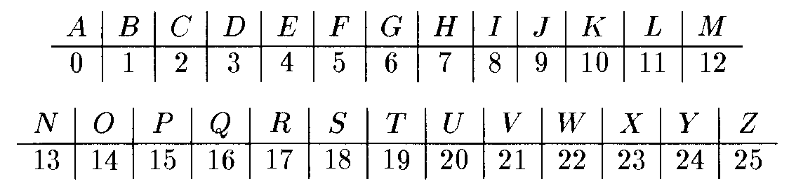
Shift Cipher
P=C=K=Z₂₆.
Encrypt：E_{k}(x)=x+k mod 26
Decrypt：D_{k}(c)=c-k mod 26
Plaintext
WEAREINCRYPTOCLASS.
+10
=Ciphertext
GOKBOSXMBIZDYMWCC
-10
WEAREINCRYPTOCLASS
=Plaintext

Slide 14
Is the shift cipher secure?
No -- only 26 possible keys!
• Given a ciphertext, try decrypting with every possible key
• If ciphertext is long enough (and plaintext is normal
English), only one possibility will “make sense”

Slide 15
Example
Ciphertext uryybjbeyq
Try every possible key…
• tqxxaiadxp
• spwwzhzcwo
• …
• helloworld

Slide 16
Kerckhoffs’s principle
The encryption scheme is not secret
• The only secret is the key
• The key must be chosen at random, kept secret
Some arguments in favor of this principle
• Easier to keep secret key than secret algorithm
• Easier to change key than to change algorithm
• Standardization
• Ease of deployment
• Public validation

Slide 17
Sufficient key space principle
The key space should be large enough to prevent
“brute-force,” exhaustive-search attacks
If an encryption scheme has a key space that is too small, then it will be vulnerable to exhaustive- search attacks

Slide 18

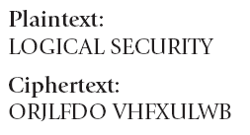
Caesar Cipher
Caesar – Shift all letters by a given number of letters in the alphabet

Slide 19
The Vigenère cipher
Vigenère – Use of a key and multiple (polyalphabetic cipher) alphabets to hide repeated characters in an encrypted message
The key is now a string, not just a character. To encrypt, shift each character in the plaintext by the amount dictated by the next character of the key
Wrap around in the key as needed
Decryption just reverses the process

Slide 20
Example
tellhimaboutme
cafecafecafeca ------------------------ veqpjiredozxoe
While Caesar has one shift alphabet, Vigenere uses 27 shift alphabets (Vigenere Table).

Slide 21
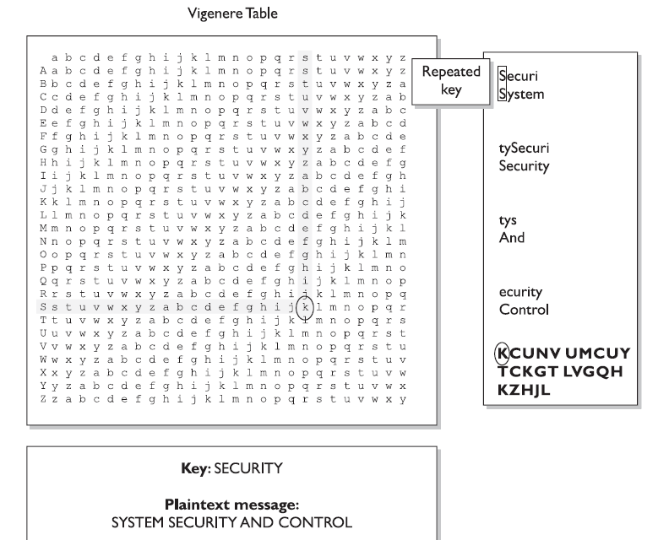
Vignère – Use of a key and multiple alphabets to hide repeated characters in an encrypted message

Slide 22
One-Time Pad
A one-time pad is a perfect encryption scheme because it is considered unbreakable if implemented properly.
It was invented by Gilbert Vernam in 1917, so sometimes it is refered to as Vernam Cipher.
The encryption process uses binary mathematical function called the exclusive-OR, denoted as XOR.

Slide 23
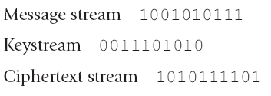
One-Time Pad
When combining two bits, if both values are the same, the result is zero (1 XOR 1 = 0). If the bits are different from each other the result is 1 (1 XOR 0= 1)

Slide 24
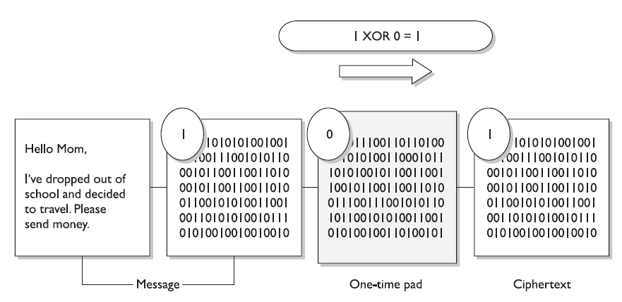
One-Time Pad-Encryption

Slide 25
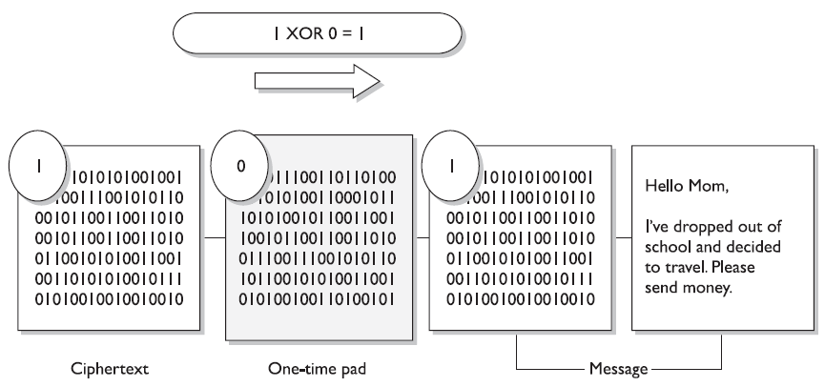
One-Time Pad-Decryption

Slide 26
One-Time Pad Requirments
The one-time pad encryption scheme is deem unbreakable if the following is true about the encryption process.
The pad must be only one-time.
The pad must be as long as the message.
The pad must be securely distributed and protected at its destination.
The pad must be made up of truly random values.

Slide 27
Data Encryption Standard(DES)
The Data Encryption Standard (DES) is a symmetric-key block cipher published by the National Institute of Standards and Technology (NIST).
The encryption process is made of two permutations (P-boxes), which we call initial and final permutations, and sixteen Feistel rounds.

Slide 28
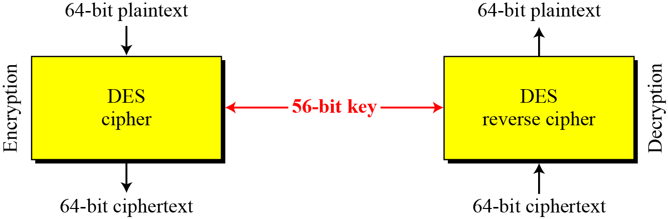
DES is a block cipher, as shown in the following Figure

Slide 29
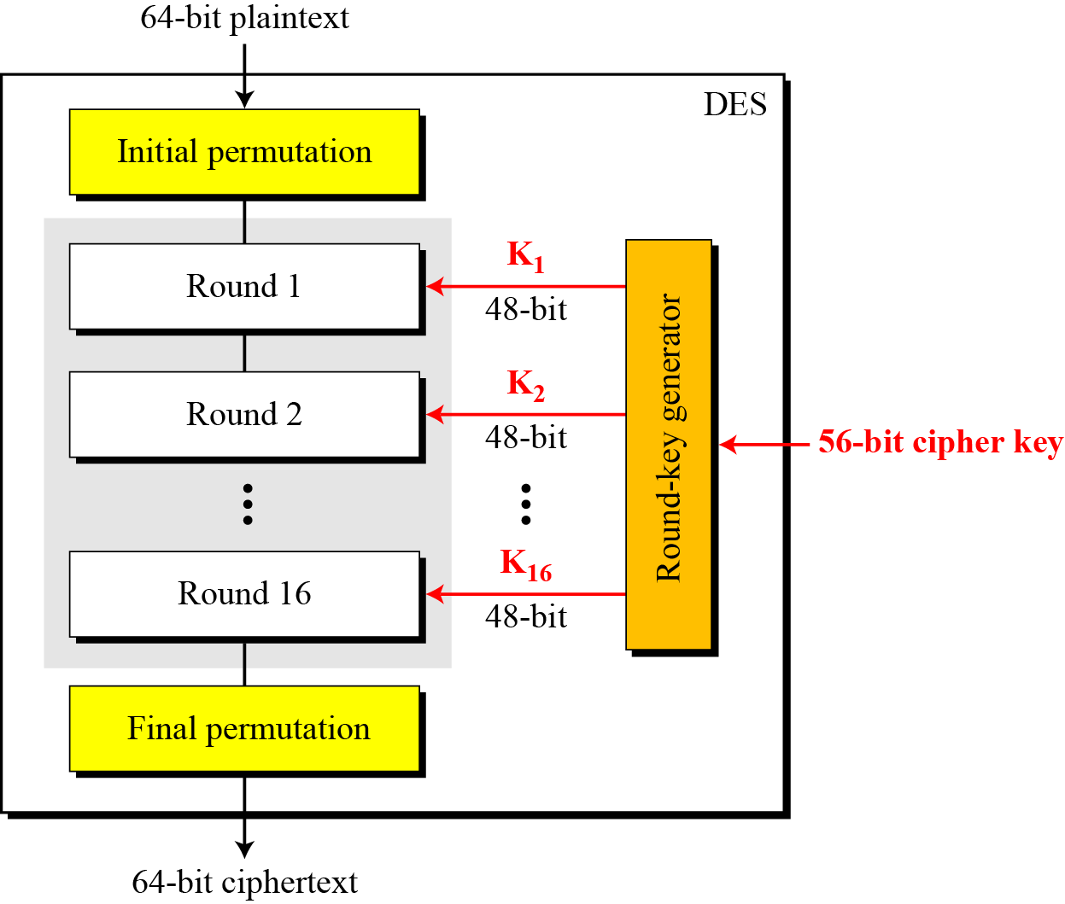
General structure of DES

Slide 30
Advanced Encryption Standard ( AES)
A replacement for DES was needed
Key size is too small
Private key symmetric block cipher
128-bit data, 128/192/256-bit keys
Notes:
The Advanced Encryption Standard (AES) was published by NIST (National Institute of Standards and Technology) in 2001. AES is a symmetric block cipher that is intended to replace DES as the approved standard for a wide range of applications. The AES cipher (& other candidates) form the latest generation of block ciphers, and now we see a significant increase in the block size - from the old standard of 64-bits up to 128-bits; and keys from 128 to 256-bits. In part this has been driven by the public demonstrations of exhaustive key searches of DES. Whilst triple-DES is regarded as secure and well understood, it is slow, especially in s/w. In a first round of evaluation, 15 proposed algorithms were accepted. A second round narrowed the field to 5 algorithms. NIST completed its evaluation process and published a final standard (FIPS PUB 197) in November of 2001. NIST selected Rijndael as the proposed AES algorithm. The two researchers who developed and submitted Rijndael for the AES are both cryptographers from Belgium: Dr. Joan Daemen and Dr.Vincent Rijmen.

Slide 31
AES Conceptual Scheme
Plaintext (128 bits)
AES
Key (128-256 bits)
Ciphertext (128 bits)

Slide 32
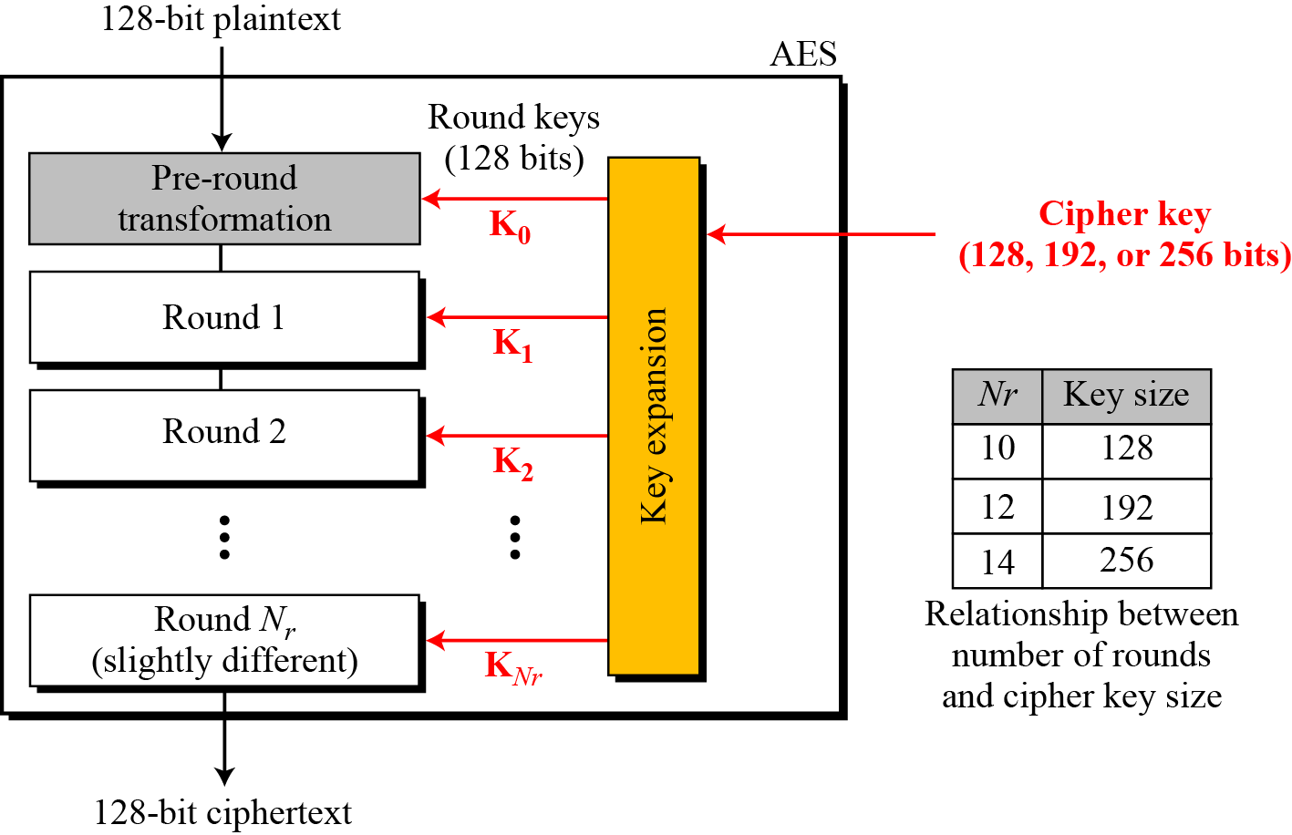
Multiple rounds
Rounds are (almost) identical
First and last round are a little different
Notes:
The input to the AES encryption and decryption algorithms is a single 128-bit block, depicted in FIPS PUB 197, as a square matrix of bytes .This block is copied into the State array, which is modified at each stage of encryption or decryption. After the final stage, State is copied to an output.
The key is expanded into 44/52/60 lots of 32-bit words (see later), with 4 used in each round.
The data computation then consists of an “add round key” step, then 9/11/13 rounds with all 4 steps, and a final 10th/12th/14th step of byte subs + mix cols + add round key. This can be viewed as alternating XOR key & scramble data bytes operations. All of the steps are easily reversed, and can be efficiently implemented using XOR’s & table lookups.

Slide 33
AES Competition Requirements
Stronger & faster than Triple-DES
Provide full specification & design details
Both C & Java implementations
Notes:
Listed above are NIST’s requirements for the AES candidate submissions. These criteria span the range of concerns for the practical application of modern symmetric block ciphers.

Slide 34
Types of Cipher
Substitution Cipher replaces bits, characters and blocks with different bits characters or blocks.
It uses key to dictate how the substitution should be carried out. In Caesar cipher, each letter is replaced with the letter three places beyond it in the alphabet. So the key is the instruction ‘Shift up three letters’.

Slide 35
Types of Cipher
Transposition Cipher : In transposition cipher, the values are scrambled, or put in different order.
The key determines the positions the values are moved to.
When implemented with complex mathematical functions, transposition can become quite sophisticated and difficult to break.

Slide 36
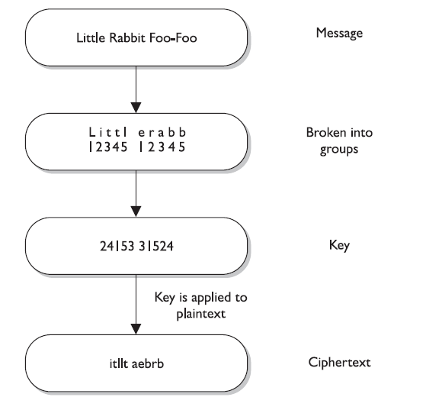

Slide 37
Substitution and Transposition
Symmetric algorithm employed today use both long sequence of complicated substitutions and transpositions on messages
The algorithm contains the possible ways that substitution and transposition processes can take place (represented in mathematical formulas).
The key is used as instruction for the algorithm, dictating exactly how these processes will happen and in what order.

Slide 38
Can we prove that some encryption scheme is secure?
First need to define what we mean by “secure” in the first place…

Slide 39
Cryptography
Characterize cryptographic system by:
type of encryption operations used
- substitution / transposition / product
number of keys used
- single-key or private / two-key or public
way in which plaintext is processed
- block cipher, in/out is one block of elements
- stream cipher, in/out is one continuous element

Slide 40
Cryptanalysis
Objective is to recover key not just message
General approaches:
Cryptanalytic attack
- rely on the nature of the algorithm
- plus general characteristics of the plaintext
- or some sample pairs of plaintext-ciphertext.
brute-force attack
- try every possible key

Slide 41
Cryptanalysis： Attacks
Goal： Compute the secret key k.
Ciphertext only attack： Given ciphertext C, find the secret key k, so that D_{k}(C) =M is the correct plaintext.
Known plaintext attack： Given C and its plaintext M, find the secret key k, so that D_{k}(C) =M.
Chosen plaintext attack： Attacker can choose any plaintext M，for which she can obtain the corresponding ciphertext C。Then，the attacker needs to find the secret key k, so that D_{k}(C) =M. Here the attacker may request many plaintext/ciphertext pairs. Notice that in the known plaintext attack, the attacker has no right to choose the plaintext of his choices. Here she might choose the plaintext so that the provided the ciphertext allow her to easily derive the secret key.

Slide 42
Chosen ciphertext attack： The attacker can choose any ciphertext C，then she can ask to get the corresponding plaintext M。Then, she is required to find the secret key k, so that D_{k}(C) =M. Here the attacker may ask many pairs ciphertext/plaintext.

Slide 43
More Definitions
unconditional security
no matter how much computer power or time is available, the cipher cannot be broken since the ciphertext provides insufficient information to uniquely determine the corresponding plaintext
computational security
given limited computing resources (eg time needed for calculations is greater than age of universe), the cipher cannot be broken

Slide 44
Brute Force Search
- always possible to simply try every key
- most basic attack, proportional to key size
- assume either know / recognise plaintext

Slide 45
Private-key cryptography
Private-key cryptography allows two users who share a secret key to establish a “secure channel”
The need to share a secret key incurs several
drawbacks…

Slide 46
The key-distribution problem
How do users share a key in the first place?
• Need to share the key using a secure channel…
This problem can be solved in some settings…
• E.g., physical proximity, trusted courier
• (Note: this does not make private-key cryptography useless)
…but not others (or at least not cheaply)

Slide 47
The key-management problem
Imagine an organization with N employees, where each pair of employees might need to communicate securely
Solution using private-key cryptography:
• Each user shares a key with all other users
⇒ Each user must store/manage N-1 secret keys!
⇒ O(N2) keys overall!

Slide 48
Lack of support for “open systems”
Say two users who have no prior relationship want to
communicate securely
• When would they ever have shared a key?
This is not at all far-fetched!
• Customer sending credit-card data to merchant
• Sending an email to a colleague

Slide 49
“Classical” cryptography
offers no solution
to these problems!

Slide 50
Public-Key Cryptography
Uses two keys – a public & a private key
Asymmetric since parties are not equal
Uses clever application of number theoretic concepts
to function
complements rather than replaces private key crypto

Slide 51
Public Key Cryptography
The mailbox analogy:
Bob has a locked mailbox
Alice can insert a letter into the box, but can’t unlock it to take mail out
Bob has the key and can take mail out
Encrypt messages to Bob with Bob’s public key
Can freely distribute
Bob decrypts his messages with his private key
Only Bob knows this

Slide 52
Why Public-Key Cryptography?
developed to address two key issues:
key distribution – how to have secure communications in general without having to trust a KDC with your key
digital signatures – how to verify a message comes intact from the claimed sender
public invention by Diffie and Hellman in 1976
known earlier in classified community
Notes:
52
The concept of public-key cryptography evolved from an attempt to attack two of the most difficult problems associated with symmetric encryption: key distribution and digital signatures. The first problem is that of key distribution, which under symmetric encryption requires either (1) that two communicants already share a key, which somehow has been distributed to them; or (2) the use of a key distribution center. This seemed to negated the very essence of cryptography: the ability to maintain total secrecy over your own communication. The second was that of "digital signatures." If the use of cryptography was to become widespread, not just in military situations but for commercial and private purposes, then electronic messages and documents would need the equivalent of signatures used in paper documents.
The idea of public key schemes, and the first practical scheme, which was for key distribution only, was published in 1976 by Diffie & Hellman. The concept had been previously described in a classified report in 1970 by James Ellis (UK CESG) - and subsequently declassified [ELLI99]. Its interesting to note that they discovered RSA first, then Diffie-Hellman, opposite to the order of public discovery! There is also a claim that the NSA knew of the concept in the mid-60’s [SIMM93].

Slide 53
public-key/two-key/asymmetric cryptography involves the use of two keys:
a public-key, which may be known by anybody, and can be used to encrypt messages, and verify signatures
a related private-key, known only to the recipient, used to decrypt messages, and sign (create) signatures
infeasible to determine private key from public key
is asymmetric because
those who encrypt messages or verify signatures cannot decrypt messages or create signatures
Notes:
53
Asymmetric algorithms rely on one key for encryption and a different but related key for decryption. These algorithms have the following important characteristic:
• It is computationally infeasible to determine the decryption key given only knowledge of the cryptographic algorithm and the encryption key.
In addition, some algorithms, such as RSA, also exhibit the following characteristic:
• Either of the two related keys can be used for encryption, with the other used for decryption.
Anyone knowing the public key can encrypt messages or verify signatures, but cannot decrypt messages or create signatures, thanks to some clever use of number theory.

Slide 54
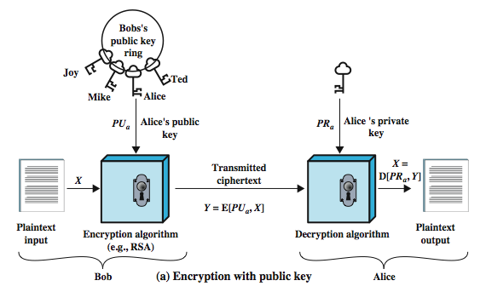
Notes:
54
Stallings Figure 9.1a “Public-Key Cryptography”, shows that a public-key encryption scheme has six ingredients:
• Plaintext: the readable message /data fed into the algorithm as input.
• Encryption algorithm: performs various transformations on the plaintext.
• Public and private keys: a pair of keys selected so that if one is used for encryption, the other is used for decryption. The exact transformations performed by the algorithm depend on the public or private key that is provided as input.
• Ciphertext: the scrambled message produced as output. It depends on the plaintext and the key. For a given message, two different keys will produce two different ciphertexts.
• Decryption algorithm: accepts the ciphertext and matching key and produces the original plaintext.
Consider the following analogy using padlocked boxes: traditional schemes involve the sender putting a message in a box and locking it, sending that to the receiver, and somehow securely also sending them the key to unlock the box. The radical advance in public key schemes was to turn this around, the receiver sends an unlocked box (their public key) to the sender, who puts the message in the box and locks it (easy - and having locked it cannot get at the message), and sends the locked box to the receiver who can unlock it (also easy), having the (private) key. An attacker would have to pick the lock on the box (hard).

Slide 55
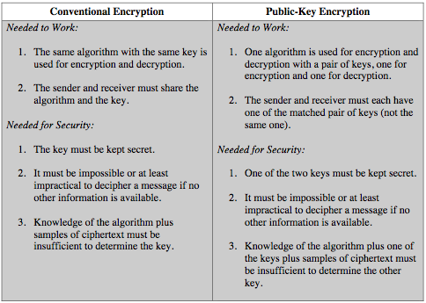
Symmetric vs Public-Key
Notes:
55
Stallings Table 9.2 summarizes some of the important aspects of symmetric and public-key encryption. To discriminate between the two, we refer to the key used in symmetric encryption as a secret key. The two keys used for asymmetric encryption are referred to as the public key and the private key. Invariably, the private key is kept secret, but it is referred to as a private key rather than a secret key to avoid confusion with symmetric encryption.

Slide 56
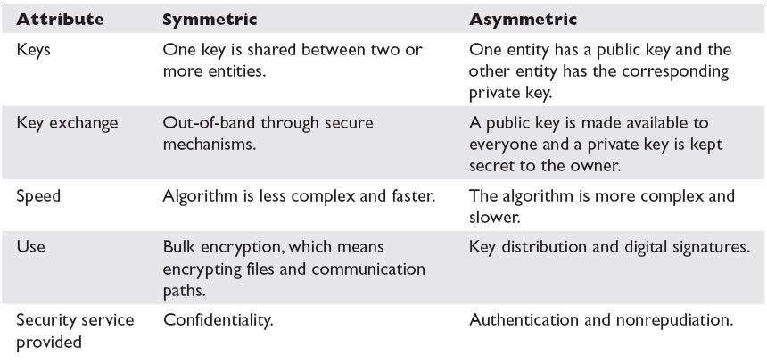
Symmetric & Asymmetric Compared

Slide 57
Block Cipher
When a block cipher is used for encryption and decryption purposes, the message is divided into blocks of bits.
64 bit block size is the most widely used.
A strong cipher contains the right level of two main attributes: Confusion and Diffusion
Confusion is commonly carried out through substitution whiles Diffusion is carried out by transposition.

Slide 58
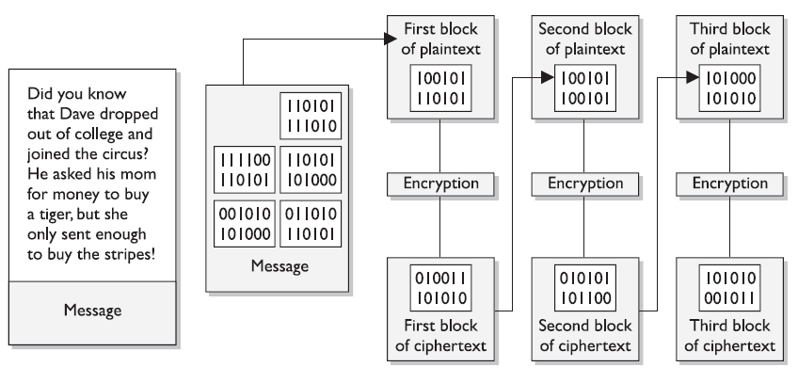
Block Cipher

Slide 59
Block Cipher
For a cipher to be strong it must contain both Confusion and Diffusion attributes to ensure reverse-engineering is basically impossible.
The randomness of the key values and the complexity of the mathematical functions dictates the level of confusion and diffusion involved.
Changing a plaintext value should change many ciphertext values and not just one.
In strong cipher, if one plaintext bit is changed, it will change every ciphertext bit with a probability of 50%

Slide 60
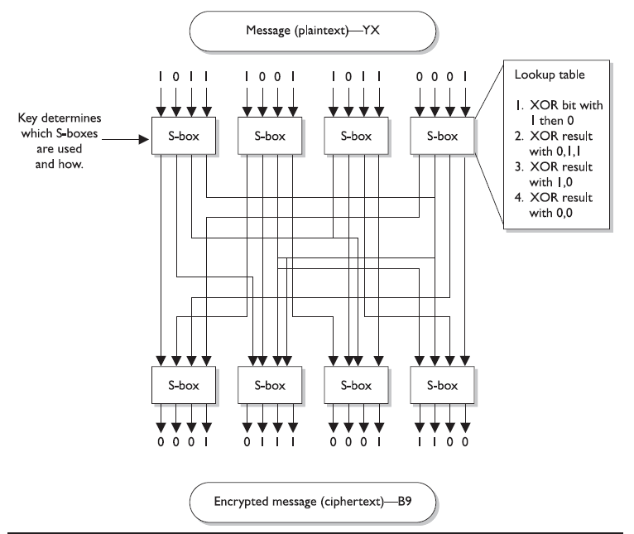
Block Cipher

Slide 61
Stream Cipher
A stream cipher treat message as a stream of bits and performs mathematical function on each bit individually.
Stream Cipher uses Keystream generator which produces a stream of bits that are XORed with the plaintext bits to produce ciphertext.
Easy for hackers to break. Why?

Slide 62
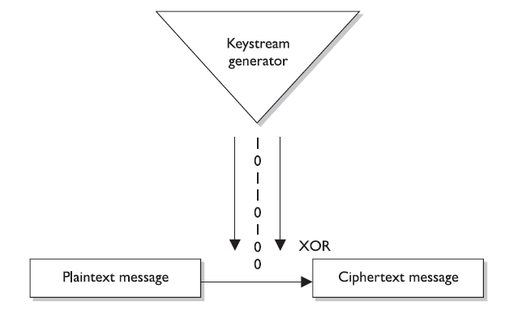
Stream Cipher

Slide 63
Stream Cipher
An attacker could get a copy of the plaintext and the resulting ciphertext, XOR them together and find the keystream to use in decrypting other messages.
A Key is usually used in stream cipher to provide the randomness to address this issue. So the stream of bits that are XORed with the plaintext is as random as possible.

Slide 64
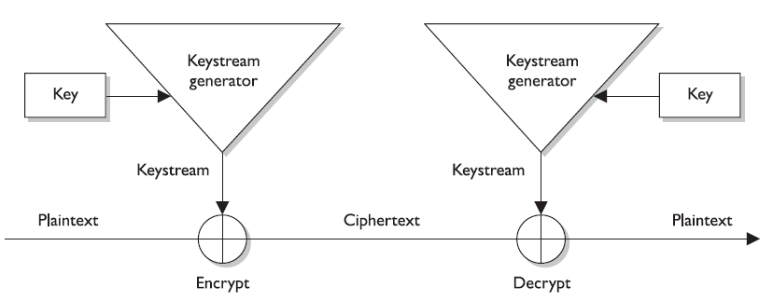
Stream Cipher

Slide 65
Block and Stream Cipher
Stream ciphers require a lot of randomness and encrypt individual bits at a time.
This require more processing power than block ciphers require which is why stream ciphers are better suited to be implemented at the hardware level.
Block ciphers do not require much processing power hence they are usually implemented at the software level
But these are just Best Practices.

Slide 66
Initialization Vector
Initialization Vectors(IVs) are random values that are used with algorithms to ensure patterns are not created during the encryption process.
They are used with keys and do not need to be encrypted when being sent to the destination.
If IVs are not used, then two identical plaintext values that are encrypted with the same key will create same ciphertext.
The IV and key are both used by algorithms to provide more randomness to encryption.

Slide 67
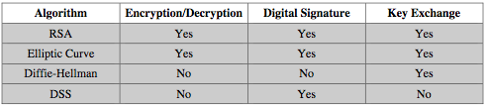
Public-Key Applications
can classify uses into 3 categories:
encryption/decryption (provide secrecy)
digital signatures (provide authentication)
key exchange (of session keys)
some algorithms are suitable for all uses, others are specific to one
Notes:
67
Public-key systems are characterized by the use of a cryptographic type of algorithm with two keys. Depending on the application, the sender uses either the sender’s private key or the receiver’s public key, or both, to perform some type of cryptographic function. In broad terms, we can classify the use of public-key cryptosystems into the three categories:
• Encryption/decryption: The sender encrypts a message with the recipient’s public key.
• Digital signature: The sender “signs” a message with its private key, either to the whole message or to a small block of data that is a function of the message.
• Key exchange: Two sides cooperate to exchange a session key. Several different approaches are possible, involving the private key(s) of one or both parties.
Some algorithms are suitable for all three applications, whereas others can be used only for one or two of these applications. Stallings Table 9.3 (shown here) indicates the applications supported by the algorithms discussed in this book.

Slide 68
Requirements
How should a public key scheme work?
Three main conditions
It must be computationally easy to encrypt or decrypt a message given the appropriate key
It must be computationally infeasible to derive the private key from the public key
It must be computationally infeasible to determine the private key from chosen plaintext attack

Slide 69
Security of Public Key Schemes
like private key schemes brute force exhaustive search attack is always theoretically possible
but keys used are too large (>512bits)
security relies on a large enough difference in difficulty between easy (en/decrypt) and hard (cryptanalyse) problems
more generally the hard problem is known, but is made hard enough to be impractical to break
requires the use of very large numbers
hence is slow compared to private key schemes
Notes:
69
Public key schemes are no more or less secure than private key schemes - in both cases the size of the key determines the security. As with symmetric encryption, a public-key encryption scheme is vulnerable to a brute-force attack. The countermeasure is the same: Use large keys. However, there is a tradeoff to be considered. Public-key systems depend on the use of some sort of invertible mathematical function. The complexity of calculating these functions may not scale linearly with the number of bits in the key but grow more rapidly than that. Thus, the key size must be large enough to make brute-force attack impractical but small enough for practical encryption and decryption. In practice, the key sizes that have been proposed do make brute-force attack impractical but result in encryption/decryption speeds that are too slow for general-purpose use. Instead, as was mentioned earlier, public-key encryption is currently confined to key management and signature applications. Another form of attack is to find some way to compute the private key given the public key. To date, it has not been mathematically proven that this form of attack is infeasible for a particular public-key algorithm.
Note also that you can't compare key sizes - a 64-bit private key scheme has very roughly similar security to a 512-bit RSA - both could be broken given sufficient resources. But with public key schemes at least there is usually a firmer theoretical basis for determining the security since its based on well-known and well studied number theory problems.

Slide 70
Exchanging keys
Alice and Bob want to communicate using a block cipher to encrypt their messages, but don’t have shared key
How do Alice and Bob get a shared key?

Slide 71
Solution 1
Alice sends the key along with her encrypted message
Eve sees encrypted message and key
Uses key to decrypt message
FAIL!

Slide 72
Solution 2
Alice sends the key at some time prior to sending Bob the encrypted message
Eve has to wait longer
If she saw the key transmission, she has the key
Uses key to decrypt message
FAIL!

Slide 73
Historical Background
1976: Diffie and Hellman proposed the first public-key encryption algorithms -- actually an algorithm for public exchange of a secret key.
1978: Rivest, Shamir, and Adleman proposed the RSA encryption method
- Currently the most widely used

Slide 74
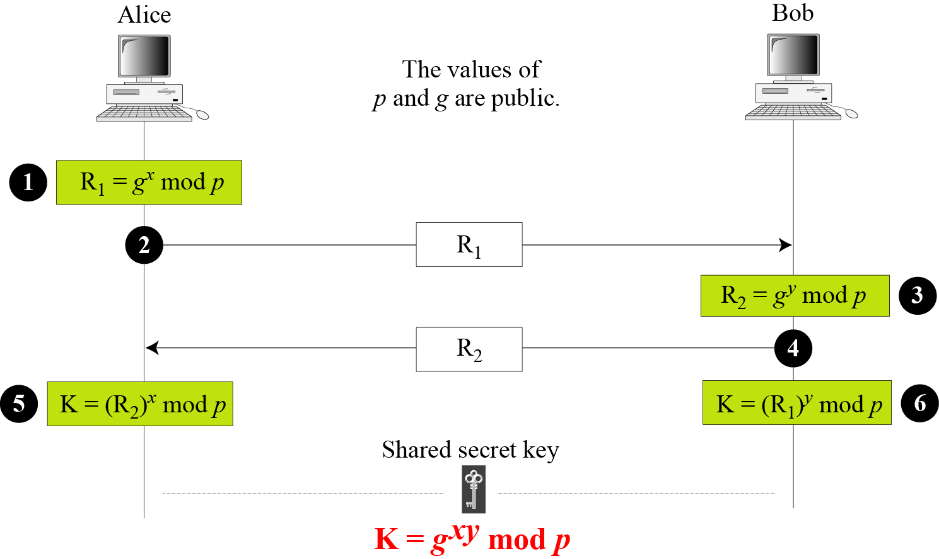
Diffie-Hellman Key Agreement
Secret x
Secret y
10.74
Notes:
74

Slide 75
Solution 3 – Use public key crypto
Diffie Hellman Key Exchange
All users share common modulus, p, and element g
g ≠ 0, g ≠ 1, and g ≠ p-1
Alice chooses her private key, k_{A}
Computes K_{A} = g^{kA} mod p and sends it to Bob in the clear
Bob chooses his private key, k_{B}
Computes K_{B} = g^{kB} mod p and sends it to Alice in the clear
When Alice and Bob want to agree on a shared key, they compute a shared secret S
S_{A,B} = K_{B}^{kA} mod p
S_{B,A} = K_{A}^{kB} mod p

Slide 76
Why does DH work?
S_{A,B} = S_{B,A}
(g^{kA}) ^{kB} mod p = (g^{kB}) ^{kA} mod p
Eve knows
g and p
K_{A} and K_{B}
Why can’t Eve compute the secret?
S_{A,B} = K_{B}^{kA} mod p
S_{B,A} = K_{A}^{kB} mod p
This was the first public key cryptography scheme

Slide 77
Diffie-Hellman Example
users Alice & Bob who wish to swap keys:
agree on prime q=353 and g=3
select random secret keys:
A chooses x_{A}=97, B chooses x_{B}=233
compute respective public keys:
K_{A}=3⁹⁷ mod 353 = 40 (Alice)
K_{B}=3²³³ mod 353 = 248 (Bob)
compute shared session key as:
S_{A,B}= K_{B}^{kA} mod 353 = 248⁹⁷ = 160 (Alice)
S_{B,A}= K_{A}^{kB} mod 353 = 40²³³ = 160 (Bob)
Notes:
77
Here is an example of Diffie-Hellman from the text using prime q=353, showing how each computes its public key, and then how after they exchange public keys, each can compute the common secret key.I n this simple example, it would be possible by brute force to determine the secret key 160. In particular, an attacker E can determine the common key by discovering a solution to the equation 3ª mod 353 = 40 or the equation 3^{b} mod 353 = 248. The brute-force approach is to calculate powers of 3 modulo 353, stopping when the result equals either 40 or 248. The desired answer is reached with the exponent value of 97, which provides 3⁹⁷ mod 353 = 40. With larger numbers, the problem becomes impractical.

Slide 78
Hard problems
Public key cryptosystems are based on hard problems
DH is based on the Discrete Logarithm Problem (DLP)
Given:
Multiplicative group G
Element a in G
Output b
Find:
Unique solution to a^{x} = b in G
x is log_{a} b
No polynomial time algorithm exists to solve this

Slide 79
Key Exchange Protocols
users could create random private/public D-H keys each time they communicate
users could create a known private/public D-H key and publish in a directory, then consulted and used to securely communicate with them
both of these are vulnerable to a meet-in-the-Middle Attack
authentication of the keys is needed
Notes:
79
Now consider a simple protocol that makes use of the Diffie-Hellman calculation. Suppose that user A wishes to set up a connection with user B and use a secret key to encrypt messages on that connection. User A can generate a one-time private key X_{A}, calculate Y_{A}, and send that to user B. User B responds by generating a private value X_{B}, calculating Y_{B}, and sending Y_{B} to user A. Both users can now calculate the key. The necessary public values q and a would need to be known ahead of time. Alternatively, user A could pick values for q and a and include those in the first message.

Slide 80
Asymmetric Cryptography
The public and private keys of an asymmetric cryptosystem are mathematically related, but if someone gets another person’s public key, he should not be able to figure out the corresponding private key.
If confidentiality is the most important security service to the sender, he would encrypt the file with the receiver’s public key. This is called a secure message format because it can only be decrypted by the person who has the corresponding private key

Slide 81
Asymmetric Cryptography
If authentication is the most important security service to the sender, he would encrypt the data with his private key. This provides assurance to receiver that the only person who could have encrypted the data is the individual who posses that private key. Encrypting data with sender’s private key is called a open message format because anyone with a copy of corresponding public key can decrypt the message. Confidentiality is not assured.

Slide 82
Asymmetric Cryptography
Asymmetric algorithms are slower than symmetric algorithms because they use much more complex mathematics to carry out their functions which requires more processing time.
Although they are slower, asymmetric algorithms can provide authentication and nonrepudiation depending on the type of algorithm used.
Asymmetric algorithm also provide for easier and more manageable key distribution than symmetric system and do not have the scalability issues of the symmetric system.

Slide 83
RSA
Rivest-Shamir-Adleman
Probably the most well-known public key scheme
First, some background

Slide 84
Euler’s Totient
Totient function φ(n)
Number of positive numbers less than n that are relatively prime to n
Two numbers are relatively prime when their greatest common divisor is 1
Example: φ(10) = 4
1, 3, 7, 9
Example: φ(7) = 6
1, 2, 3, 4, 5, 6
If n is prime, φ(n) = n-1

Slide 85
RSA keys
Choose 2 large primes, p and q
N = pq
φ(N) = (p-1)(q-1)
Choose e < N such that gcd(e, φ(N))=1
d such that ed = 1 mod φ(N)
Public key: {N, e}
Private key: {d}
p and q must also be kept secret

Slide 86


RSA encryption/decryption
Alice wants to send Bob message m
She knows his public key, {N,e}
m = c^{d} mod N
c = m^{e} mod N
c
Bob
Alice

Slide 87
INPUT
FINISH
START
BigInteger -ProbablePrime
Message
“HI”
Message
“HI”
stringToNumber
numberToString
p
q
…
Calculate N and φ(N)
Calculate e and d
Message
7273
decrypt/
chineseRemainder
Public Keys
e N
Private Keys
d N
encrypt/
encryptSquare
Ciphertext
RSA Algorithm Flowchart
Notes:
87

Slide 88
Correctness
We only need to show : c^{d}=m^{ed}=m mod N.
Case gcd(m, N)=1:
In fact , from d=e⁻¹ modφ(N), ed=kφ(N)+1. So , c^{d} =m^{ed}=m^{kφ(N)+1} mod N. So m^{φ(N)=}1 mod N, we have m^{kφ(N)+1} mod N=m.

Slide 89
Correctness
gcd(m,N)≠1
Let m=cp
gcd(m,q)=1, From Euler Theorem, we have m^{φ(q)}≡1 mod q，
m^{kφ(q)}≡1 mod q,
[m^{kφ(q)}]^{φ(p)}≡1 mod q,
m^{kφ(N)}≡1 mod q
So, m^{kφ(N)}=1+rq，multiply m=cp
m^{kφ(N)+1}=m+rcpq=m+rcn
i.e. m^{kφ(N)+1}≡m mod N，so c^{d} mod N≡m

Slide 90
Some notes about d,e, p, and q
p and q must be large for security
e, the encryption exponent, does not have to be that large (2¹⁶ – 1 = 65535 is good)
d, the decryption exponent, needs to be sufficiently large (512 to 2048 bits)
Having to work with such large numbers, we need to look at some other elements of RSA.

Slide 91
Security Analysis
If attacker factors N=pq, then what is going on?
Attacker knows p, q, he can compute modφ(N)=(p-1)(q-1). Euclidean algorithm computes d=e⁻¹ modφ(N).
If attacker can not factor N=pq, then what?
the security of RSA means that it is hard to compute m from m^{e} mod N. This is called a RSA problem. From our analysis, if we can factor N, then we can solve RSA problem. How about the reverse? Currently, this problem is unknown. But it is widely believed that they are equivalent. So RSA is based on factoring problem.

Slide 92
ElGamal Cryptosystem
Besides RSA, another public-key cryptosystem is ElGamal. ElGamal is based on the discrete logarithm problem
10.92
Notes:
92

Slide 93
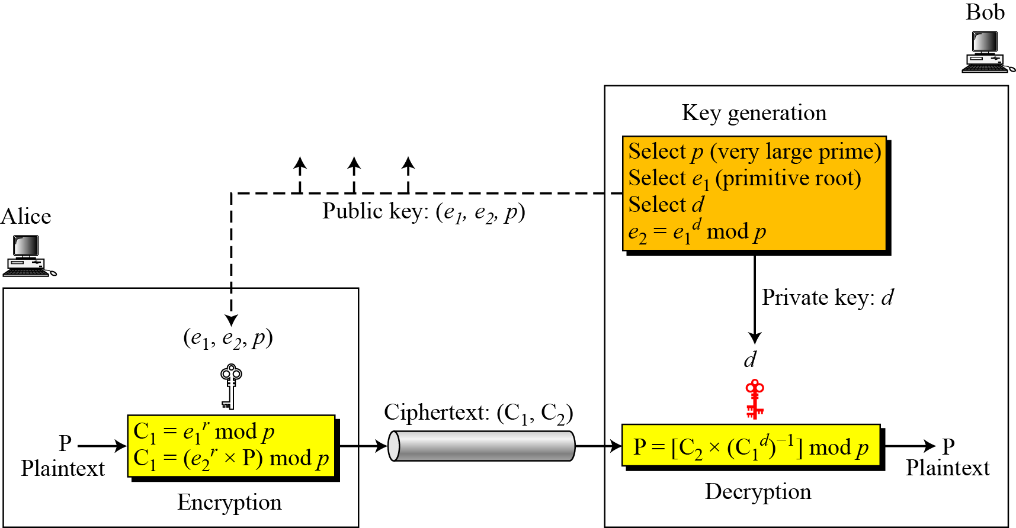
Key generation, encryption, and decryption in ElGamal
C2
10.93
Notes:
93

Slide 94
Hybrid Encryption Method
In Hybrid approach, the two technologies (symmetric and asymmetric) are used in a complementary manner, with each performing different functions.
A symmetric algorithm creates keys used for encrypting bulk data and asymmetric algorithm create keys used for automated key distribution.
Because the message will most likely be longer than the key, the faster algorithm (symmetric) is used on the message and the slower(asymmetric) is used on the key.

Slide 95
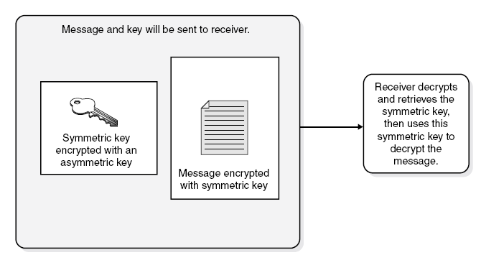
Hybrid Encryption Method

Slide 96
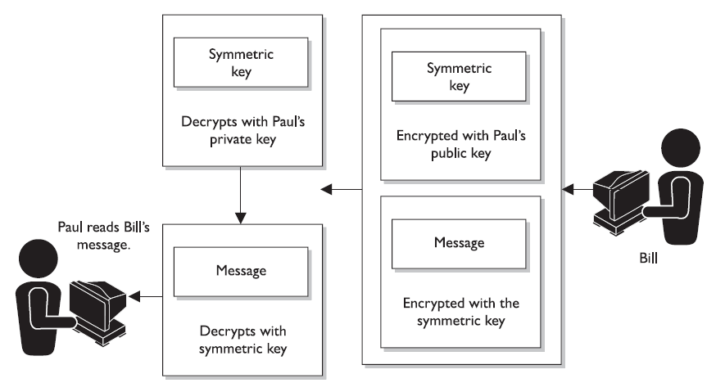
Hybrid Encryption Method

Slide 97
Hybrid Encryption Method
This combines the scalability and key management features of the asymmetric algorithms with the speed of symmetric ones
This is usually called Digital Envelope.
The Secure Sockets Layer (SSL) protocol negotiates which asymmetric and symmetric algorithms to use in a hybrid system to protect TCP connections, such as an HTTP connection between a web browser and web server.

Slide 98
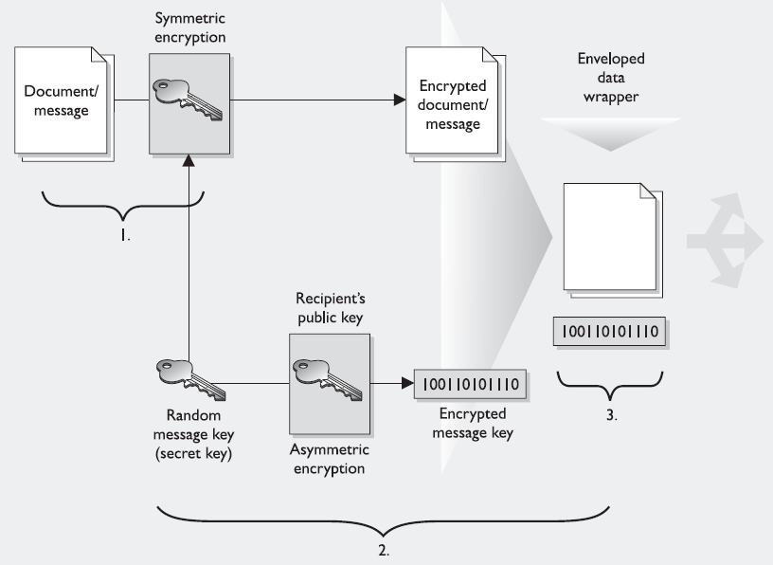
Hybrid Encryption Method

Slide 99
Lets Reason out
If a symmetric key is encrypted with receiver's public key, what security service(s) is provided?
If data is encrypted with sender’s private key, what security service(s) is provided?
If the sender encrypt data with receiver’s private key, what security service(s) is provided?
Why do we encrypt message with the symmetric key?
Why don’t we encrypt the symmetric key with another symmetric key?

Slide 100
Key Generation
10.100
Notes:
100

Slide 101
10.101
Notes:
101

Slide 102
10.102
Notes:
102

Slide 103
Proof of ElGamal Cryptosystem
10.103
Notes:
103

Slide 104
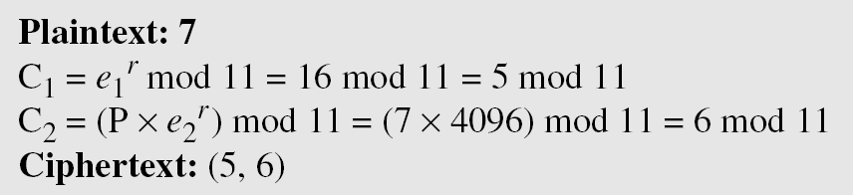
Here is a trivial example. Bob chooses p = 11 and e₁ = 2. and d = 3 e₂ = e₁^{d} = 8. So the public keys are (2, 8, 11) and the private key is 3. Alice chooses r = 4 and calculates C1 and C2 for the plaintext 7.
Bob receives the ciphertexts (5 and 6) and calculates the plaintext.
10.104
Notes:
104

Slide 105
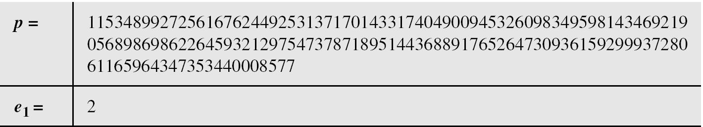
Bob uses a random integer of 512 bits. The integer p is a 155-digit number (the ideal is 300 digits). Bob then chooses e₁, d, and calculates e₂, as shown below:
10.105
Notes:
105

Slide 106
Alice has the plaintext P = 3200 to send to Bob. She chooses r = 545131, calculates C1 and C2, and sends them to Bob.
Bob calculates the plaintext P = C₂ × ((C₁)^{d})⁻¹ mod p = 3200 mod p.
10.106
Notes:
106

