Slide 1
Advanced SQL

Slide 2

Outline
JDBC, Embedded SQL
Triggers
Security
Authorization
Authorization in SQL
Syntax illustrated here may not work exactly on your database system; check the system manuals

Slide 3
Accessing SQL From a Programming Language
API for an application to interact with DB server
  Connect with the database server
  Send SQL commands to the database server
  Fetch tuples of result one-by-one into program variables
Various tools
  ODBC (Open Database Connectivity) works with C, C++, C#, and Visual Basic. Other API’s such as ADO.NET sit on top of ODBC
  JDBC (Java Database Connectivity) works with Java
  Embedded SQL

Slide 4
ODBC
Open DataBase Connectivity (ODBC) standard
  standard for application program to communicate with a database server.
  application program interface (API) to
    open a connection with a database,
    send queries and updates,
    get back results.
Applications such as GUI, spreadsheets, etc. can use ODBC

Slide 5


JDBC
JDBC is a Java API for communicating with database systems supporting SQL
JDBC supports a variety of features for querying and updating data, and for retrieving query results
JDBC also supports metadata retrieval, such as querying about relations present in the database and the names and types of relation attributes
Model for communicating with the database:
  Open a connection
  Create a “statement” object
  Execute queries using the Statement object to send queries
  Use ResultSet object to fetch results
  Exception mechanism to handle errors

Slide 6
Sample JDBC Code
  public static void JDBCexample(String dbid, String userid, String passwd) {
  try {
    Class.forName ("oracle.jdbc.driver.OracleDriver");
    Connection conn = DriverManager.getConnection("jdbc:oracle:thin:@oracle.gl.umbc.edu:1521:gl",
    userid, passwd);
  Statement stmt = conn.createStatement();
  ResultSet rset = stmt.executeQuery("SELECT branchName FROM account");
  while (rset.next()) {
    System.out.println(rset.getString("branchName") );
  }
  rset.close();
  stmt.executeUpdate( “INSERT INTO account VALUES ('A-9732', 'Perryridge', 1200)");
  stmt.close();
  conn.close();
  }
  catch (SQLException e) {
  System.out.println("SQLException : " + e);
  }
}

Slide 7
Procedural Extensions and Stored Procedures
SQL provides a module language
  permits definition of procedures in SQL, with if-then-else statements, for and while loops, etc.
Stored Procedures
  Can store procedures in the database
  then execute them using the call statement
  permit external applications to operate on the database without knowing about internal details

Slide 8

Application Architectures
Applications can be built using one of two architectures

Slide 9
Two-tier Model
E.g. Java code runs at client site and uses JDBC to communicate with the backend server
Benefits:
  flexible, need not be restricted to predefined queries
Problems:
  Security: passwords available at client site, all database operation possible
  More code shipped to client
  Not appropriate across organizations, or in large ones like universities

Slide 10
Three-tier Model
E.g. Web client + Java Servlet using JDBC to talk with database server
Client sends request over http or application-specific protocol
Application or Web server receives request
Request handled by CGI program or servlets
Security handled by application at server
  Better security
  Fine granularity security
Simple client, but only packaged transactions

Slide 11
Embedded SQL
The SQL standard defines embeddings of SQL in a variety of programming languages such as Pascal, PL/I, Fortran, C, and Cobol.
A language to which SQL queries are embedded is referred to as a host language, and the SQL structures permitted in the host language comprise embedded SQL.
The basic form of these languages follows that of the System R embedding of SQL into PL/I.
EXEC SQL statement is used to identify embedded SQL request to the preprocessor
EXEC SQL <embedded SQL statement > END-EXEC
Note: this varies by language. E.g. the Java embedding uses
# SQL { …. } ;

Slide 12
Embedded SQL Example Query
From within a host language, find the names and cities of customers with more than the variable amount dollars in some account.
Specify the query in SQL and declare a cursor for it
EXEC SQL
declare c cursor for
SELECT customer-name, customer-city
from depositor, customer, account
WHERE depositor.customer-name = customer.customer-name
and depositor account-number = account.account-number
and account.balance > :amount
END-EXEC

Slide 13
Embedded SQL
The open statement causes the query to be evaluated
EXEC SQL open c END-EXEC
The fetch statement causes the values of one tuple in the query result to be placed on host language variables.
EXEC SQL fetch c into :cn, :cc END-EXEC
Repeated calls to fetch get successive tuples in the query result
A variable called SQLSTATE in the SQL communication area (SQLCA) gets set to ‘02000’ to indicate no more data is available
The close statement causes the database system to delete the temporary relation that holds the result of the query.
EXEC SQL close c END-EXEC
Note: above details vary with language. E.g. the Java embedding defines Java iterators to step through result tuples.

Slide 14
Extensions to SQL

Slide 15
Functions and Procedures
Functions/procedures can be written in SQL itself, or in an external programming language (e.g., C, Java)
It supports a rich set of imperative constructs, including
  Loops, if-then-else, assignment
SQL functions are in fact parameterized views that generalize the regular notion of views by allowing parameters
Functions written in external languages are particularly useful with specialized data types such as images and geometric objects.
Some systems support table-valued functions, which can return a relation as a result.
Many DBMS have proprietary procedural SQL extensions.

Slide 16
SQL Functions
SQL functions are in fact parameterized views that generalize the regular notion of views by allowing parameters
Define a function that, given the name of a department, returns the count of the number of instructors in that department.
The function dept_count can be used to find the department names and budget of all departments with more that 12 instructors.
create function dept_count (dept_name varchar(20)) returns integer
begin
declare d_count integer;
select count (* ) into d_count
from instructor where instructor.dept_name = dept_name;
return d_count;
end;
select dept_name, budget
from department
where dept_count (dept_name ) > 12;

Slide 17
Table Functions
SQL:2003 added functions that return a relation as a result
Example: Return all instructors in a given department
Usage
create function instructor_of (dept_name char(20))
returns table (ID varchar(5), name varchar(20), dept_name varchar(20), salary numeric(8,2))
return table ( select ID, name, dept_name, salary
from instructor
where instructor.dept_name = instructor_of.dept_name);
select *
from table (instructor_of (‘Music’));

Slide 18
SQL Procedures
The dept_count function could instead be written as procedure:
Procedures can be invoked either from an SQL procedure or from embedded SQL, using the call statement.
create procedure dept_count_proc (in dept_name varchar(20),
out d_count integer)
begin
select count(*) into d_count
from instructor
where instructor.dept_name = dept_count_proc.dept_name;
end;
declare d_count integer;
call dept_count_proc( ‘Physics’, d_count);

Slide 19
Language Constructs for Procedures & Functions
SQL supports constructs that gives it almost all the power of a general-purpose programming language.
begin … end, if-then-else, While, and repeat statements, Signaling and handinling of exception conditions
For loops – permiting iteration over all results of a query
  Example: Find the budget of all departments
  declare n integer default 0;
  for r as
  select budget from department
  do
  set n = n + r.budget
  end for
SQL:1999 permits the use of functions and procedures written in other languages such as C or C++
Declaring external language procedures and functions
create procedure dept_count_proc(in dept_name varchar(20),
out count integer)
language C
external name ’ /usr/avi/bin/dept_count_proc’
create function dept_count(dept_name varchar(20))
returns integer
language C
external name ‘/usr/avi/bin/dept_count’

Slide 20
External Language Routines
Benefits of external language functions/procedures:
  more efficient for many operations, and more expressive power.
Drawbacks
  Code to implement function may need to be loaded into database system and executed in the database system’s address space.
    risk of accidental corruption of database structures
    security risk, allowing users access to unauthorized data
  There are alternatives, which give good security at the cost of potentially worse performance.
  Direct execution in the database system’s space is used when efficiency is more important than security.

Slide 21
Security with External Language Routines
To deal with security problems, we can do on of the following:
  Use sandbox techniques
    That is, use a safe language like Java, which cannot be used to access/damage other parts of the database code.
  Run external language functions/procedures in a separate process, with no access to the database process’ memory.
    Parameters and results communicated via inter-process communication
Both have performance overheads
Many database systems support both above approaches as well as direct executing in database system address space.

Slide 22
Triggers

Slide 23
Triggers
A trigger is a statement that is executed automatically by the system as a side effect of a modification to the database.
To design a trigger mechanism, we must:
  Specify the conditions under which the trigger is to be executed.
  Specify the actions to be taken when the trigger executes.

Slide 24
Triggering Events and Actions in SQL
Triggering event can be insert, delete or update
Triggers on update can be restricted to specific attributes
Values of attributes before and after an update can be referenced: referencing [old|new] row as
Triggers can be activated before an event; eg, convert blank grades to null.
create trigger credits_earned after update of takes on grade
create trigger setnullTrigger
before update on takes
referencing new row as nrow
for each row
when nrow.grade = ‘ ‘ set nrow.grade = null;

Slide 25
Trigger Example
Trigger to Maintain credits_earned
create trigger credits_earned after update of takes on (grade)
referencing new row as nrow
referencing old row as orow
for each row
when nrow.grade <> ’F’ and nrow.grade is not null
and (orow.grade = ’F’ or orow.grade is null)
begin atomic
update student
set tot_cred= tot_cred +
(select credits
from course
where course.course_id= nrow.course_id)
where student.id = nrow.id;
end;

Slide 26
Statement Level Triggers
Instead of executing a separate action for each affected row, a single action can be executed for all rows affected by a transaction
  Use for each statement instead of for each row
  Use referencing old table or referencing new table to refer to temporary tables (called transition tables) containing the affected rows
  Can be more efficient when dealing with SQL statements that update a large number of rows

Slide 27
Triggers and External World Actions
We sometimes require external world actions to be triggered on a database update
  E.g. re-ordering an item whose quantity in a warehouse has become small, or turning on an alarm light, etc
Triggers cannot be used to directly implement external-world actions, BUT
  Triggers can be used to record actions-to-be-taken in a separate table
  Have an external process that repeatedly scans the table, carries out external-world actions and deletes action from table

Slide 28
When Not To Use Triggers
Triggers were used earlier for tasks such as
  maintaining summary data (e.g. total salary of each department)
  Replicating databases by recording changes to special relations (called change or delta relations) and having a separate process that applies the changes over to a replica
There are better ways of doing these now:
  Databases today provide built in materialized view facilities to maintain summary data
  Databases provide built-in support for replication
Encapsulation facilities can be used instead of triggers in many cases
  Define methods to update fields
  Carry out actions as part of the update methods instead of
  through a trigger

Slide 29
Recursive Queries

Slide 30
Recursive Views in SQL
Example: find the transitive closure of the prereq relation, i.e. which courses are a prerequisite, whether directly or indirectly, for a specific course
with recursive rec_prereq(course_id, prereq_id) as (
select course_id, prereq_id from prereq
union
select rec_prereq.course_id, prereq.prereq_id,
from rec_rereq, prereq
where rec_prereq.prereq_id = prereq.course_id
)
select ∗
from rec_prereq;

Slide 31
The Power of Recursion
Recursive views make it possible to write queries, such as transitive closure queries, that cannot be written without recursion or iteration.
  Intuition: Without recursion, a non-recursive non-iterative program can perform only a fixed number of joins of prereq with itself
  Computing transitive closure using iteration, adding successive tuples to the recurvise view
Recursive views are required to be monotonic. That is, if we add tuples to prereq the view rec_prereq contains all of the tuples it contained before, plus possibly more; eventually converges to a fixed point relation

Slide 32


Example of Fixed-Point Computation

Slide 33
Advanced Aggregation Features

Slide 34
Ranking
Ranking is done in conjunction with an order by specification.
Suppose we are given a relation
student_grades(ID, GPA)
giving the grade-point average of each student
Find the rank of each student.
select ID, rank() over (order by GPA desc) as s_rank
from student_grades
An extra order by clause is needed to get them in sorted order
select ID, rank() over (order by GPA desc) as s_rank
from student_grades
order by s_rank
Ranking may leave gaps: e.g. if 2 students have the same top GPA, both have rank 1, and the next rank is 3
  dense_rank does not leave gaps, so next dense rank would be 2

Slide 35
Ranking
Ranking can be done using basic SQL aggregation, but resultant query is very inefficient
  select ID, (1 + (select count(*)
  from student_grades B
  where B.GPA > A.GPA)) as s_rank
  from student_grades A
  order by s_rank;

Slide 36
Ranking (Cont.)
Ranking can be done within partition of the data.
“Find the rank of students within each department.”
select ID, dept_name,
rank () over (partition by dept_name order by GPA desc)
as dept_rank
from dept_grades
order by dept_name, dept_rank;
Multiple rank clauses can occur in a single select clause.
Ranking is done after applying group by clause/aggregation
Can be used to find top-n results
  More general than the limit n clause supported by many databases, since it allows top-n within each partition

Slide 37

Ranking (Cont.)
Other ranking functions:
  percent_rank (within partition, if partitioning is done)
  cume_dist (cumulative distribution)
    fraction of tuples with preceding values
  row_number (non-deterministic in presence of duplicates)
SQL:1999 permits the user to specify nulls first or nulls last
select ID,
rank ( ) over (order by GPA desc nulls last) as s_rank
from student_grades

Slide 38
Ranking (Cont.)
For a given constant n, the ranking the function ntile(n) takes the tuples in each partition in the specified order, and divides them into n buckets with equal numbers of tuples.
E.g.,
select ID, ntile(4) over (order by GPA desc) as quartile
from student_grades;

Slide 39
Windowing
Used to smooth out random variations.
E.g., moving average: “Given sales values for each date, calculate for each date the average of the sales on that day, the previous day, and the next day”
Window specification in SQL:
  Given relation sales(date, value)
select date, sum(value) over
(order by date between rows 1 preceding and 1 following)
from sales

Slide 40
Windowing
Examples of other window specifications:
  between rows unbounded preceding and current
  rows unbounded preceding
  range between 10 preceding and current row
    All rows with values between current row value –10 to current value
  range interval 10 day preceding
    Not including current row

Slide 41
Windowing (Cont.)
Can do windowing within partitions
E.g., Given a relation transaction (account_number, date_time, value), where value is positive for a deposit and negative for a withdrawal
  “Find total balance of each account after each transaction on the account”
  select account_number, date_time,
  sum (value) over
  (partition by account_number
  order by date_time
  rows unbounded preceding)
  as balance
  from transaction
  order by account_number, date_time

Slide 42
OLAP

Slide 43
Data Analysis and OLAP
Online Analytical Processing (OLAP)
  Interactive analysis of data, allowing data to be summarized and viewed in different ways in an online fashion (with negligible delay)
Data that can be modeled as dimension attributes and measure attributes are called multidimensional data.
  Measure attributes
    measure some value
    can be aggregated upon
    e.g., the attribute number of the sales relation
  Dimension attributes
    define the dimensions on which measure attributes (or aggregates thereof) are viewed
    e.g., attributes item_name, color, and size of the sales relation

Slide 44

Example sales relation
...
...
...
...
...
...
...
...

Slide 45
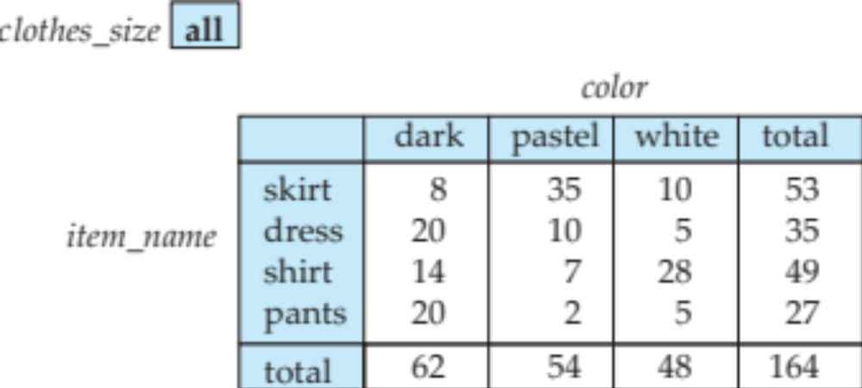
Cross Tabulation of sales by item_name and color
The table above is an example of a cross-tabulation (cross-tab), also referred to as a pivot-table.
  Values for one of the dimension attributes form the row headers
  Values for another dimension attribute form the column headers
  Other dimension attributes are listed on top
  Values in individual cells are (aggregates of) the values of the
  dimension attributes that specify the cell.

Slide 46
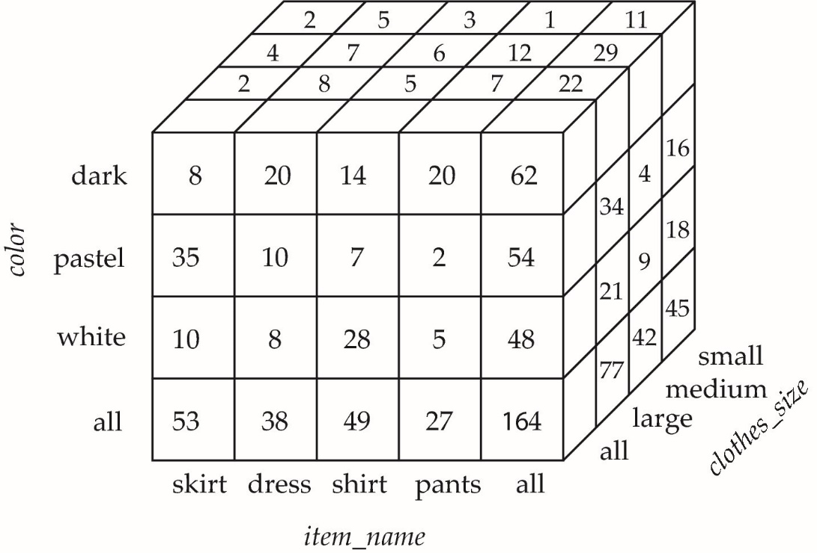

Data Cube
A data cube is a multidimensional generalization of a cross-tab
Can have n dimensions; we show 3 below
Cross-tabs can be used as views on a data cube

Slide 47

Hierarchies on Dimensions
Hierarchy on dimension attributes: lets dimensions to be viewed at different levels of detail
  E.g., the dimension DateTime can be used to aggregate by hour of day, date, day of week, month, quarter or year

Slide 48

Cross Tabulation With Hierarchy
Cross-tabs can be easily extended to deal with hierarchies
  Can drill down or roll up on a hierarchy

Slide 49

Relational Representation of Cross-tabs
Cross-tabs can be represented as relations
  We use the value all is used to represent aggregates.
  The SQL standard actually uses null values in place of all despite confusion with regular null values.

Slide 50
Extended Aggregation to Support OLAP
The cube operation computes union of group by’s on every subset of the specified attributes
Example relation for this section
sales(item_name, color, clothes_size, quantity)
E.g. consider the query
select item_name, color, size, sum(number)
from sales
group by cube(item_name, color, size)
This computes the union of eight different groupings of the sales relation:
{ (item_name, color, size), (item_name, color),
(item_name, size), (color, size),
(item_name), (color),
(size), ( ) }
where ( ) denotes an empty group by list.
For each grouping, the result contains the null value
for attributes not present in the grouping.

Slide 51
Online Analytical Processing Operations
Relational representation of cross-tab that we saw earlier, but with null in place of all, can be computed by
select item_name, color, sum(number)
from sales
group by cube(item_name, color)
The function grouping() can be applied on an attribute
  Returns 1 if the value is a null value representing all, and returns 0 in all other cases.
select item_name, color, size, sum(number),
grouping(item_name) as item_name_flag,
grouping(color) as color_flag,
grouping(size) as size_flag,
from sales
group by cube(item_name, color, size)

Slide 52
Online Analytical Processing Operations
Can use the function decode() in the select clause to replace
such nulls by a value such as all
  E.g., replace item_name in first query by
  decode( grouping(item_name), 1, ‘all’, item_name)

Slide 53
Extended Aggregation (Cont.)
The rollup construct generates union on every prefix of specified list of attributes
E.g.,
select item_name, color, size, sum(number)
from sales
group by rollup(item_name, color, size)
  Generates union of four groupings:
{ (item_name, color, size), (item_name, color), (item_name), ( ) }
Rollup can be used to generate aggregates at multiple levels of a
hierarchy.
E.g., suppose table itemcategory(item_name, category) gives the category of each item. Then
select category, item_name, sum(number)
from sales, itemcategory
where sales.item_name = itemcategory.item_name
group by rollup(category, item_name)
would give a hierarchical summary by item_name and by category.

Slide 54
Extended Aggregation (Cont.)
Multiple rollups and cubes can be used in a single group by clause
  Each generates set of group by lists, cross product of sets gives overall set of group by lists
E.g.,
select item_name, color, size, sum(number)
from sales
group by rollup(item_name), rollup(color, size)
generates the groupings
{item_name, ()} X {(color, size), (color), ()}
= { (item_name, color, size), (item_name, color), (item_name),
(color, size), (color), ( ) }

Slide 55
Online Analytical Processing Operations
Pivoting: changing the dimensions used in a cross-tab is called
Slicing: creating a cross-tab for fixed values only
  Sometimes called dicing, particularly when values for multiple dimensions are fixed.
Rollup: moving from finer-granularity data to a coarser granularity
Drill down: The opposite operation - that of moving from coarser-granularity data to finer-granularity data

Slide 56
OLAP Implementation
The earliest OLAP systems used multidimensional arrays in memory to store data cubes, and are referred to as multidimensional OLAP (MOLAP) systems.
OLAP implementations using only relational database features are called relational OLAP (ROLAP) systems
Hybrid systems, which store some summaries in memory and store the base data and other summaries in a relational database, are called hybrid OLAP (HOLAP) systems.

Slide 57
OLAP Implementation (Cont.)
Early OLAP systems precomputed all possible aggregates in order to provide online response
  Space and time requirements for doing so can be very high
    2^{n} combinations of group by
  It suffices to precompute some aggregates, and compute others on demand from one of the precomputed aggregates
    Can compute aggregate on (item_name, color) from an aggregate on (item_name, color, size)
      For all but a few “non-decomposable” aggregates such as median
      is cheaper than computing it from scratch
Several optimizations available for computing multiple aggregates
  Can compute aggregate on (item_name, color) from an aggregate on (item_name, color, size)
  Can compute aggregates on (item_name, color, size),
  (item_name, color) and (item_name) using a single sorting
  of the base data

