Slide 1

Collision avoidance simulator in autonomous driving PROJECT SOFTWARE-DEFINED COMMUNICATION SYSTEMS
Umberto Pirovano - Andrea Conese - Andrea Paternò - Hamze Ghorbani Koujani
Kick-off presentation 08/04/24

Slide 2
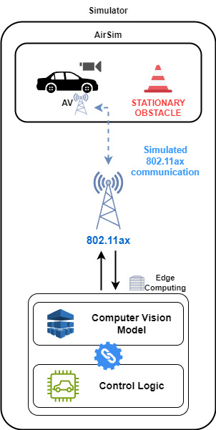
Project description
This project simulates an autonomous urban driving scenario using AirSim. Video frames are analyzed to detect objects, measure their distance, and provide information on speed and path planning for a full collision avoidance control system.
The project also simulates a Wi-Fi 6 (IEEE 802.11ax) transmission channel to transmit video frames from AirSim to the computer vision model and steering decisions back to AirSim.

Slide 3
Objectives
Simulating an urban scenario using Airsim simulator
Detecting objects from the simulated environment using a Computer Vision model
Implementing path control logic
Measuring the distance.
Deciding for speed change, steering, and possible path change.
Simulating a transmission channel considering IEEE 802.11ax standard
Transmitting video frames from airsim simulator to CV model.
Transmitting steering commands back to airsim from CV.
Providing a real system configuration including bandwidth, latency, and packet loss in the simulator.

Slide 4


Project Timeline
VERSION 0
0
Simulating an urban scenario. Preparing the data and detecting the objects frame by frame.
2/05/2024
VERSION 1
1
Establishing a simulation of Wifi-6 connection. Implementing path control logic. Transmitting information for steering and speed change.
10/06/2024
VERSION 2
2
Implementing GUI design and providing the final simulator.
27/06/2024

Slide 5
PBS-Product Breakdown Structure
Collision Avoidance Control
GUI implementation
Simulation environment
Edge service for collision avoidance
Analysis of the output performance by means of KPIs*
Ideal urban scenario selection
Input parameters definition
Collision Avoidance algorithm
IEEE 802.11ax channel simulation
Object Detection model
Selection of the best model for our purpose
Detection of the obstacles
Performance evaluation tool
*KPI: Bandwidth usage, Latency, Packet loss

Slide 6
Milestones and WBS-Work Breakdown Structure
Version 0
Identifying requirements and tools setup
Urban scenario modeling
Version 1
Wireless channel simulator establishment
Path logic development
Version 2
Final refining of the simulator
GUI implementation
CV model integration
Results’ analysis
System assessment based on KPIs

Slide 7
Gantt Chart
Initiative | Objective | April 1 | April 2 | April 3 | April 4 | May 1 | May 2 | May 3 | May 4 | June 1 | June 2 | June 3 | June 4
Version 0 | Simulate the urban scenario in AirSim and achieve video frames.
 | Prepare the data and feed it to the CV model and detecting objects.
 | Basic results’ analysis
Version 1 | Measure the distance from detected objects. Providing steering and speed change information.
 | Establish a IEEE 802.11ax channel simulator, transmitting images from airsim to CV model.
 | Refine the channel simulator to send steering data back to theAirsim. Integrate the whole project.
 | Results’ analysis and evaluation
Version 2 | Develop GUI for the final project. Prepare detailed reports.

