Slide 1
IDSS Practical Work 2 Umberto Salviati
Sheida Jabbedari Khiabani, Atefeh Batani, Ehsan Khanmohammadi,
A hybrid decision support system for heart failure diagnosis using neural networks and statistical process control,
Healthcare Analytics
3/11/2023

Slide 2
Synthesis, data sources, goals, and IDSS scope’s
Problem: The paper proposes a hybrid decision support system (DSS) based on neural networks and statistical process control charts for diagnosing and controlling myocardial infarction (MI) and continuously monitoring the patient’s blood pressure.
Data Sources: clinical data and blood pressure measurements of 175 (MI) patients in Iran (92 actual samples)
Goals: to support the doctor in various stages of diagnosis, from recognizing clinical symptoms to determining the type and severity of the infarction, and to prevent a recurring attack
Scope of IDSS: A hybrid system based on neural networks and statistical control charts that follows the diagnostic policy of the WHO and uses a series of graphical tools to guide the decision-making process

Slide 3
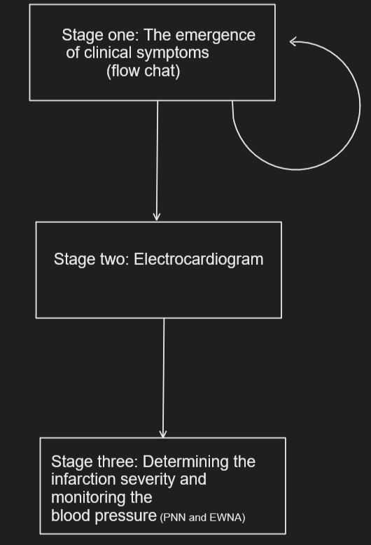
Graphical representation of the IDSS
The authors propose a DSS based on three stages:
a guiding flowchart for the emergence of clinical symptom
a graphical rule table for evaluating the electrocardiogram
a hybrid model of neural networks and control charts for determining the infarction severity and monitoring the blood pressure.

Slide 4
Intelligent Methods for Heart Failure Diagnosis
The DSS consists of three stages:
The first stage uses a guiding flowchart to investigate the emergence of MI clinical symptoms based on the World Health Organization (WHO) policy.
The second stage uses a graphical rule table to evaluate the electrocardiogram (ECG).
The third stage uses a rule table along with a control chart (EWMA) to determine the MI severity level and monitor the blood pressure using the residual values generated by a perceptron neural network (PNN) (two layers, a hidden and an output layer).

Slide 5
Evaluation of the IDSS
80% of the 92 data inputs to the neural network are applied to determine the control chart parameters, and the rest are used for validation purposes.
The performance of the IDSS was evaluated using as main metric the accuracy
The IDSS was compared with four machine learning algorithms (Support Vector Machine, Functional Tree, Bayes Net, and J48) to evaluate its performance.
The results showed that the IDSS had higher accuracy and precision in diagnosing myocardial infarction (MI) compared to the other algorithm

