Slide 1

Umbrella Operator's Handbook
Björn Abt
B.Abt PSI <number>

Slide 2
The necessity of an Operator's Handbook:
People working on Umbrella with no knowledge or experience with Umbrella
People are going on vacation and others should be able to accomplish tasks
A lot of existing high- and mid-level documentation but no comprehensive and complete low-level technical documentation
Handover of Umbrella to ILL
B.Abt, PSI <number>

Slide 3
The General Structure:
Overview of Components
Multi-master LDAP
Multiple Identity Providers
Umbrella Webapp
GeoDNS
Service Provider Setup
B.Abt, PSI <number>

Slide 4
The Detailed Structure of a Chapter:
Explanation
Local Installation
Configuration
Operations:
  Commands
  Backup
  Logfiles
  Monitoring
  Upgrade Procedures
B.Abt, PSI <number>

Slide 5
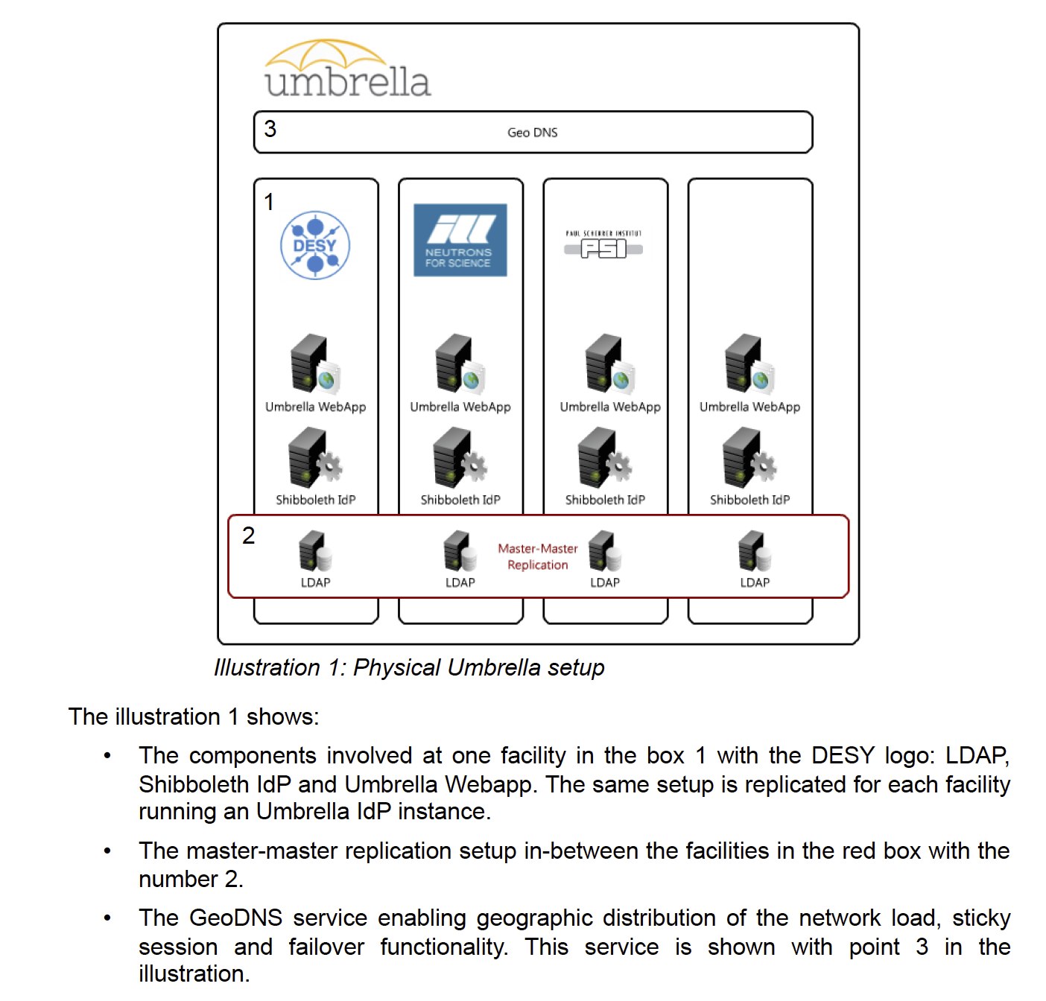
Excerpt:
B.Abt, PSI <number>

Slide 6
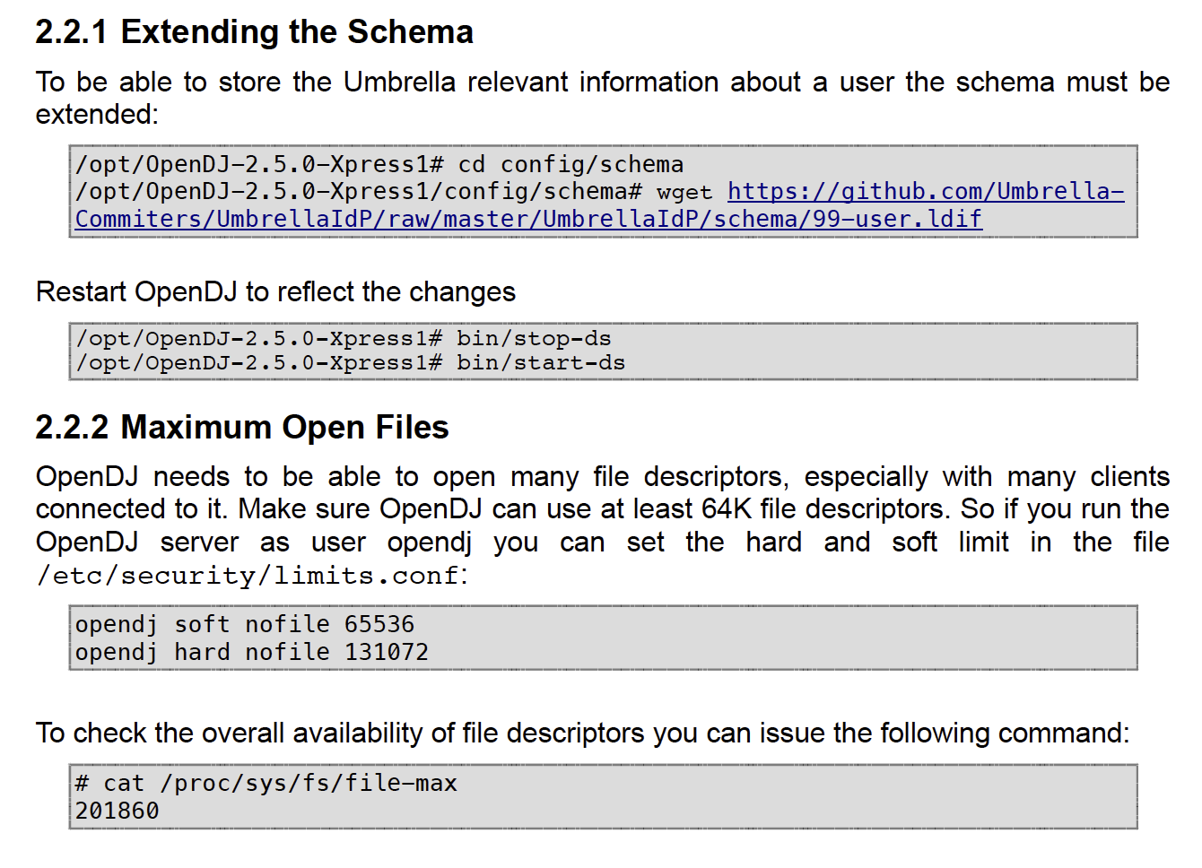
Excerpt:
B.Abt, PSI <number>

Slide 7
Next steps:
Finalise document
Does it make sense to convert the document into a Wiki?
Further developments and changes must be documented as well
B.Abt, PSI <number>

Slide 8
Thank you for your attention!
B.Abt PSI <number>

