Slide 1
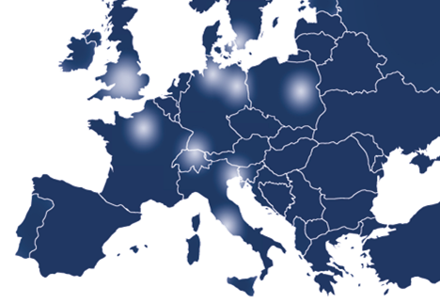
TERENA Code of Conduct
Björn Abt
B.Abt PSI <number>

Slide 2
What is the TERENA Data Protection Code of Conduct?
The Data protection Code of Conduct describes an approach to meet the requirements of the EU Data Protection Directive in federated identity management.
The Data protection Code of Conduct defines behavioral rules for Service Providers which want to receive user attributes from the Identity Providers managed by the Home Organisations.
B.Abt, PSI <number>

Slide 3
What does it contain?
Ensure that the SAML 2.0 elements conform to the SAML 2 Profile for the Code of Conduct.
Remind the Service Provider to check that the Service Provider's mdui:Description and mdui:DisplayName elements are understandable and useful for common end users.
Check that the Service Provider's Privacy Policy document is available and indicates commitment to the Code of Conduct.
Remind the Service Provider to make sure that the list of requested attributes is consistent with the Privacy Policy document.
B.Abt, PSI <number>

Slide 4
SAML2 Profile: CoC
<Extensions>
<EntityAttributes xmlns="urn:oasis:names:tc:SAML:metadata:attribute">
<Attribute xmlns="urn:oasis:names:tc:SAML:2.0:assertion”
Name="http://macedir.org/entity-category"
NameFormat="urn:oasis:names:tc:SAML:2.0:attrname-format:uri">
<AttributeValue>http://www.geant.net/uri/dataprotection-code-of-conduct/v1</AttributeValue>
</Attribute>
</EntityAttributes>
</Extensions>
B.Abt, PSI <number>

Slide 5
SAML2 Profile: mdui
<Extensions>
<UIInfo xmlns=”urn:oasis:names:tc:SAML:metadata:ui”>
<DisplayName xml:lang="fi">FileSender</DisplayName>
<DisplayName xml:lang="en">FileSender</DisplayName>
<Description xml:lang="fi">FileSender tarjoaa helpon tavan jakaa suuria tiedostoja.</Description>
<Description xml:lang="en">FileSender offers an easy way to share large files with anyone.</Description>
<PrivacyStatementURL xml:lang="fi">https://filesender.example.org/privacy-fi.html</PrivacyStatementURL>
<PrivacyStatementURL xml:lang="en">https://filesender.example.org/privacy-en.html</PrivacyStatementURL>
</UIInfo>
</Extensions>
B.Abt, PSI <number>

Slide 6
SAML2 Profile: Attributes
<AttributeConsumingService>
<RequestedAttribute
FriendlyName="EAAHash"
Name="urn:oid:1.3.6.1.4.1.9999.1.1.1"
NameFormat="urn:oasis:names:tc:SAML:2.0:attrname-format:uri"
isRequired="true"/>
<RequestedAttribute
FriendlyName="EAAKey"
Name="urn:oid:1.3.6.1.4.1.9999.1.1.3"
NameFormat="urn:oasis:names:tc:SAML:2.0:attrname-format:uri"
isRequired="true"/>
<RequestedAttribute
FriendlyName="uid"
Name="urn:oid:0.9.2342.19200300.100.1.1"
NameFormat="urn:oasis:names:tc:SAML:2.0:attrname-format:uri"
isRequired="true"/>
</AttributeConsumingService>
B.Abt, PSI <number>

Slide 7
Privacy Policy
Attribute | Description
Service Name | SHOULD be the same as mdui:DisplayName
Service Description | SHOULD be the same as mdui:Description
Data Controller | Institute name storing data and a contact person
Jurisdiction | The country in which the Service Provider is established and whose laws are applied.
Personal data processed | Show the user which of his data is processed
B.Abt, PSI <number>

Slide 8
Privacy Policy
Attribute | Description
Purpose of the processing of personal data | What is the purpose of collecting personal data.
Third parties to whom personal data is disclosed | Is personal data given to third parties?
How to access, rectify and delete personal data | Contact the contact person.
Data retention | When is the user record going to be deleted or anonymised?
Data protection code of conduct | Show the reference to the Terena code of conduct for service providers.
B.Abt, PSI <number>

Slide 9
Next steps:
Shall we implement this Code of Conduct?
Service Providers must provide the neccessary information
The information must be evaluted and integrated into the existing system.
B.Abt, PSI <number>

Slide 10
Thank you for your attention!
B.Abt PSI <number>

