Slide 1

EduGain-Bridge and Moonshot for Umbrella Production
Björn Abt
B.Abt PSI <number>

Slide 2
Agenda:
Show status of eduGain Bridge
Show status of Moonshot implementation
Decide on productionalise these implementations
B.Abt, PSI <number>

Slide 3
Status of eduGain Bridge:
Fully implemented on the Umbrella Test System
Acts as a Service Provider in the eduGain Super-Federation
Each account serviced by an IdP in eduGain can connect to an Umbrella account
B.Abt, PSI <number>

Slide 4
eduGain Umbrella Workflow:
Matching Accounts Workflow
Request login to an Umbrella Service Provider
On the Umbrella Login-Page choose “Login via your Organisation”
Select your Home-IdP
Login at your Home-IdP
Login to Umbrella as well
Choose to link the accounts
Done
B.Abt, PSI <number>

Slide 5
eduGain Umbrella Workflow:
Login Workflow
Request login to an Umbrella Service Provider
On the Umbrella Login-Page choose “Login via your Organisation”
Select your Home-IdP
Login at your Home-IdP (if you do not have a session already)
B.Abt, PSI <number>

Slide 6
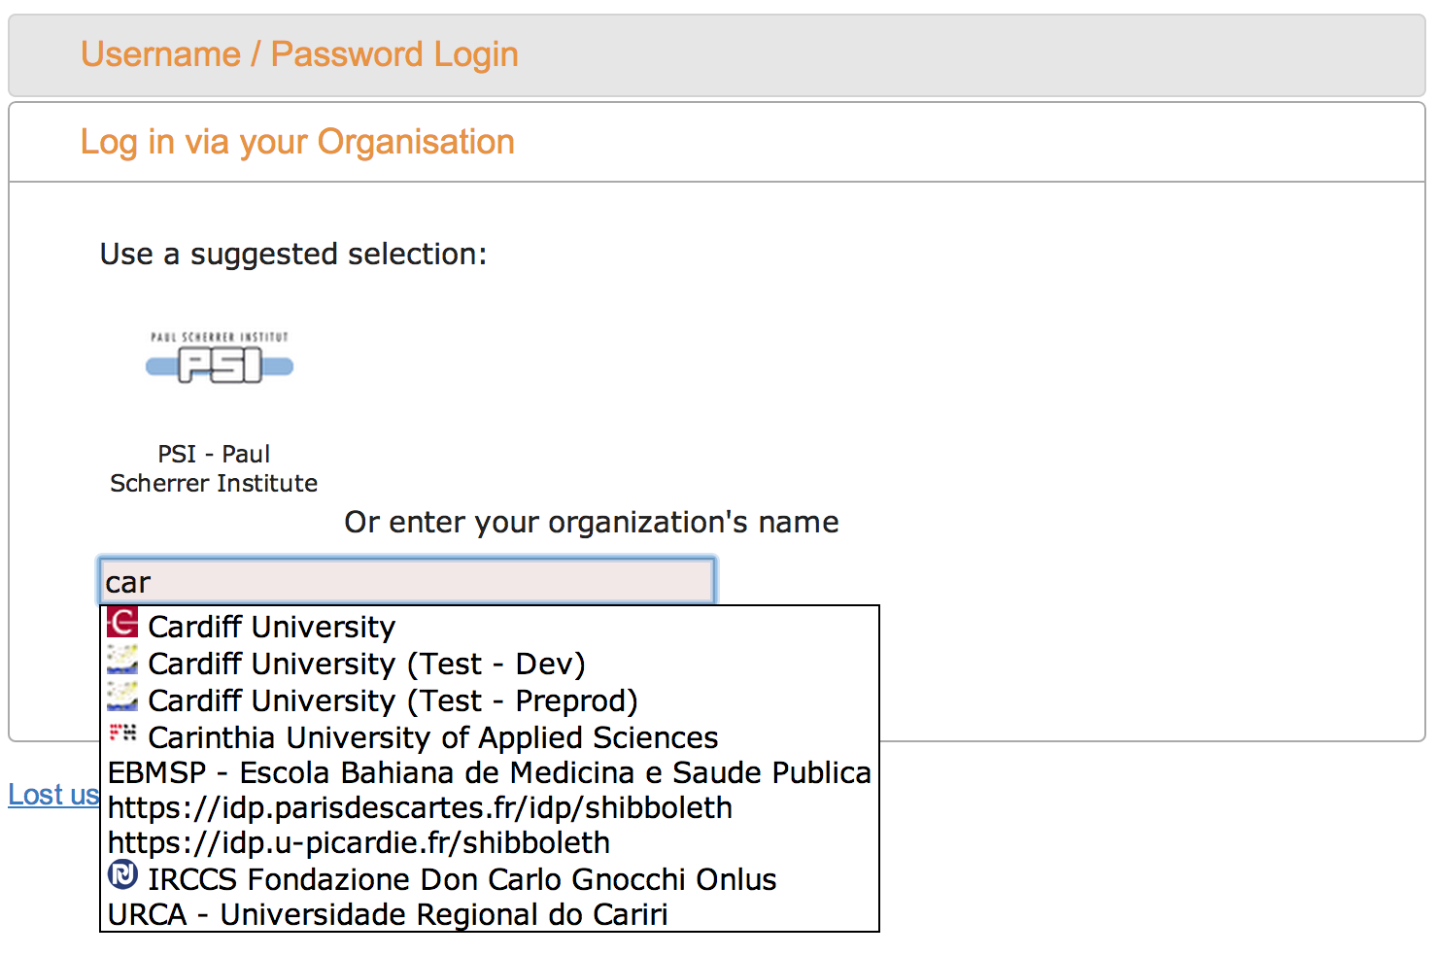
Choose “Login via your Organisation”
B.Abt, PSI <number>

Slide 7
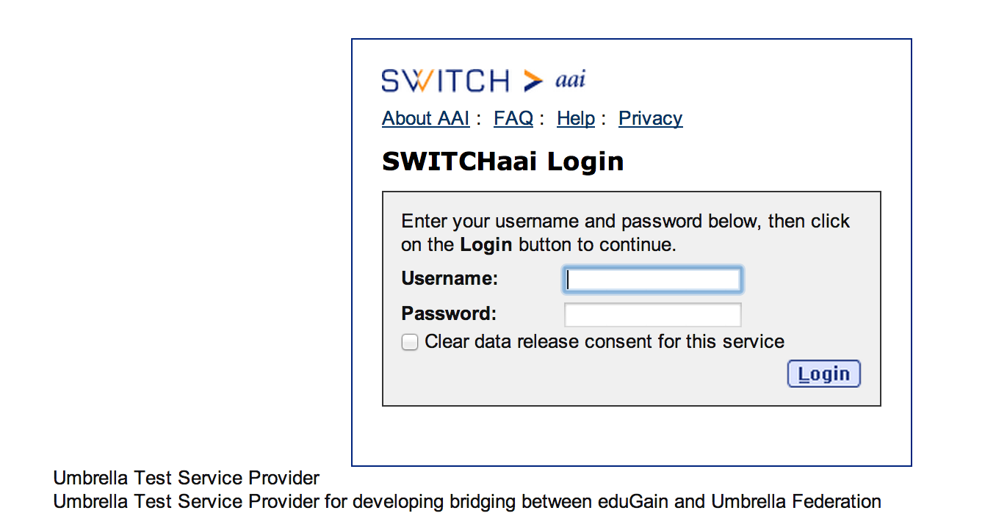
Login at your Home-IdP
B.Abt, PSI <number>

Slide 8
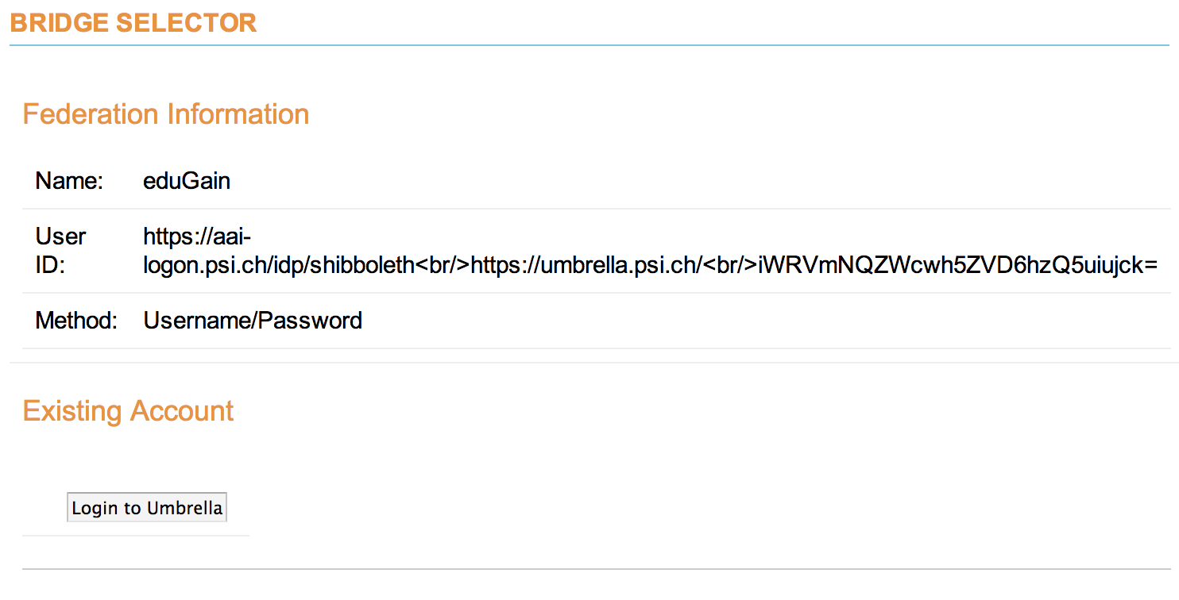
Login to Umbrella as well
B.Abt, PSI <number>

Slide 9
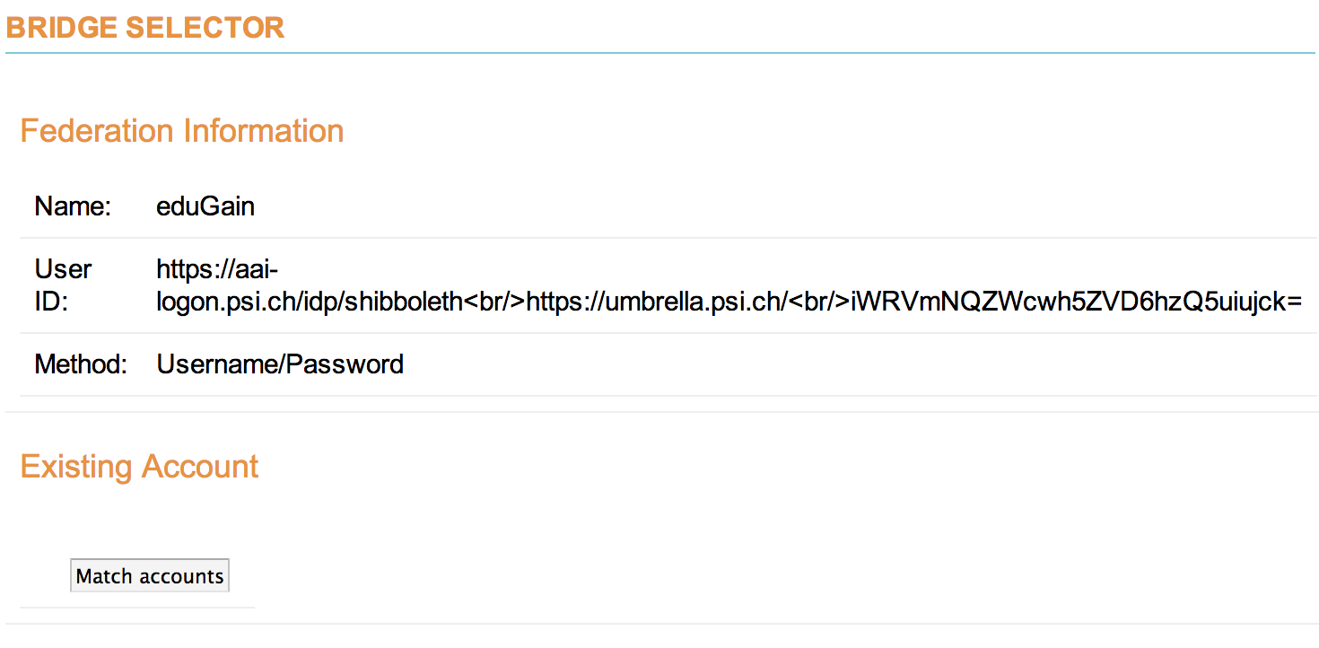
Match accounts
B.Abt, PSI <number>

Slide 10
EduGain Bridge:
Next steps:
Decide on implementation to production Umbrella system
Identitfy still missing parts
B.Abt, PSI <number>

Slide 11
Status of Moonshot:
(almost)Fully implemented on the Umbrella Test System
No extensive testing done yet
Connected to the JANET TrustRouter
Any service on the TrustRouter could potentially use Umbrella as an IdP to login users.
B.Abt, PSI <number>

Slide 12
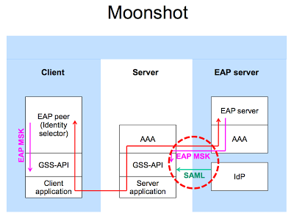
Status of Moonshot:
B.Abt, PSI <number>

Slide 13
Moonshot:
Next steps:
Decide on implementation to production Umbrella system
Identitfy still missing parts
B.Abt, PSI <number>

Slide 14
Thank you for your attention!
B.Abt PSI <number>

