Slide 1
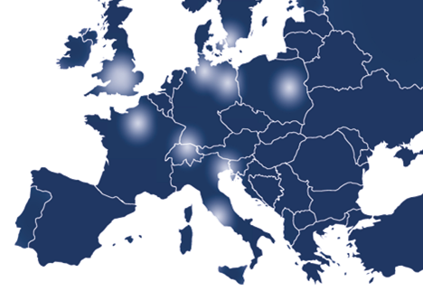
Umbrella AAI for
Photon / Neutron Community
Mirjam van Daalen, Heinz Weyer, Björn Abt
M van Daalen <number>

Slide 2
Umbrella is the revolutionary AAI concept for the Photon and Neutron community
It is the first time that such a kind of IT environment is offered
European wide
Community overlapping
Shared between different EU projects
M van Daalen, PSI <number>

Slide 3
Umbrella is part of several FP7 projects:
EuroFEL- ESFRI project Free Electron Lasers of Europe
PaNData-Europe, PaNData ODI- FP7 projects
CRISP – Cluster project of different ESFRI projects
CALIPSO – renewal of I3 ELISA FP7
NMI3 - I3 neutron community
BioStruct-X – renewal of I3 ELISA FP7 (only struct. biol)
Instruct – ESFRI project
M van Daalen, PSI <number>

Slide 4
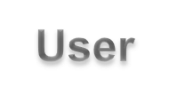


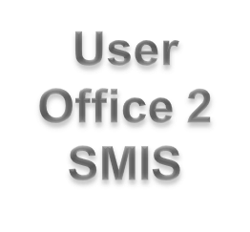
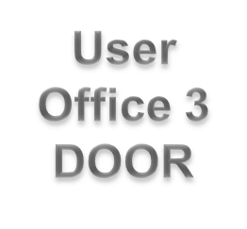
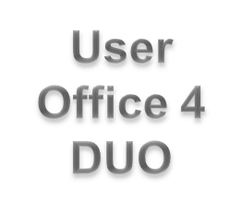
How does it work?
M van Daalen, PSI <number>

Slide 5
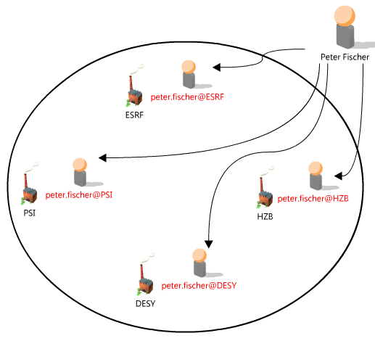
Current Situation
Peter Fischer has 4 different accounts at photon and neutron research facilities.
He has to remember 4 different username and password combinations.
Probably 4 different tools for data access.
M van Daalen, PSI <number>

Slide 6
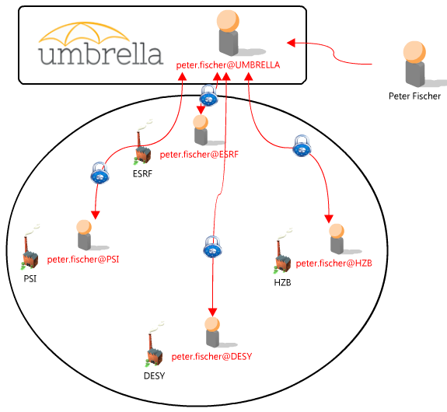
The Umbrella Concept
Peter Fischer creates an Umbrella account.
Connection of the Umbrella account with the 4 existing accounts at other research facilities by login in to the application.
From now on only Umbrella username and password necessary to get access to all his existing accounts.
The existing accounts are now permanently linked with each other.
The link can be removed if e.g. an account ceases to exist.
This link acts as a common basis for tools which can exploit synergies between facilities, e.g. standardized tools for data access to facilities.
M van Daalen, PSI <number>

Slide 7
Umbrella Concept
Peter Fischer creates an Umbrella account
Option 1: P. Fischer has a user account at a facility (e.g. PSI):
Enters PSI user office DUO (local WUO).
He extends his DUO account to an Umbrella account (once only).
He links his Umbrella account to his accounts at other facilities (once only).
Based on Umbrella he can link to a new facility and create a new account by transferring his credentials from Umbrella to the new WUO.
Option 2 P. Fischer has no user account:
0. P. Fischer has to open an account at a user facility.
Local WUO account is needed
M van Daalen, PSI <number>
Notes:
Flexibele multi layered authentisierungs struktur

Slide 8
Initiation of Umbrella
The Umbrella tool was developed first in WP2 of the EuroFEL ESFRI project „User needs and policies“ (lead H. Weyer, O. Schwarzkopf).
WP2 defined a general access policy, and developed the Umbrella authentication and authorisation prototype tool. Coaching of new users as well as proposal handling were part of this developments.
Umbrella should guarantee efficient and transparent use of all distributed FEL facilities and beamlines involved. Based on these procedures, a web-based access point was foreseen.
EuroFEL ended on the 31.04.2011 and the MoU was signed on the 31.05.2012. The Umbrella project though did not stop and was carried on with first under the PaNData Europe project and now und the PaNData ODI and CRISP projects.
M van Daalen, PSI <number>

Slide 9
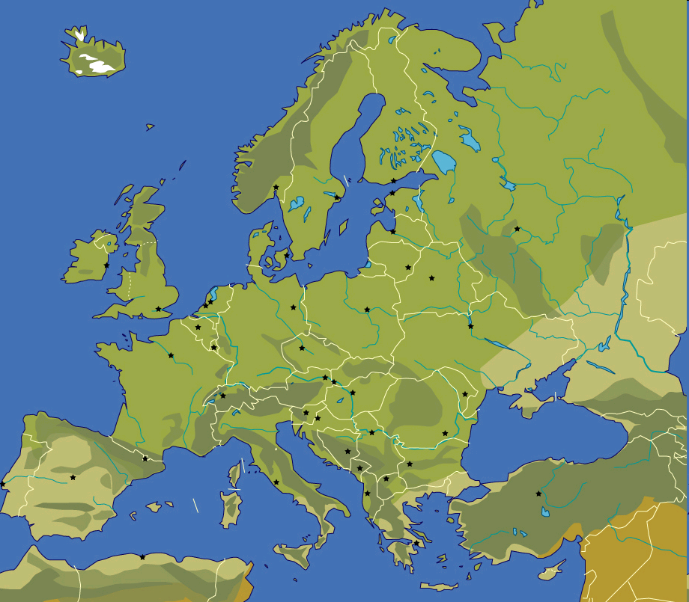











PaNdata Partners
Alba, Spanish National Sychrotron Facility
Diamond UK Synchrotron facility
European Synchrotron Radiation Facility (ESRF)
Deutsches Elektronen Synchrotron (DESY)
Institut Laue–Langevin (ILL)
Max IV Laboratory Lund
ISIS STFC Neutron source
HZB, Helmholtz Zentrum Berlin
Paul Scherrer Institut (PSI), hosting SINQ and SLS
Soleil, French National Synchrotron Facility
M van Daalen, PSI <number>
Notes:
The first slide indicates the projects
Upgrade of existing facilities (on a single site)
New projects (single site)

Slide 10
PaNData Europe / ODI
PaNdata Europe (2010-2011), PaNData ODI (2011-2014).
PANdata brings together European synchrotron, FEL and neutron research infrastructures to create an information infrastructure supporting the scientific process.
It aims to provide user communities with data repositories and data management tools to access, analyse and archive large data sets.
PaNdata is working together with CRISP to achieve some of these aims.
PSI has the lead of WP3 object: Umbrella as solution of the FIM demands.
PSI,

Slide 11






CRISP IT Partners
European Synchrotron Radiation Facility (ESRF)
Deutsches Elektronen Synchrotron (DESY)
European Organisation for Nuclear Research (CERN)
European Spallation Source (ESS)
GSI Helmholtz Centre for Heavy Ion Research
(GSI)
Institut Laue–Langevin (ILL)
European X-ray Free Electron Laser (XFEL)
Paul Scherrer Institut (PSI)
M van Daalen, PSI <number>
Notes:
The first slide indicates the projects
Upgrade of existing facilities (on a single site)
New projects (single site)

Slide 12
CRISP
CRISP: Cluster of Research Infrastructures and Synergies in Physics
Objective: Build up collaborations and create long-term synergies. Facilitate the implementation and enhance the efficiency and attractiveness of the (future) RIs.
Who: Initial group of eleven ESFRI-PPs projects (EuroFEL, ELI, EU XFEL, FAIR, ILL2020, ESRF up, ESS, Spiral2, ILC)
The project is divided in to four main topics: 1) Accelerators, 2) Instruments & Experiments, 3) Detectors & Data Acquisition, and 4) Information Technology & Data Management.
PSI lead of WP 16, objective: to develop and deploy a pan-european system for unique identification (Authentication and Authorisation infrastructure) AAI for all users of the participating RI‘s
Umbrella for Pan European services: account management, proposal management, remote data access, remote experiment resource access
PSI,

Slide 13
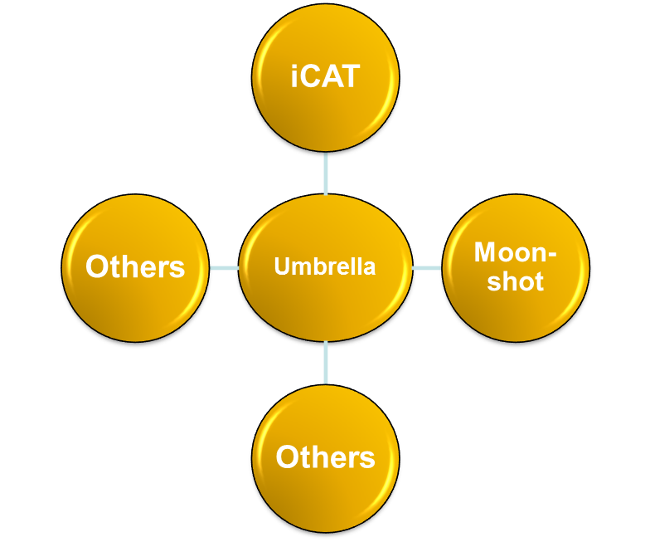
Umbrella as basis
Others
Umbrella
Umbrella is the basic IT environment to get access to common software tools used in the community such as:
Moonshot (non web based acces)
iCAT (metadata catalogue)
and many others to come in the future
Others
Moonshot
iCAT
PSI,

Slide 14
Status Umbrella
  Umbrella was tested by friendly users
    February 1 – March 31 2012
  Central Applications that were tested
    Prototype of central Umbrella web site
    EAA: registration, mutation
    Examples for bridging: Alfresco, Indico, Issue tracker, Wiki
  Participants
    Facilities: DESY, Diamond (iCAT service, Moonshot), ESRF, PSI
    ‘Friendly’ users
      ~30, all over EU
      External expert users (ETH, BioStruct, and others)
      Local facility experts (DESY)
  Feedback
    In spite of the very early development stage (only initial functionalities)
    Highly welcomed by the users
M. Van Daalen, PSI <number>

Slide 15
Status Umbrella
    With Umbrella we try to use synergies on EU level:
    Using synergies between these different EU projects.
    Not invent the wheel twice.
    Harmonisation meetings every 6 months (partners of all the projects)
    We take part in Federated Identity Meetings (different communities) every 6 months
    Implementation of Umbrella planned for spring 2013
    Other communities are interested in Umbrella
    Umbrella cited in TERENA AAI paper
M van Daalen, PSI <number>
Notes:
The Trans-European Research and Education Networking Association offers a forum to collaborate, innovate and share knowledge in order to foster the development of Internet technology, infrastructure and services to be used by the research and education community.

Slide 16
Umbrella Characteristics
Incorporate confidentiality aspects
  High competition, especially structural biology
  Time-window-structured access to experiments and data
Rely on existing local user office structure
  Great experience
  DIY (Do It Yourself) operation
    Users: manage their personal entries
    User offices: supervising; manage authorizations
Base system on professional authentication standard
  Shibboleth, federated Single-Sign-On System (SAML), widely used
  Special photon / neutron user federation
  Only one identity provider
  Supervising by local User Offices
Concept
  Unique user identification on EU scale
  Hybrid information storage
  No possibility for cross-facility information pull
  Multi-level identification (maximum autonomy to facilities)
  Waterproof but slim data protection system
M van Daalen, PSI <number>

Slide 17
Umbrella next steps
  Next steps before implementation
    Legal issues
    Affiliation db (ESRF)
    Sync with other programs (CALYPSO, NMI3)
      iCAT meetings (ILL, RAL)
      Moonshot (non web based access)
  Overlapping IT communities, bridging
    Edugain (large facilities and universities)
    Large facilities and research labs
    Different communities
  Umbrella Website
M van Daalen,, PSI <number>

Slide 18
Operational concept
Facilities
  Keep existing administration structures as much as possible
  During implementation parallel operation
    smooth transition
    No time-zero
Users
  DIY (Do It Yourself) operation
    Users: manage their personal entries
    User offices: supervising; manage authorizations
Collaborations
  Self organization of data access via collaborations
  Principal investigator / main proposer controls who is allowed
  to access data
Applications
  Multi-level trust
  applications define level
  Lowest level: Google-type handshake
  Higher level: explicit authentication at facility user offices
M van Daalen, PSI <number>

Slide 19
What are the IT requests?
Huge datasets
  Novel 2D detectors, quantum leap in data quality, but also data volumes
  Multi-image techniques (tomography, lens-less imaging)
  Molecular movies at FELs
  ‘Petabyte’ ‘normal’ unity; time over for ‘hard-disk in the trouser pocket’
Trans-facility experiments
  Single Sign On (SSO)
  Standardize proposal procedures on EU scale
Remote data access
  Analyze data remotely at facility
  Combine datasets taken at different facilities
  Clouds (commercial, community-based)
  Respect confidentiality restrictions
Remote experiment access
  Basic: passive online access to measured data
  Advanced: active control
M van Daalen, PSI <number>

Slide 20
Umbrella collaborators
  ALBA
    Joachim Metge, Sergio Vicente
  DESY
    Frank Schluenzen, Rolf Treusch, Jan-Peter Kurz, Ulrike Lindemann
  Fermi/Elettra
    Ornela Degiacomo, Giorgio Paolucci
  ESRF
    Rudolf Dimper, Dominique Porte, Stefan Schulze
  European XFEL
    Krzysztof Wrona
  GSI
    Peter Malzacher, Almudena Montiel
  HZB
    Thomas Gutberlet, Dietmar Herrendoerfer, Olaf Schwarzkopf
  I LL
    Jean-Francois Perrin
  IPJ (Poland)
    Robert Nietubic
  MaxLAB
    Ulf Johansson
  PSI
    Bjoern Abt, Stephan Egli, Stefan Janssen, Markus Knecht, Mirjam
    van Daalen, Heinz J Weyer
  Soleil
    Frederique Fraissard
  STFC
    Anthony Gleeson, Bill Pulford
M. van Daalen, PSI <number>

Slide 21
Thank you for your attention!
M van Daalen, H. Weyer PSI <number>

Slide 22
Umbrella as Prototype
Incorporate confidentiality aspects
  High competition, especially structural biology
  Time-window-structured access to experiments and data
Rely on existing local user office structure
  Great experience
  DIY (Do It Yourself) operation
    Users: manage their personal entries
    User offices: supervising; manage authorizations
Base system on professional authentication standard
  Shibboleth, federated Single-Sign-On System (SAML), widely used
  Special photon / neutron user federation
  Only one identity provider
  Supervising by local User Offices
Concept
  Unique user identification on EU scale
  Hybrid information storage
  No possibility for cross-facility information pull
  Multi-level identification (maximum autonomy to facilities)
  Waterproof but slim data protection system
Heinz J Weyer, PSI <number>

Slide 23
Operation Concept
Bottom-up: Delegation and direct feedback
Facilities
  Keep existing administration structures as much as possible
    Proposal workflow
    Guest house / restaurant, access badges, stock room, …
  During implementation parallel operation
    smooth transition
    No time-zero
Users
  DIY (Do It Yourself) operation
    Users: manage their personal entries
    User offices: supervising; manage authorizations
Collaborations
  Self organization of data access via collaborations
  Principal investigator / main proposer controls who is allowed
  to access data
Applications
  Multi-level trust
  applications define level
  Lowest level: Google-type handshake
  Higher level: authentication at facility user offices, no external ??
Heinz J Weyer, PSI <number>

Slide 24

User Level
Project Level
Facility Level
Users
Projects
Proposals
Experiments / Data
Pjxx
PpA1
Facility A
PpA1_{Data1}
User1
User1
….
User1
User3
User3
PpA1_{DataN}
User5
User5
User2
PpB1
Facility B
PpB1_{Data1}
Pjyy
User1
….
User3
User3
PpB1_{DataN}
User1
User5
User2
PpB2
PpB2_{Data1}
User4
User1
….
Pjzz
User2
PpB2_{DataN}
User5
User3
User4
PpC1
Facility C
User3
PpC1_{Data1}
User5
….
User4
PpC1_{DataN}
User5
M. van Daalen, PSI <number>

Slide 25
Umbrella and BioStruct
a) Standard
User
c) BioStruct with Umbrella
User
WUO1
WUO2
WUO3
Central
BioStruct
User Office
Facility Web-based User Offices
b) BioStruct as present present
Central
Umbrella
User
WUOS1
WUOS2
Central
BioStruct
User Office
Other BioStruct services
WUO1
WUO2
WUO3
Facility Web-based User Offices
Other BioStruct
services
WUO1
WUO2
WUO3
Facility Web-based User Offices
Heinz J Weyer, PSI <number>

