Slide 1
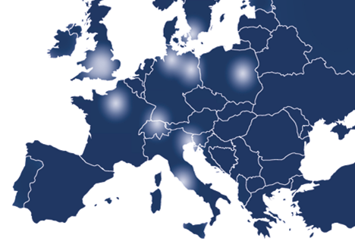
Umbrella AAI for
Photon / Neutron Community
Mirjam van Daalen, Heinz Weyer, Björn Abt
M van Daalen <number>

Slide 2
Umbrella is the revolutionary Authentication and Authorisation Infrastructure (AAI) concept for the Photon and Neutron community
It is the first time that such a kind of IT environment is offered
European wide
Community overlapping
Shared between different EU projects
M van Daalen, PSI <number>

Slide 3
Umbrella is part of several FP7 projects:
EuroFEL- ESFRI project Free Electron Lasers of Europe
PaNData-Europe, PaNData ODI- FP7 projects
CRISP – Cluster project of different ESFRI projects
CALIPSO – renewal of I3 ELISA FP7
NMI3 - I3 neutron community
BioStruct-X – renewal of I3 ELISA FP7 (only struct. biol)
Instruct – ESFRI project
M van Daalen, PSI <number>

Slide 4






How does it work?
M van Daalen, PSI <number>

Slide 5
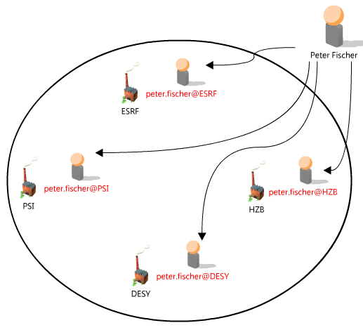
Current Situation
Peter Fischer has 4 different accounts at photon and neutron research facilities.
He has to remember 4 different username and password combinations.
Probably 4 different tools for data access.
M van Daalen, PSI <number>

Slide 6
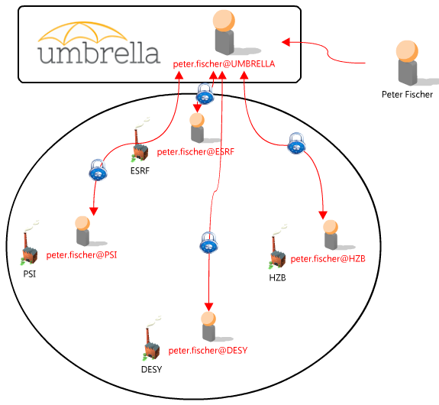
The Umbrella Concept
Peter Fischer creates an Umbrella account.
Connection of the Umbrella account with the 4 existing accounts at other research facilities by login in to the application.
From now on only Umbrella username and password necessary to get access to all his existing accounts.
The existing accounts are now permanently linked with each other.
The link can be removed if e.g. an account ceases to exist.
This link acts as a common basis for tools which can exploit synergies between facilities, e.g. standardized tools for data access to facilities.
M van Daalen, PSI <number>

Slide 7
Initiation of Umbrella
The Umbrella tool was developed first in WP2 of the EuroFEL ESFRI project „User needs and policies“.
WP2 defined a general access policy, and developed the Umbrella Authentication and Authorisation prototype tool. Coaching of new users as well as proposal handling were part of this developments.
Umbrella should guarantee efficient and transparent use of all distributed FEL facilities and beamlines involved. Based on these procedures, a web-based access point was foreseen.
EuroFEL ended on the 31.04.2011 and the MoU was signed on the 31.05.2012. The Umbrella project though did not stop and was carried on with first under the PaNData Europe project and now und the PaNData ODI and CRISP projects.
M van Daalen, PSI <number>
Notes:
European Strategy Forum on Research Infrastructures, is a strategic instrument to develop the scientific integration of Europe and to strengthen its international outreach.

Slide 8
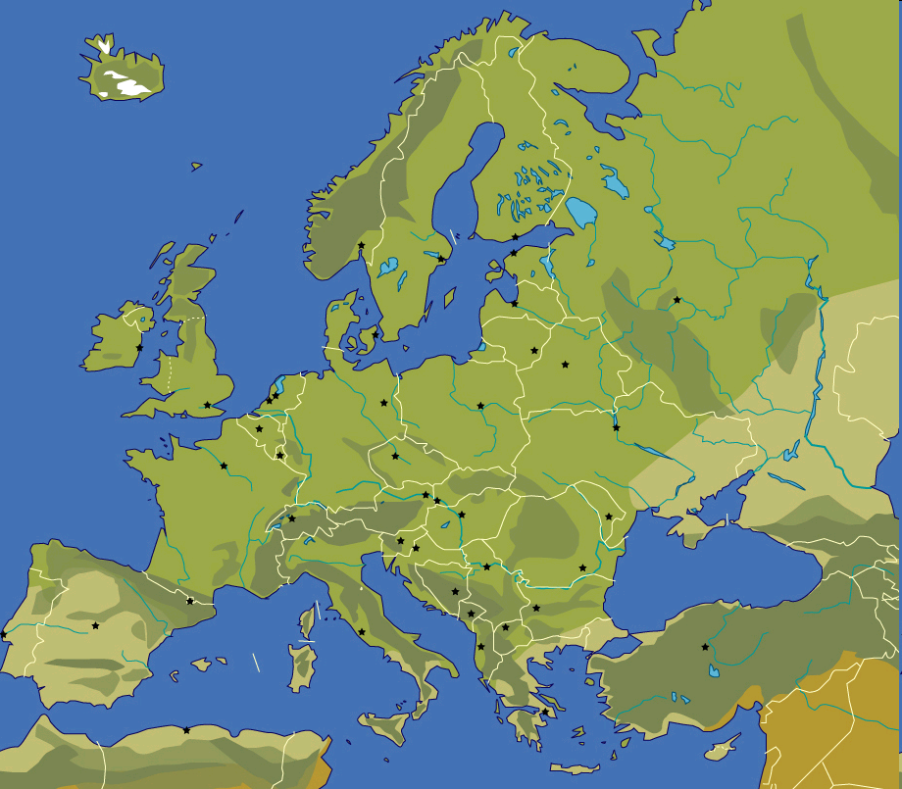











PaNdata Partners
Alba, Spanish National Sychrotron Facility
Diamond UK Synchrotron facility
European Synchrotron Radiation Facility (ESRF)
Elettra Sinchrotrone Trieste
Deutsches Elektronen Synchrotron (DESY)
Institut Laue–Langevin (ILL)
Max IV Laboratory Lund
ISIS STFC Neutron source
HZB, Helmholtz Zentrum Berlin
Paul Scherrer Institut (PSI), hosting SINQ and SLS
Soleil, French National Synchrotron Facility
M van Daalen, PSI <number>
Notes:
The first slide indicates the projects
Upgrade of existing facilities (on a single site)
New projects (single site)

Slide 9
PaNData Europe / ODI
PaNdata Europe (2010-2011), PaNData ODI (2011-2014).
PaNdata brings together European synchrotron, FEL and neutron research infrastructures to create an information infrastructure supporting the scientific process.
It aims to provide user communities with data repositories and data management tools to access, analyse and archive large data sets.
PaNdata is working together with CRISP to achieve some of these aims.
PSI has the lead of WP3 object: Umbrella as solution of the Federated Identity Management (FIM) demands.
PSI,

Slide 10
PaNData Europe / ODI
WP1 Management
WP2 Dissemination
WP3 User Catalogue and AAI Service (PSI)
  To deploy, operate and evaluate a system for pan-European user identification across the participating facilities and implement common processes for the joint maintenance of that system.
WP4 Data Catalogue iCAT (Elettra)
  To deploy, operate and evaluate a generic catalogue of scientific data across the participating facilities and promote its integration with other catalogues beyond the project.
WP5 Virtual laboratories (DESY)
  To deploy a set of integrated end-to-end user and data services supporting three specific techniques:
    Structural 'joint refinement' against X-ray & neutron powder diffraction data
    Simultaneous analysis of SAXS and SANS data for large scale structures
    Access to tomography data exemplified through paleontological samples

Slide 11
PaNData Europe / ODI
WP6 Provenance (STFC)
  To develop a conceptual framework, which can record and recall the “data continuum”, and especially the analysis process, and to provide a software infrastructure which implements that model to record analysis steps hence enabling the tracing of the derivation of analysed data outputs.
WP7 Preservation (ILL)
  To incorporate models and tools oriented towards long-term data preservation into the PaNdata infrastructure, focussing on several aspects considered of benefit: an OAIS-based infrastructure; persistent identifiers; and certification of authenticity and integrity.
WP8 Scalability (STFC)
  To develop a scalable data processing framework combining parallel filesystems with a parallelized standard data format (pNexus pHDF5) to permit applications to make most efficient use of dedicated multi-core environments and to permit simultaneous ingest of data from various sources, while maintaining the possibility for real-time data processing.
Notes:
Data continuum, continuity of data, follow process proposal, raw data, analysed data, publication
DAWN analyse tool synchrotron
MANTID Neutrons
Persistent identifier, identification does not change over time

Slide 12






CRISP IT Partners
European Synchrotron Radiation Facility (ESRF)
Deutsches Elektronen Synchrotron (DESY)
European Organisation for Nuclear Research (CERN)
European Spallation Source (ESS)
GSI Helmholtz Centre for Heavy Ion Research
(GSI)
Institut Laue–Langevin (ILL)
European X-ray Free Electron Laser (XFEL)
Paul Scherrer Institut (PSI)
M van Daalen, PSI <number>
Notes:
The first slide indicates the projects
Upgrade of existing facilities (on a single site)
New projects (single site)

Slide 13
CRISP
CRISP: Cluster of Research Infrastructures and Synergies in Physics
Objective: Build up collaborations and create long-term synergies. Facilitate the implementation and enhance the efficiency and attractiveness of the (future) RIs.
Who: Initial group of eleven ESFRI-PPs projects (EuroFEL, ELI, EU XFEL, FAIR, ILL20/20, ESRF up, ESS, Spiral2, ILC, PrepSka, SLHC)
PSI,

Slide 14
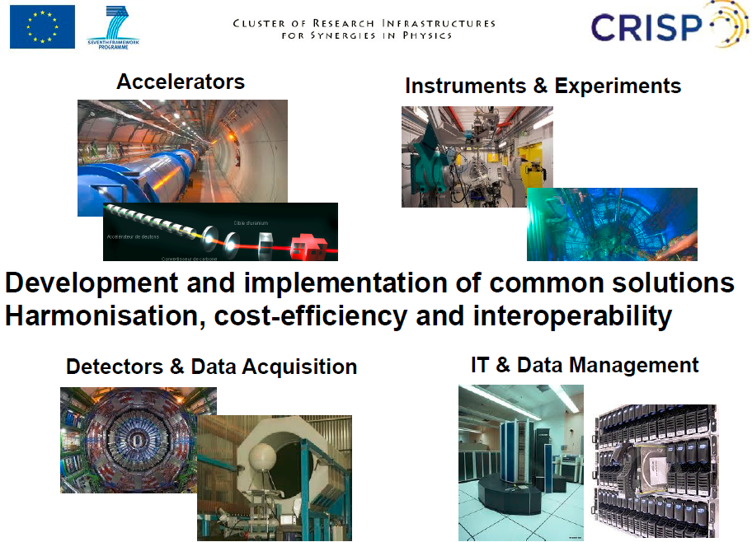
CRISP

Slide 15
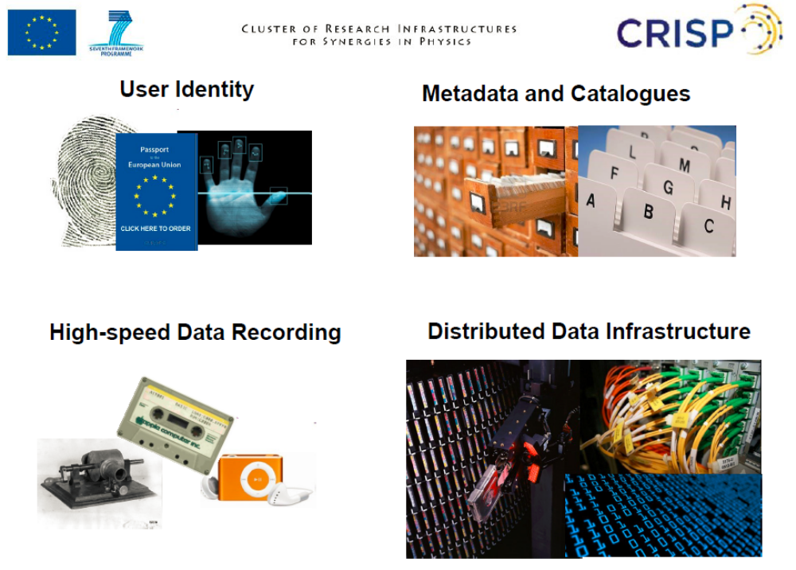
CRISP

Slide 16
CRISP
WP16: Common User Identity Systems
Objective:
“Develop and deploy a pan-European system for unique identification”
Partners: ESRF, ESS, GSI, ILL, XFEL
Lead PSI
PSI,

Slide 17
PaNData ODI/CRISP
Umbrella is the basis for various user services under development
Info & service portal
European proposal support (NMI3 & CALIPSO)
Remote experiment access
Remote file access
Metdata catalogue (iCAT)
Without a unique identifier it will not be possible to have unified access and work with these tools.
Notes:
Unified acces. Same method to acces tools and identify

Slide 18
Umbrella Characteristics
Concept
  Unique + persistent user identification on EU scale
  Single sign-on
  Hybrid information storage
  No possibility for cross-facility information pull
  Multi-level identification, different for different actions (maximum autonomy to facilities)
  Waterproof but slim data protection system
Incorporate confidentiality aspects
  High competition, especially structural biology
  Time-window-structured access to experiments and data
M van Daalen, PSI <number>

Slide 19
Umbrella Characteristics
Rely on existing local user office structure
  Great experience
  DIY (Do It Yourself) operation
    Users: manage their personal entries
    User offices: supervising; manage authorizations
    Principal investigators: have responsability for their teams and can handle authorisation within their group
Base system on professional authentication standard
  Shibboleth, federated Single-Sign-On System (SAML), widely used
  Special photon / neutron user federation
  Supervising by local User Offices
M van Daalen, PSI <number>

Slide 20
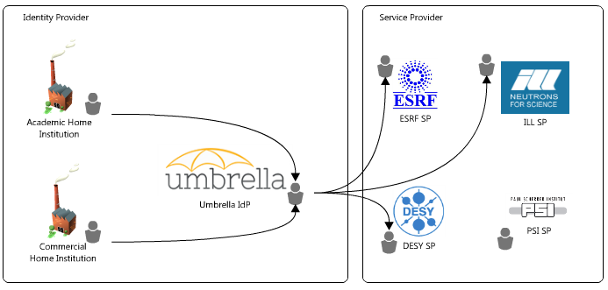
Umbrella Characteristics
Overview
M. Van Daalen, PSI <number>

Slide 21
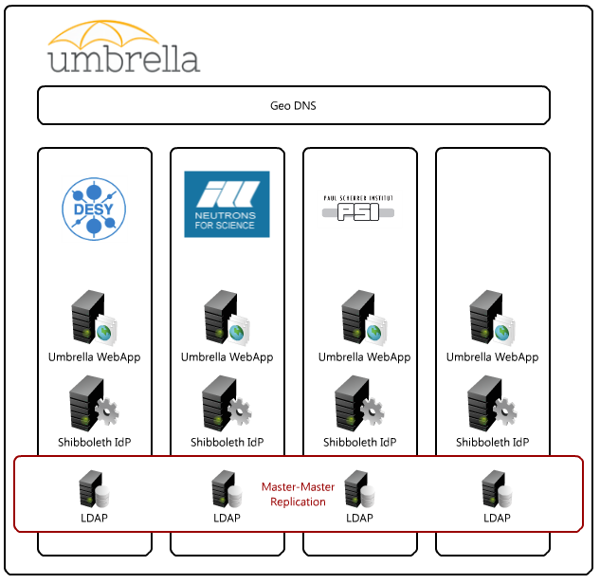
Umbrella Characteristics
Identity Provider
M. Van Daalen, PSI <number>

Slide 22

Umbrella Characteristics
Master-Master Replication
Master-Master Replication of LDAP user information
First tests with ILL and DESY positive
This is the only level in the Umbrella IdP stack which needs synchronisation
M. van Daalen, PSI <number>

Slide 23

Shibboleth IdP
Independend Shibboleth IdP installations
Needs a ServletContainer (e.g. Apache Tomcat) to run
Only separated by Geo DNS
M. van Daalen, PSI <number>

Slide 24

Umbrella WebApp
Independend Umbrella WebApp installations
Needs a ServletContainer (e.g. Apache Tomcat) to run
Only separated by Geo DNS
M. van Daalen, PSI <number>

Slide 25
Umbrella Characteristics
Geo DNS
Central Geo DNS provider
Best Solution still to be evaluated (e.g. http://www.geoscaling.com/competitors.html)
Distributes requests to the Umbrella by IP address of a client
M. Van Daalen, PSI <number>

Slide 26
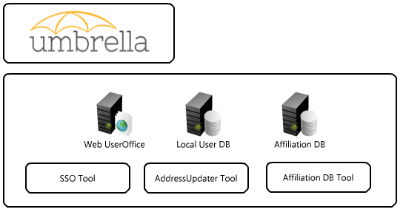
Umbrella Characteristics
Service Provider
M. Van Daalen, PSI <number>

Slide 27
Umbrella next steps
  Next steps before implementation
    2 implementation teams (representatives of participating institutions)
    harmonisation meeting twice a year
    Legal issues (MoU for continuation after the end of CRISP & PaNdata projects)
    Affiliation data base (ESRF)
    Sync with other programs
      iCAT meetings (ILL, RAL)
      Moonshot (non web based access) (JANET; SWITCH)
      Harmonized proposal handling (format) (CALYPSO, NMI3)
  Overlapping IT communities, bridging
    Edugain (large research institutes, universities)
    Other federations (e.g. GRID; google; industry)
  Implementation in 4 phases
    First facilities: ILL, ESRF, PSI
    Open to all users September 2013
  Umbrella Website
M van Daalen,, PSI <number>

Slide 28
Umbrella collaborators
  ALBA
    Daniel Salvat
  DESY
    Frank Schluenzen, Rolf Treusch, Thorsten Kracht, Jan-Peter Kurz, Ulrike Lindemann
  Fermi/Elettra
    Cecilia Blasetti, Ornela Degiacomo, Giorgio Paolucci
  ESRF
    Rudolf Dimper, Dominique Porte, Julien Savoyet, Stefan Schulze
  European XFEL
    Krzysztof Wrona
  GSI
    Peter Malzacher, Almudena Montiel Gonzalez, Kilian Schwarz
  HZB
    Thomas Gutberlet, Dietmar Herrendoerfer
  I LL
    Jean-Francois Perrin
  IPJ (Poland)
    Robert Nietubic
  MaxLAB
    Krister Johansson
  PSI
    Bjoern Abt, Stephan Egli, Stefan Janssen, Markus Knecht, Mirjam
    van Daalen, Heinz J Weyer
  Soleil
    Frederique Fraissard
  STFC
    Anthony Gleeson, Tom Griffin, Alistair Mills, Bill Pulford
M. van Daalen, PSI <number>

Slide 29
Thank you for your attention!
M van Daalen, H. Weyer PSI <number>

