Slide 1
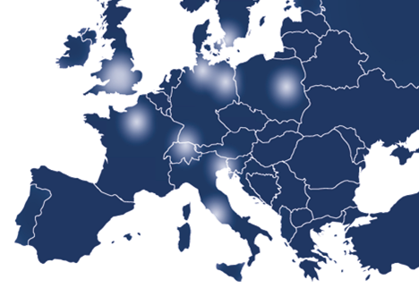
Umbrella AAI for
Photon / Neutron Community
Mirjam van Daalen, Heinz Weyer, Björn Abt
M van Daalen <number>

Slide 2
Contents todays presentation
Part 1: Overview Umbrella Project, PaNData and CRISP projects (M. van Daalen)
Part 2: Technical background of Umbrella (Björn Abt)
M van Daalen, PSI <number>

Slide 3
Umbrella is the revolutionary Authentication and Authorisation Infrastructure (AAI) concept for the Photon and Neutron community
It is the first time that such a kind of IT environment is offered
European wide
Community overlapping
Shared between different EU projects
M van Daalen, PSI <number>

Slide 4
Umbrella is part of several FP7 projects:
EuroFEL- ESFRI project Free Electron Lasers of Europe
PaNData-Europe, PaNData ODI- FP7 projects
CRISP – Cluster project of different ESFRI projects
CALIPSO – renewal of I3 ELISA FP7
NMI3 - I3 neutron community
BioStruct-X – renewal of I3 ELISA FP7 (only struct. biol)
Instruct – ESFRI project
M van Daalen, PSI <number>

Slide 5
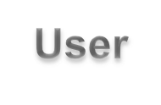


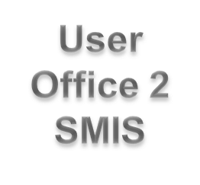
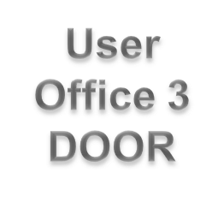
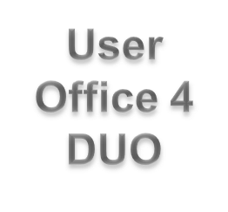
How does it work?
M van Daalen, PSI <number>

Slide 6
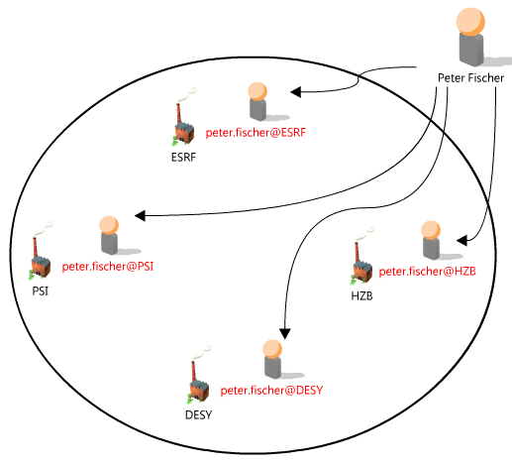
Current Situation
Peter Fischer has 4 different accounts at photon and neutron research facilities.
He has to remember 4 different username and password combinations.
Probably 4 different tools for data access.
M van Daalen, PSI <number>

Slide 7
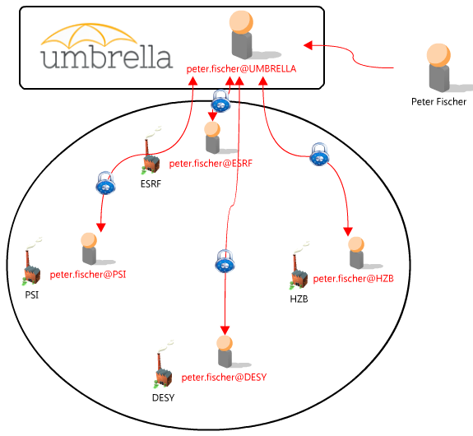
The Umbrella Concept
Peter Fischer creates an Umbrella account.
Connection of the Umbrella account with the 4 existing accounts at other research facilities by login in to the application.
From now on only Umbrella username and password necessary to get access to all his existing accounts.
The existing accounts are now permanently linked with each other.
The link can be removed if e.g. an account ceases to exist.
This link acts as a common basis for tools which can exploit synergies between facilities, e.g. standardized tools for data access to facilities.
M van Daalen, PSI <number>

Slide 8
Umbrella Concept
Peter Fischer creates an Umbrella account
Option 1: P. Fischer has a user account at a facility (e.g. PSI):
Enters PSI user office DUO (local Web User Office WUO).
He extends his DUO account to an Umbrella account (once only).
He links his Umbrella account to his accounts at other facilities (once only).
Based on Umbrella he can link to a new facility and create a new account by transferring his credentials from Umbrella to the new WUO.
Option 2 P. Fischer has no user account:
0. P. Fischer has to open an account at a user facility.
Local WUO account is needed
M van Daalen, PSI <number>
Notes:
Flexibele multi layered authentisierungs struktur

Slide 9
Initiation of Umbrella
The Umbrella tool was developed first in WP2 of the EuroFEL ESFRI project „User needs and policies“ (lead H. Weyer, O. Schwarzkopf).
WP2 defined a general access policy, and developed the Umbrella Authentication and Authorisation prototype tool. Coaching of new users as well as proposal handling were part of this developments.
Umbrella should guarantee efficient and transparent use of all distributed FEL facilities and beamlines involved. Based on these procedures, a web-based access point was foreseen.
EuroFEL ended on the 31.04.2011 and the MoU was signed on the 31.05.2012. The Umbrella project though did not stop and was carried on with first under the PaNData Europe project and now und the PaNData ODI and CRISP projects.
M van Daalen, PSI <number>
Notes:
European Strategy Forum on Research Infrastructures, is a strategic instrument to develop the scientific integration of Europe and to strengthen its international outreach.

Slide 10
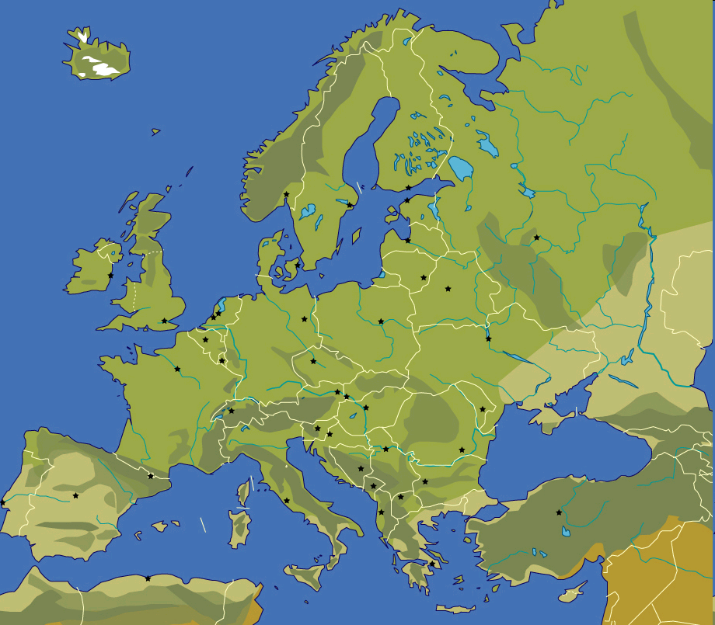











PaNdata Partners
Alba, Spanish National Sychrotron Facility
Diamond UK Synchrotron facility
European Synchrotron Radiation Facility (ESRF)
Elettra Sinchrotrone Trieste
Deutsches Elektronen Synchrotron (DESY)
Institut Laue–Langevin (ILL)
Max IV Laboratory Lund
ISIS STFC Neutron source
HZB, Helmholtz Zentrum Berlin
Paul Scherrer Institut (PSI), hosting SINQ and SLS
Soleil, French National Synchrotron Facility
M van Daalen, PSI <number>
Notes:
The first slide indicates the projects
Upgrade of existing facilities (on a single site)
New projects (single site)

Slide 11
PaNData Europe / ODI
PaNdata Europe (2010-2011), PaNData ODI (2011-2014).
PaNdata brings together European synchrotron, FEL and neutron research infrastructures to create an information infrastructure supporting the scientific process.
It aims to provide user communities with data repositories and data management tools to access, analyse and archive large data sets.
PaNdata is working together with CRISP to achieve some of these aims.
PSI has the lead of WP3 object: Umbrella as solution of the Federated Identity Management (FIM) demands.
PSI,

Slide 12
PaNData Europe / ODI
WP1 Management
WP2 Dissemination
WP3 User Catalogue and AAI Service (PSI)
  To deploy, operate and evaluate a system for pan-European user identification across the participating facilities and implement common processes for the joint maintenance of that system.
WP4 Data Catalogue iCAT (Elettra)
  To deploy, operate and evaluate a generic catalogue of scientific data across the participating facilities and promote its integration with other catalogues beyond the project.
WP5 Virtual laboratories (DESY)
  To deploy a set of integrated end-to-end user and data services supporting three specific techniques:
    Structural 'joint refinement' against X-ray & neutron powder diffraction data
    Simultaneous analysis of SAXS and SANS data for large scale structures
    Access to tomography data exemplified through paleontological samples

Slide 13
PaNData Europe / ODI
WP6 Provenance (STFC)
  To develop a conceptual framework, which can record and recall the “data continuum”, and especially the analysis process, and to provide a software infrastructure which implements that model to record analysis steps hence enabling the tracing of the derivation of analysed data outputs.
WP7 Preservation (ILL)
  To incorporate models and tools oriented towards long-term data preservation into the PaNdata infrastructure, focussing on several aspects considered of benefit: an OAIS-based infrastructure; persistent identifiers; and certification of authenticity and integrity.
WP8 Scalability (STFC)
  To develop a scalable data processing framework combining parallel filesystems with a parallelized standard data format (pNexus pHDF5) to permit applications to make most efficient use of dedicated multi-core environments and to permit simultaneous ingest of data from various sources, while maintaining the possibility for real-time data processing.
Notes:
Data continuum, continuity of data, follow process proposal, raw data, analysed data, publication
DAWN analyse tool synchrotron
MANTID Neutrons
Persistent identifier, identification does not change over time

Slide 14






CRISP IT Partners
European Synchrotron Radiation Facility (ESRF)
Deutsches Elektronen Synchrotron (DESY)
European Organisation for Nuclear Research (CERN)
European Spallation Source (ESS)
GSI Helmholtz Centre for Heavy Ion Research
(GSI)
Institut Laue–Langevin (ILL)
European X-ray Free Electron Laser (XFEL)
Paul Scherrer Institut (PSI)
M van Daalen, PSI <number>
Notes:
The first slide indicates the projects
Upgrade of existing facilities (on a single site)
New projects (single site)

Slide 15
CRISP
CRISP: Cluster of Research Infrastructures and Synergies in Physics
Objective: Build up collaborations and create long-term synergies. Facilitate the implementation and enhance the efficiency and attractiveness of the (future) RIs.
Who: Initial group of eleven ESFRI-PPs projects (EuroFEL, ELI, EU XFEL, FAIR, ILL20/20, ESRF up, ESS, Spiral2, ILC, PrepSka, SLHC)
PSI,

Slide 16
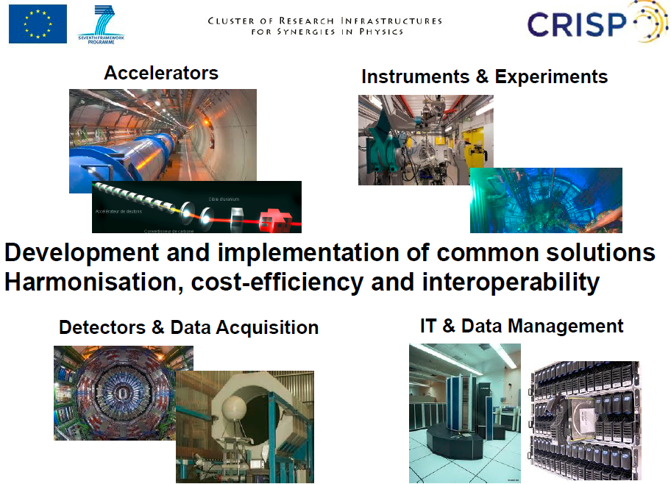
CRISP

Slide 17
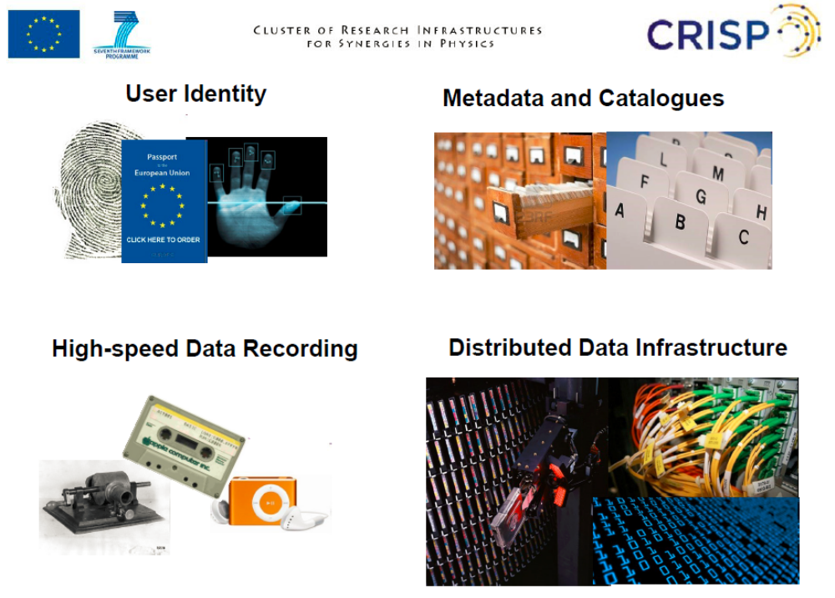
CRISP

Slide 18
CRISP
WP16: Common User Identity Systems
Objective:
“Develop and deploy a pan-European system for unique identification”
Partners: ESRF, ESS, GSI, ILL, XFEL
Lead PSI
PSI,

Slide 19
CRISP
Pan-European Services:
• Account management: ‘Self-service’ approach desirable
• User offices only need to manage local authorization
• Proposal management:The proposal is the ordering element and authorization source
• Remote data access: 1) Access to data taken at several facilities,
  b) Analysis “@home”
• Remote experiment resource access: Online participation in the experiment
PSI,

Slide 20
CRISP
WP17: Metadata Management and Data Continuum
Objectives:
1.“Select and deploy metadata management and mining services”
2.“Enable a data continuum from raw data to publications”
Partners: ESRF, DESY, CERN,
Lead ILL

Slide 21
CRISP
Metadata Management and Data Continuum
• Metadata management and mining
–Evaluate and select metadata catalogues
–Enhance and deploy at the participating RIs
–Connect as one seamless resource.
• Data continuum
–From raw data to publications
–Persistent Identifiers for experimental data
–The participating RIs are the data producers
–Need to persistently identify their data sets
PSI,

Slide 22
CRISP
WP18: High-speed Data Recording
Objectives:
1.“High-speed recording of data to permanent storage and archive”
2.“Optimised and secure access to data using standard protocols”
Partners: ESRF, DESY, ESS, GANIL, ILL, XFEL
Lead EU XFEL
PSI,

Slide 23
CRISP
• High-speed Recording of Data
– Data rates that exceed tens of GB/s
• In some cases from multiple sources
• To permanent storage and archive
• Cost-effective method
• Optimised and secured access
– To data using standard protocols
PSI,

Slide 24
CRISP
WP19: Distributed Data Infrastructure
Objectives:
1.“Analyse existing data infrastructures from a network and technology perspective.”
2.“Plan their evolution to support the expanding data management needs”
Partners: DESY, CERN, GSI, MTA SZTAKI, U. OXF
Lead CERN

Slide 25
PaNData ODI/CRISP
As you see Umbrella is the basis for the topics of all the workpackages listed before, without a unique identifier it will not be possible to have unified access and work with these tools.
Notes:
Unified acces. Same method to acces tools and identify

Slide 26
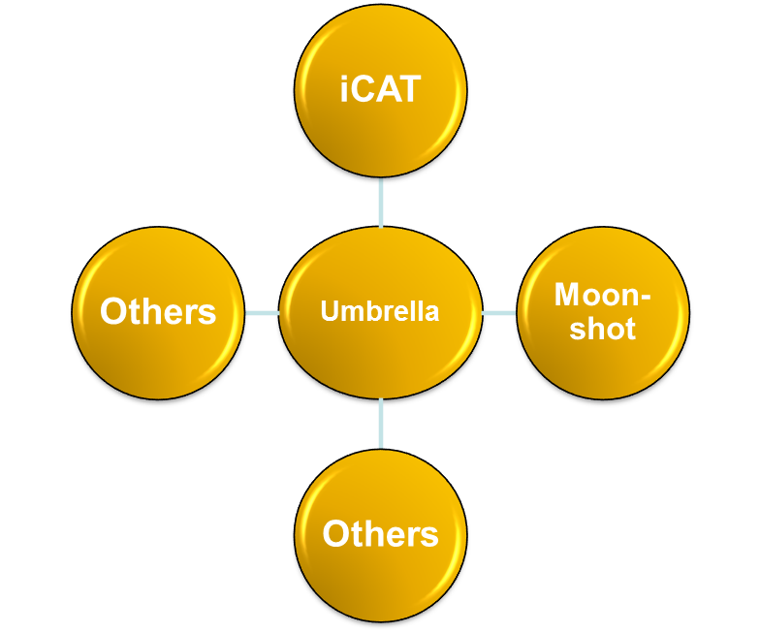
Umbrella as basis
Others
Umbrella
Umbrella is the basic IT environment to get access to common software tools used in the community such as:
Moonshot (non web based acces)
iCAT (metadata catalogue)
and many others to come in the future
Others
Moonshot
iCAT

Slide 27
Status Umbrella
  Umbrella was tested by friendly users
    February 1 – March 31 2012
  Central Applications that were tested
    Prototype of central Umbrella web site
    EAA: registration, mutation
    Examples for bridging: Alfresco, Indico, Issue tracker, Wiki
  Participants
    Facilities: DESY, Diamond (iCAT service, Moonshot), ESRF, PSI
    ‘Friendly’ users
      ~30, all over EU
      External expert users (ETH, BioStruct, and others)
      Local facility experts (DESY)
  Feedback
    In spite of the very early development stage (only initial functionalities)
    Highly welcomed by the users
M. Van Daalen, PSI <number>

Slide 28
Status Umbrella
    With Umbrella we try to use synergies on EU level:
    Using synergies between these different EU projects.
    Not invent the wheel twice.
    Harmonisation meetings every 6 months (partners of all the projects)
    We take part in Federated Identity Meetings (different communities) every 6 months. PSI is speaker for Photon / Neutron Community.
    Implementation of Umbrella planned for spring 2013
    Other communities are interested in Umbrella
    Umbrella cited in TERENA AAI paper
M van Daalen, PSI <number>
Notes:
The Trans-European Research and Education Networking Association offers a forum to collaborate, innovate and share knowledge in order to foster the development of Internet technology, infrastructure and services to be used by the research and education community.

Slide 29
Umbrella Characteristics
Concept
  Unique + persistent user identification on EU scale
  Single sign-on
  Hybrid information storage
  No possibility for cross-facility information pull
  Multi-level identification, different for different actions (maximum autonomy to facilities)
  Waterproof but slim data protection system
Incorporate confidentiality aspects
  High competition, especially structural biology
  Time-window-structured access to experiments and data
M van Daalen, PSI <number>

Slide 30
Umbrella Characteristics
Rely on existing local user office structure
  Great experience
  DIY (Do It Yourself) operation
    Users: manage their personal entries
    User offices: supervising; manage authorizations
    Principal investigators: have responsability for their teams and can handle authorisation within their group
Base system on professional authentication standard
  Shibboleth, federated Single-Sign-On System (SAML), widely used
  Special photon / neutron user federation
  Supervising by local User Offices
M van Daalen, PSI <number>

Slide 31
Umbrella next steps
  Next steps before implementation
    2 implementation teams (representatives of participating institutions)
    harmonisation meeting twice a year
    Legal issues (MoU for continuation after the end of CRISP & PaNdata projects)
    Affiliation data base (ESRF)
    Sync with other programs
      iCAT meetings (ILL, RAL)
      Moonshot (non web based access) (JANET; SWITCH)
      Harmonized proposal handling (format) (CALYPSO, NMI3)
  Overlapping IT communities, bridging
    Edugain (large research institutes, universities)
    Other federations (e.g. GRID; google; industry)
  Umbrella Website
M van Daalen,, PSI <number>

Slide 32
Advantages SwissFEL/SLS
Umbrella as an EU wide common basis for access to other standardized tools:
  Remote data access
  Remote experiment access
  Data transfer
  Access to data analysis tools
  Digital logbook
  Data Archiving
  Proposal handling
Users internal and external
  Same access to all beamlines at SLS or SwissFEL
  Improvement of efficiency of the workflow from data access to final publication of the data by combining Umbrella (unique user identifier) and data continuum (unique data identifier).
For SwissFEL preparation of this fundamental tools now and not when the facility is already running
M van Daalen, PSI <number>

Slide 33
What are the IT requests? I
Huge datasets
  Novel 2D detectors, quantum leap in data quality, but also data volumes
  Multi-image techniques (tomography, lens-less imaging)
  Molecular movies at FELs
  ‘Petabyte’ ‘normal’ unity; time over for ‘hard-disk in the trouser pocket’
  Many talk about storing data, but must also to talk about handling, need for new strategies
Trans-facility experiments
  Standardize proposal procedures on EU scale
  Standardize metadata
Remote, non-local data access
  Analyze data remotely at facility
  Combine datasets taken at different facilities [Umbrella(PSI)+ICAT(STFC)?]
  Combine different data types (raw, derived, published)
  Clouds (commercial, community-centered)

Slide 34
What are the IT requests? II
Remote experiment access
  Basic: passive online access to measured data
  Advanced: active control [Umbrella(PSI)+Moonshot(STFC)?]
International identity
  Unique
  Persistent
  User friendly
Online, On-the-fly data analysis
  Are the experimental parameters right?
  Filtering?
PR Issues
  Improve corporate identity
  Improve public lobbying

Slide 35
Umbrella collaborators
  ALBA
    Joachim Metge, Sergio Vicente
  DESY
    Frank Schluenzen, Rolf Treusch, Jan-Peter Kurz, Ulrike Lindemann
  Fermi/Elettra
    Cecilia Blasetti, Ornela Degiacomo, Giorgio Paolucci
  ESRF
    Rudolf Dimper, Dominique Porte, Stefan Schulze
  European XFEL
    Krzysztof Wrona
  GSI
    Peter Malzacher, Almudena Montiel
  HZB
    Thomas Gutberlet, Dietmar Herrendoerfer, Olaf Schwarzkopf
  I LL
    Jean-Francois Perrin
  IPJ (Poland)
    Robert Nietubic
  MaxLAB
    Ulf Johansson
  PSI
    Bjoern Abt, Stephan Egli, Stefan Janssen, Markus Knecht, Mirjam
    van Daalen, Heinz J Weyer
  Soleil
    Frederique Fraissard
  STFC
    Anthony Gleeson, Bill Pulford
M. van Daalen, PSI <number>

Slide 36
Thank you for your attention!
M van Daalen, H. Weyer PSI <number>

