Slide 1


E-shop Comment Analysis System
Internal
Yuming Yang, Keguo Zhou, SAP
Nov 15, 2016
Good looking! My kid love this.
This skirt is awesome!!
Terrible service

Slide 2





Problem
love it, even better then expected
I bought this mouse like 3 weeks ago and it broke. wtf
?
Low quality, is not a deal
solid sweatshirt. A bit smaller than an American Large
……
……

Slide 3
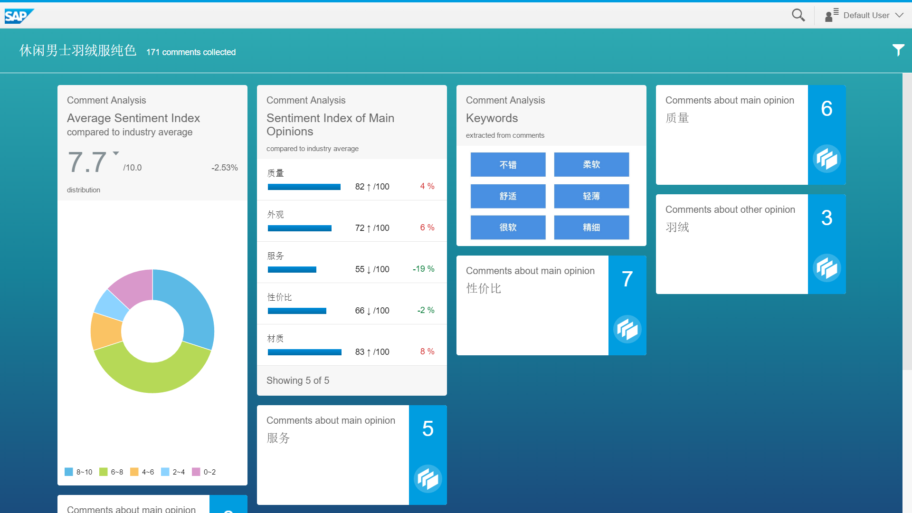
Solution on B1
Independent Analysis Server
Integrated with B1
B1 client
Analysis Server

Slide 4
Specific comments of main opinions:
Extract related comments
Extract frequent expressions: high quality, look beautiful ,……
Other opinions:
Extract words and expressions that are mentioned a lot of times by customers
Display related comments
Integrate people’s comments into several main opinions: Quality, Appearance, Service ……
And calculate people’s average sentiment index in each opinion dimension.

Slide 5
Solution on B1
Independent Analysis Server
Integrated with B1
B1 client
Analysis Server

Slide 6
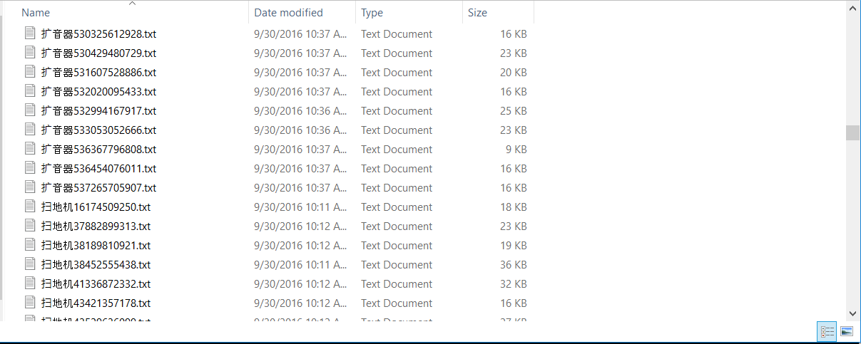
Solution Data Preparation
Get product comments on E-commerce platforms by categories. Already have comments of 59864 products.
Use these comment corpus to train word2vec in our NLP Unit.

Slide 7
Solution Comment Analysis Server
API entrance（item ID）
Get comments
(currently by crawler)
NLP Unit
Output (JSON)

Slide 8
Solution NLP Unit
Consist of three parts: keyword extraction, similarity calculation, and sentiment analysis.
Can cluster words with similar meaning and quantify customer’s sentiment by their expressions.

Slide 9
Demo

Slide 10

What can Mary get?
Quick overview
Multi-dimensional analysis
Opinion extraction

Slide 11
Expectation: Integrated with Anywhere
Comment Analysis Dashboard on product information page
Third party evaluation function on E-shop page
Anywhere Platform
Analysis Server

Slide 12
Ultimate Goal
Independent comment analysis service, independent front end for query and display
Integrated with SME’s products, perfecting their solutions to E-commerce customers

Slide 13
Thank you

