Slide 1
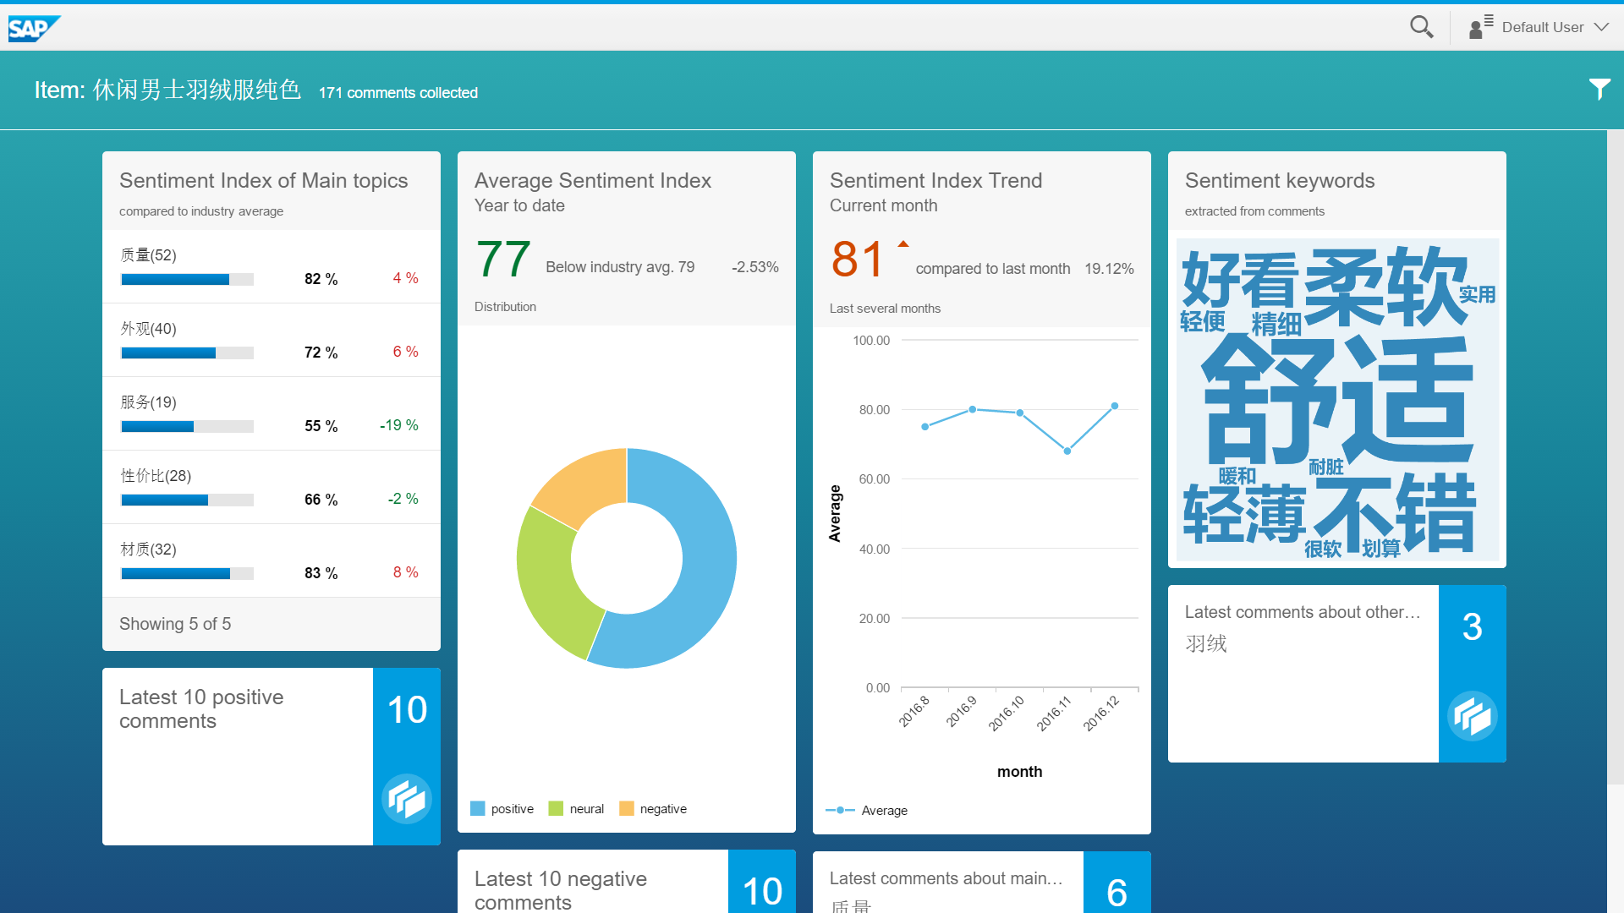

E-shop Comment Analysis System Outline
Problem:
Solution:
E-commerce company
E-commerce company
Amazon
Tmall
…(E-shops)
ERP system
…
?
Analysis Server
love it, even better then expected
Data preparation and training
Comments Extractor
Comment Analysis Core
I bought this mouse like 3 weeks ago and it broke. wtf
solid sweatshirt. A bit smaller than an American Large
……

Slide 2
Demo

Slide 3
E-shop Comment Analysis System Analysis Core: Opinion mining and Sentiment Analysis
ERP system
Comment Analysis Core
…
Item ID
Comments Extractor
Keyword Extractor
comment text
TF-IDF
TextRank
POS-tag
keywords
Data Preparation and Training
Similarity Calculation and Clustering
Unlabelled Corpus
Spectral Clustering
Word2vec
topics
Labelled Corpus
Sentiment Analysis
Word Segmentation
Naive Bayes Classifier

Slide 4
Thank you

