Slide 1
Handwritten Text Recognition A Comprehensive Approach
Umer Amir _ 2112241
December 24, 2021

Slide 2
Problem Statement: Difficulty in recognizing handwritten text from images.
Introduction
Project Goal:
Develop a system to accurately segment and recognize handwritten text.

Slide 3
Core Objective: Extract text from segmented images.
Project Overview
Challenges: Handwriting variability, image quality, and computational complexity.

Slide 4
Duration: 3 months Effort: Around 60 hours of dedicated work
Time Investment

Slide 5
Development Phases and Challenges
Initial Setup and Basic Image Processing:
Grayscale conversion and binary thresholding.
Challenge: Handling different image qualities.
Enhanced Image Processing and Testing:
Contrast enhancement techniques.
Challenge: Poor contrast in initial images.
Advanced Processing Techniques:
Histogram equalization, erosion, and morphological operations.
Challenge: Low contrast and noise.
Comprehensive Methodological Overhaul:
Multiple new strategies for contrast enhancement and adaptive thresholding.
Challenge: Complex processing requirements and computational overhead.
Integration of Feedback and Refinement:
Fine-tuning to remove paper lines and background noise.
Challenge: Persistent artifacts.
Finalization and Model Integration:
Refined segmentation process.
Challenge: Achieving high accuracy in text recognition.

Slide 6
Segmentation Quality and File Organization
Segmentation Performance: Effective for most images, but struggles with extremely poor contrast.
File and Model Integration:
Segmented images saved in "Seg Imgs" folder.
Local model (network.mat) for offline processing.
Online model (VisionEncoderDecoderModel) for cloud-based processing.
Challenge: Current models have suboptimal accuracy.

Slide 7
Research and Resources
Academic Courses and Presentations: Theoretical insights.
ChatGPT and Gemini: Quick queries and coding tips.
YouTube and MathWorks: Practical tutorials and code examples.
GitHub: Exploring existing projects and community solutions.

Slide 8
Challenges and Incompleteness
Incomplete system due to suboptimal model performance.
Unresolved challenges: paper line removal and high accuracy text recognition.

Slide 9
Future Recommendations
Model development: Continued exploration and refinement.
Data resource expansion: More diverse and extensive training datasets.
Expert and community engagement: Seek guidance and collaboration.

Slide 10
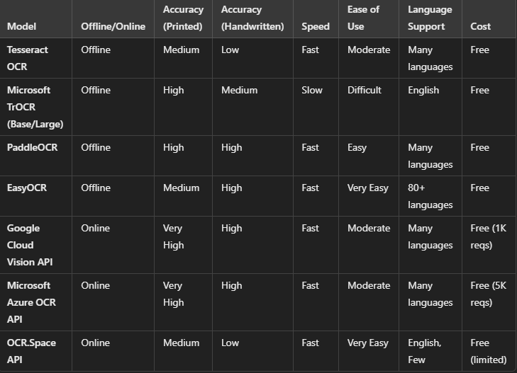
Model Implementation
Used these models:

Slide 11
Model Implementation
ChatGPT:
98%
Gemini:
80%
Microsoft Copilot:
Finds text images too sensitive Aria AI:
90%

Slide 12
Final Learning Moment
Complexity is the enemy of maintainability.
If you can't explain it to a six-year-old, you don't understand it yourself
*Final Codes are only around 150 lines long*

Slide 13
Conclusion
Significant research and development to create a robust system.
Strong foundation for future enhancements.
Clear pathways for ongoing research and development.

