Slide 1

Abstract Trees
Asra Masood
Department of Creative Technologies
Air University Islamabad

Slide 2
Outline
This topic we will discuss:
  Hierarchical ordering
  Description of an Abstract Tree/Hierarchy
  Applications
  Implementation
  Local definitions

Slide 3
Outline
A hierarchical ordering of a finite number of objects may be stored in a tree data structure
Operations on a hierarchically stored container include:
  Accessing the root:
  Given an object in the container:
    Access the parent of the current object
    Find the degree of the current object
    Get a reference to a child,
    Attach a new sub-tree to the current object
    Detach this tree from its parent

Slide 4
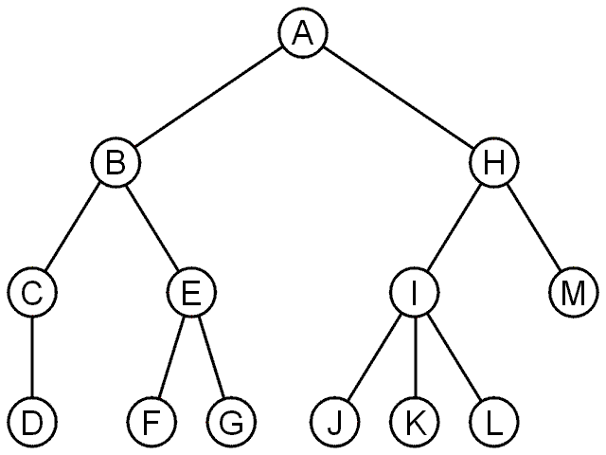
Abstract Trees
An abstract tree (or abstract hierarchy) does not restrict the number of nodes
  In this tree, the degrees vary:
Degree | Nodes
0 | D, F, G, J, K, L, M
1 | C
2 | A, B, E, H
3 | I

Slide 5
Abstract Trees: Design
We implement an abstract tree or hierarchy by using a class that:
  Stores a value
  Stores the children in a linked-list

Slide 6
Implementation
The class definition would be:
    class Simple_tree {
    private:
    int node_value;
    Simple_tree *parent_node;
    linkedlist<simple_tree> children;
    public:
    Simple_tree( int = int(), Simple_tree * = nullptr );
    int retrieve() const;
    Simple_tree *parent() const;
    int degree() const;
    bool is_root() const;
    bool is_leaf() const;
    Simple_tree *child( int n ) const;
    int height() const;
    void insert( int const & );
    void attach( Simple_tree * );
    void detach();
    };

Slide 7
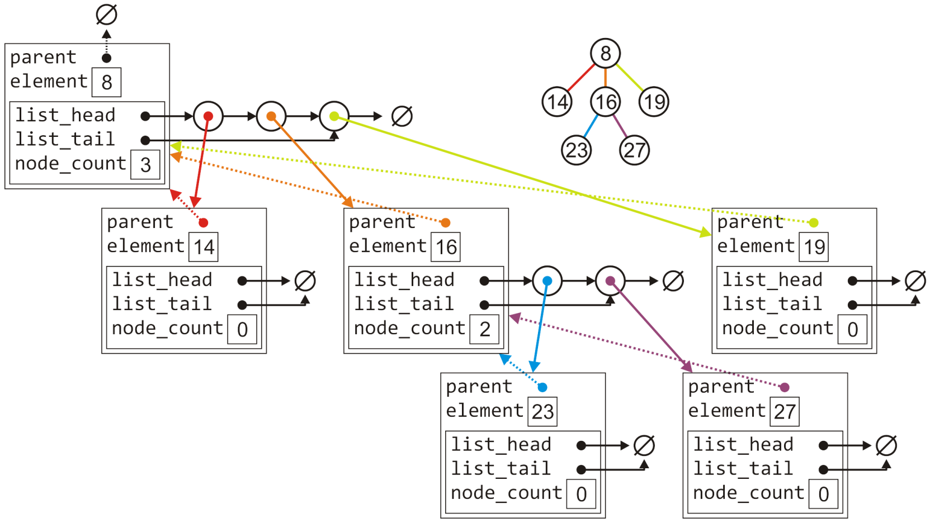
Implementation
The tree with six nodes would be stored as follows:

Slide 8
Implementation
The class definition would be:
    template <typename Type>
    class Simple_tree {
    private:
    Type node_value;
    Simple_tree *parent_node;
    linkedlist<Simple_tree *> children;
    public:
    Simple_tree( Type const & = Type(), Simple_tree * = NULL );
    Type retrieve() const;
    Simple_tree *parent() const;
    int degree() const;
    bool is_root() const;
    bool is_leaf() const;
    Simple_tree *child( int n ) const;
    int size() const;
    int height() const;
    void insert( Type const & );
    void attach( Simple_tree * );
    void detach();
    };

Slide 9
Implementation
Much of the functionality is similar to that of the linkedlist class
    template <typename Type>
    Simple_tree<Type>::Simple_tree( Type const &obj, Simple_tree *p ):
    node_value( obj ),
    parent_node( p ) {
    // Empty constructor
    }
    template <typename Type>
    Type Simple_tree<Type>::value() const {
    return node_value;
    }
    template <typename Type>
    Simple_tree<Type> *Simple_tree<Type>::parent() const {
    return parent_node;
    }

Slide 10
Implementation
Much of the functionality is similar to that of the Linkedlist class:
    template <typename Type>
    bool Simple_tree<Type>::is_root() const {
    return ( parent() == nullptr );
    }
    template <typename Type>
    int Simple_tree<Type>::degree() const {
    return children.size();
    }
    template <typename Type>
    bool Simple_tree<Type>::is_leaf() const {
    return ( degree() == 0 );
    }

Slide 11
Implementation
Accessing the n^{th} child requires a for loop (Θ(n)):
template <typename Type>
Simple_tree<Type> *Simple_tree<Type>::child( int n ) const {
if ( n < 0 || n >= degree() ) {
return nullptr;
}
Simple_tree *child = children.head();
// Skip the first n - 1 children
for ( int i = 1; i < n; ++i ) {
child = child->next();
}
return child->value();
}

Slide 12
Implementation
Attaching a new object to become a child is similar to a linked list:
    template <typename Type>
    void Simple_tree<Type>::attach( Type const &obj ) {
    children.push_back( new Simple_tree( obj, this ) );
    }

Slide 13
Implementation
To detach a tree from its parent:
  If it is already a root, do nothing
  Otherwise, erase this object from the parent’s list of children and set the parent pointer to zero
    template <typename Type>
    void Simple_tree<Type>::detach() {
    if ( is_root() ) {
    return;
    }
    parent()->children.erase( this );
    parent_node = nullptr;
    }

Slide 14
Implementation
Attaching an entirely new tree as a sub-tree, however, first requires us to check if the tree is not already a sub-tree of another node:
  If so, we must detach it first and only then can we add it
    template <typename Type>
    void Simple_tree<Type>::attach( Simple_tree<Type> *tree ) {
    if ( !tree->is_root() ) {
    tree->detach();
    }
    tree->parent_node = this;
    children.push_back( tree );
    }

Slide 15
Implementation
Suppose we want to find the size of a tree:
  An empty tree has size 0, a tree with no children has size 1
  Otherwise, the size is one plus the size of all the children
  template <typename Type>
  int Simple_tree<Type>::size() const {
  if ( this == nullptr ) {
  return 0;
  }
  int tree_size = 1;
  for ( Simple_tree *child = children.begin(); child != children.end(); child = child->next() ) {
  tree_size += child->value()->size();
  }
  return tree_size ;
  }

Slide 16
Implementation
Suppose we want to find the height of a tree:
  An empty tree has height –1 and a tree with no children is height 0
  Otherwise, the height is one plus the maximum height of any sub tree
  #include <algorithm>
  template <typename Type>
  int Simple_tree<Type>::height() const {
  if ( this == nullptr ) {
  return -1;
  }
  int tree_height = 0;
  for ( Simple_tree *child = children.begin(); child != children.end(); child = child->next() ) {
  tree_height = std::max( h, 1 + child->value()->height() );
  }
  return tree_height;
  }

Slide 17
Implementation
Implementing a tree by storing the children in an array is similar,
however, we must deal with the full structure
  A general tree using an array would have a constructor similar to:
    template <typename Type>
    Simple_tree<Type>::Simple_tree( Type const &obj, Simple_tree *p ):
    node_value( obj ),
    parent_node( p ),
    child_count( 0 ),
    child_capacity( 4 ),
    children( new Simple_tree *[child_capacity] ) {
    // Empty constructor
    }

