Slide 1
Introduction to NumPy array
By
Sikandar Hayat

Slide 2
What is NumPy?
NumPy is the fundamental package for scientific computing in Python. NumPy arrays facilitate advanced mathematical and other types of operations on large numbers of data. Typically, such operations are executed more efficiently and with less code than is possible using Python’s built-in sequences.

Slide 3
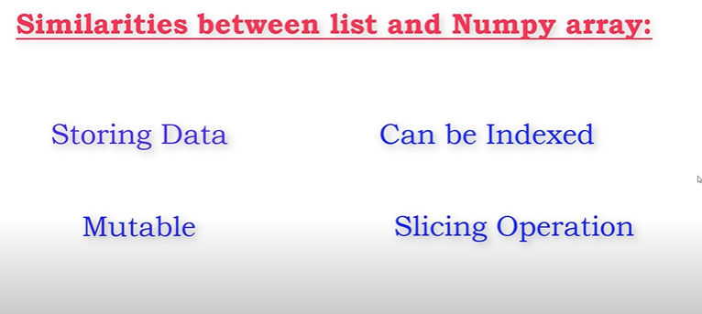

Slide 4
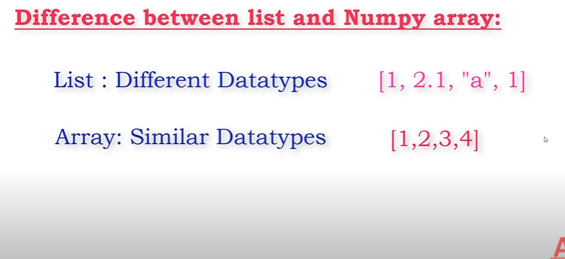

Slide 5

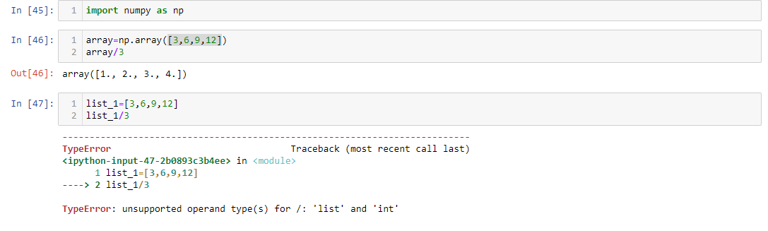
S vsd

Slide 6


Slide 7
Why is NumPy faster in Python?
NumPy Arrays are faster than Python Lists because of the following reasons:
An array is a collection of homogeneous data-types that are stored in contiguous memory locations(stored in one continuous location). On the other hand, a list in Python is a collection of heterogeneous data types stored in non-contiguous memory locations.
The NumPy package breaks down a task into multiple fragments and then processes all the fragments parallelly.
The NumPy package integrates C, C++ in Python. These programming languages have very little execution time compared to Python.

Slide 8
