Slide 1
ROUND 1 · PROBLEM 3
NovaSense: predict failures before they happen
An AI co-pilot that watches every machine and tells the team exactly what to fix next.
Ctrl.Alt.Elite
Umer Basith · Muizzur Rahman
Ctrl.Alt.Elite · Cobot-Ex Hackathon 2026
01 / 10
Notes:
Good morning judges. We are Ctrl.Alt.Elite. In the next 5 minutes we will show a working system, not just an idea.

Slide 2
02 · THE PROBLEM
“
Machines fail without warning, and teams find out only after production stops.
20%
of productive time lost to unplanned downtime
Every hour of downtime costs lakhs in lost output.
Ctrl.Alt.Elite · Cobot-Ex Hackathon 2026
02 / 10
Notes:
Start with the pain. Pause after the number.

Slide 3
03 · OUR SOLUTION
One platform, three superpowers
NovaSense turns raw sensor readings into early warnings and clear actions.
🧠
01
⚡
02
💬
03
Predict
Alert
Explain
A gradient-boosting model scores failure risk from temperature, vibration, load and run hours.
High-risk machines raise instant, prioritised alerts with the main cause.
An AI assistant answers questions in plain English using live data.
Ctrl.Alt.Elite · Cobot-Ex Hackathon 2026
03 / 10

Slide 4
04 · ARCHITECTURE
From sensor to decision in under a second
1
2
3
4
Sensors / CSV
FastAPI backend
ML model
React dashboard
Readings arrive live or as an upload
Validates input and stores history in SQLite
Scores risk and explains the top factors
Charts, alerts and the AI assistant
Ctrl.Alt.Elite · Cobot-Ex Hackathon 2026
04 / 10

Slide 5
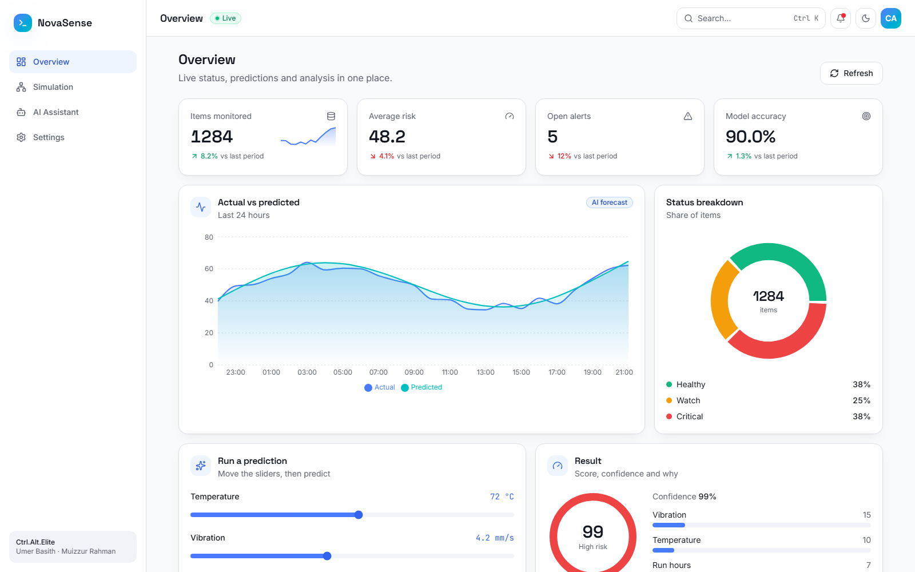
05 · LIVE DEMO
The dashboard the team actually uses
localhost:5173/app
Live KPIs and 24-hour forecast
1
2
Risk score with reasons
3
Status mix at a glance
4
Upload any CSV to analyse
localhost:5173/app — running live
Ctrl.Alt.Elite · Cobot-Ex Hackathon 2026
05 / 10

Slide 6
06 · RESULTS
Measured, not guessed
90%
0.96
<1s
6/6
Accuracy on 1,000 unseen rows
ROC-AUC
Time to score a machine
Automated tests passing
Model trained on a synthetic dataset modelled on real sensor ranges. Real plant data would be the next step.
Ctrl.Alt.Elite · Cobot-Ex Hackathon 2026
06 / 10

Slide 7
07 · WHY IT'S BETTER
Before vs after NovaSense
With NovaSense
Today
✕
Fix after it breaks
✓
Warned hours earlier
✕
Paper logs
✓
Live dashboard
✕
Experts guess the cause
✓
Top causes shown
✕
Hours of downtime
✓
Planned, short stops
Ctrl.Alt.Elite · Cobot-Ex Hackathon 2026
07 / 10

Slide 8
08 · COMPARISON
How we compare
★ BEST
Feature | Manual checks | Basic alarms | NovaSense
Predicts early | No | No | Yes
Explains cause | Sometimes | No | Yes
Plain-English assistant | No | No | Yes
Cost to start | High | Medium | Low
Ctrl.Alt.Elite · Cobot-Ex Hackathon 2026
08 / 10

Slide 9
09 · ROADMAP
What comes next
1
2
3
4
Today
Month 1
Month 3
Month 6
Working prototype with model, dashboard and assistant
Pilot on one real production line
Edge device + live sensor stream
Multi-plant rollout and mobile alerts
Ctrl.Alt.Elite · Cobot-Ex Hackathon 2026
09 / 10

Slide 10
Thank you
NovaSense: from raw signals to the right action, in seconds.
Ctrl.Alt.Elite
Umer Basith · Muizzur Rahman
Questions? We'd love to show you the live demo.
Ctrl.Alt.Elite · Cobot-Ex Hackathon 2026
10 / 10

