Slide 1
Info Tech Classroom
Presented By: Umer Bin Ijaz (09162213012)

Slide 2

Problem Statement
The current educational systems often face significant challenges, including
Course Management
Attendance Tracking
Limited access to learning resources
Difficulties in generating question papers.

Slide 3

Proposed Solution
The Info Tech Classroom (ITC) project aims to provide a comprehensive solution that enhances the educational experience for students and teachers through a user-friendly online platform.
User Management:
Course Management:
Attendance Tracking:
File Sharing:
Auto Question Paper Generator Module
Robust Back-End Processing:
Secure Data Storage:

Slide 4
Stakeholder's
Developed by: Umer Bin Ijaz
Supervised by: Dr. Adeel Anjum
All Faculty Members
Students

Slide 5
Related System Analysis
Application | Weakness | Proposed Project Solution
MS Teams | Only tracks attendance for online classes. | The ITC system will provide a comprehensive attendance tracking feature that integrates with course management. The ITC will offer a built-in question paper generator that allows teachers to create papers based on uploaded resources. The ITC will use academic IDs for student identification, ensuring easy recognition and management by teachers.
 | No feature for generating question papers.
Google Classroom | Lacks a question paper generation feature.
 | No feature for tracking attendance.
 | Student IDs are not aligned with their academic IDs, making it difficult for teachers to recognize students.

Slide 6
Project Scope
The scope of the proposed project, Info Tech Classroom (ITC), is to create an integrated online learning platform with the following features:
Course Management:
Attendance Tracking:
Question Paper Generation:
Resource Sharing:
User Authentication:
Mobile Accessibility:

Slide 7
Modules
USER MANAGEMENT:
User Registration: Allows users (teachers, and administrators) to create accounts by providing necessary details such as name, email, academic ID, and password.
User Authentication: Includes secure login functionality for users to access their accounts using their academic IDs and passwords.

Slide 8
Modules
COURSE MANAGEMENT:
Course Creation: Enables teachers and administrators to create new courses, specifying details like course name with the shift name, description.
Course Enrollment: Allows students to enroll in courses using a unique class code provided by the teacher.
Course Materials: Provides a module for teachers to upload and share course materials like PDFs, PPTs, and videos with enrolled students.

Slide 9
Modules
ATTENDANCE TRACKING:
Attendance Take: Take attendance of students in their classes.
Attendance Reports: Generate reports showing attendance records for individual students or entire classes.
Question Paper Generation:
  Material Selection: Choose relevant content from lecture notes, slides, or other uploaded materials.
  Question Formatting: Create different types of questions (e.g., multiple choice, short answer) and format them accordingly.
  Export Options: Export the question paper in various formats (e.g., PDF, Word) for distribution to students.

Slide 10
Modules
ANALYTICS AND REPORTING:
Student Performance: Generates reports on student attendance.
Course Analytics: Provides insights into course metrics like enrollment, student engagement.
MOBILE ACCESSIBILITY:
Responsive Design: Ensures that the ITC system is optimized for both desktop and mobile devices, providing a seamless experience for users on the go.

Slide 11
Non Functional Requirements
Performance: The system should support at least 500 concurrent users without degradation of performance.
Security: All user data must be encrypted, and secure access protocols must be implemented.
Usability: Usability here refers to how easy and efficient it is for users to interact with the system.

Slide 12
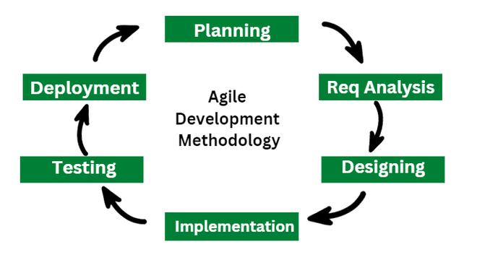
Task Management
Task management in the ITC project uses an agile approach, which means the team works in small steps and gets feedback along the way. Tasks are prioritized based on how important they are for the overall project goals. This helps keep the project on track and allows it to adapt to any changes or new requirements that come up.

Slide 13
Task Management
Project Milestones:
Planning: Completed
Requirement Analysis: SRS Completed
Designing: SDR Completed
Implementation: 10%
Testing: Pending
Deployment: Pending

Slide 14
User Roles & Responsibilities:
Administrators:
Manage student accounts (create, update, delete).
Approve course creation requests from teachers.
Export reports on attendance and performance metrics.
Teachers:
Create courses with unique class codes.
Take attendance during classes.
Upload course materials such as presentations and documents.
Utilize the Auto Question Paper Generator module to create assessments based on uploaded materials.

Slide 15
User Roles & Responsibilities:
Students:
Register for courses using class codes provided by teachers.
Access uploaded course materials.
View their attendance records.

Slide 16





TOOLS AND TECHNOLOGIES
Development Tool: VS Code
Database Management System: MYSQL
Design Work: Figma
Font-end-Development: React JS, Tailwind CSS
Back-end-Development: Node JS, Express

Slide 17

THE END

