Slide 1


Analysis of Superstore Sales Data Project & Data Management
Presented by: Muhammad Umer Mehmood
University of Hertfordshire

Slide 2
Project Overview:
To analyze a retail sales dataset and extract meaningful insights related to trends, customer behavior, and profitability. The goal is to support better decision-making in sales strategy, inventory management, and customer segmentation.

Slide 3
Data Ingestion
The dataset used in this study is a retail transaction log, Sample - Superstore.csv, containing historical sales data across multiple dimensions such as product category, region, and order details. The data was loaded into a Python environment using the pandas library, providing a structured dataframe with over 9,000 records.
Data Pipeline
This section outlines the end-to-end data processing and modeling workflow employed in this study to forecast profit from transactional sales data. The pipeline was designed to ensure data integrity, efficient feature engineering, and optimized model performance using industry-standard machine learning techniques.

Slide 4
Data Cleaning
Missing Values: All missing values in the selected numerical and categorical features were dropped to maintain modeling reliability.
Profit Filtering: Records with Profit values less than or equal to -1 were excluded to allow for safe application of logarithmic transformations (log1p), which are undefined for negative values.
Data Consistency: The dataset was reviewed for data type consistency, ensuring numerical fields (e.g., Sales, Discount, Quantity) and categorical fields (e.g., Category, Segment, Ship Mode) were correctly interpreted.

Slide 5
Pre-Processing
Logarithmic Transformation: The target variable (Profit) and primary feature (Sales) were transformed using log1p to address data skewness and reduce the influence of outliers. This helped models better capture underlying patterns and relationships.
Categorical Encoding: Categorical features such as Category, Segment, Region, and Ship Mode were converted to numerical format using one-hot encoding (with drop_first=True to avoid multicollinearity).
Feature Selection: Based on exploratory analysis, the most relevant predictors for Profit were chosen, including Sales, Discount, Quantity, and key categorical dimensions.

Slide 6
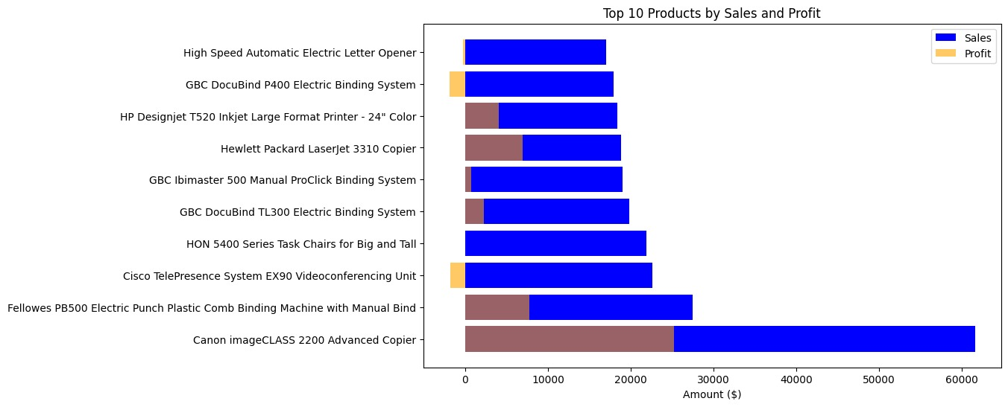
Top 10 Products by Sales and Profit

Slide 7
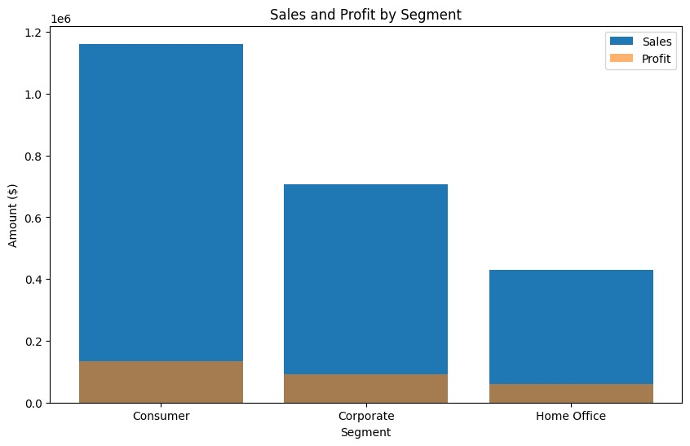
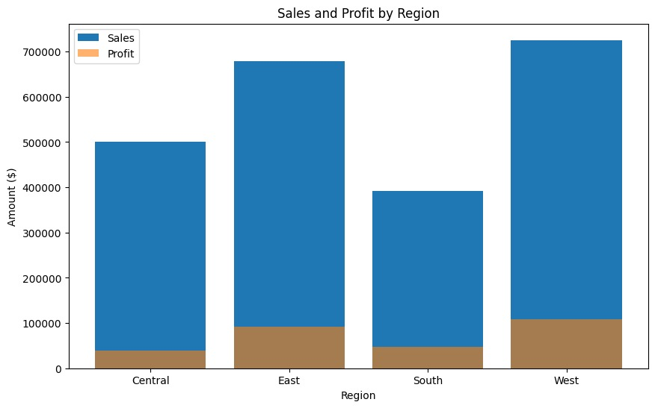
Exploratory Analysis

Slide 8
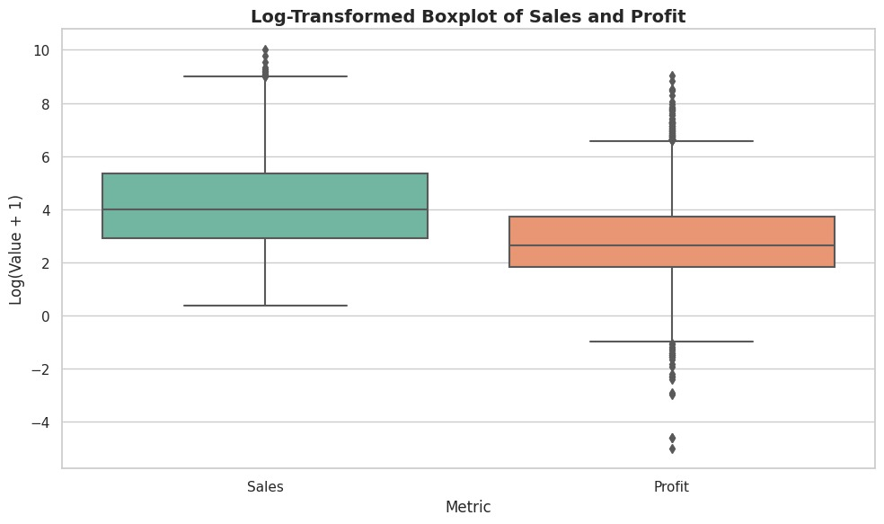

Slide 9
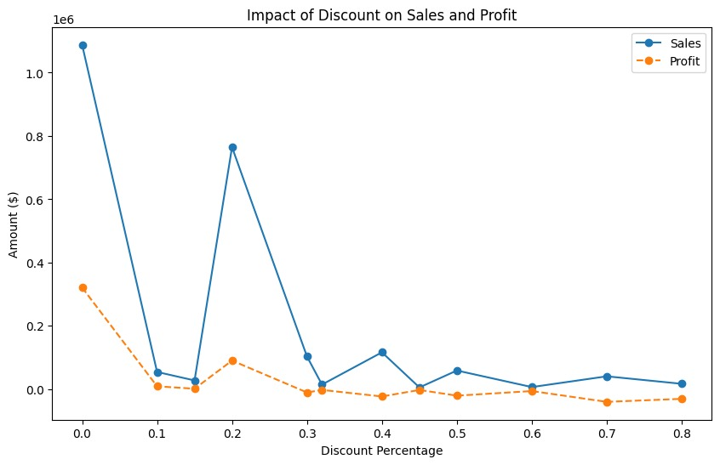
Impact of Discount on Sales and Profit

Slide 10
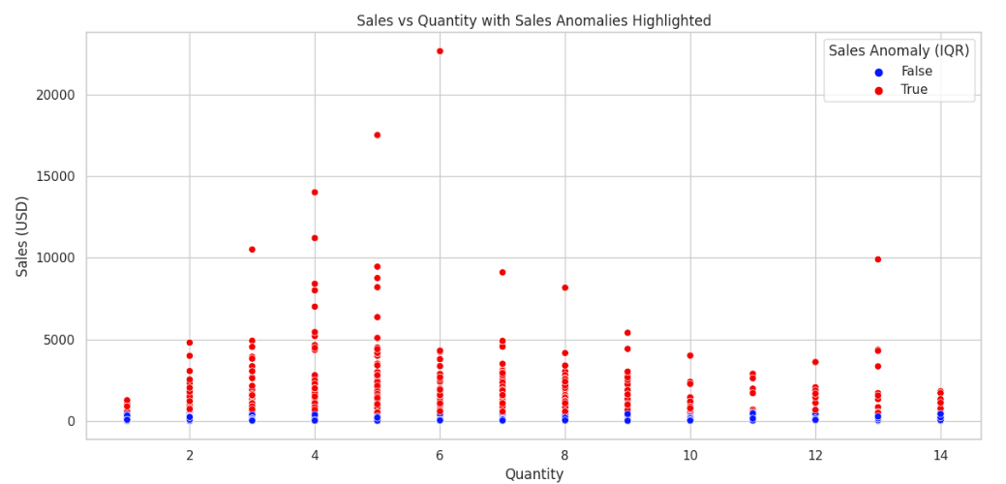
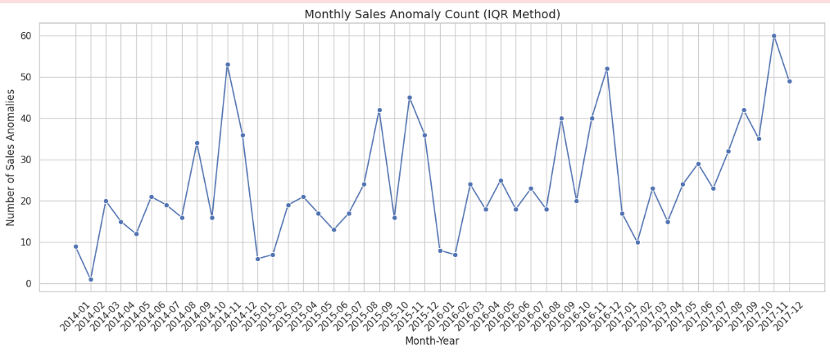
Anomalies in Demand

Slide 11
Suitability of Models
Applied three regression models: Linear Regression, Random Forest, and Gradient Boosting to predict Profit using features like Sales, Quantity, Discount, and Category.
Used log transformation on the Profit variable and optimized model performance through GridSearchCV for hyperparameter tuning.
Evaluated models using MAE, RMSE, and R²; Gradient Boosting achieved the best performance by capturing non-linear patterns effectively.
Feature engineering included handling categorical variables, filtering extreme outliers, and normalizing skewed distributions.
Visual comparisons of model metrics and prediction trends helped interpret performance differences among algorithms.
Time-based anomaly detection and exploratory analysis provided insights into irregular sales behavior and data quality issues.

Slide 12
Linear Model
Linear Regression is a foundational predictive model that assumes a straight-line relationship between input features and the target variable.
The model is simple, fast to train, and provides easily interpretable coefficients.
In this analysis, it used Sales, Quantity, and Discount to estimate Profit.
Model Setup
The target variable (Profit) was log-transformed using log1p to reduce skewness and stabilize variance.
Input features included numeric variables: Sales, Quantity, and Discount.
An 80/20 train-test split was used to evaluate generalization performance.
The model was initialized with default settings and later fine-tuned using GridSearchCV for best results.

Slide 13
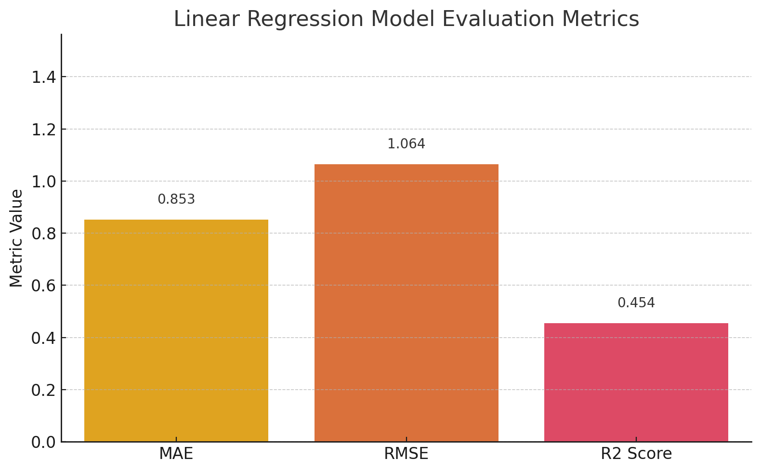
Linear Regression Performance

Slide 14
Random Forest Model
Random Forest is an ensemble model that builds multiple decision trees and aggregates their outputs for robust predictions.
It captures complex nonlinear relationships in data with minimal preprocessing or scaling required.
Exogenous features can be easily integrated, and the model provides feature importance scores to interpret influential factors.
It is highly resistant to overfitting on large datasets, making it suitable for real-world, high-dimensional business data.
Random Forest can handle both numerical and categorical features, offering flexibility in modeling structured datasets.

Slide 15
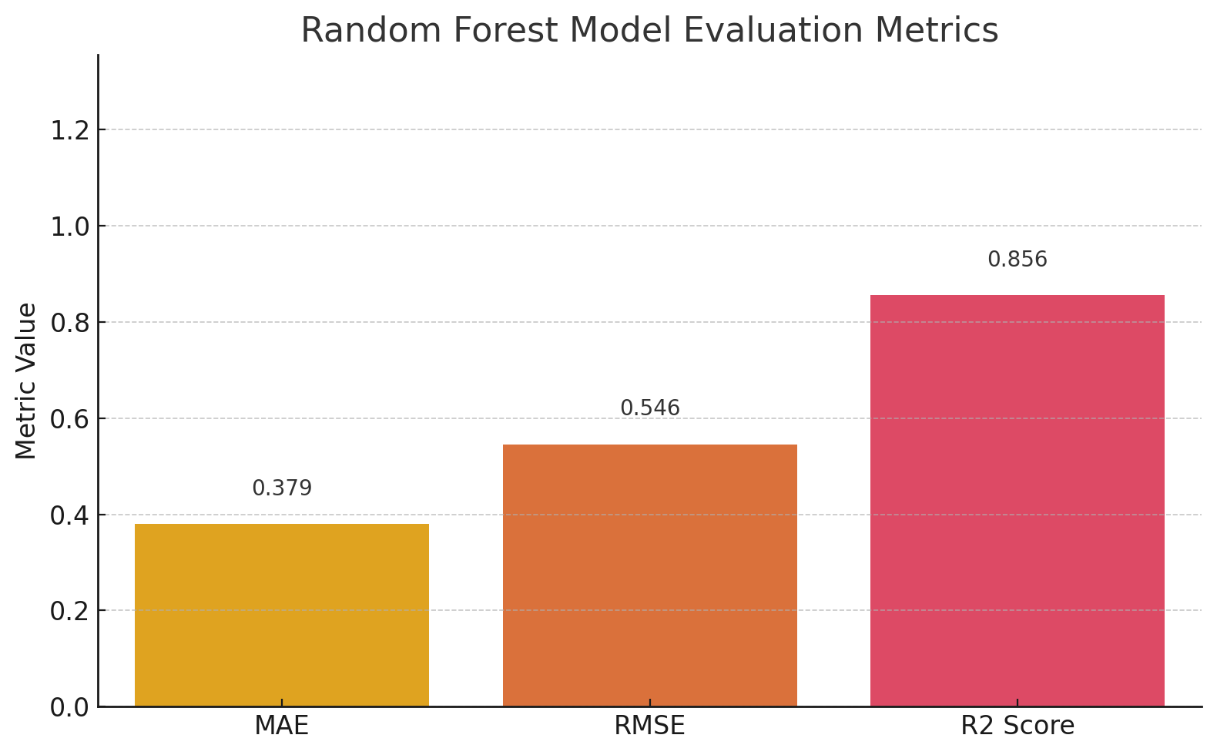
Random Forest Performance

Slide 16
Gradient Boosting
Gradient Boosting is an ensemble model that builds decision trees sequentially, with each tree learning from the errors of the last.
It excels at capturing complex, nonlinear relationships in both structured and unstructured data.
The model allows the integration of exogenous variables and fine-tuning through hyperparameters like learning rate and tree depth.
It provides feature importance metrics, helping interpret which variables most influence predictions.
Gradient Boosting is known for its high predictive accuracy, especially in tabular business datasets.

Slide 17

Gradient Boosting Performance

Slide 18
Outcomes of Project
The dataset was cleaned, transformed (log of Profit), and key features like Sales, Quantity, and Discount were selected.
Three models — Linear Regression, Random Forest, and Gradient Boosting — were trained and evaluated using MAE, RMSE, and R².
Gradient Boosting outperformed others with the highest accuracy and best overall model fit.
The project demonstrates that advanced ensemble models are effective in predicting business profit from sales data.

Slide 19
References
Breiman, L. (2001). Random Forests. Machine Learning, 45(1), 5–32. https://doi.org/10.1023/A:1010933404324
→ Reference for the Random Forest algorithm used in model development.
Friedman, J. H. (2001). Greedy Function Approximation: A Gradient Boosting Machine. The Annals of Statistics, 29(5), 1189–1232. https://doi.org/10.1214/aos/1013203451

Slide 20


