Slide 1
Forecasting Glucose Levels in Type 1 Diabetes Using Time-Series Approaches
Muhammad Umer Mehmood
23102319
M.Sc. Data Science Student
University of Hertfordshire

Slide 2
Background & Motivation
Background:
Continuous Glucose Monitors (CGM) record blood glucose every 5 minutes, generating rich time series data that can be leveraged for predictive modelling.
Motivation:
Traditional statistical models fail to capture the complex, non-linear patterns in CGM data — deep learning models like LSTM, GRU and CNN offer a powerful solution.

Slide 3
Research Question & Objectives
Research Question:
Can deep learning models (LSTM, GRU and CNN) accurately forecast blood glucose levels 30 minutes ahead using CGM data from patients?
Objectives:
To evaluate and compare model performance using MAE, RMSE and R² metrics.
To identify the most accurate and clinically reliable model for blood glucose forecasting.
To build and train three deep learning models (LSTM, GRU and CNN) for 30-minute ahead glucose forecasting.

Slide 4
Literature Overview & References
Literature Overview:
ML Progress: LSTM, GRU and CNN models improve glucose forecasting by learning complex sequential dependencies from CGM time series data.
Challenge Identified: patient-specific variability, unpredictable time intervals, and a lack of clinical interpretability.
References:
Jaloli, M. & Cescon, M. (2023). Long-term prediction of blood glucose levels in type 1 diabetes using a CNN-LSTM-based deep neural network.
Li, K. et al. (2019). GluNet: A deep learning framework for accurate glucose forecasting.

Slide 5
Dataset Overview
Target Variable: gl — Blood glucose level (mg/dL)
Records: 647,858 rows of patient time-series CGM data
Features:
Target Variable: gl — Blood glucose level (mg/dL)
Clinical Data: Insulin dosage, comorbidities, diagnosis age
Demographics: Gender, race, education level, income
Temporal: Timestamped every 5 minutes (CGM device)
Challenges: Sparse insulin entries, patient-wise variability, missing values in some fields

Slide 6
Feature Engineering & Preprocessing
Added hour of day and lag features to tell the model what glucose was 5, 10 and 15 minutes ago.
Added rolling average to show whether glucose is rising or falling over the last 30 minutes and 1 hour.
Removed extreme values and scaled all glucose readings between 0 and 1 for stable model training.
Converted data into sequences of 12 readings to predict next 6 readings with a 70/15/15 train/val/test split.

Slide 7
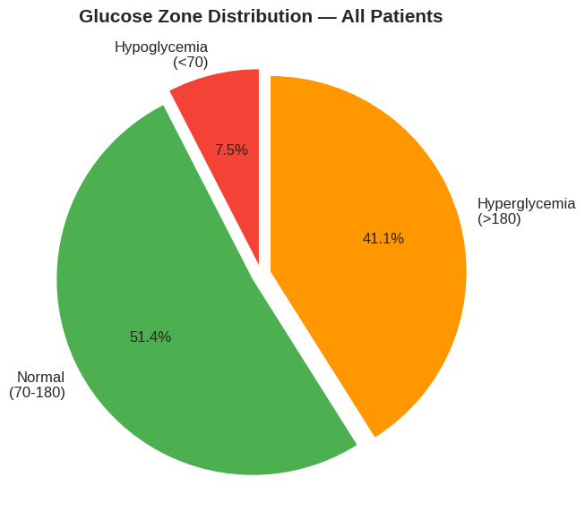
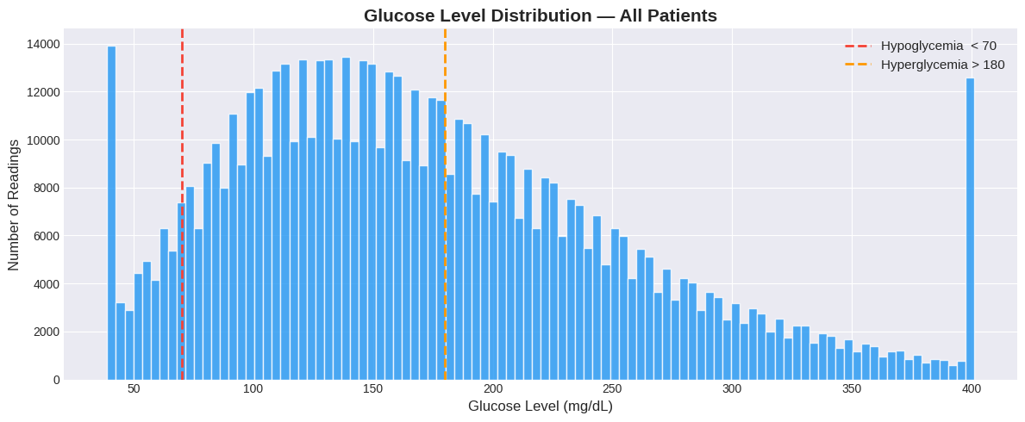
Exploratory Data Analysis (EDA)
Glucose Zones:
Only 51.4% of readings are in the normal
range — 48.6% in dangerous zones.
Glucose Levels:
Distribution with mean 173.9 mg/dL —
majority of readings in hyperglycemic zone.

Slide 8
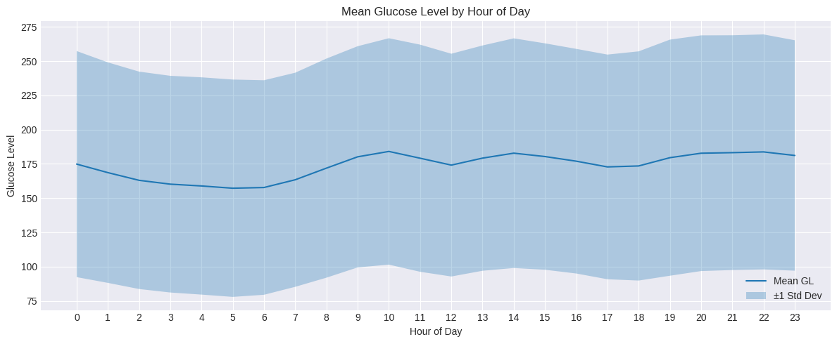
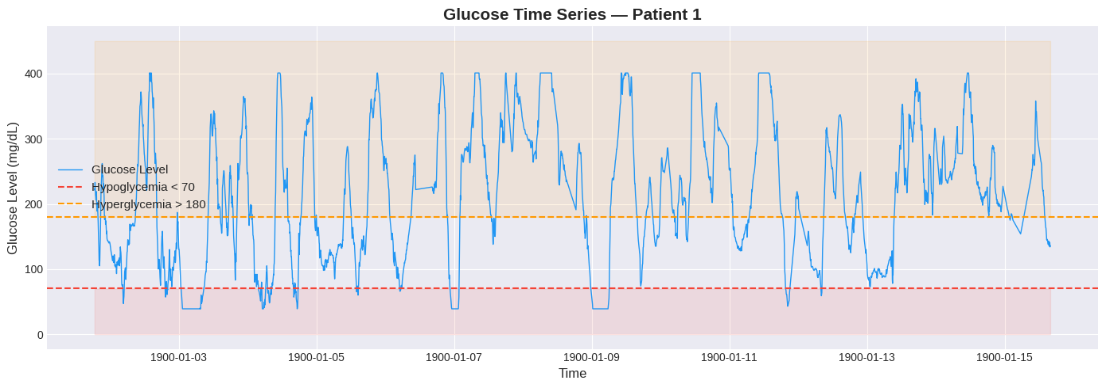
Patient Time Series:
Highly volatile glucose patterns in Patient 1 — mean 213.8 mg/dL over 2 weeks.
Glucose by Hour of Day:
Lowest glucose at 4–6 AM, peaks at 10 AM — clear daily temporal pattern.

Slide 9
Methodology & Model Selection
LSTM (Long Short-Term Memory) Captures sequential patterns and long-range dependencies in glucose data
GRU (Gated Recurrent Unit) Lightweight alternative to LSTM with faster training and competitive performance
Random Forest Robust, non-linear ensemble model—great for handling mixed feature types and baseline comparison

Slide 10
Training & Evaluation
Setup:
Time-based 70% / 15% / 15% train/validation/test split across 200 T1D patients.
12 timesteps × 12 engineered features per sequence.
Early Stopping and ReduceLROnPlateau applied to all models.
Models evaluated using MAE, RMSE and R² on unseen test data.

Slide 11
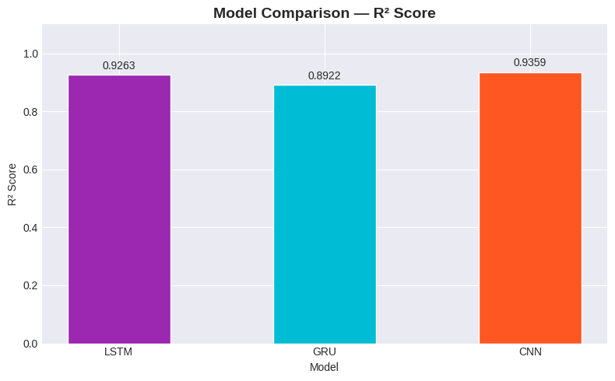
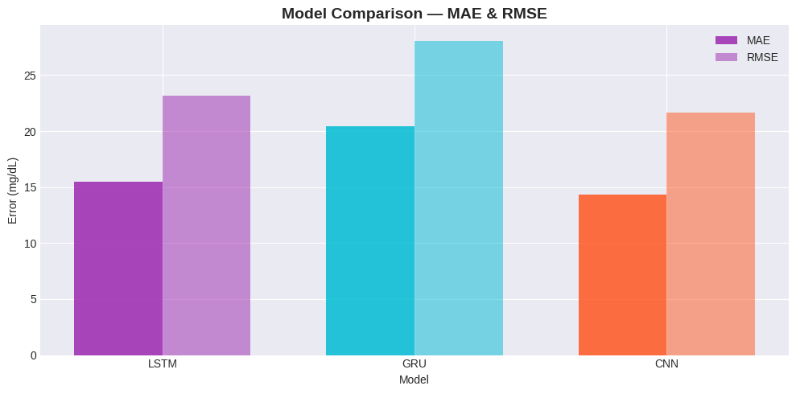
Results
CNN:
Best performer across all 3 metrics
Lowest MAE (14.31) and RMSE (21.63), highest R² (0.9359)
LSTM:
Strong performance, second best overall
Stable predictions with R² of 0.9263
GRU:
Slightly weaker performance across all metrics
May benefit from further hyperparameter tuning

Slide 12
Critical Discussion & Limitations
🔄 Patient Variability
Glucose patterns differ significantly across patients personalized models are essential.
📉 GRU Underperformance
GRU showed higher error rates may require deeper hyperparameter tuning.
📦 Dataset Limitations
Placeholder dates (year 1900) reduce the quality of temporal features.
🧩 Feature Gaps
Some clinical and lifestyle fields contain missing or noisy values.
⏱️ Temporal Granularity
Irregular time gaps can disrupt sequence continuity and affect model precision.

Slide 13
Implications
📈 Accurate glucose prediction enables proactive care.
💉 Supports personalized insulin management for T1D patients.
📱 Powers real-time CGM apps for continuous monitoring.
🏥 Enhances clinical decision-making for healthcare professionals.
🔄 Scalable to wider Type 1 Diabetes patient populations.

Slide 14
Conclusion & Future Work
CNN achieved the best forecasting performance with MAE of 14.31 mg/dL and R² of 0.9359.
All three models demonstrated strong predictive accuracy with R² scores above 0.89.
Train on larger & more diverse T1D patient datasets to improve generalizability.
Integrate real-time prediction with CGM devices for clinical deployment.
Explore hybrid models and attention mechanisms for further accuracy improvement.

Slide 15
Reference & Github
Jaloli, M. & Cescon, M. (2023). Long-term prediction of blood glucose levels in type 1 diabetes using a CNN-LSTM-based deep neural network. Journal of Diabetes Science and Technology, 17(6), 1590-1601.
https://github.com/MuhammadUmerMehmood/Forecasting-Glucose-Levels-in-Type-1-Diabetes-Using-Time-Series-Approaches-/tree/main

Slide 16
Any Question? Please

