Slide 1
Hospital Management System
Saif ur Rehman, Humayun Masood, Umer Farooq

Slide 2
Table of contents
01
About The
04
Non-Functional
02
Problem
05
Project Stages
03
Main
06
Project
Requirements
Statement
Conclusion
Features

Slide 3
About the project

Slide 4
Introduction
Problem
Affects
Results
Issues identified with hospitals include a lack of coordination, management problems, and a lack of efficiency.
Inadequate resource allocation, insufficient staff
training, disorganized record-keeping, and poor inter-professional coordination.
A significant
number of avoidable deaths caused by administrative mismanagement.

Slide 5
Advantages
Pilot Implementation
Useful small clinic
Built-in communication

Slide 6
Constraints
Not secure
Controlled use only
Not built for large organization

Slide 7
Non Functional Recquirements
Performance
Compatibility
Reliability
Scalability

Slide 8
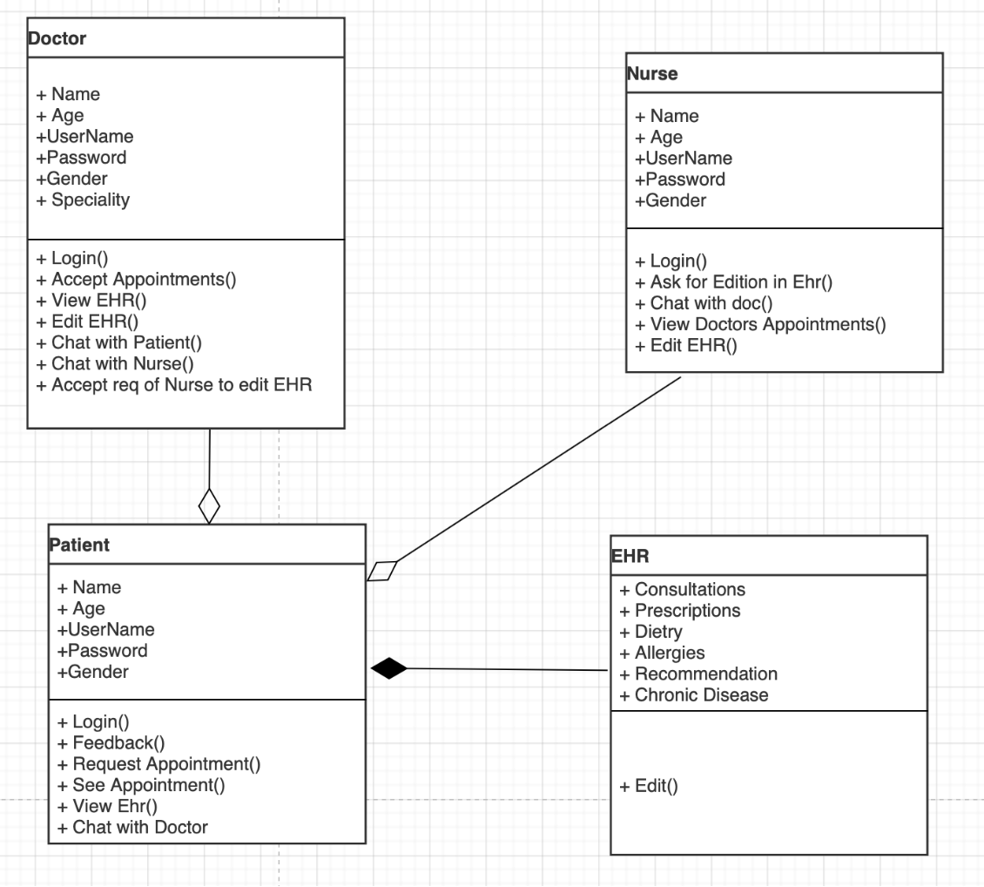
Design
Class Diagram

Slide 9
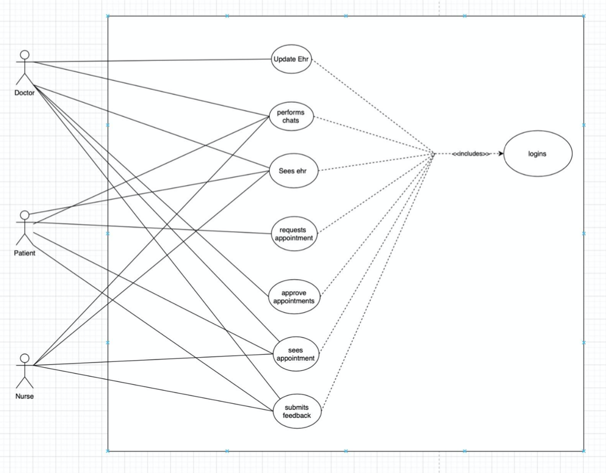
Design
Use-Case Diagram

Slide 10
Layer Architecture
User Interface
Registration/Login
Person Login
EHR Management
Appointments
Chats
Django Forms
Database

Slide 11
Implementation Screenshots

Slide 12
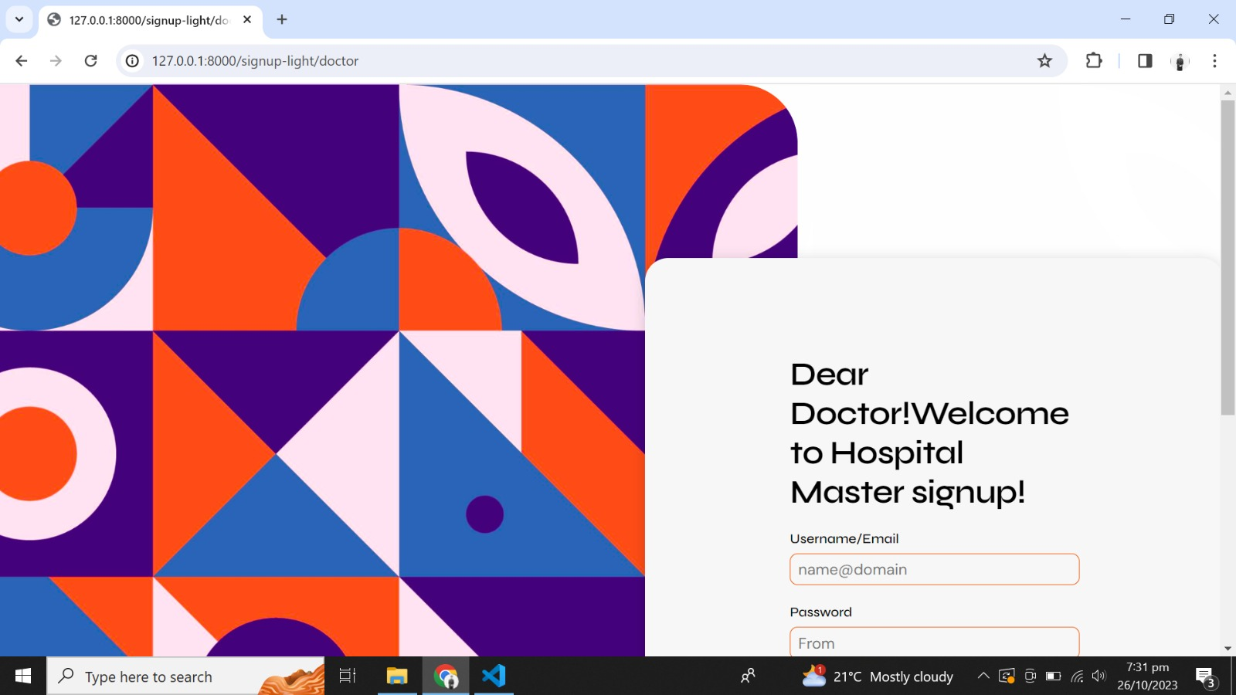

Slide 13
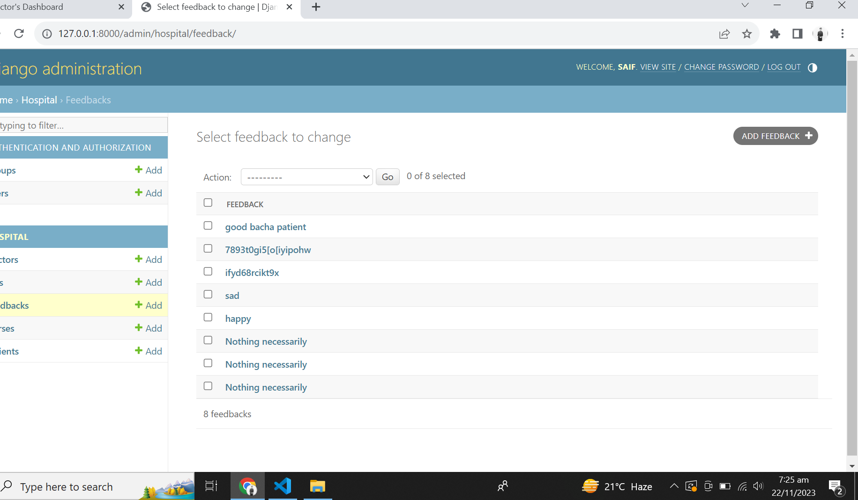

Slide 14
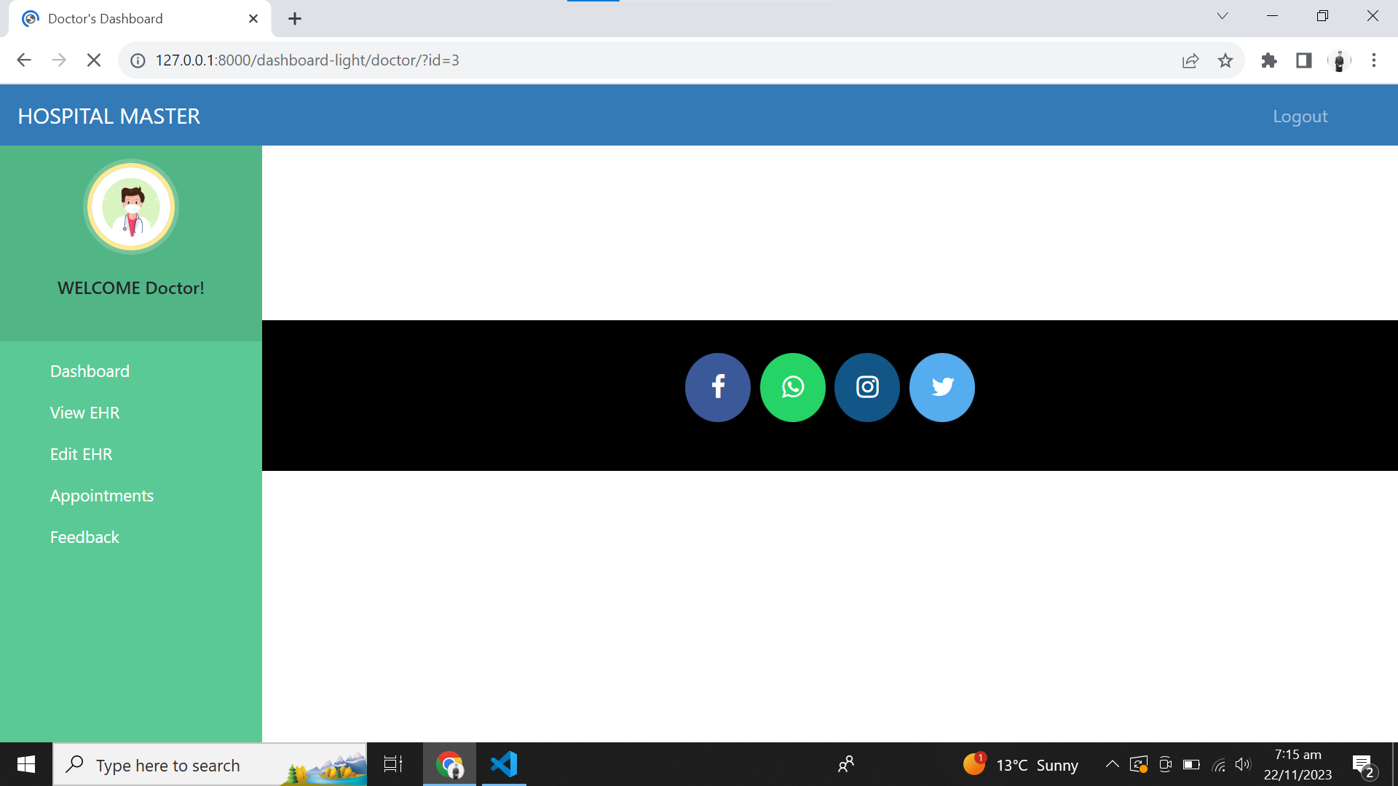

Slide 15
Conclusion

Slide 16
Thanks!
Any Questions?

Slide 17
Contributions
Saif-ur-Rehman
Database management
EHR Creation
Appointment Approvals
Dynamic Styling
Chat system
Humayun Masood
Login Management
EHR Updation
Appointments requests
Design Artifacts
Static Styling
Umer Farooq
Frond-End management
Patient Feedback Form
Documentation
Trello board management

