Slide 1

Basic Details of the Team and Problem Statement
Ministry/Organization Name/Student Innovation: Govt of Himachal Pradesh
PS Code: SIH1383
Problem Statement Title: Optimizing Doctor Availability and Appointment Allocation in Hospitals through Digital Technology and Al Integration.
Team Name: SqUAdRAMa
Team Leader Name: Umer Salim Khan
Institute Code (AISHE):
Institute Name: Anjuman-I-Islam's M. H. Saboo Siddik College of Engineering
Theme Name:

Slide 2
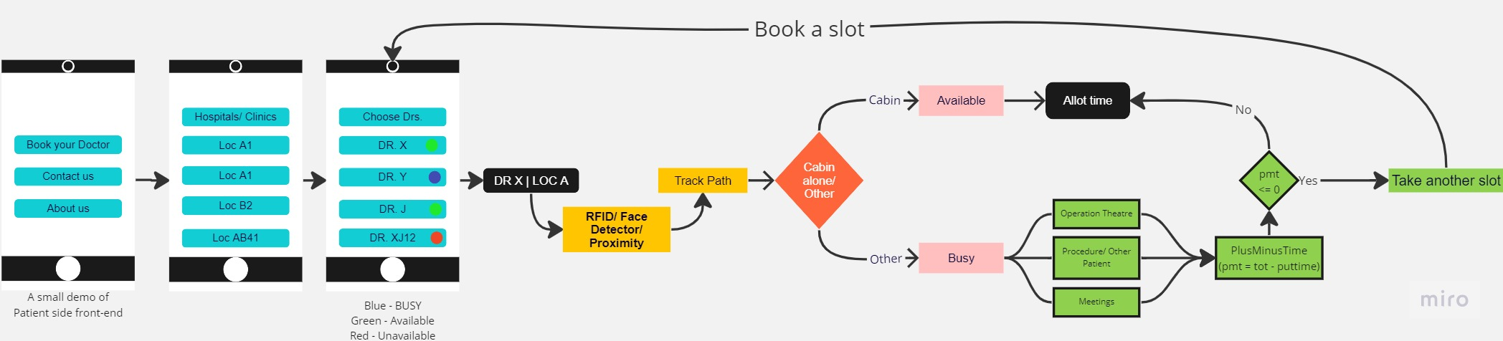
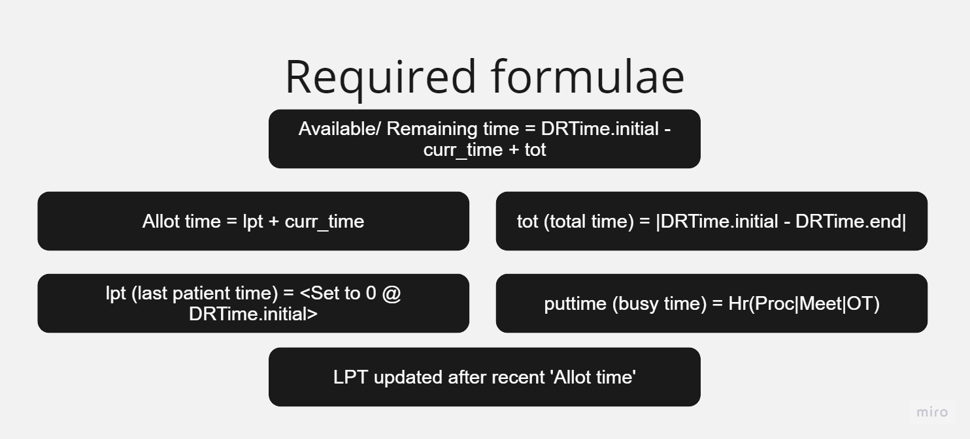
Idea/Approach Details
Idea/ Solution:
We will be adopting web approach to make it accessible to every person.
Time will be allotted based on AI Allot time function. It will be adaptable to any change making it agile.
It will help patients to avoid sitting for long, rather time will be allotted based on there appointment and doctors availability.
Estimate time for appointment.
Real time notification updates as reminder of appointment also will acknowledge if any condition occur.
Easy for doctors to keep a track of patients about there appointment.

Slide 3
Idea/Approach Details
Describe your Dependencies / Show stopper here
Describe your Technology stack here:
Front End – HTML, CSS, JS
Backend – Node JS, Flask, Axios
Database – MySQL
Server – AWS
Other possible less use technologies
Possible third parties – Msg 91/ Twilio/ Some other JS libraries for user Auth.
Session management – JWT
Describe your Use Cases here
For situation where adaptability should be quick.
Agile methodology for faster delivery
For doctor management of patients.
For avoiding long waiting time
Patient convinience
Doctor feasibility
High snowy places can cause propagation delay.
User – User conflict: Type of conflict where both users take appointment at same time. (This can be reduced by FCFS approach from HR-MIN-SEC)
Doctor available but a small query of patient in the room will display it busy. (This can be tackle using delay in time).
Proximity/ RFID/ Face detection intrinsic flaws (Like error in reader/ detector).
Availability can be mistaken by proximity (Can be tackle by using all three at once).
Long/ Short range sensors can be some time less effective in estimating.
Too many sensors required.

Slide 4
Team Member Details
Team Leader Name: Umer Salim Khan
Branch: BE Stream: CSE (AI & ML) Year: IV
Team Member 1 Name: Adiba Naaz Khan
Branch: BE Stream: CSE (AI & ML) Year: III
Team Member 2 Name: Sana Khan
Branch: BE Stream: CSE (AI & ML) Year: III
Team Member 3 Name: Tuba Sultana Ansari
Branch: BE Stream: CSE (AI & ML) Year: III
Team Member 4 Name: Mohammed Kalsekar
Branch: BE Stream: CSE (AI & ML) Year: IV
Team Member 5 Name: Rutaab Ahmed Khan
Branch: BE Stream: CSE (AI & ML) Year: IV
Team Mentor 1 Name: Arshi Khan
Category: Acedemic Expertise: AI/ ML & Electronics Domain Experience: 15+

