Slide 1
Copyright © 2011 Pearson Education, Inc. publishing as Prentice Hall
Notes:
Human Resources Management 12e
Gary Dessler
Copyright © 2011 Pearson Education, Inc. publishing as Prentice Hall
8–<number>

Slide 2

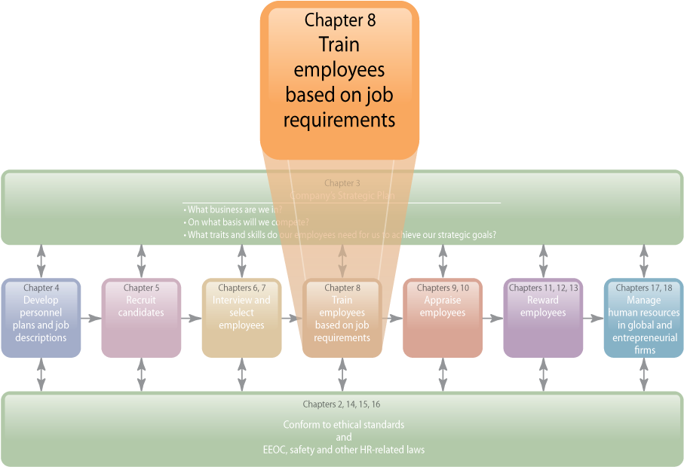
WHERE WE ARE NOW…
Copyright © 2011 Pearson Education, Inc. publishing as Prentice Hall
8–<number>
Notes:
Human Resources Management 12e
Gary Dessler
Copyright © 2011 Pearson Education, Inc. publishing as Prentice Hall
8–<number>
The purpose of this chapter is to increase your effectiveness in training employees. The main topics we’ll cover include orienting employees, the training process, analyzing training needs, implementing training and development programs, and evaluating the training effort.

Slide 3
LEARNING OUTCOMES
Summarize the purpose and process
of employee orientation.
List and briefly explain each of the four steps in the training process.
Discuss how you would motivate trainees.
Describe and illustrate how you would identify training requirements.
Explain how to distinguish between problems you can fix with training and those you can’t.
Explain how to use five training techniques.
Copyright © 2011 Pearson Education, Inc. publishing as Prentice Hall
8–<number>
Notes:
Human Resources Management 12e
Gary Dessler
Copyright © 2011 Pearson Education, Inc. publishing as Prentice Hall
8–<number>

Slide 4
LEARNING OUTCOMES (cont’d)
List and briefly discuss four management development programs.
List and briefly discuss the importance of the eight steps in leading organizational change.
Answer the question, “What is organizational development and how does it differ from traditional approaches to organizational change?”
Copyright © 2011 Pearson Education, Inc. publishing as Prentice Hall
8–<number>
Notes:
Human Resources Management 12e
Gary Dessler
Copyright © 2011 Pearson Education, Inc. publishing as Prentice Hall
8–<number>

Slide 5
Purpose of Orientation
Orientation Helps New Employees
Feel welcome and at ease
Understand the organization
Know what is expected in work and behavior
Begin the socialization process
Copyright © 2011 Pearson Education, Inc. publishing as Prentice Hall
8–<number>
Notes:
Human Resources Management 12e
Gary Dessler
Copyright © 2011 Pearson Education, Inc. publishing as Prentice Hall
8–<number>
Employee orientation (often called “onboarding” today) provides new employees with the information they need to function; ideally, though, it should also help new employees start getting emotionally attached to the firm.

Slide 6
The Orientation Process
Employee benefit information
Company organization and operations
Employee Orientation
Personnel
policies
Safety measures
and regulations
Daily
routine
Facilities
tour
Copyright © 2011 Pearson Education, Inc. publishing as Prentice Hall
8–<number>
Notes:
Human Resources Management 12e
Gary Dessler
Copyright © 2011 Pearson Education, Inc. publishing as Prentice Hall
8–<number>
An orientation typically includes information on employee benefits, personnel policies, the daily routine, company organization and operations, safety measures and regulations, and a facilities tour.

Slide 7
The Training Process
Training
  Is the process of teaching new employees
  the basic skills they need to perform their jobs
  Is a hallmark of good management
  Reduces an employer’s exposure to negligent training liability
Training’s Strategic Context
  The aims of firm’s training programs must make sense in terms of the company’s strategic goals.
  Training fosters employee learning, which results in enhanced organizational performance.
Copyright © 2011 Pearson Education, Inc. publishing as Prentice Hall
8–<number>
Notes:
Human Resources Management 12e
Gary Dessler
Copyright © 2011 Pearson Education, Inc. publishing as Prentice Hall
8–<number>
Training means giving new or current employees the skills they need to perform their jobs. Training is a hallmark of good management. Employers today must make sure that their training programs are supporting their firms’ strategic goals.

Slide 8
Steps in the Training Process
The Four-Step Training Process
1
Needs analysis
2
Instructional design
3
Program implementation
4
Evaluation
Copyright © 2011 Pearson Education, Inc. publishing as Prentice Hall
8–<number>
Notes:
Human Resources Management 12e
Gary Dessler
Copyright © 2011 Pearson Education, Inc. publishing as Prentice Hall
8–<number>
Training programs consist of four steps.
In the needs analysis step, identify the specific knowledge and skills the job requires, and compare these with the prospective trainees’ knowledge and skills.
In the instructional design step, formulate specific, measurable knowledge and performance training objectives, review possible training program content (including workbooks, exercises, and activities), and estimate a budget for the training program.
Implement the program, by actually training the targeted employee group using methods such as on-the-job or online training.
In the evaluation step, assess the program’s success (or failures).

Slide 9
Training, Learning, and Motivation
Make the Learning Meaningful
  At the start of training, provide a bird’s-eye view
  of the material to be presented to facilitate learning.
  Use a variety of familiar examples.
  Organize the information so you can present it logically, and in meaningful units.
  Use terms and concepts that are already familiar
  to trainees.
  Use as many visual aids as possible.
  Create a perceived training need in trainees’ minds.
Copyright © 2011 Pearson Education, Inc. publishing as Prentice Hall
8–<number>
Notes:
Human Resources Management 12e
Gary Dessler
Copyright © 2011 Pearson Education, Inc. publishing as Prentice Hall
8–<number>

Slide 10
Training, Learning, and Motivation (cont’d)
Make Skills Transfer Easy
  Maximize the similarity between the training situation and the work situation.
  Provide adequate practice.
  Label or identify each feature of the machine
  and/or step in the process.
  Direct the trainees’ attention to important aspects
  of the job.
  Provide “heads-up,” preparatory information that lets trainees know what might happen back on
  the job.
Copyright © 2011 Pearson Education, Inc. publishing as Prentice Hall
8–<number>
Notes:
Human Resources Management 12e
Gary Dessler
Copyright © 2011 Pearson Education, Inc. publishing as Prentice Hall
8–<number>

Slide 11
Training, Learning, and Motivation (cont’d)
Reinforce the Learning
  Trainees learn best when the trainers immediately reinforce correct responses, perhaps with a quick
  “well done.”
  The schedule is important. The learning curve goes down late in the day, so that “full day training is not as effective as half the day or three-fourths of the day.”
Copyright © 2011 Pearson Education, Inc. publishing as Prentice Hall
8–<number>
Notes:
Human Resources Management 12e
Gary Dessler
Copyright © 2011 Pearson Education, Inc. publishing as Prentice Hall
8–<number>

Slide 12
Analyzing Training Needs
Training Needs Analysis
Task Analysis:
Assessing new employees’ training needs
Performance Analysis: Assessing current employees’ training needs
Copyright © 2011 Pearson Education, Inc. publishing as Prentice Hall
8–<number>
Notes:
Human Resources Management 12e
Gary Dessler
Copyright © 2011 Pearson Education, Inc. publishing as Prentice Hall
8–<number>
Task analysis is a detailed study of the job to determine what specific skills the job requires. Performance analysis is the process of verifying that there is a performance deficiency and determining whether the employer should correct such deficiencies through training or some other means (like transferring the employee).

Slide 13

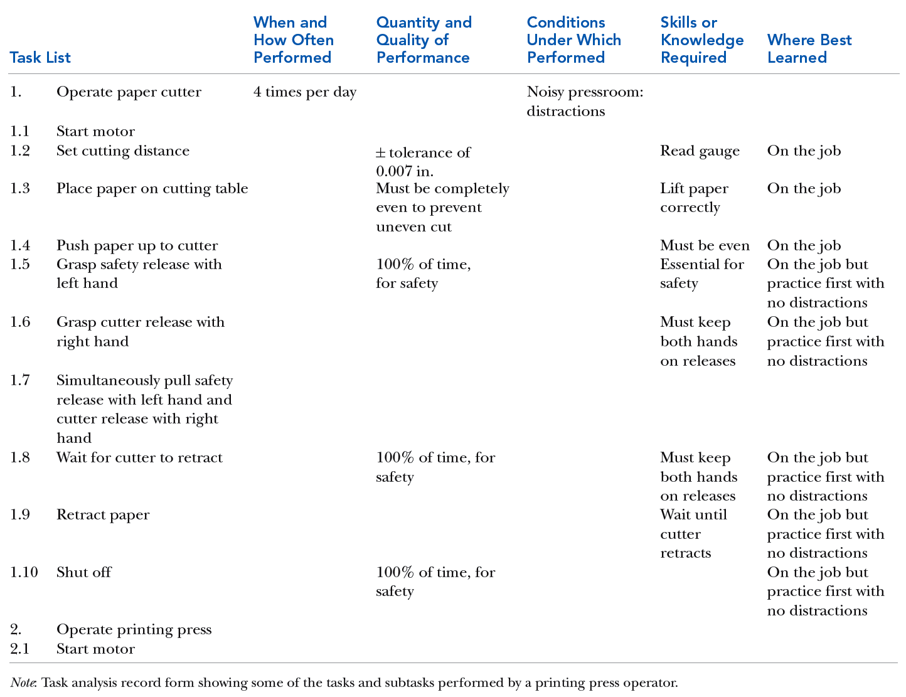
TABLE 8–1 Sample Task Analysis Record Form
Copyright © 2011 Pearson Education, Inc. publishing as Prentice Hall
8–<number>
Notes:
Human Resources Management 12e
Gary Dessler
Copyright © 2011 Pearson Education, Inc. publishing as Prentice Hall
8–<number>
As Table 8-1 illustrates, the task analysis record form consolidates six types of information regarding required tasks and skills that is helpful for determining training requirements.

Slide 14
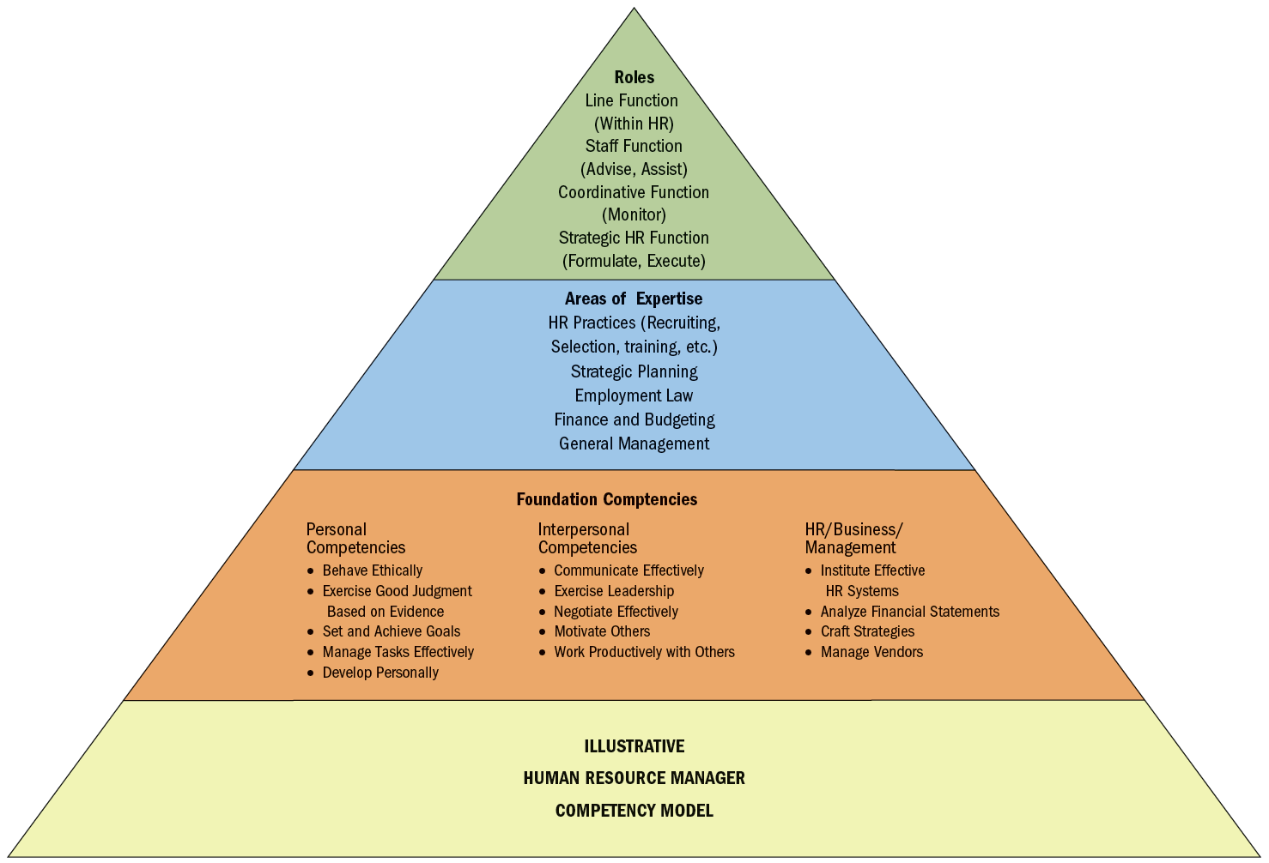
FIGURE 8–2 Example of Competency Model for Human Resource Manager
Copyright © 2011 Pearson Education, Inc. publishing as Prentice Hall
8–<number>
Notes:
Human Resources Management 12e
Gary Dessler
Copyright © 2011 Pearson Education, Inc. publishing as Prentice Hall
8–<number>
The competency model consolidates, usually in one diagram, a precise overview of the competencies (knowledge, skills, and behaviors) someone would need to do a job well. As an example, Figure 8-2 shows an illustrative competency model for a human resource manager.
In this case, the model shows three things: At the top of the pyramid, it shows four roles we would expect the human resource manager to fill—line, staff, coordinative, and strategic. Beneath that, it shows the areas of expertise in which he or she must be expert to fill these roles, such as an expertise in HR practices and strategic planning. Next step down are basic competencies one would need to exhibit the required expertise and to fill the HR manager’s roles.

Slide 15
Performance Analysis:
Assessing Current Employees’ Training Needs
Specialized Software
Assessment Center Results
Performance Appraisals
Methods
for Identifying Training Needs
Individual Diaries
Job-Related Performance Data
Attitude Surveys
Observations
Tests
Interviews
Can’t-do or Won’t-do?
Copyright © 2011 Pearson Education, Inc. publishing as Prentice Hall
8–<number>
Notes:
Human Resources Management 12e
Gary Dessler
Copyright © 2011 Pearson Education, Inc. publishing as Prentice Hall
8–<number>
Performance analysis is the process of verifying that there is a performance deficiency and determining whether the employer should correct such deficiencies through training or other means (motivation).
The heart of performance analysis is determining why performance is down. It is futile to train an employee whose work actually is deficient because of insufficient motivation. Distinguishing between can’t-do and won’t-do problems is therefore crucial.

Slide 16

Training Methods
On-the-Job Training
Apprenticeship Training
Informal Learning
Job Instruction Training
Lectures
Programmed Learning
Audiovisual-Based Training
Vestibule Training (Simulated Learning)
Teletraining and Videoconferencing
Electronic Performance Support Systems (EPSS)
Computer-Based Training (CBT)
Internet-Based Training
Learning Portals
Copyright © 2011 Pearson Education, Inc. publishing as Prentice Hall
8–<number>
Notes:
Human Resources Management 12e
Gary Dessler
Copyright © 2011 Pearson Education, Inc. publishing as Prentice Hall
8–<number>
With the program designed and budgeted and objectives set, you can turn to implementing the training program. This means actually doing the training, choosing and using one or more of the simpler, low-tech methods and, then perhaps, proceeding on to computer-based ones.

Slide 17

The OJT Training Method
On-the-Job Training (OJT)
  Having a person learn a job
  by actually doing the job.
Types of On-the-Job Training
  Coaching or understudy
  Job rotation
  Special assignments
Advantages
  Inexpensive
  Learn by doing
  Immediate feedback
Copyright © 2011 Pearson Education, Inc. publishing as Prentice Hall
8–<number>
Notes:
Human Resources Management 12e
Gary Dessler
Copyright © 2011 Pearson Education, Inc. publishing as Prentice Hall
8–<number>
On-the-job training (OJT) means having a person learn a job by actually doing it. Every employee, from mailroom clerk to CEO, gets on-the-job training when he or she joins a firm. In many firms, OJT is the only training available.

Slide 18
On-the-Job Training
Steps to Help Ensure OJT Success
1
Prepare the learner
2
Present the operation
3
Do a tryout
4
Follow up
Copyright © 2011 Pearson Education, Inc. publishing as Prentice Hall
8–<number>
Notes:
Human Resources Management 12e
Gary Dessler
Copyright © 2011 Pearson Education, Inc. publishing as Prentice Hall
8–<number>
Don’t take the success of an on-the-job training effort for granted. Train the trainers themselves (often the employees’ supervisors), and provide the training materials. Trainers should know, for instance, the principles of motivating learners.
Because low expectations on the trainer’s part may translate into poor trainee performance, supervisors/trainers should emphasize the high expectations they have for their trainees’ success.

Slide 19
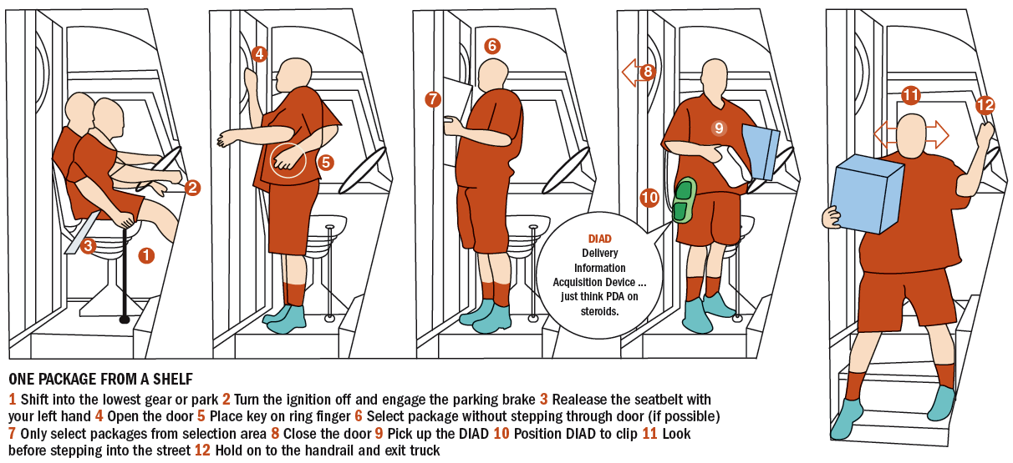
FIGURE 8–4 Job Instruction Training at UPS
Copyright © 2011 Pearson Education, Inc. publishing as Prentice Hall
8–<number>
Notes:
Human Resources Management 12e
Gary Dessler
Copyright © 2011 Pearson Education, Inc. publishing as Prentice Hall
8–<number>
Many jobs (or parts of jobs) consist of a logical sequence of steps that one best learns step-by-step. This step-by-step training is called job instruction training (JIT). Figure 8-4 shows the step-by-step graphical instructions UPS uses to train new drivers in how to park their trucks and disembark.

Slide 20
Delivering Effective Lectures
Don’t start out on the wrong foot.
Give your listeners signals.
Be alert to your audience.
Maintain eye contact with audience.
Make sure everyone in the room can hear.
Control your hands.
Talk from notes rather than from a script.
Break a long talk into a series of five-minute talks.
Practice and rehearse your presentation.
Copyright © 2011 Pearson Education, Inc. publishing as Prentice Hall
8–<number>
Notes:
Human Resources Management 12e
Gary Dessler
Copyright © 2011 Pearson Education, Inc. publishing as Prentice Hall
8–<number>
Lecturing is a quick and simple way to present knowledge to large groups of trainees, as when the sales force needs to learn a new product’s features. Here are some guidelines for presenting a lecture.

Slide 21
Programmed Learning
Presenting questions, facts, or problems to the learner
Allowing the person to respond
Providing feedback on
the accuracy
of answers
Advantages
  Reduced training time
  Self-paced learning
  Immediate feedback
  Reduced risk of error for learner
Copyright © 2011 Pearson Education, Inc. publishing as Prentice Hall
8–<number>
Notes:
Human Resources Management 12e
Gary Dessler
Copyright © 2011 Pearson Education, Inc. publishing as Prentice Hall
8–<number>
Programmed learning (or programmed instruction) is a step-by-step, self-learning method that consists of three parts.

Slide 22

Intelligent Tutoring Systems
Advantages
  Reduced learning time
  Cost effectiveness
  Instructional consistency
Types of Programmed Learning
  Interactive multimedia training
  Virtual reality training
  Virtual classroom
Copyright © 2011 Pearson Education, Inc. publishing as Prentice Hall
8–<number>
Notes:
Human Resources Management 12e
Gary Dessler
Copyright © 2011 Pearson Education, Inc. publishing as Prentice Hall
8–<number>
Intelligent tutoring systems are computerized, supercharged, programmed instruction programs. In addition to the usual programmed learning, intelligent tutoring systems learn what questions and approaches worked and did not work for the learner, and therefore adjust the suggested instructional sequence to the trainee’s unique needs.

Slide 23
TABLE 8–2 Names of Various Computer-Based Training Techniques
PI Computer-based programmed instruction
CBT Computer-based training
CMI Computer-managed instruction
ICAI Intelligent computer-assisted instruction
ITS Intelligent tutoring systems
Simulation Computer simulation
Virtual Reality Advanced form of computer simulation
Copyright © 2011 Pearson Education, Inc. publishing as Prentice Hall
8–<number>
Notes:
Human Resources Management 12e
Gary Dessler
Copyright © 2011 Pearson Education, Inc. publishing as Prentice Hall
8–<number>
Table 8-2 summarizes the main terminology of computer-based training.

Slide 24
Internet-Based Training
Teletraining and Videoconferencing
Distance Learning Methods
Electronic Performance Support
Systems (EPSS)
Computer-Based Training
E-learning and learning portals
Copyright © 2011 Pearson Education, Inc. publishing as Prentice Hall
8–<number>
Notes:
Human Resources Management 12e
Gary Dessler
Copyright © 2011 Pearson Education, Inc. publishing as Prentice Hall
8–<number>
Learning management systems (LMS) play an important role in Internet training. They are special software packages that support Internet training by helping employers identify training needs, and in scheduling, delivering, assessing, and managing the online training itself.

Slide 25

FIGURE 8–5 Partial List of E-Learning Vendors
Copyright © 2011 Pearson Education, Inc. publishing as Prentice Hall
8–<number>
Notes:
Human Resources Management 12e
Gary Dessler
Copyright © 2011 Pearson Education, Inc. publishing as Prentice Hall
8–<number>
When an employer contracts with applications service providers (ASP) like those listed in Figure 8-5, employees can go to their firm’s learning portal to access a menu of training courses that the ASP company contracted with the employer to offer.

Slide 26

All rights reserved. No part of this publication may be reproduced, stored in a retrieval system, or transmitted, in any form or by any means, electronic, mechanical, photocopying, recording, or otherwise, without the prior written permission of the publisher. Printed in the United States of America.
Copyright © 2011 Pearson Education, Inc. publishing as Prentice Hall
8–<number>
Notes:
Human Resources Management 12e
Gary Dessler
Copyright © 2011 Pearson Education, Inc. publishing as Prentice Hall
8–<number>

