Slide 1

Fundamentals of
Data Warehouse
Project
Airlines Management
By Umera Noor Mohammed Syed
Group 108158-1

Slide 2
Airlines Management
Airlines represent a complex web of interconnected systems—from flight scheduling and passenger bookings to logistics and operational precision. By delving into this domain, we gain insights into the challenges and intricacies of managing a dynamic and fast-paced industry.

Slide 3
Passengers
Star Schema
Flight
Booking
Airlines management
Price
Aircraft
Services
Cabin Class

Slide 4

Star Schema
A star schema is a type of data warehouse schema where a central fact table is connected to one or more dimension tables
Understandability
Ease of Maintenance
Optimized for analytics
Scalability
Enhanced Business Performance
Why Star Schema ?

Slide 5
DIMENSION
DIMENSION
DIMENSION
Price
Price_ID
Currency
Base_Price
Tax_Amount
Discount_Amt
Total_Price
DIMENSION
Cabin_Class
Class_ID
Class_Name
Seat_Num
Availability_Status
Passenger
PAX_ID
PAX_Name
PAX_Age
PAX_Gender
PAX_phoneNum
PAX_EmailID
Loyalty_Points
FACT TABLE
Flight
Flight_ID
Flight_Num
Flight_Date
Depart_Airport
Arrival_Airport
Depart_Time
Arrival_Time
Gate_Num
Booking
Booking_ID
PAX_ID
Flight_ID
Class_ID
Service_ID
Price_ID
Aircraft_ID
Booking_Date
Booking_Status
DIMENSION
DIMENSION
Services
Service_ID
Priority_Boarding
Lounge_Access
Baggage_Option
Meal_Service
InFlight_Media
Aircraft
Aircraft_ID
Aircraft_Name
Aircraft_Type
Aircraft_Model
Aircraft_Capacity
Manufacturer

Slide 6
Generate data using OpenAI API
Data Processing & Formatting
Importing to Microsoft SQL Server
Create Visualization
Next Steps to Follow
Generate synthetic data for each tables in our database
Converted to .csv files for database
compatibility.
Import each .csv files to SSMS
SQL Queries and Python codes to create visualizations

Slide 7
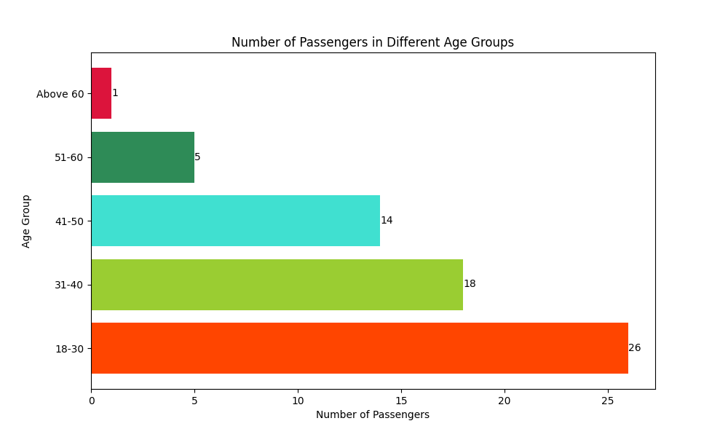

Slide 8
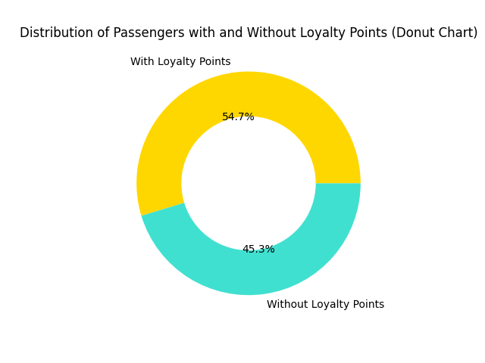

Slide 9
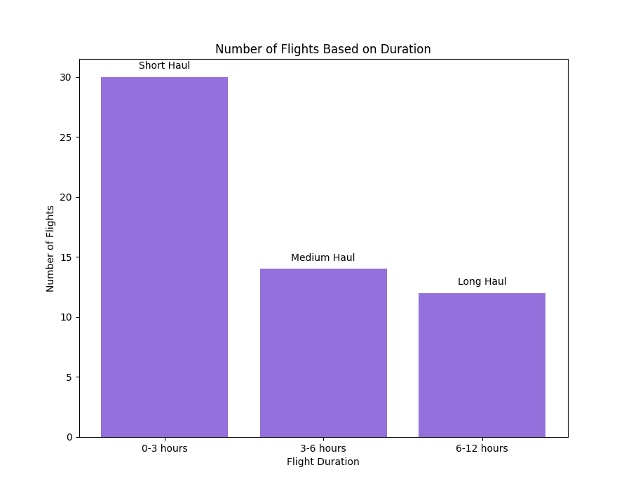

Slide 10
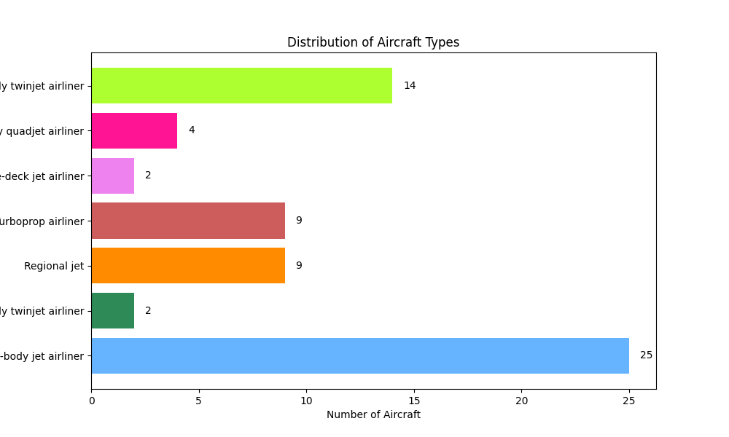

Slide 11
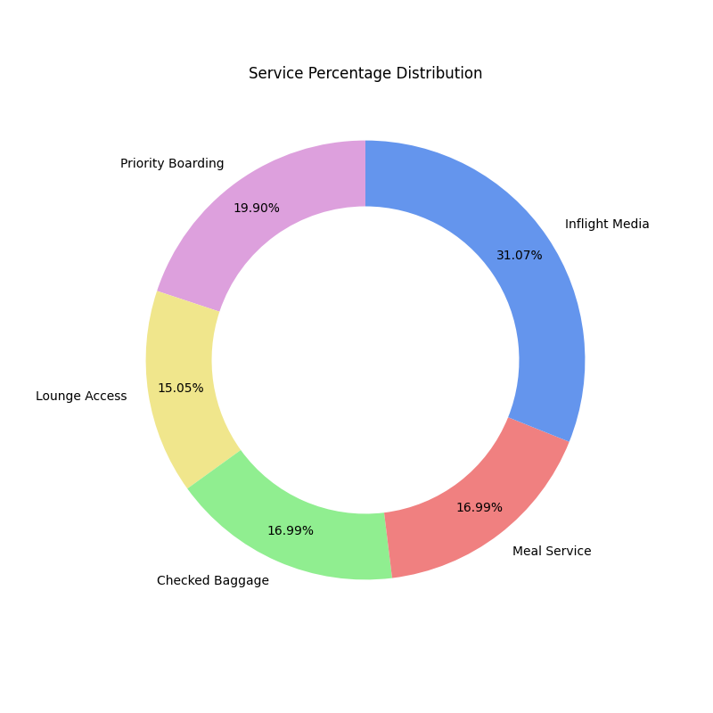
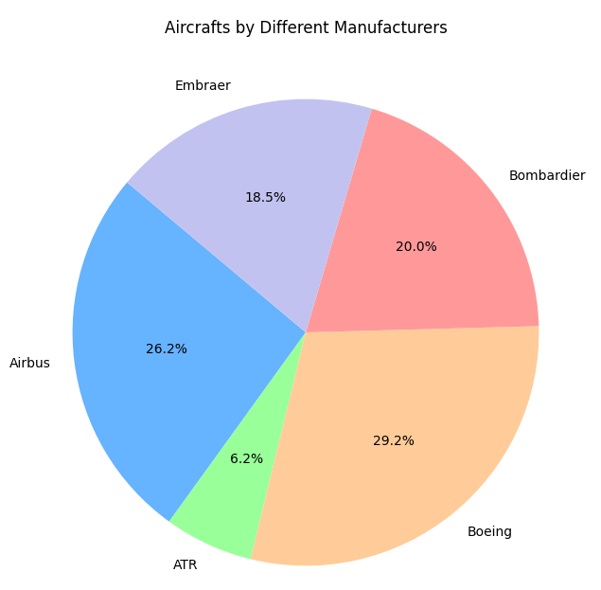

Slide 12
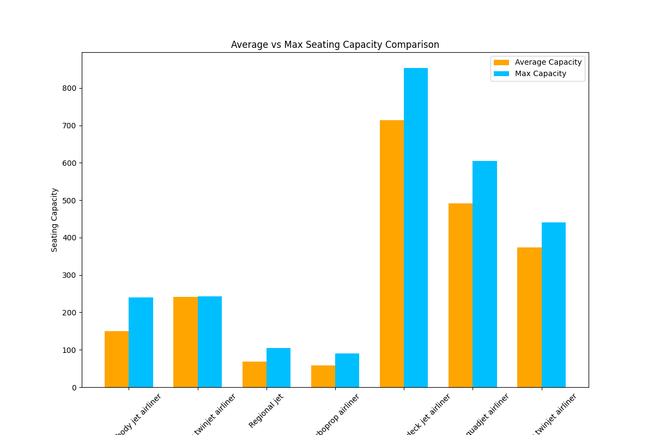

Slide 13




CONCLUSIONS
We will draw some conclusions based on the SQL queries as well as the visualization graphs
54.7 %
Average age of Male passengers is 42 &
Average age of Female passengers is 27
of total passengers are frequent flyers of this airline
Most of the flights are short haul (1 to 3 hours of duration)
Amsterdam, Los Angeles, Lima and Buenos Aires, are some of the popular destinations

Slide 14








USD, EUR, CAD, AUD are the most preferred currencies
Average prices
AUD 447.22
CAD 429.58
EUR 404.66
USD 449.13
This fleet has aircrafts with higher than average seating capacities.
Boeing is the most preferred manufacturer of our airline, followed by Airbus and Bombardier
Most popular months for booking are March and February, followed by May, January, April and lastly June.
This means most travelers prefer the winter and spring seasons as compared to summer.
51.25 % of total passengers opted for Priority Boarding
38.75 % opted for Lounge Access
43.75% opted for Checked Baggage
43.75% opted for Meal Service
80% opted for In-Flight Media

Slide 15

This marks the end of my presentation.
Thank you.

