Slide 1
Wireframes, Mockups & Prototypes Online Pizza Ordering System QCCPIZZA
WEB DEVELOPMENT TEAM
Web Design Capstone Project
ET712 SPRING 2018
TEAM 1
Umer Farooq
Marc Crisostomo
James Reyes

Slide 2
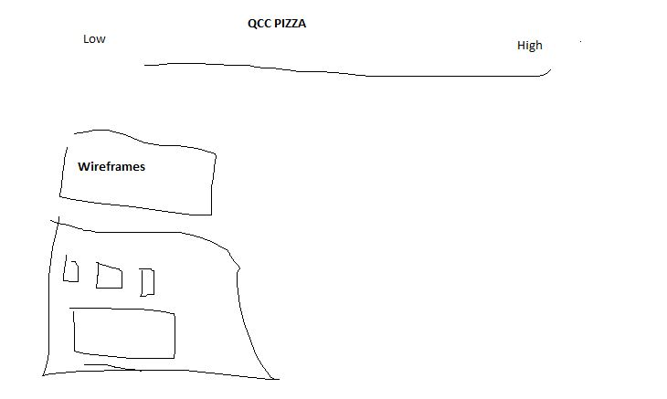
Wireframes

Slide 3
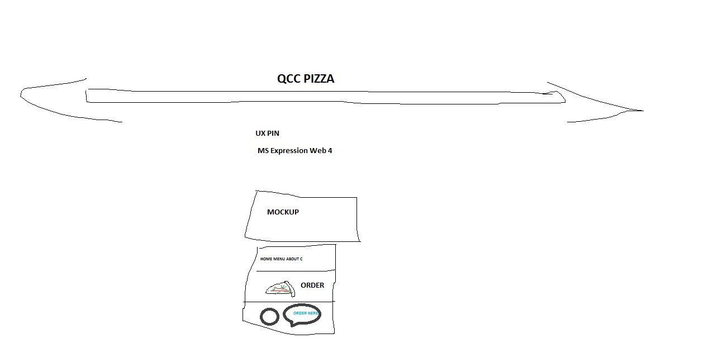
Mockups

Slide 4
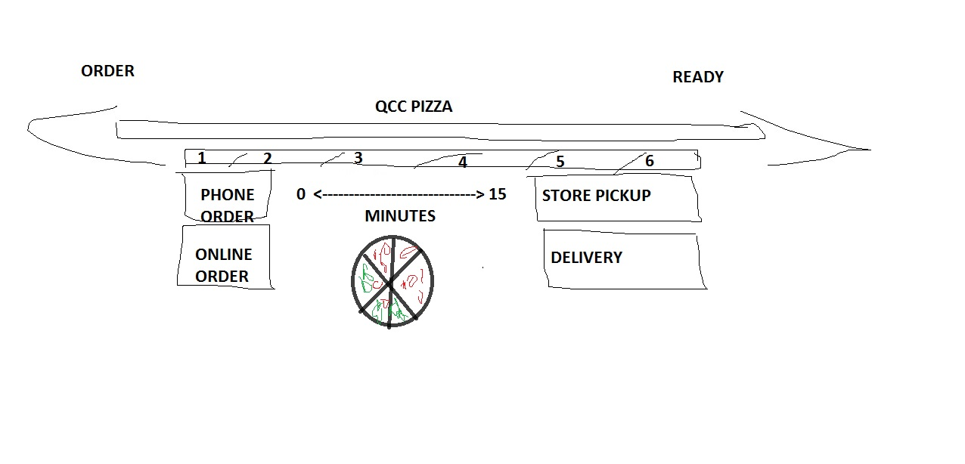
PROTYPE

Slide 5
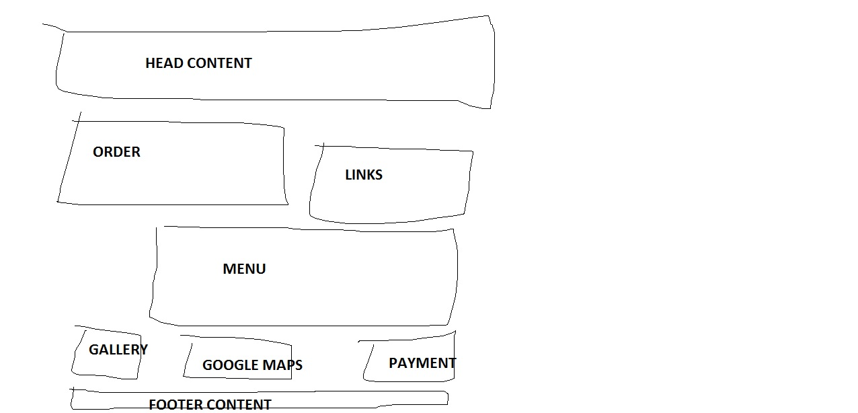
Wireframe QCCPIZZA

Slide 6
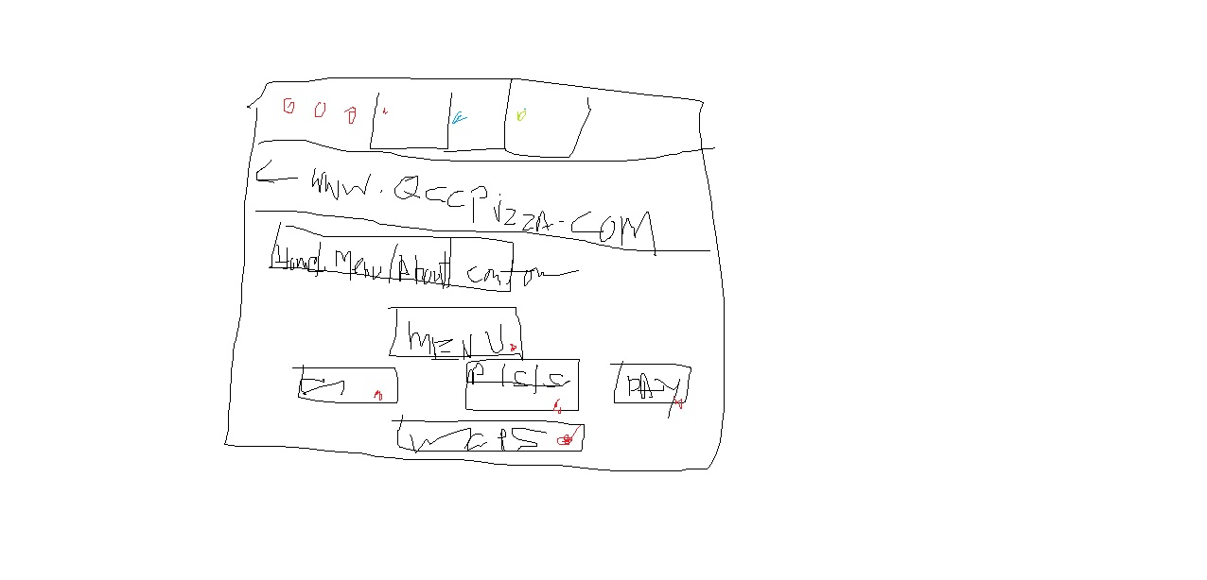
Allow Quantity Filtering

Slide 7
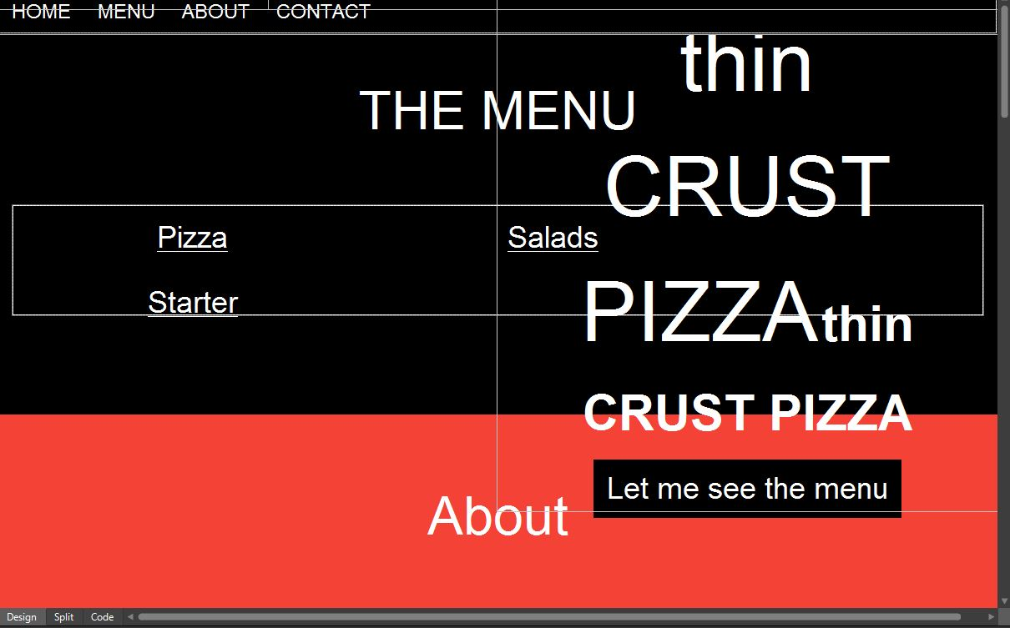
Mockup QCCPIZZA

Slide 8
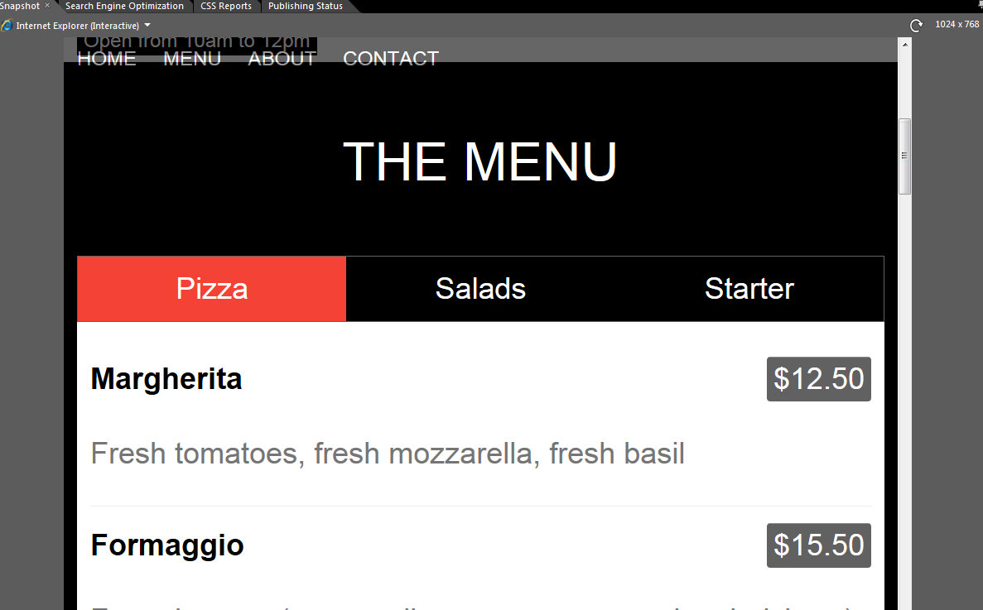
Searching Menu

Slide 9
Allow Google MAP API
document.getElementById("myLink").click();
</script>
<script src="https://www.google.com/maps/place/Gaby's+Pizza/@40.7211784,-73.7606885,15z/data=!4m2!3m1!1s0x0:0xc87b858882c31101?sa=X&ved=0ahUKEwje5KnV7fTaAhWjuVkKHckgCb0Q_BIItgEwCg"></script>
<!--
To use this code on your website, get a free API key from Google.
Read more at: https://www.w3schools.com/graphics/google_maps_basic.asp
-->

Slide 10
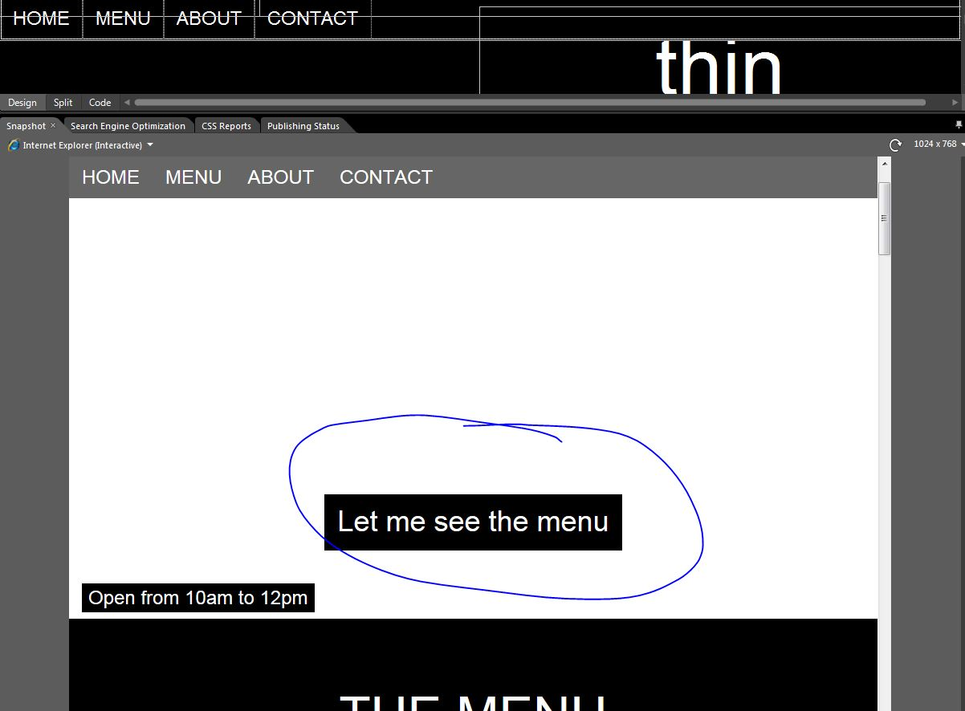
Allow Liking

Slide 11
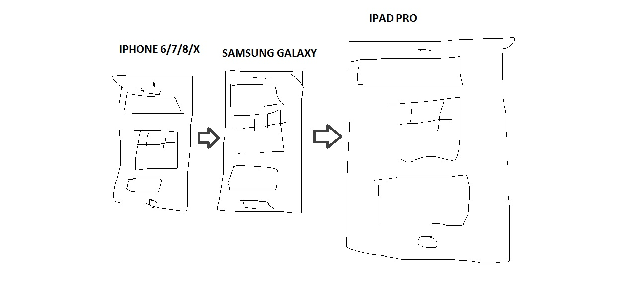
Wireframe a Delivery App iphone, Samsung, ipad

Slide 12
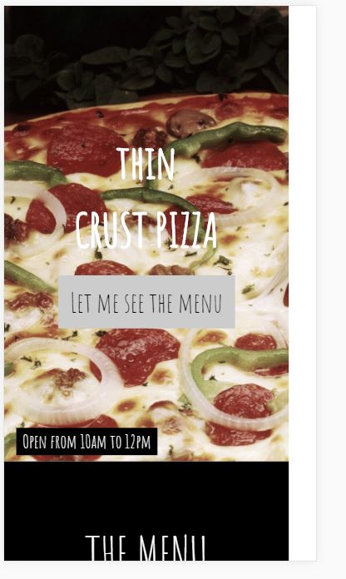
Delivery App Iphone 6/7/8/X

Slide 13
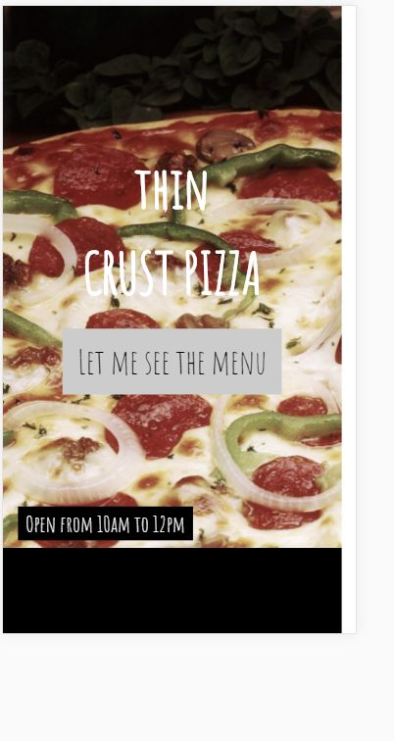
Delivery App Samsung Galaxy

Slide 14
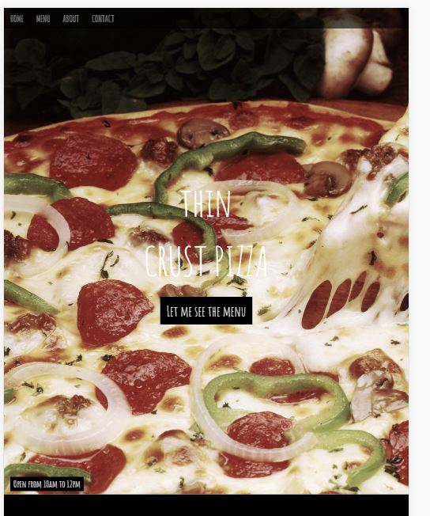
Delivery App Ipad Pro

