Slide 1
Simulink model for Unity Feedback Position control of Qube servo
Guided By : Dr. Debanjan Das
Umesh Sinha
211010252
Sanjiv Kushwaha
211010246
Soumya Rayast
211010248
Department Of Electronics and Communication
International Institute of Information Technology, Naya Raipur

Slide 2
Outlines
Introduction
Goal
Block Diagram Of The Entire System
Mathematical Modelling Of System
Overall Transfer Function Of The Model
Characteristic Equation
R-H Criteria
PID block after and before tuning
Output of step input
Desired Specifications In Time Domain Range
*
International Institute of Information Technology, Naya Raipur
‹#›

Slide 3
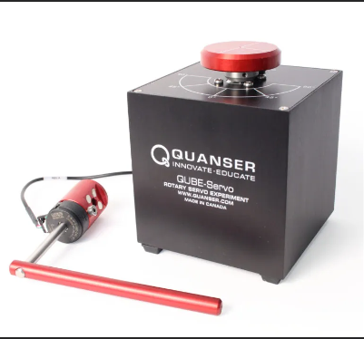
Introduction
The Qube Servo is a popular and versatile motor control solution used in a variety of applications, including robotics, automation, and industrial control systems. One of the key features of the Qube Servo is its ability to be controlled using a variety of feedback mechanisms, including position control.
Position control is a fundamental aspect of many motor control applications, as it enables precise control over the position of a motor or actuator. In the context of the Qube Servo, position control involves using feedback from an encoder or other position sensing device to adjust the motor's position in real-time.

Slide 4
Goal:
To control the position of qube servo 02 (SRV02) with unity feedback control system.
Design a PID controller that can accurately control the position of the Qube servo motor.
To get familiar with the PID controller which help to control the response of system to get desired Output.
*
International Institute of Information Technology, Naya Raipur
‹#›

Slide 5
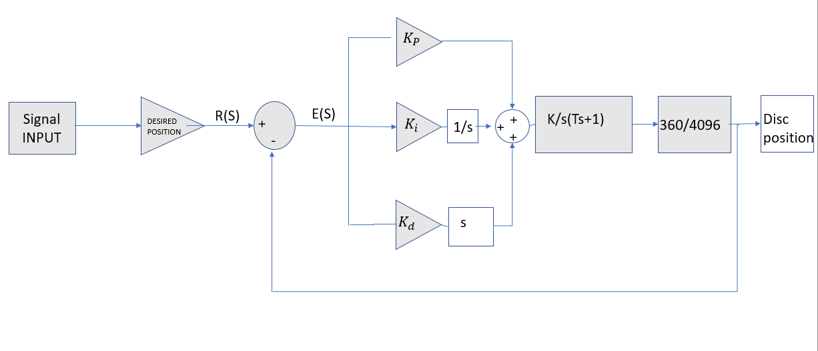
Block Diagram Of The Entire System :
*
International Institute of Information Technology, Naya Raipur
‹#›

Slide 6
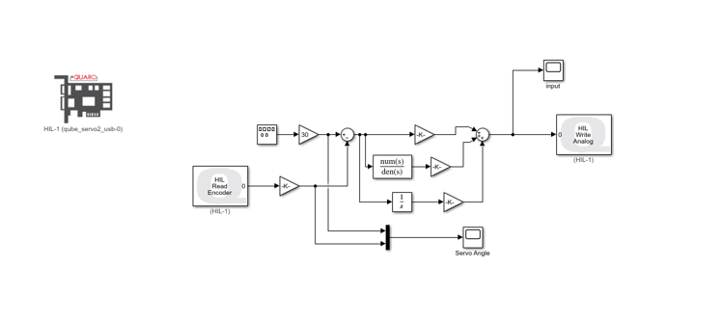
Simulink Model

Slide 7
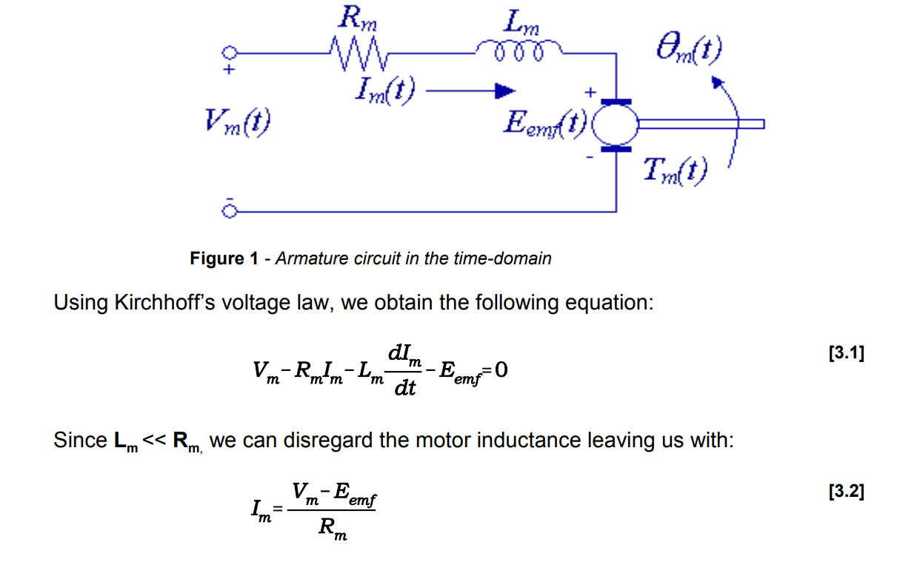
Mathematical modelling
*
International Institute of Information Technology, Naya Raipur
‹#›

Slide 8
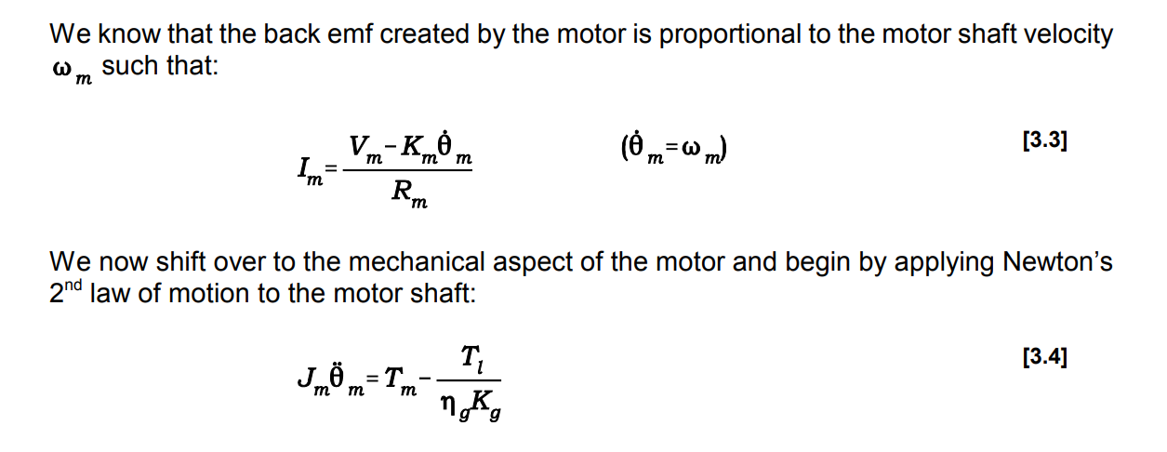
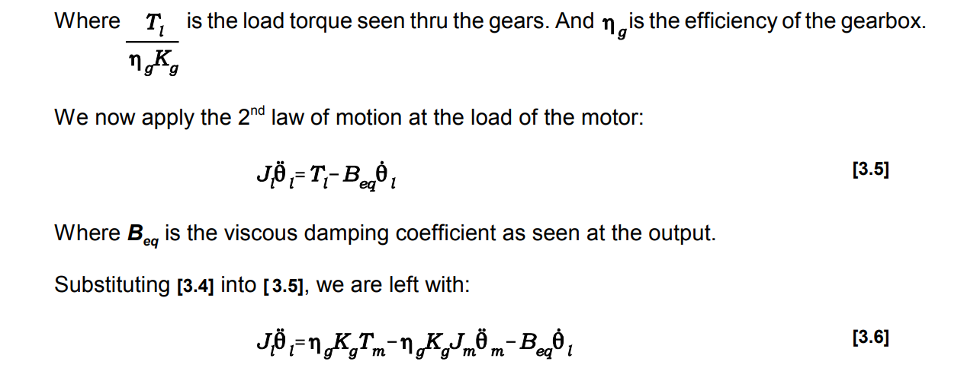
*
International Institute of Information Technology, Naya Raipur
‹#›

Slide 9
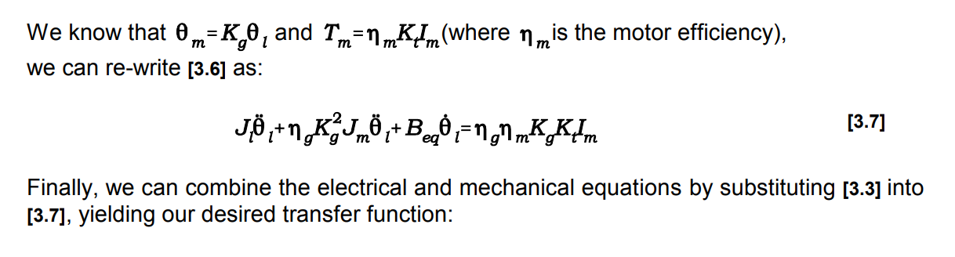
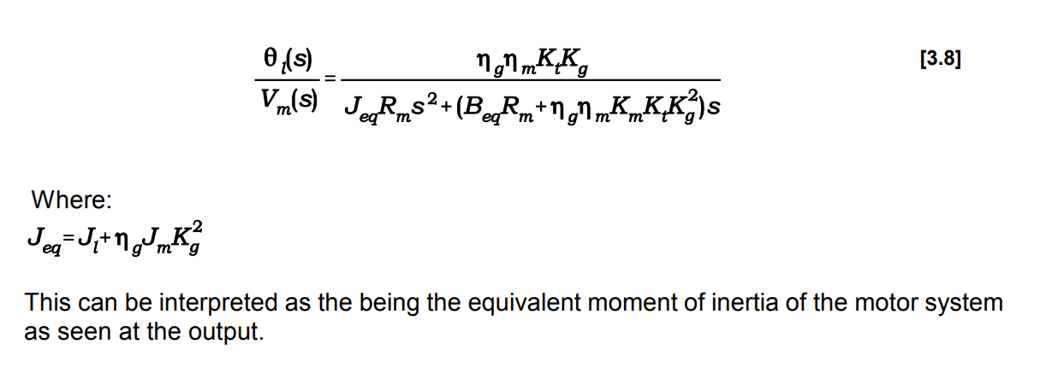
*
International Institute of Information Technology, Naya Raipur
‹#›
Notes:
total=10
TOTAL=999
print(total) #10
print(TOTAL) #999

Slide 10
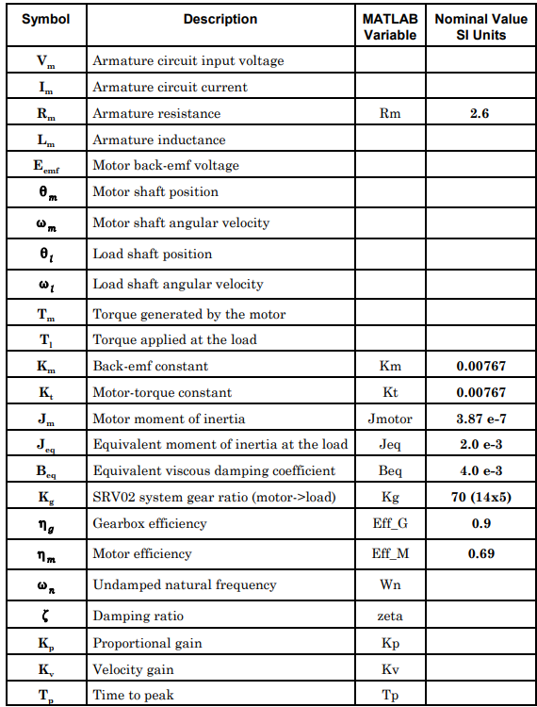

Slide 11


On putting values of parameters of qube servo motor we get transfer function:
= 0.33/0.26S^2 +0.7S
Overall transfer function Of the system :
= (1.08S^2 + 3.895S + 2.437)/(0.26S^3 + 1.78S^2 + 3.9S +2.43)
*
International Institute of Information Technology, Naya Raipur
‹#›

Slide 12
R-H Criteria
Characteristic Equation = 0.26S^3 + 1.78S^2 + 3.9S +2.43
S^3 | 0.26 | 3.9
S^2 | 1.78 | 2.43
S^1 | 3.544 | 0
S^0 | 2.43
All values are positive so system is stable
Stability range k > 0

Slide 13
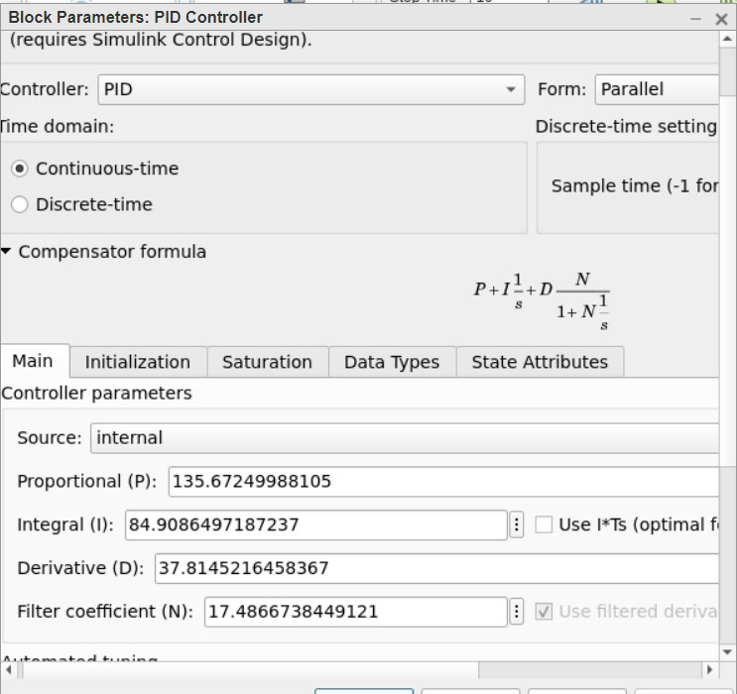
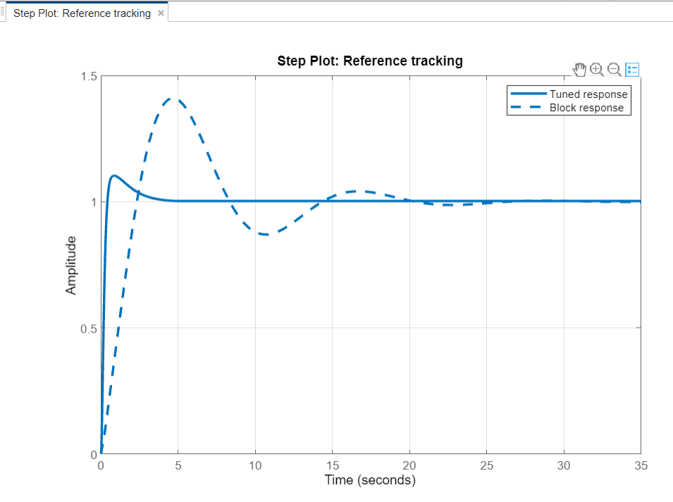
Simulink Simulation:
*
International Institute of Information Technology, Naya Raipur
‹#›

Slide 14
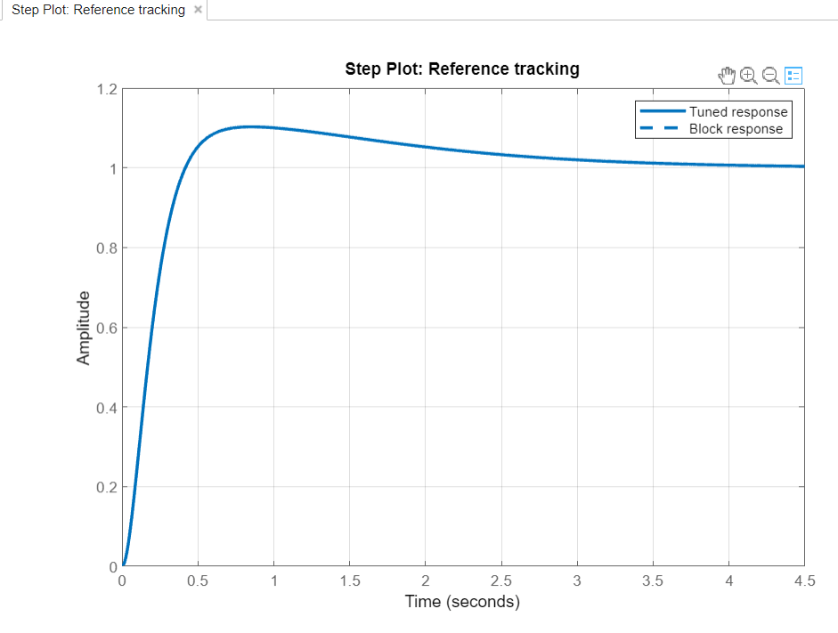
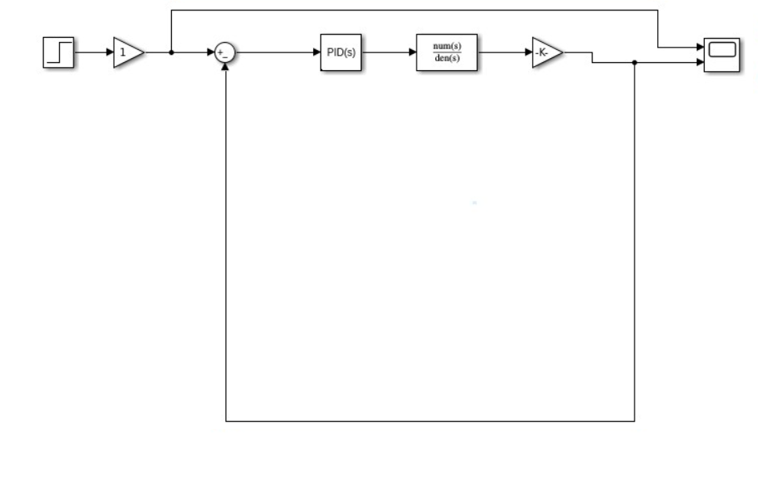
*
International Institute of Information Technology, Naya Raipur
‹#›

Slide 15
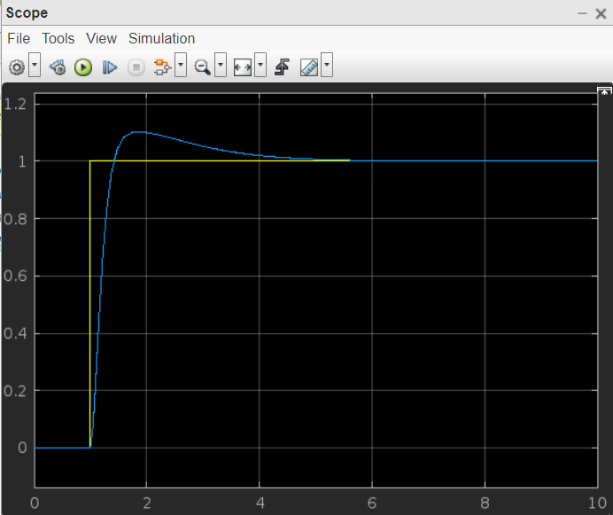
Response at a Step input :

Slide 16
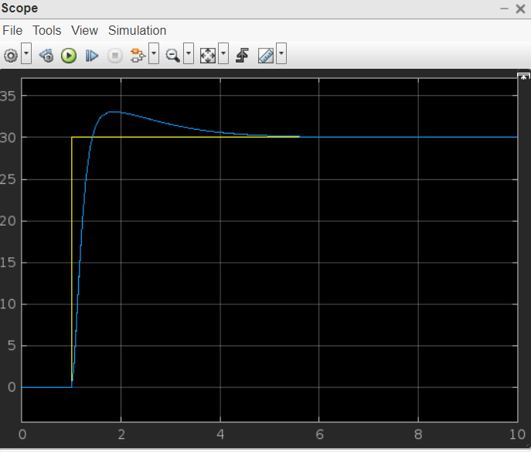
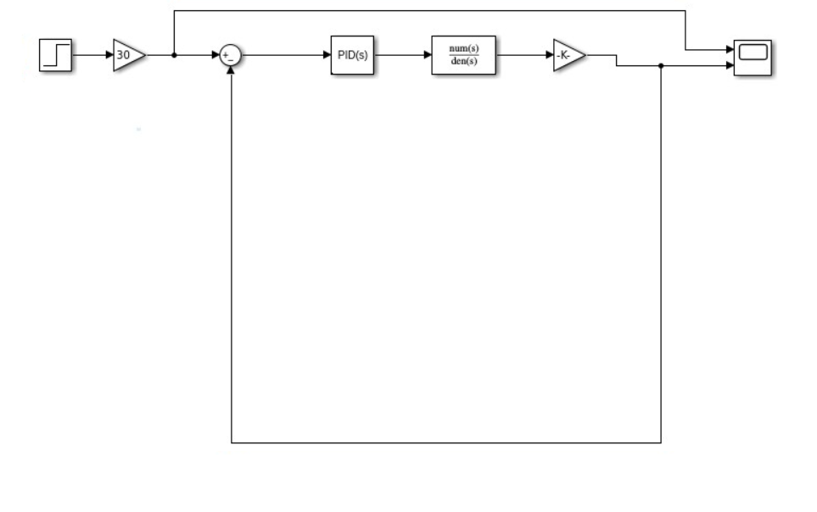
Response at a particular angle :
*
International Institute of Information Technology, Naya Raipur
‹#›

Slide 17
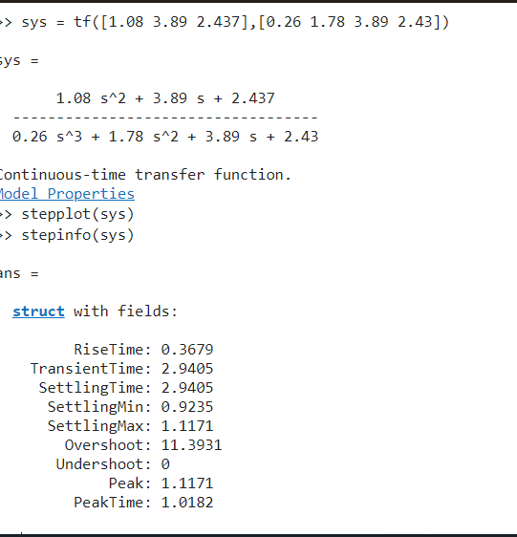
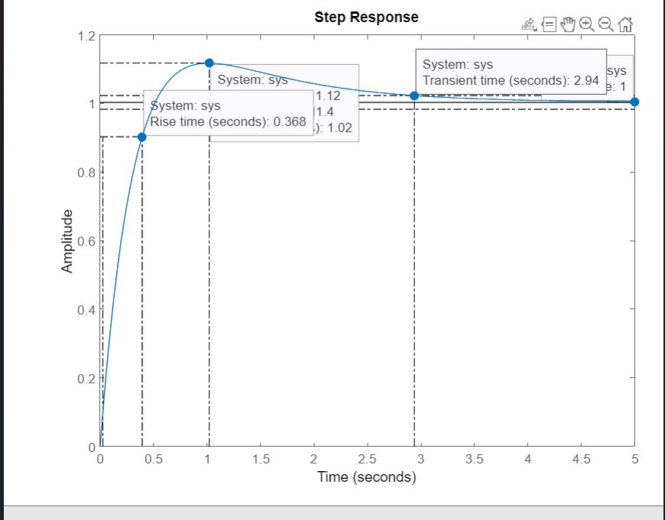
Time domain specification for step input:
*
International Institute of Information Technology, Naya Raipur
‹#›
Notes:
Eg:
1) >>> f=0B11.01
2) File "<stdin>", line 1
3) f=0B11.01
4) ^
5) SyntaxError: invalid syntax
6)
7) >>> f=0o123.456
8) SyntaxError: invalid syntax
9)
10) >>> f=0X123.456
11) SyntaxError: invalid syntax

Slide 18
In conclusion, the project "Unity Feedback Position Control of Quanser Qube Servo using PID Controller" successfully implemented a PID controller to regulate the position of the Quanser Qube Servo. The PID controller was designed and tuned using MATLAB/Simulink, and the results were validated through experiments on the physical system.
The implementation of the PID controller provided stable and accurate position control of the Quanser Qube Servo, with minimal overshoot and settling time. The results of the experiments demonstrated the effectiveness of the PID controller in regulating the position of the system, and the controller was able to compensate for disturbances and maintain a steady-state position.

Slide 19
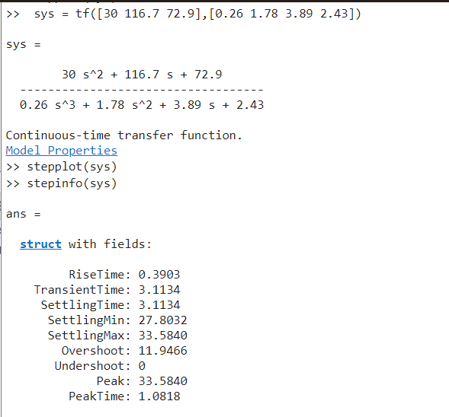
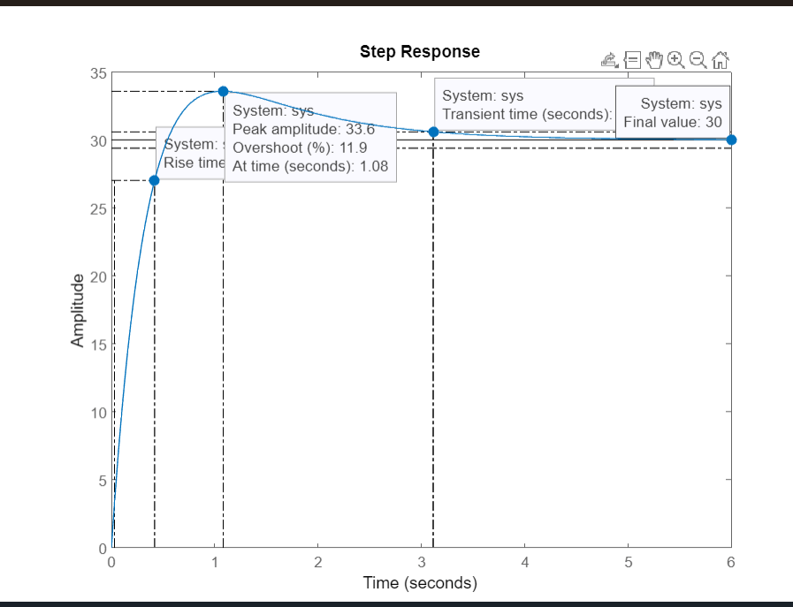
Time domain specification for particular angle:

Slide 20
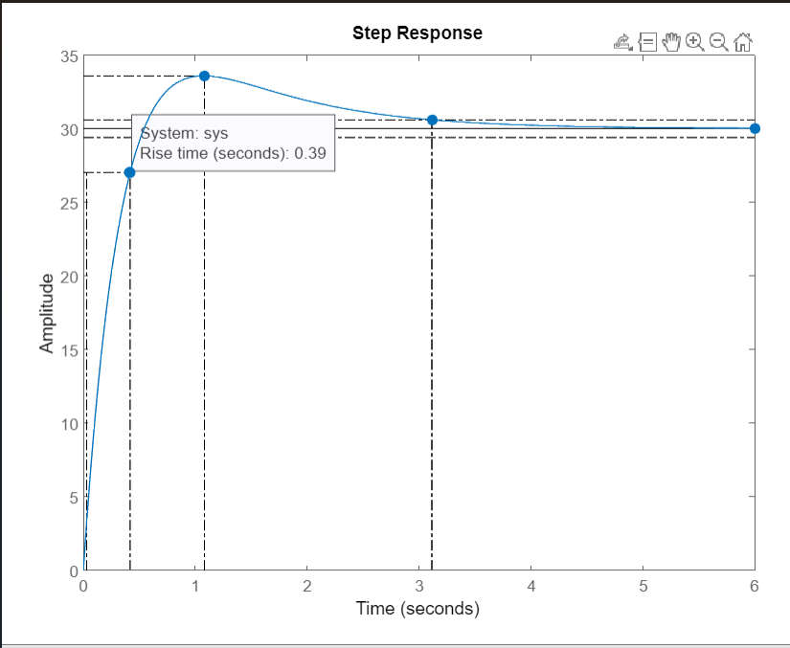

Slide 21
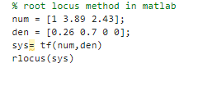
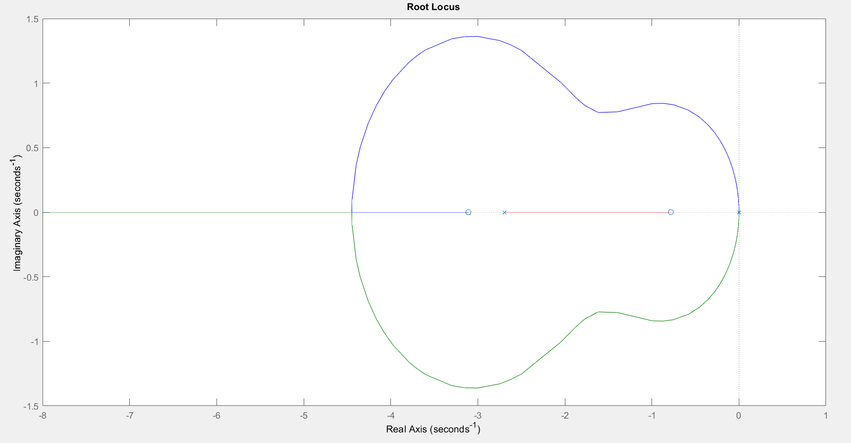
Root Locus
Root locus is a powerful tool for analyzing the stability and performance of a control system.The root locus provides valuable insights into the stability and performance of a control system.
By examining the root locus, one can determine the range of values of the parameter that will result in a stable closed-loop system.
In addition, the root locus provides information on the damping and natural frequency of the closed-loop poles, which are important indicators of the system's performance.

Slide 22
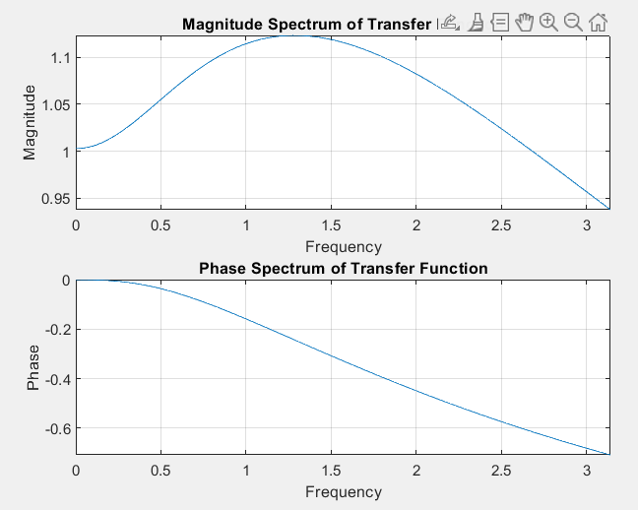
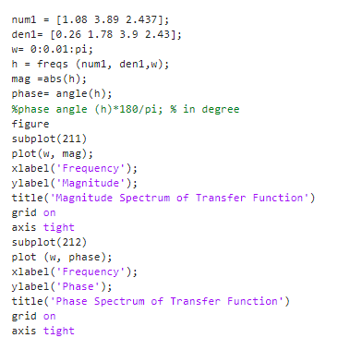
Frequency Response
A frequency response describes the steady-state response of a system to sinusoidal inputs of varying frequencies.
The frequency response is typically represented by a graph or plot that shows the gain or magnitude response and phase response of the system as a function of frequency. The gain response describes the amount of amplification or attenuation of the input signal by the system at each frequency, while the phase response describes the phase
shift or delay introduced by the system at each frequency.

Slide 23
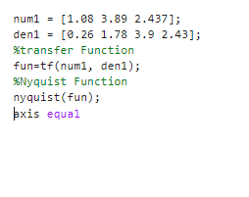
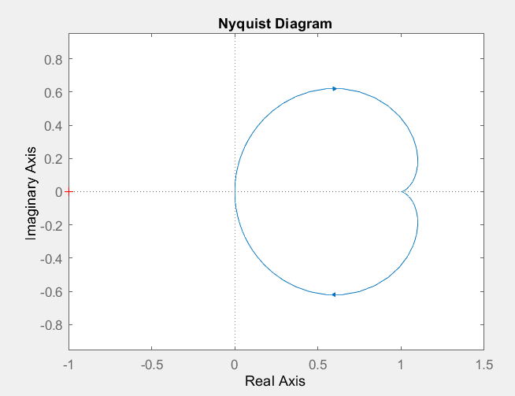
Nyquist Plot

Slide 24
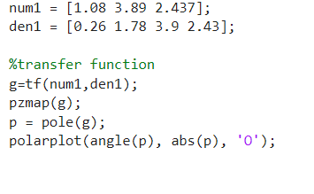
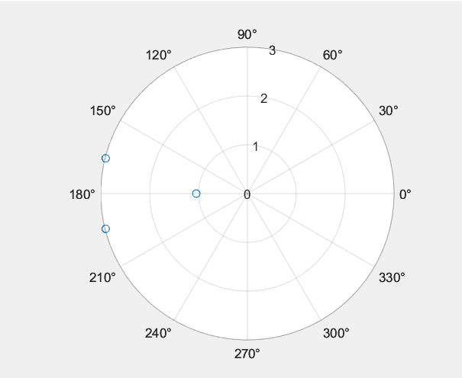
Polar Plot

Slide 25
Bode Plot
A Bode plot is a graphical representation of the frequency response of a linear, time-invariant (LTI) system.
It consists of two plots: one showing the magnitude response of the system and the other showing the phase response, both plotted as a function of frequency.
It allows us to quickly and easily determine the system's gain margin and phase margin, which are important indicators of stability.
The gain margin is the amount of additional gain that can be applied to the system before it becomes unstable, while the phase margin is the amount by which the phase of the system's output can be changed before it becomes unstable.

Slide 26
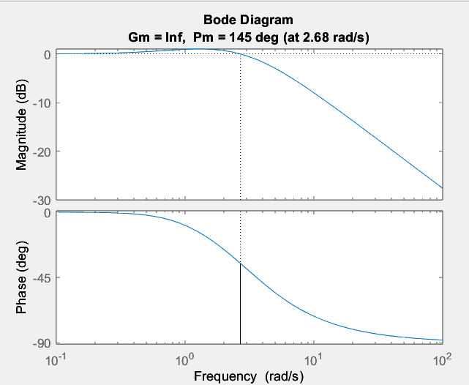
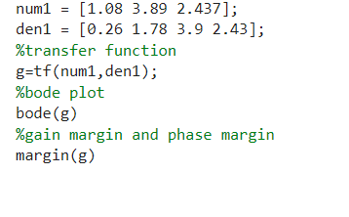
A gain margin of infinity (or "inf") means that the system has infinite gain at the frequency where the phase angle is -180 degrees (i.e., the frequency where the system is on the verge of becoming unstable). This indicates that the system is stable for all values of gain.
A phase margin of 145 degrees means that the phase angle of the system's open-loop transfer function is 35 degrees away from -180 degrees at the frequency where the gain is 1 (i.e., where the magnitude response of the system is 0 dB).
In general, a larger phase margin indicates a more stable system, while a smaller phase margin indicates a less stable system. Similarly, a larger gain margin indicates a more robust system, while a smaller gain margin indicates a less robust system.

Slide 27
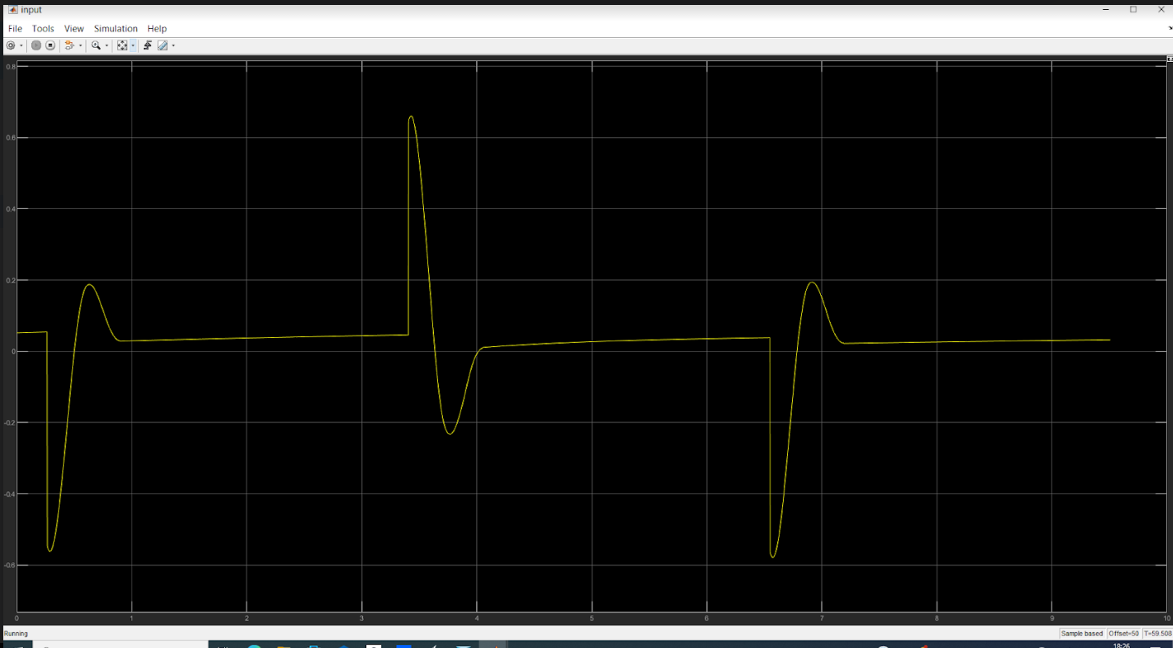
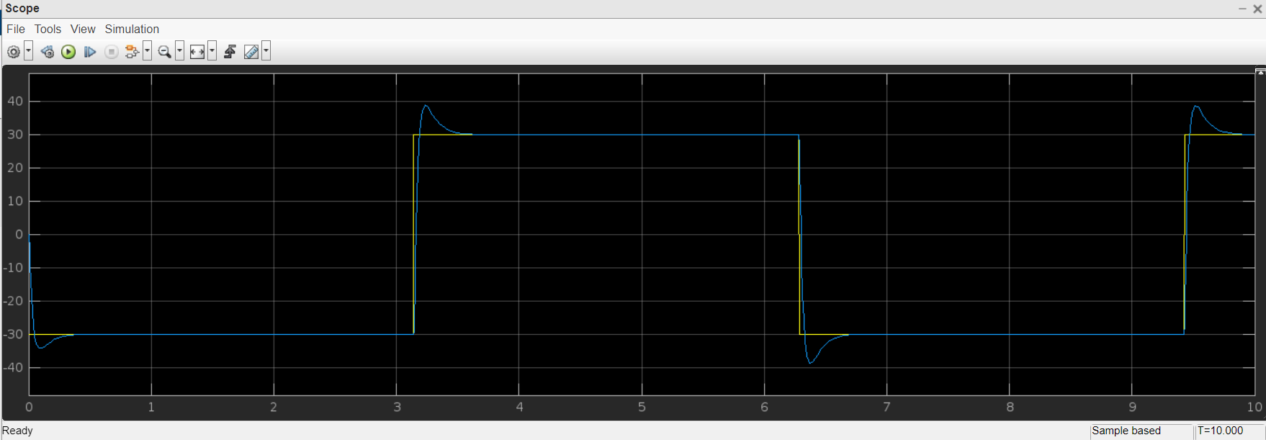
Input :
Output :

Slide 28

Thank You !
..
Dr. Shyama Prasad Mukherjee International Institute of Information Technology, Naya Raipur
*
‹#›
International Institute of Information Technology, Naya Raipur

