Slide 1
WSO2 Polling
Database Polling

Slide 2
What is DB Event Listener
Trigger an event with the data of table row when a new record is added or updated. Optionally, delete the row associated with the event after triggering the event
Trigger an event when a Boolean field is flipped in a particular table row.

Slide 3
Working of DB Event Listener
In an enterprise system, a relational database table is used to store customer information.
Customers' information is added by an external system to the database which is not in enterprise's control.
As soon as a new customer is inserted, the system need to pick up and process its data. WSO2 EI is used here to listen to DB changes and invoke the relevant processes.
It can invoke backend APIs or place data into a message bus after required data transformations. However, for simplicity of this example, we will just log the message.
You can extend the sample as required using WSO2 EI mediators.

Slide 4
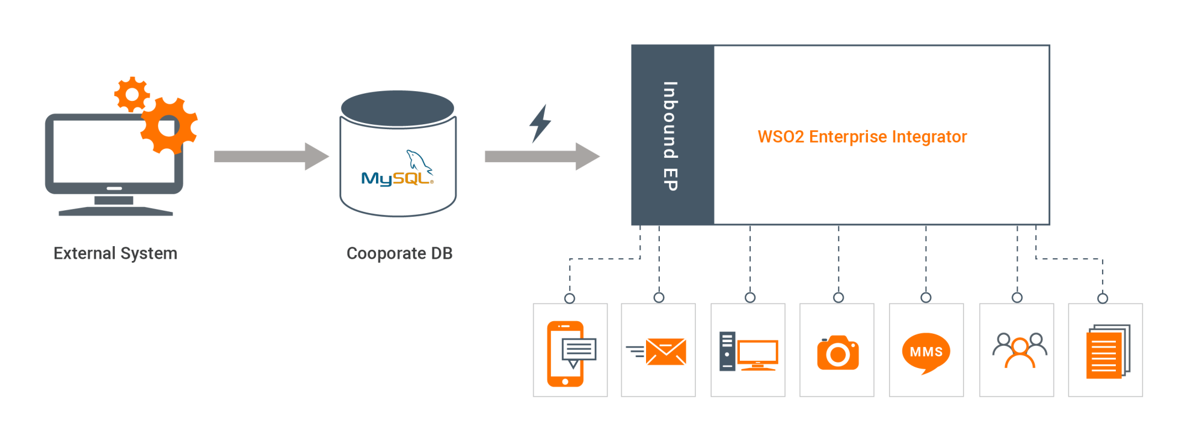
Working of DB Event Listener

Slide 5
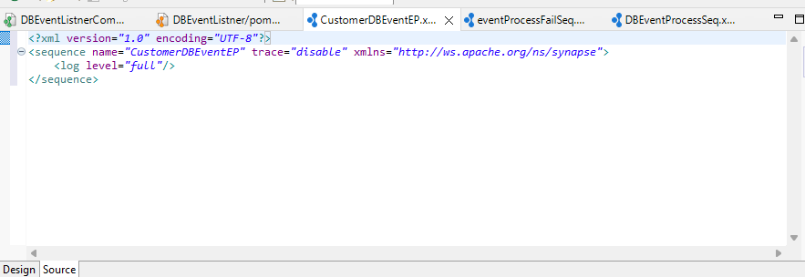
Create Process Sequence

Slide 6
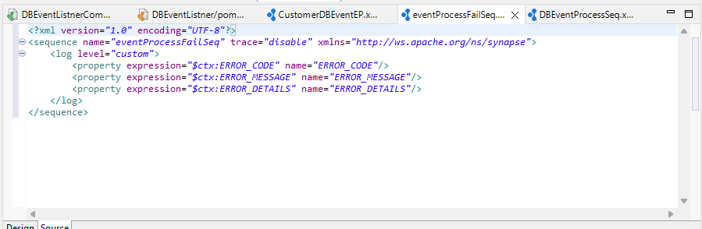
Create Error Sequence

Slide 7
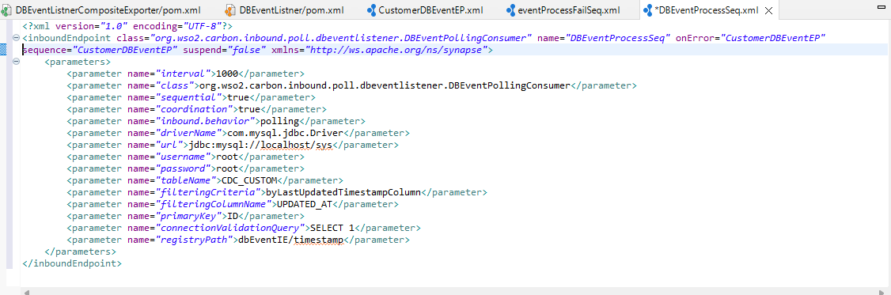
Create Inbound Endpoint

Slide 8
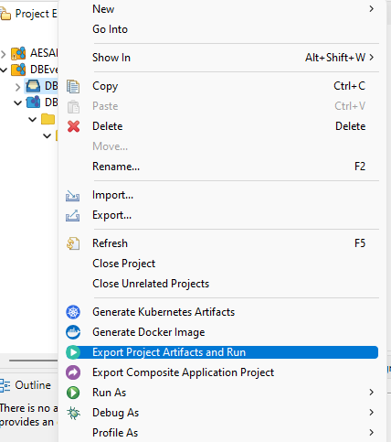
Run CAR File

Slide 9
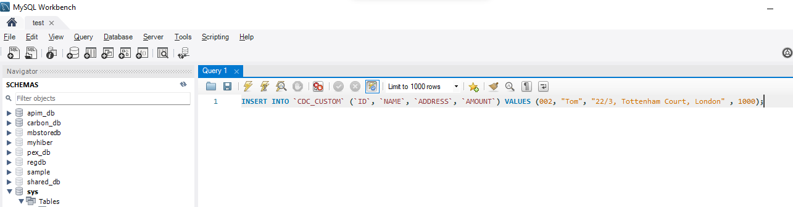
Insert Data into Table

Slide 10
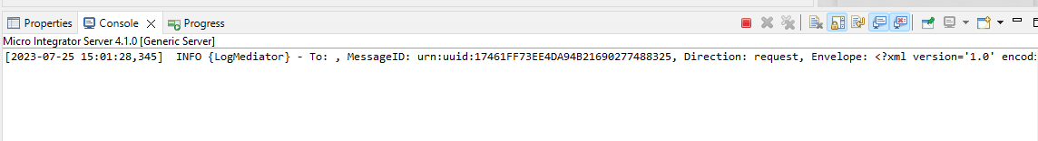
Check in Console

Slide 11


