Slide 1
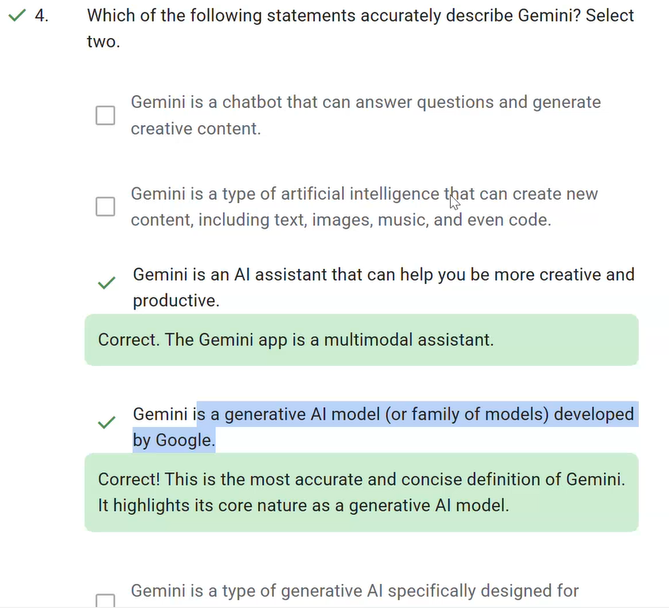

Slide 2
Generative AI is a type of artificial intelligence that helps users create new content and ideas, including text, images, music, and even code. Yet, the way you apply gen AI can come in different forms. It's a technology that can be integrated into different applications, not an application itself.
The Gemini app is Google’s generative AI chatbot, where you can get help with writing, planning, learning, and more. But the Gemini app is just that, an application. Gemini itself is actually one of Google’s gen AI models. Engineers use the Gemini model to build many applications, one of which is the Gemini App.
Gemini is also built into tools like Gemini for Looker to aid in analytics and Gemini in BigQuery to help you generate, explain, and troubleshoot your SQL queries and Python code. You can also use Gemini with various services in Google Cloud to automate the creation and modification of resources or to help you troubleshoot issues and suggest solutions.
MultiModal gen AI
Multimodal gen AI expands the capabilities of AI by allowing it to process and integrate different data types, like images, audio, and video, alongside text and numbers. This leads to a more complete and nuanced understanding of business processes, which is essential for solving complex problems.
Vertex AI Search is a Google Cloud service that allows developers to easily integrate advanced search capabilities into their applications. It's a fully managed, scalable service that can handle large volumes of multimodal data and complex search queries.

Slide 3
how gen AI actually works
It all starts with something called foundation models. Foundation models are large AI models trained on enormous data sets. This broad training allows them to develop a deep understanding of the data and be adapted to a wide range of downstream tasks. Understanding foundation models is crucial because they represent a paradigm shift in AI. They offer the potential to streamline processes, automate tasks, and unlock new possibilities across various business functions.
Artificial intelligence (AI) is when computer systems perform tasks that typically require human intelligence, such as understanding language or making decisions. This is often achieved through machine learning (ML), where systems learn from data to solve specific problems.
Traditionally, AI models were trained for a single purpose using specific data, like filtering spam emails from your inbox. Foundation models are different. They're trained on massive amounts of diverse data (text, images, and code), enabling them to adapt to many different tasks. This flexibility is what makes them so groundbreaking.
LLMs or large language models are probably the most famous type of foundation model. They are a specialized type of foundation model that focuses specifically on language.

Slide 4
How are foundation models used for gen AI?
Foundation models, like other AI models, take in inputs, which are called prompts, to produce outputs.
While all AI models have inputs or prompts, foundation models are usually much more flexible in what you can prompt. For example, some AI models have strict requirements on the type of inputs they can handle. They may only handle numbers, emails, or images.
Foundation models, and especially multimodal foundation models, can take in a much broader set of inputs.

Slide 5
Prompting inputs and outputs
What are these inputs and outputs? It might be easier to understand with some examples.
Input (prompt) | Output
Question | The answer to the question
Request for an image based on a text description | The image
Request a summary of a file | The file summary
Sample code with errors | Corrected code with no errors
The inputs you can prompt your foundation models on are endless. Depending on the foundation model, they can be versatile to many different forms of prompts.
Creating these prompts for your gen AI models is an art and a science in itself. There are lots of different techniques and methodologies to write better prompts. You may have heard of this referred to as prompting, prompt engineering, or prompt design.
Prompting is one of the most important skills in maximizing the value of gen AI models and tools.

Slide 6
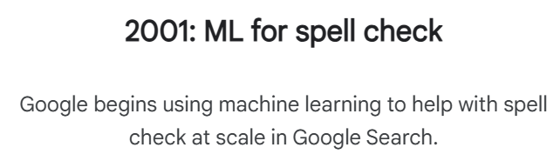
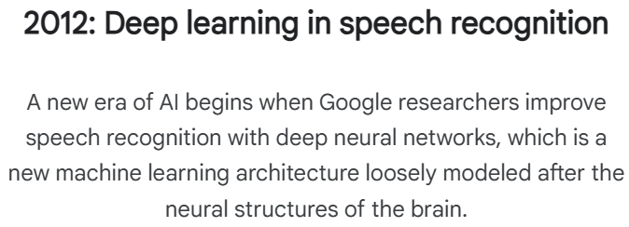
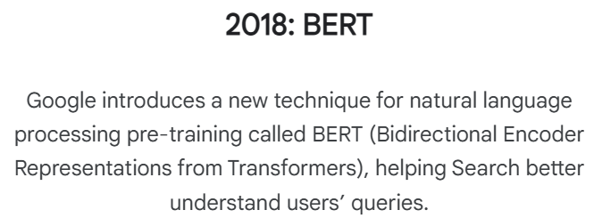
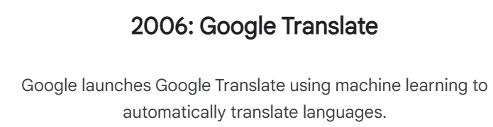

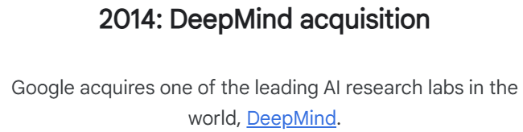
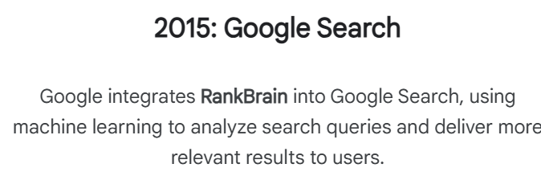
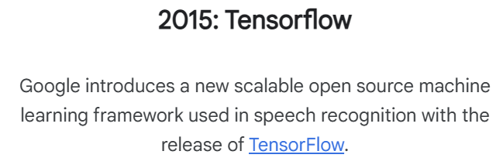
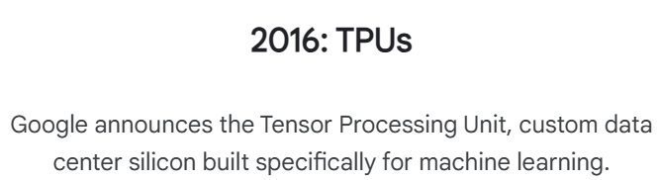
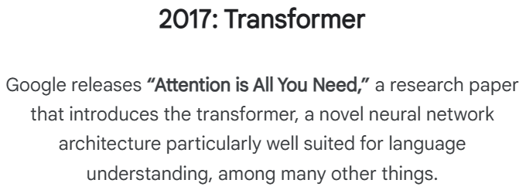
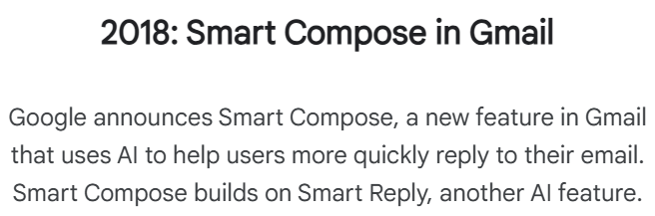

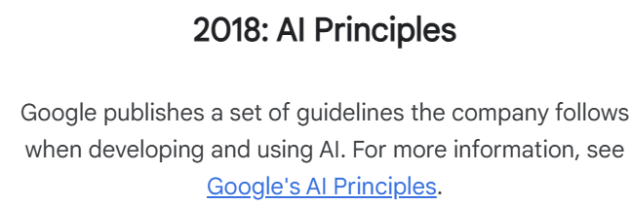
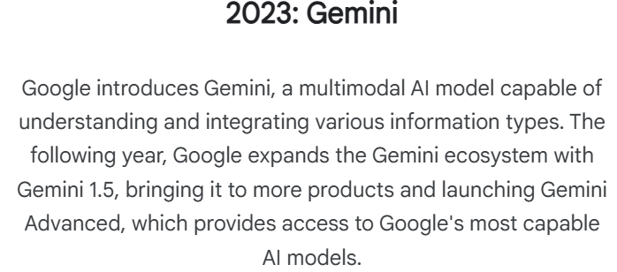

Slide 7
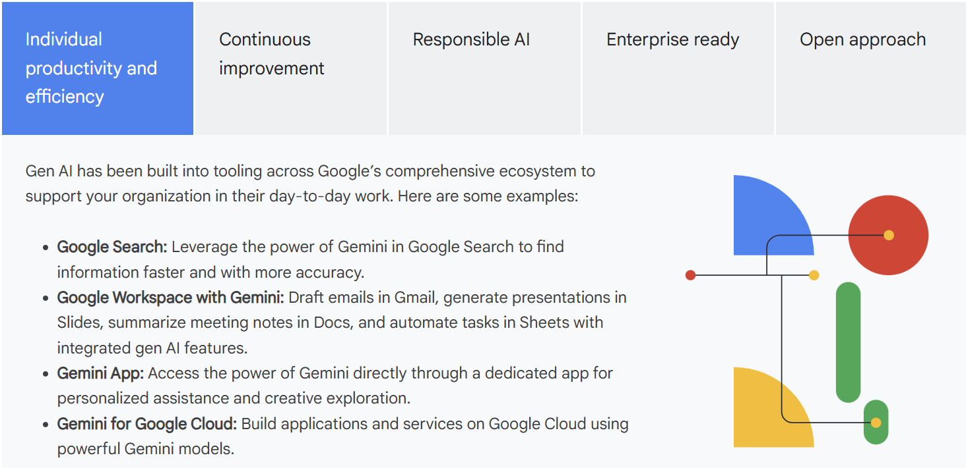

Slide 8
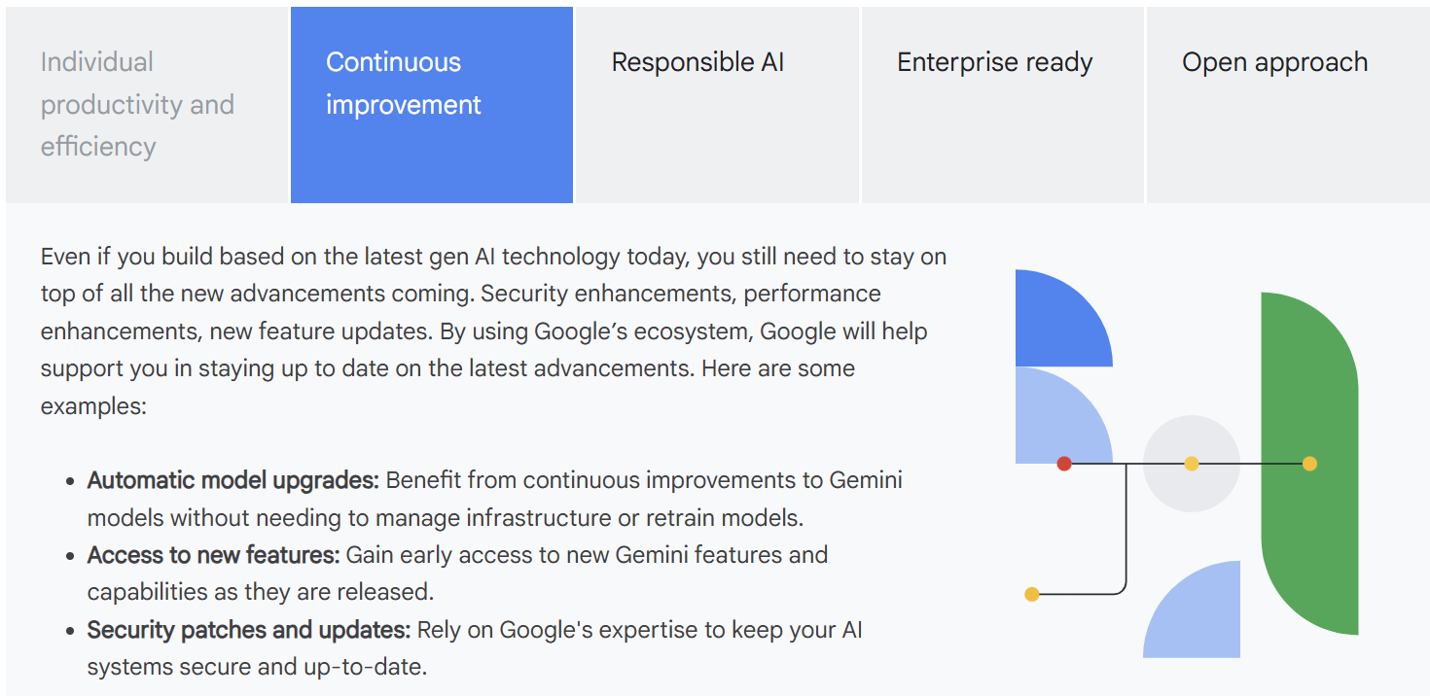

Slide 9
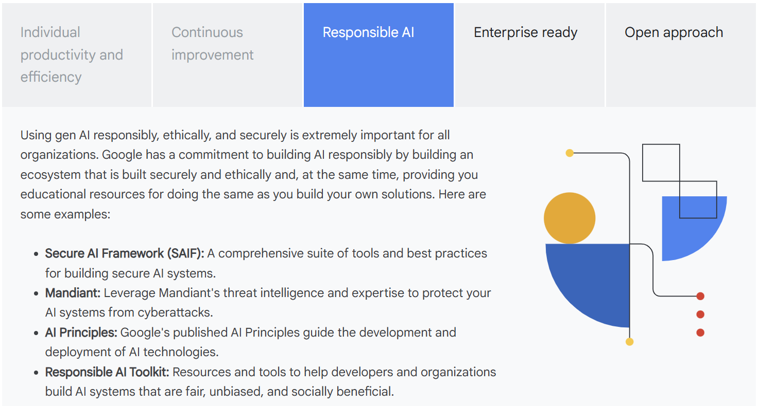

Slide 10
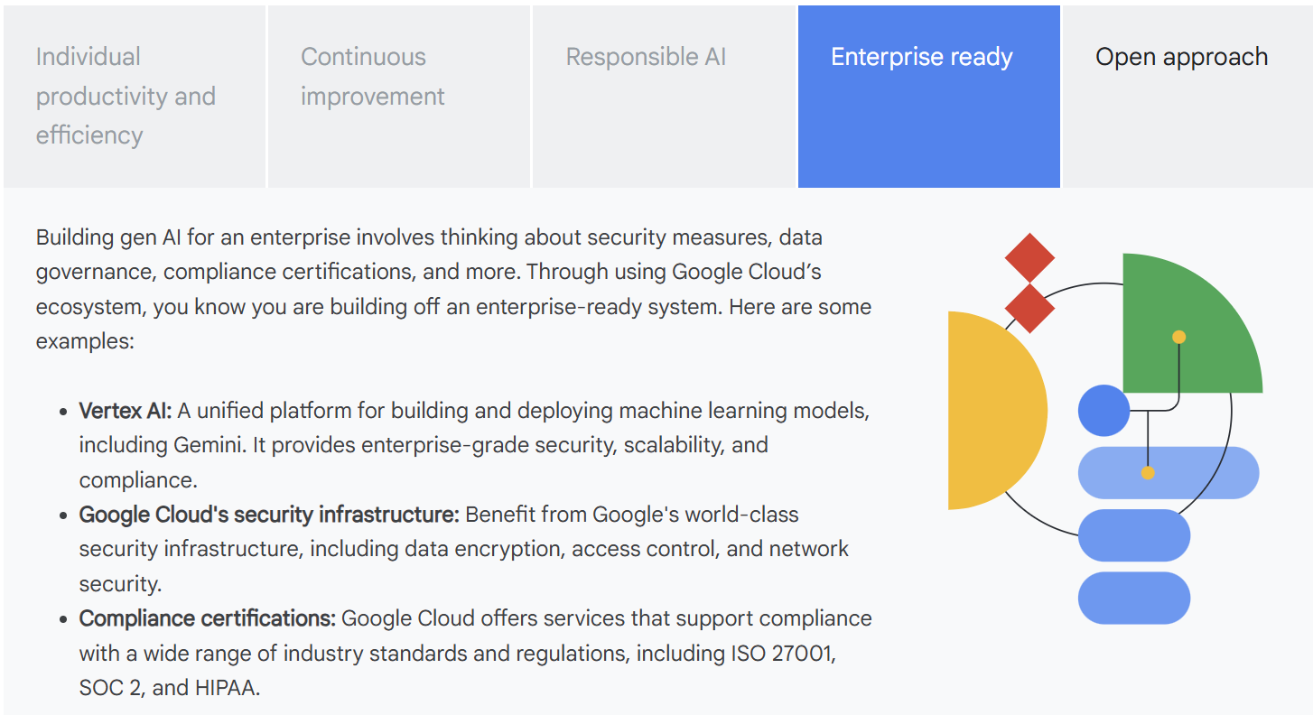

Slide 11
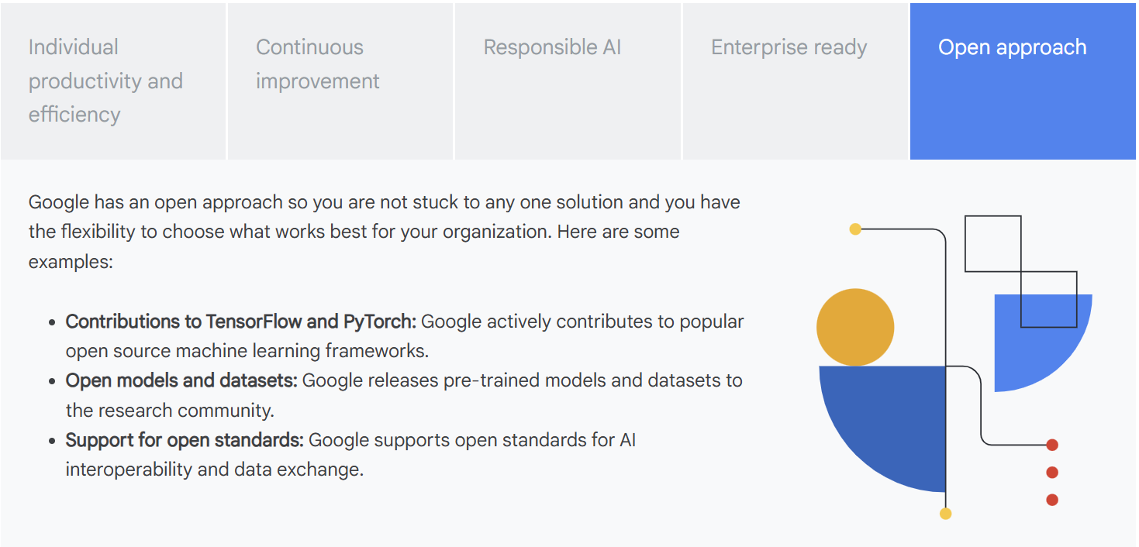

Slide 12
A creative matrix is great because it can help your team think through different aspects of what gen AI can do.
ation versus automation
Use gen AI to enhance or your strategic thinking for:
  Critical thinking and problem solving: Gen AI can provide data and insights, but humans are still needed to interpret those insights and make informed decisions.
  Creativity and innovation: Gen AI can assist in generating ideas and exploring possibilities, but human ingenuity is still essential for pushing boundaries and developing truly innovative solutions.
  Relationship building and collaboration: Gen AI can facilitate communication and information sharing, but strong interpersonal skills are still crucial for building trust, fostering collaboration, and navigating complex human dynamics.
  Strategic planning and vision: Gen AI can help with forecasting and trend analysis, but human leadership is essential for setting a long-term vision, defining goals, and charting a course for the future.

Slide 13
Use gen AI to automate tasks that are:
  Repetitive and rule-based: data entry, information retrieval, content formatting, and basic code generation.
  Time-consuming and resource-intensive: research, data analysis, content summarization, and initial draft creation.
Even for task automation, humans-in-the-loop are a necessary component for the gen AI implementation and continuous improvement. Use people for:
  Data selection and preparation: ensuring that gen AI models are trained on high-quality, relevant data that is representative of the intended use cases.
  Prompt design and refinement: crafting prompts that elicit accurate and useful responses from gen AI models.
  Output evaluation and refinement: reviewing and editing gen AI-generated content to ensure accuracy, relevance, and alignment with brand guidelines.
  Continuous monitoring and feedback: providing feedback on gen AI performance and identifying areas for improvement.
The most effective use of generative AI is to human strategic thinking and creativity, while automating repetitive tasks. In both cases, humans must remain central to the process to ensure successful implementation, with roles ranging from prompt design and output evaluation to continuous monitoring.

Slide 14
AI is all about building or creating machines that normally require us humans to use our brains.
ML is all about using data to train machines to perform specific tasks.
how do AI systems, powered by ML, actually accomplish these tasks?
  The simple answer is math. The math itself is a bit beyond the scope of this learning path, but……essentially, we call the math the model. When you plug an input into the math or model, you receive an output similar to any mathematical equation.
AI is all about building or creating machines that normally require us humans to use our brains. There are different ways to achieve learning, problem-solving, and decision-making, and one popular approach is machine learning, or ML for short. ML is all about using data to train machines to perform specific tasks.
Gen AI, short for generative AI, is a subset of machine learning that focuses on creating new content, like images, text, or music. While other types of AI might analyze data to predict an outcome, like whether an email is spam or not, generative AI uses data to create something entirely new.
The model is often a complex structure with many parameters and algorithms that process input data to generate outputs. More like a system of equations.
Imagine you're teaching a child to paint. Traditional AI is like showing them a painting and saying, "This is a good painting. These are the characteristics of a good painting." The child learns to judge paintings based on those rules. Generative AI is like showing the child many different paintings and providing them with a set of brushes and colors, then asking them to create their own unique painting based on what they've learned.
Gen AI models learn the underlying patterns and structures of the data they are trained on, and then use what they learned to generate new, similar content.
AI is the broad field, machine learning is a method or approach within AI, and generative AI is an application of AI that creates new content.

Slide 15
Let’s recap the key differences between AI, ML, and gen AI from the video.
Artificial intelligence (AI): The broad field of building machines that can perform tasks requiring human intelligence.
Machine learning (ML): A subset of AI where machines learn from data.
Generative AI: An application of AI that creates new content.

Slide 16
Data is information, and it can come in many forms—numbers (like the temperature), dates, text descriptions (like descriptions of the milk's appearance), and even images or sounds. Depending on what you want your machine learning model to do, some types of data will be more relevant than others.
Choosing the right data is crucial. If you want to predict milk spoilage, the song on the radio isn't helpful, but the date and temperature are key pieces of information. A machine learning model needs the right kind of data to learn effectively.
ML models analyze the data they've been given, identify patterns, and then calculate the likelihood of different outcomes when presented with new information.

Slide 17
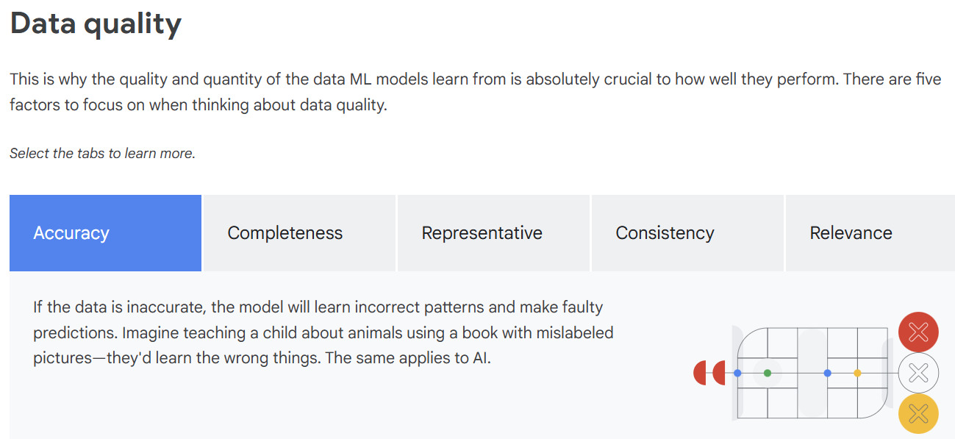

Slide 18
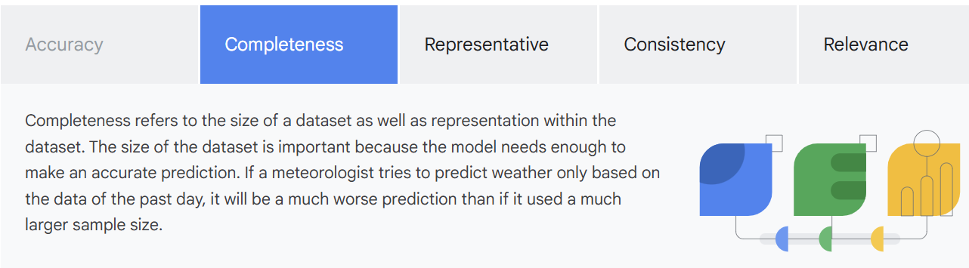
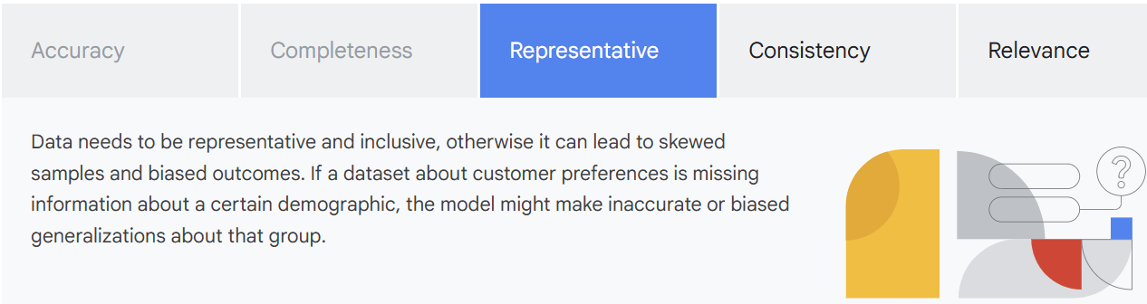

Slide 19
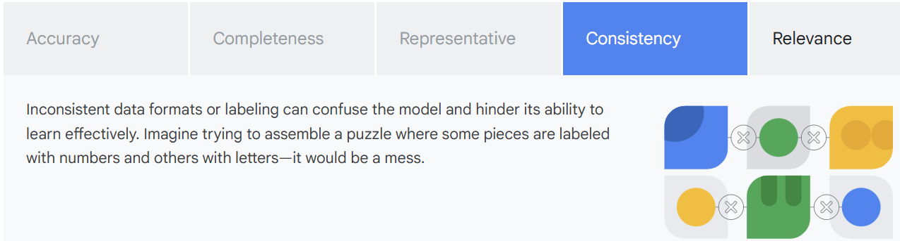
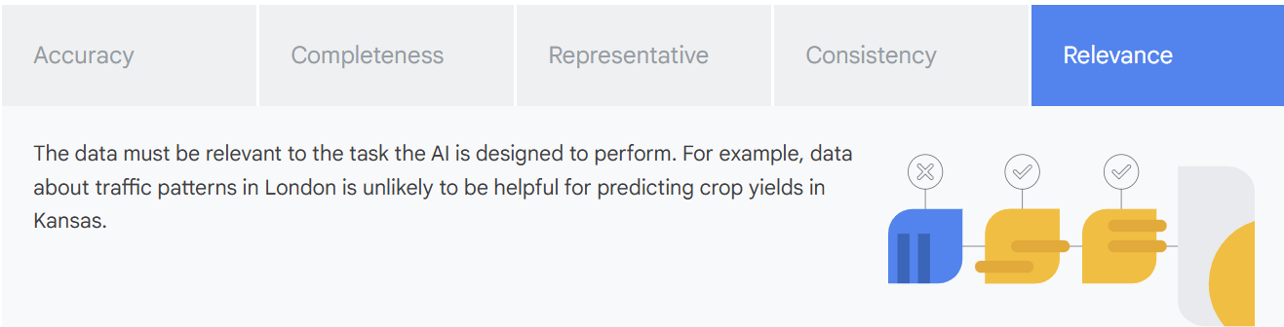

Slide 20
Data accessibility
The ability of AI systems to effectively utilize this data is directly tied to data accessibility. Data accessibility ensures that the necessary data is readily available, usable, and of high quality, allowing for comprehensive model training and reducing potential biases. Without accessible data, even the most sophisticated algorithms are limited in their ability to learn and provide accurate predictions.
Availability: If the necessary data simply isn't available, the AI model can't be trained. For some problems, the data might exist, but it might be locked behind paywalls or restricted due to privacy concerns.
Cost: Gathering and cleaning data can be expensive. The cost of acquiring high-quality data can be a significant barrier to AI development, especially for smaller organizations.
Format: Data needs to be in a format that the AI model can understand and process. Converting data into the appropriate format can be time-consuming and technically challenging.
Key Takeaway:
Data is the foundation of any AI system, with data quality and accessibility being essential for effective AI development. Understanding the types and quality of your data, including accuracy, completeness, consistency, relevance, availability, cost, and format is crucial for successful AI initiatives.

Slide 21
Understanding data types
Data is central to many business processes and various data types can be used in machine learning, but data isn’t just about numbers and files. Business datasets help organizations understand customers, optimize operations, and drive strategic decisions.
Larger datasets frequently improve model performance, particularly for complex generative AI models that produce diverse content. However, a large dataset isn’t the only thing that matters because model performance is heavily dependent on the type of data used for training. This includes the data’s volume and its organization and structure.
Understanding your data, its quality, availability, and form is essential for understanding the realm of what will be possible in terms of using that data for AI.

Slide 22
Data forms
Data comes in various forms, just like information itself. We can broadly categorize this data into two main types: structured and unstructured.
Structured Data
Structured data is easy to search and find the information you need. This type of data is often stored in something called a relational database, which is like a super-organized digital filing cabinet with information neatly arranged in tables. E.g.: Imagine your contact list on your phone. It has names, phone numbers, and maybe addresses, all organized in a list.
Unstructured Data
Unstructured data lacks a predefined structure. It is messy and complex by nature. It cannot be easily organized into rows and columns, so more sophisticated analysis techniques are required. E.g: text documents, emails, images, audio & video

Slide 23
Types of learning
Machine learning approaches and data requirements
The quality, accessibility, and form of data are fundamental, but how that data is used for ML depends on the specific learning method. Machine learning has three primary learning approaches: supervised, unsupervised, and reinforcement learning, each with its own data requirements.
Supervised models rely on labeled data, unsupervised models work with unlabeled data, and reinforcement learning learns through interaction and feedback.
Labeled Data
Labeled data has tags, such as a name, type, or number. These tags, whether applied manually or by automated systems, assign meaning to the data. E.g.: For instance, an image dataset for training a cat-detection model would label each picture as either a cat or dog. Similarly, a set of customer reviews might be labeled as positive, negative, or neutral. These labels enable algorithms to learn relationships and make accurate predictions.
Unlabeled data
Unlabeled data is simply data that is not tagged or labeled in any way. It's raw, unprocessed information without inherent meaning.
Examples of unlabeled data include a collection of unorganized photos, a stream of audio recordings, or website traffic logs without user categorization. In these cases, algorithms must independently discover patterns and structures within the data, as there are no pre-existing labels to guide the learning process.

Slide 24
Supervised machine learning
Supervised machine learning trains models on labeled data, where each input is paired with its correct output, allowing the model to learn the relationship between them. The model's goal is to identify patterns and relationships within this labeled data, enabling it to accurately predict outputs for new, unseen inputs. Predicting housing prices is a common example of supervised learning. A model is trained on a dataset where each house has labeled data, such as its size, number of bedrooms, location, and the corresponding sale price. This labeled data allows the algorithm to learn the relationship between the features of a house and its price. Once trained, the model can then predict the price of a new house based on its features.

Slide 25
Unsupervised learning
Unsupervised Machine learning models deal with raw, unlabeled data to find natural groupings. Instead of learning from labeled data, it dives headfirst into a sea of unlabeled data.
For example, an unsupervised learning algorithm could analyze customer purchase history from your company's database. It might uncover hidden segments of customers with similar buying habits, even though you never explicitly labeled those segments beforehand. This can be incredibly valuable for targeted marketing or product recommendations.
Think of it as exploratory analysis. Unsupervised learning helps you understand the underlying structure of your data and uncover insights that you might not have even known to look for.

Slide 26
Reinforcement learning
Reinforcement learning is all about learning through interaction and feedback. Imagine a robot learning to navigate a maze. It starts with no knowledge of the maze's layout. As it explores and interacts with the maze, it collects data—bumping into walls (negative feedback) or finding shortcuts (positive feedback). Through this process of trial and error, the algorithm learns which actions lead to the best outcomes.
It's like training a pet. You reward good behavior and discourage bad behavior. And over time, the pet learns to perform the desired actions. Similarly, in reinforcement learning, the algorithm learns to maximize rewards and minimize penalties by interacting with its environment.
This type of learning is particularly useful in situations where you can't provide explicit instructions or labeled data. For example, you could use reinforcement learning to train a self-driving car to navigate complex traffic situations or to optimize the performance of a robot in a manufacturing plant.

Slide 27
Examples of machine learning approaches on Google Cloud
Predictive maintenance with Vertex AI (Supervised Learning)
  How it works
    By training a model on sensor data from machines like temperature, pressure, and vibration, Vertex AI can predict when a machine is likely to fail, enabling proactive maintenance and reducing downtime.
Anomaly Detection with BigQueryML (Unsupervised learning)
  How it works
    BigQuery ML can analyze historical transaction data (amount, location, time, etc.) to identify patterns and flag unusual transactions that deviate significantly from the norm. This helps prevent fraud and minimize financial losses.
Product Recommendations with Vertex AI (Reinforcement Learning)
  How it works
    Vertex AI can train a reinforcement learning model to recommend products to users based on their browsing history, purchase behavior, and other factors. The model learns to maximize user engagement and sales by continuously refining its recommendations.
Key takeaway
Machine learning models can be trained using supervised, unsupervised, or reinforcement learning approaches. The choice of approach depends on the specific task and the nature of the data available.

Slide 28
Turning data into learning using Google Cloud
Data tools and management for ML workloads
The key to building an ML model is data. But the journey from scattered data to actionable insights isn't always easy. There are a few key steps that it takes to get to having a working solution, and if you are building a solution for an enterprise, along the way you need to consider many factors such as security, robustness, and scalability.
Google Cloud offers a comprehensive suite of data tools and management capabilities tailored for ML workloads. These tools and capabilities are designed to support the entire ML lifecycle, from data preparation and model training to deployment and monitoring.

Slide 29
Key stages of making data accessible for AI
Data Gathering
Data gathering, also called data ingestion, involves collecting raw data from various sources. To effectively train and test your model, determine the data you need based on the outcome you want to achieve.
Google Cloud supports data ingestion through several tools.
  Pub/Sub handles real-time streaming data processing, regardless of the structure of the data.
  Cloud Storage is well-suited for storing unstructured data.
  Cloud SQL and Cloud Spanner are used to manage structured data.

Slide 30
Data Preparation
Data preparation is the process of cleaning and transforming raw data into a usable format for analysis or model training. This involves formatting and labeling data properly.
Google Cloud offers tools like BigQuery for data analysis and Data Catalog for data governance. These tools help prepare data for ML models.
  With BigQuery, you can filter data, correct its inconsistencies, and handle missing values.
  With Data Catalog, you can find relevant data for your ML projects. This tool provides a centralized repository to easily discover datasets in your organization.

Slide 31
Training your Model
The process of creating your ML model using data is called model training. Google Cloud's Vertex AI platform provides a managed environment for training ML models.
With Vertex AI, you can set parameters and build your model, using prebuilt containers for popular machine learning frameworks, custom training jobs, and tools for model evaluation. Vertex AI also provides access to powerful computing resources to make the model training process faster.

Slide 32
Deploy & Predict
Model deployment is the process of making a trained model available for use.
Vertex AI simplifies this by providing tools to put the model into action for generating predictions. This includes scaling the deployment, which means adjusting the resources allocated to the model to handle varying amounts of usage.

Slide 33
Manage your Model
Model management is the process of managing and maintaining your models over time. Google Cloud offers tools for managing the entire lifecycle of ML models. This includes the following:
  Versioning: Keep track of different versions of the model.
  Performance tracking: Review the model metrics to check the model's performance.
  Drift monitoring: Watch for changes in the model's accuracy over time.
  Data management: Use Vertex AI Feature Store to manage the data features the model uses.
  Storage: Use Vertex AI Model Garden to store and organize the models in one place.
  Automate: Use Vertex AI Pipelines to automate your machine learning tasks.

Slide 34
Google Cloud tools work together
All these Google Cloud tools are designed to work together seamlessly. You can also connect them with your existing tools or build your own custom solutions. And throughout the entire process, Google Cloud's infrastructure ensures your solution is available and reliable. At the same time, Identity and Access Management (IAM) keeps your data safe and ensures only the right people have access.
Key takeaway
The ML lifecycle encompasses several key stages: data ingestion and preparation, model training, model deployment, and model management. Google Cloud provides a comprehensive suite of tools and capabilities to support each stage of this lifecycle. It includes Vertex AI for model training and deployment, and various data tools for ingestion, preparation, and management. By understanding and effectively managing this lifecycle, organizations can maximize the value of their initiatives and ensure long-term success.

Slide 35
Deep Learning
Machine Learning: A broad field that encompasses many different techniques, one of which is deep learning (DL).
Deep Learning
A powerful subset of machine learning, distinguished by its use of artificial neural networks. These networks enable the processing of highly complex patterns and the generation of sophisticated predictions.
Neural networks can leverage both labeled and unlabeled data, a strategy known as semi-supervised learning. They train on a blend of a small amount of labeled data and a large amount of unlabeled data. That way, they learn foundational concepts and generalize effectively to novel examples.
Generative AI uses the power of deep learning to create new content spanning text, images, audio, and beyond. Deep learning techniques, particularly those centered on neural networks, are the engine behind these generative models.

Slide 36
Foundation Models
Foundation models use deep learning. They are trained on massive datasets that allow them to learn complex patterns and perform a variety of tasks across different domains. They are incredibly powerful machine learning models trained on a massive scale, often using vast amounts of unlabeled data. This training allows them to develop a broad understanding of the world, capturing intricate patterns and relationships within the data they consume.
Think of a foundation model as a highly advanced learner. It's like a student who has read everything in an entire library, absorbing knowledge from countless books, articles, and websites. This deep and extensive learning allows foundation models to be adapted to a wide range of tasks.

Slide 37
Large language models (LLMs)
One particularly exciting type of foundation model is the LLM. These models are specifically designed to understand and generate human language.
They can translate languages, write different kinds of creative content, and answer your questions in an informative way, even if they are open ended, challenging, or strange. This is likely the most common foundation model you've encountered, such as in popular generative AI chatbots like Gemini. They also help power many search engines you use today.

Slide 38
Diffusion Models
Diffusion models are another type of foundational model. They excel in generating high-quality images, audio, and even video by iteratively refining noise (or unstructured/random data and patterns) into structured data.
Key takeaway
To summarize, deep learning provides the core technology, foundation models are the powerful architectures built on deep learning, and generative AI is the application of these models to create new and original content.

Slide 39
Choosing a model
Factors when choosing a model for your use case
When picking a model for your gen AI use case, it's important to start to think about some criteria for different models. Here are some important factors to keep in mind.
  Modality
  When selecting a generative AI model, it's crucial to consider the modality of your input and output. Modality refers to the type of data the model can process and generate, such as text, images, video, or audio. If your application focuses on a single data type, like generating text-based articles or creating audio files, you'll want to choose a model optimized for that specific modality. For applications that require handling multiple data types, such as generating image captions (processing images and producing text) or creating video with accompanying audio, you'll need a multimodal model. These models can understand and synthesize information across different modalities.

Slide 40
  Context Window
  The context window refers to the amount of information a model can consider at one time when generating a response. A larger context window allows the model to "remember" more of the conversation or document, leading to more coherent and relevant outputs, especially for longer texts or complex tasks. However, larger context windows often come with increased computational costs. You need to balance the need for context with the practical limitations of your resources.
  Security
  Security is paramount, especially when dealing with sensitive data. Consider the model's security features, including data encryption, access controls, and vulnerability management. Ensure the model complies with relevant security standards and regulations for your industry.
  Availability and reliability
  The availability and reliability of the model are crucial for production applications. Choose a model that is consistently available and performs reliably under load. Consider factors like uptime guarantees, redundancy, and disaster recovery mechanisms.

Slide 41
  Cost
  Generative AI models can vary significantly in cost. Consider the pricing model, which might be based on usage, compute time, or other factors. Evaluate the cost-effectiveness of the model in relation to your budget and the expected value of your application. This is where selecting the right model for the right task is important. Be sure to match the model to the task; bigger isn't always better, and multi-modal capabilities aren't always necessary.
  Performance
  The performance of the model, including its accuracy, speed, and efficiency, is a critical factor. Evaluate the model's performance on relevant benchmarks and datasets. Consider the trade-offs between performance and cost.
  Fine tuning & Customization
  Some models can be fine-tuned or customized for specific tasks or domains. If you have a specialized use case, consider models that offer fine-tuning capabilities. This often involves training the model further on a specific dataset related to your use case
  Ease of Integration
  The ease of integrating the model into your existing systems and workflows is an important consideration. Look for models that offer well-documented APIs and SDKs.

Slide 42
Google Cloud’s ML models
Vertex AI streamlines the integration of advanced artificial intelligence capabilities into business applications, allowing for seamless discovery, deployment, and customization. These models empower businesses to leverage cutting-edge AI, providing the flexibility to work with many different models without the need for extensive in-house model development.
With Vertex AI you can access models developed by Google including Gemini, Gemma, Imagen, and Veo. You can also access proprietary third-party models, and openly available models.

Slide 43
Gemini
Gemini, a multimodal model, can understand and operate across diverse data formats, such as text, images, audio, and video. Gemini's multimodal design supports applications that require complex multimodal understanding, advanced conversational AI, content creation, and nuanced question answering.
Gemma
A family of lightweight, open models is built upon the research and technology behind Gemini. They offer developers a user-friendly and customizable solution for local deployments and specialized AI applications.
Imagen
A powerful text-to-image diffusion model, it excels at generating high-quality images from textual descriptions. This makes it invaluable for creative design, ecommerce visualization, and content creation.
Veo
A model capable of generating video content. It can produce videos based on textual descriptions or still images. Its functionality allows for the creation of moving images for applications such as film production, advertising, and online content.
Collectively, these Google Cloud foundation models empower businesses to enhance customer experiences through intelligent chatbots and personalized content. They increase productivity by automating tasks and improving information retrieval. They foster innovation by generating new ideas and designs. They also derive data-driven insights for improved decision-making.
Key Takeaway
When choosing a generative AI model, consider factors such as modality, context window, security, availability, cost, performance, fine-tuning, and ease of integration. Google Cloud offers a suite of foundation models, including Gemini, Gemma, Imagen, and Veo, each with unique strengths and capabilities.
These models can be accessed and customized through Vertex AI, empowering businesses to enhance customer experiences, increase productivity, foster innovation, and improve decision-making.

Slide 44
Grounding is basically tying an AI model's answers to specific sources. This makes the AI's output more accurate and relevant. In an enterprise context, this means training the AI on a company's specific data. This allows it to generate tailored responses relevant to your organization, not just generic ones.
This data could include anything from internal documents and reports, to customer data, and even code. It gives the AI the context it needs to understand the company's unique language and provide accurate, relevant responses.

Slide 45
Foundation model limitations
Foundation models, while groundbreaking, aren't without limitations. Recognizing these limitations is essential for the responsible and effective utilization of these powerful tools.
  Data Dependency
  The performance of foundation models is heavily data-dependent. They require large datasets, and any biases or incompleteness in that data will inevitably seep into their outputs. It's like asking a student to write an essay on a book they haven't read. If the data or questions are inaccurate or biased, the AI's performance will suffer.
  Knowledge Cutoff
  Knowledge cutoff is the last date that an AI model was trained on new information. Models with older knowledge cutoffs may not know about recent events or discoveries. This can lead to incorrect or outdated answers, since AI models don't automatically update with the latest happenings around the world. For example, if an AI tool's last training date was in 2022, it wouldn't be able to provide information about events or information that happened after 2022.
  Bias
  An LLM learns from large amounts of data, which may contain biases. You can think of bias as an unbalanced dataset in LLMs. Due to their statistical learning nature, they can sometimes amplify existing biases present in the data. Even subtle biases in the training data can be magnified in the model's outputs.

Slide 46
  Fairness
  Even with perfectly balanced data, defining what constitutes fairness in an LLM's output is a complex task. Fairness can be interpreted in various ways. Fairness assessments for generative AI models, while valuable, have inherent limitations. These evaluations typically focus on specific categories of bias, potentially overlooking other forms of prejudice. Consequently, these benchmarks do not provide a complete picture of all potential risks associated with the models' outputs, highlighting the ongoing challenge of achieving truly equitable AI.
  Hallucinations
  Foundation models can sometimes experience hallucinations, which means they produce outputs that aren't accurate or based on real information. Because foundation models can't verify information against external sources, they may generate factually incorrect or nonsensical responses. These cause significant concern in accuracy-critical applications. The responses might sound convincing, but they are completely wrong.
  Edge Cases
  Rare and atypical scenarios can expose a model's weaknesses, leading to errors, misinterpretations, and unexpected results.
Key Takeaway
Foundation models have limitations, including data dependency, knowledge cut-offs, biases, potential for hallucinations, and issues with fairness and edge cases. There are techniques to address these challenges and improve the accuracy, reliability, and fairness of foundation models.

Slide 47
Techniques to address the limitations
Grounding
Grounding is the process of connecting the AI's output to verifiable sources of information—like giving AI a reality check. By providing the model with access to specific data sources, we tether its output to real-world information, reducing the risk of invented content. Grounding is essential for building trustworthy and reliable AI applications. By connecting your models to verifiable data, you ensure accuracy and build confidence. It offers several key benefits, including reducing hallucinations, which prevents the AI from generating false or fictional information. Grounding also anchors responses, ensuring the AI's answers are rooted in your provided data sources. Furthermore, it builds trust by enhancing the trustworthiness of the AI's output by providing citations and confidence scores, allowing you to verify the information.

Slide 48
Retrieval-ed generation (RAG)
There are many different options on how you can ground in data. For example, you can ground in enterprise data or you can ground using Google Search. One common grounding method to do this is with retrieval-ed generation, or RAG. RAG is a grounding method that uses search to find relevant information from a knowledge base and provides that information to the LLM, giving it necessary context. The first step is retrieval. When you ask an AI a question, RAG uses a search engine to find relevant information. This search engine uses an index that understands the semantic meaning of the text, not just keywords. This means it finds information based on meaning, ensuring higher relevance. The retrieved information is then added to the prompt given to the AI. This is the ation phase. The AI then uses this ed prompt, along with its existing knowledge, to generate a response. This is referred to as the generation phase.

Slide 49
Prompt engineering
Prompting offers the most rapid and straightforward approach to supplying supplementary background information to models. This involves crafting precise prompts to guide the model towards desired outputs. It refines results by understanding the factors that influence a model's responses. However, prompting is limited by the model's existing knowledge; it can't conjure information it hasn't learned.
Fine Tuning
When prompt engineering doesn't deliver the desired outcomes, fine-tuning can enhance your model's performance. Pre-trained models are powerful, but they're designed for general purposes. Tuning helps them excel in specific areas. This process is particularly useful for specific tasks or when you need to enforce specific output formats, especially if you have examples of the desired output.
Key Takeaway
To address foundation model limitations and improve their accuracy and reliability, several key techniques are used. These include grounding with methods like Retrieval-ed Generation (RAG), using prompt engineering to guide the model, fine-tuning a model on specific data, and incorporating humans-in-the-loop for critical review and oversight.

Slide 50
Tuning involves further training a pre-trained or foundation model on a new dataset specific to your task. This process adjusts the model's parameters, making it more specialized for your needs. Google Cloud Vertex AI provides tooling to facilitate tuning. Here are some examples of how tuning can be used:
  Fine-tuning a language model to generate creative content in a specific style.
  Fine-tuning a code generation model to generate code in a particular programming language.
  Fine-tuning a translation model to translate between specific languages or domains.

Slide 51
Humans in the loop (HITL)
Beyond these techniques, we must remember the invaluable role of humans in the loop (HITL). Machine learning models are powerful, but they sometimes need a human touch. For tasks requiring judgment, context, or handling incomplete data, human expertise is essential. HITL systems integrate human input and feedback directly into the ML process. This collaboration makes models more adaptable, especially in areas like the following.
Content Moderation
HITL ensures accurate and contextually appropriate moderation of user-generated content, filtering out harmful or inappropriate material that algorithms alone might miss.
Sensitive applications
In fields like healthcare or finance, HITL provides oversight for critical decisions, ensuring accuracy and mitigating risks associated with automated systems.

Slide 52
High Risk decision making
When ML models inform decisions with significant consequences, such as medical diagnoses or criminal justice assessments, HITL acts as a safeguard, providing a layer of human review and accountability.
Pre Generation review
Before deploying ML-generated content or decisions, human experts can review and validate the outputs, catching potential errors or biases before they impact users.
Post Generation review
After ML outputs are deployed, continuous human review and feedback help identify areas for improvement, enabling models to adapt to evolving contexts and user needs.

Slide 53
Feature | RAG | Fine-tuning | Grounding
Definition | s LLMs by retrieving relevant information from external knowledge bases and adding it to the prompt. | Further trains a pre-trained model on a new dataset to adapt it to a specific task or domain. | Connects an AI model's output to verifiable sources of information.
Process | Retrieve relevant information. → Add it to the prompt. → Generate a response. | Select a pre-trained model. → Gather data. → Train the model. → Evaluate and refine. | Provide access to data sources. → Use RAG or fine-tuning to connect the output.
Data sources | External knowledge bases (databases, documents, internet). | Task- or domain-specific datasets. | External knowledge bases or specific datasets.
Relationship to grounding | A specific technique for achieving grounding. | Improves a model's ability to be grounded in specific domains. | The overarching goal, achieved through techniques like RAG and fine-tuning.

Slide 54
What does Secure AI mean?
Secure AI is about preventing intentional harm being done to your applications. This is about protecting AI systems from malicious attacks and misuse. For all applications, including AI, you need to ensure security throughout the full lifecycle from development through deployment. This includes considering the data, infrastructure, and how and where applications are deployed.
Gather your data
The foundation of any robust AI system is secure data. Therefore, data must be protected and secured at all times. Access controls must be implemented to restrict who can access the data. They are also necessary to restrict who can add or input to the data. This is crucial to prevent data poisoning, a malicious attack where bad actors corrupt your AI model’s training data by introducing manipulated data. This can cause your model to learn incorrect patterns and make flawed (biased, inaccurate, or even harmful) predictions. It's akin to someone secretly swapping out vital ingredients in a recipe, leading to a disastrous final dish.

Slide 55
Prepare your data
During data preparation, special attention should be paid to confidential or sensitive data that might be present in the training data. Where feasible, anonymization techniques should be applied to this data, mitigating potential privacy risks. Data also should be rigorously validated, using integrity checks and anomaly detection to prevent poisoning. Data should be securely processed with encryption both at rest and in use. Logging and real-time monitoring should also be performed.
Train your model
Securing the model and the training process is paramount. This means safeguarding both the training data and model parameters from unauthorized access or modification. Model theft, where attackers steal proprietary or sensitive AI models, is a significant threat. Beyond gaining a competitive advantage, the stolen models could be used for malicious purposes, exploiting vulnerabilities or replicating sensitive functionality.
Deploy and predict
Once your model is trained and ready for action, it's crucial to safeguard it within its operating environment. This means controlling access to the model, determining who can interact with it and how. If you're using a pre-built model, it's essential to verify its source and check for any potential vulnerabilities.
Manage your model
Continuous monitoring and maintenance of the model's security are essential. Stay up to date on the latest security best practices in the field, specifically for your platform and model, and regularly update to patch vulnerabilities. Monitor model performance and outputs for anomalies or signs of tampering, and regularly review access permissions.

Slide 56
Think of it like installing a high-tech security system in your office. You wouldn't give everyone the master key, right? Similarly, you need to restrict access to your model and filter the information it receives and sends out.
One major risk here is adversarial attacks, where attackers try to trick the model with misleading information. Imagine someone trying to bypass your security system with a fake ID—that's essentially what an adversarial attack does to your AI. Therefore, it's critical to have safeguards in place to filter, sanitize, and check the data coming into your model, ensuring it's not being fed misleading information. Likewise, you need to monitor the information your model sends out. Think of it as screening outgoing messages to prevent any accidental leaks of sensitive data or the spread of harmful content.

Slide 57
Keeping AI applications secure demands constant vigilance and staying informed about the latest security threats and research.
Applying the Secure AI Framework (SAIF)
Google has developed the Secure AI Framework, or SAIF, to establish security standards for building and deploying AI systems responsibly. This comprehensive approach to AI/ML model risk management addresses the key concerns of security professionals in the rapidly evolving landscape of AI. Following the security practices outlined in SAIF can help your organization find and stop threats, automatically strengthen its defenses, and manage the unique risks of each AI system. The framework is designed to integrate with your company’s existing security, ensuring that AI models are secure by default.
Google Cloud security tools
Platforms such as Google Cloud can facilitate secure development. In addition to the Secure AI Framework, Google Cloud offers a range of tools to ensure applications remain secure throughout their lifecycle. Google Cloud has built security into its core through a secure-by-design infrastructure, encompassing its global network and hardware, as well as robust encryption in transit and at rest. It provides customers with detailed control over access and usage of cloud resources through Identity and Access Management (IAM). Google Cloud Security Command Center provides a centralized view of your security posture across your entire Google Cloud environment, and Google Cloud also offers tools for monitoring various workloads.
Key Takeaway
AI offers significant benefits, but it also introduces security risks like data poisoning, model theft, and prompt injection. To address these challenges, a secure foundation for AI applications is essential. Google Cloud's SAIF framework, combined with security tools, can help as you build and maintain secure AI systems.

Slide 58
Responsible AI
Responsible AI means ensuring your AI applications avoid intentional and unintentional harm. It’s important to consider ethical development and positive outcomes for the software you develop. The same holds true, and perhaps even more so, for AI applications.
Building on security
The foundation of responsible AI is security. Secure applications protect both your company and your users. Think of it like building a house: if the foundation is weak, the entire structure is compromised, no matter how beautiful the design. Just as a strong foundation ensures a stable and safe house, robust security forms the essential foundation for building truly responsible AI.

Slide 59
Transparency is key
Transparency is paramount for responsible applications. Users need to understand how their information is being used and how the AI system works. This transparency should extend to all aspects of the AI's operation, including data handling, decision-making processes, and potential biases.
Privacy in the age of AI
Protecting privacy often involves anonymizing or pseudonymizing data, ensuring individuals can't be easily identified. AI models can sometimes inadvertently leak sensitive information from their training data, so it's crucial to implement safeguards to prevent this.

Slide 60
Data quality, bias, and fairness
  Ethical AI requires high quality data
  Machine learning and generative AI applications are fundamentally based on data. Therefore, responsible AI requires high-quality data. Inaccurate or incomplete data can lead to biased outcomes. Remember, technology often reflects existing societal biases. Without careful consideration, AI can amplify these biases, leading to unfair and discriminatory results. Beyond data quality, it's crucial to consider the responsible use of the data itself. Was it collected consensually? Could it perpetuate harmful biases?
  Understanding and mitigating biases
  AI systems are not independent of the world they are built in. They can inherit and amplify existing societal biases. This can lead to unfair outcomes, such as a resume-screening tool that favors a certain demographic of candidates due to historical biases in hiring data. It's like training a dog with biased commands; the dog will learn and replicate those biases. To counter this, fairness must be a core principle in AI development.
Accountability and explainability
  Fairness requires accountability
  Fairness requires accountability. We need to know who is responsible for the AI's actions and understand how it makes decisions. This is where explainability comes in. Explainable AI makes the decision-making processes of AI models transparent and understandable. This is crucial for building trust, debugging errors, and uncovering hidden biases. Think of it like a judge explaining their verdict; without a clear explanation, it's hard to trust the decision. Tools like Google Cloud’s Vertex Explainable AI can help understand model outputs and identify potential biases. Understanding how your application uses and interprets the AI's output is crucial for ensuring responsible use.

Slide 61
Legal Implications
Beyond considerations like fairness and bias, AI development is increasingly governed by legal frameworks. Key areas include data privacy, non-discrimination, intellectual property, and product liability.
Laws mandate responsible data handling, bias mitigation, and transparency in algorithmic decision-making.
Organizations must also adhere to the specific rules and limitations of the AI models they employ, ensuring compliance with licensing agreements and legal standards.
The legal landscape is rapidly evolving, requiring organizations to stay informed and seek legal counsel to ensure compliance.
Legal compliance is not just a regulatory hurdle. Navigating these legal implications is crucial for building trustworthy AI.

Slide 62
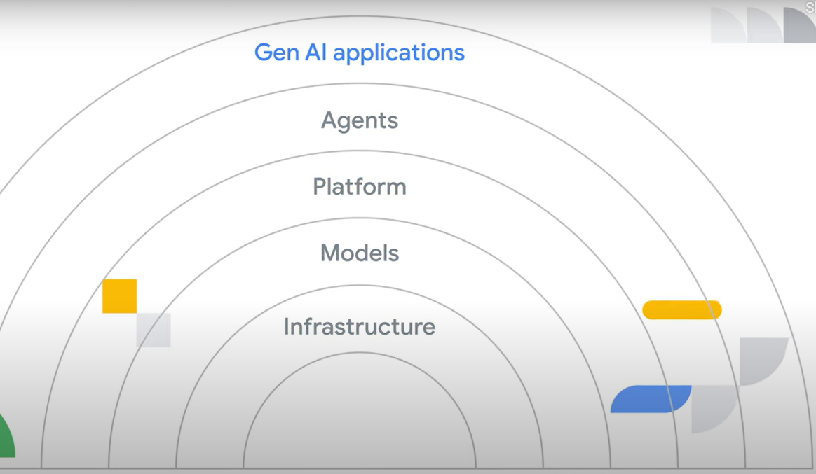
Understanding the layers of gen AI
Generative AI is a powerful technology composed of interconnected layers, each playing a vital role in its capabilities. GenAI is composed of 5 layers.
Infrastructure
Models
Platform
Agents
Gen AI Powered Applications

Slide 63
Gen AI powered application layer
It is the most familiar layer as it's the user-facing part of generative AI, or the frontend. This is the layer that delivers the AI capability to users through interfaces. This is the layer that allows users to interact with and leverage the capabilities of AI. Examples of gen AI powered applications include the Gemini app, Google Workspace with Gemini, or NotebookLM.
Agent Layer
An agent is a piece of software that learns how to best achieve a goal based on inputs and tools available to it. This layer focuses on autonomous action, which describes the ability to independently set goals and carry them out within a defined environment. Agents analyze situations, use multiple tools, and make informed decisions without requiring constant human input. They are also capable of handling multi-step tasks that a model alone cannot, such as researching a topic, troubleshooting code, or accessing a system by chaining together actions. You can have a variety of agents, such as customer agents, code agents, data agents, and many more.
This layer utilizes the capabilities of the model layer to perform more complex actions. This layer interacts with the environment, gathers information and makes decisions and executes actions based on the information received.

Slide 64
Platform layer
The platform layer typically sits between agents and models, providing the infrastructure for them to interact. The platform layer sits above the model and infrastructure layers, providing the necessary tools and infrastructure for AI development. It offers APIs, data management capabilities, and model deployment tools. This layer acts as the backbone of the system, bridging the gap between models and agents while simplifying the complexities of managing the underlying infrastructure.
This is the layer that consists of tools and services that help with building and deploying AI models. This includes model training platforms like Vertex AI and data management tools.
Model Layer
The "brain" of the agent is the AI model. These models are complex algorithms trained on vast amounts of data. They learn patterns and relationships in the data, allowing them to generate new content, translate languages, answer questions, and much more.
The model is where the brains of the AI system reside. It comprises various algorithms that learn patterns from data and can make predictions or generate new content. Examples are large language models (LLMs) like Gemini, image recognition models, and recommendation systems.

Slide 65
Infrastructure layer
The infrastructure layer is the foundation upon which everything else rests. It provides the core computing resources needed for generative AI. This includes the physical hardware (like servers, GPUs, and TPUs) and software needed to store and run AI models and training data.
The foundation of any AI system, comprising the hardware (physical servers, cloud computing resources, specialized chips like GPUs and TPUs) and software (operating systems, networking) that provide the necessary computing power, storage, and connectivity to train, deploy, and scale AI models.
Key Takeaway
Each layer plays a crucial role in enabling the capabilities of generative AI, from the underlying computing power to the user-facing tools. By grasping the interplay between these layers, you'll be better equipped to make informed decisions, foster innovation, and unlock the transformative potential of generative AI for your business.

Slide 66
Agents and gen AI powered applications

Slide 67
What can agents do?
Gen AI agents can process information, reason over complex concepts, and take actions. They can also be used in a variety of applications, including customer service, employee productivity, and creative tasks.
A gen AI agent is an application that tries to achieve a goal by observing the world and acting upon it using the tools it has at its disposal.
Google Cloud tools like AI Applications help teams create AI agents using natural language rather than having to write complex code to do the same thing.

Slide 68
How do agents relate to gen AI powered applications?
Think of agents as the intelligent pieces within a larger gen AI powered application. They bring specific capabilities to the table.
Understanding & responding to natural language
This allows applications to have more intuitive interfaces, like chatbots that can actually understand complex requests.
Automating Complex Tasks
Agents can handle multi-step processes within an application, such as gathering information, making decisions based on that information, and taking action.
Personalization
Agents can learn user preferences and tailor the application experience accordingly.

Slide 69
What is the role of agents in gen AI powered applications?
Think of gen AI powered applications as the user-facing layer. They provide the structure and context for agents to operate within. They define the user interface, the overall goals, and the specific tasks that agents will help with. Often, multiple agents with different specializations work together within a single application to create a richer, more dynamic user experience. This is known as a multi-agent system.
E.g: A travel booking app
Key Takeaway
Agents enhance applications by adding intelligence and automation and the applications provide the framework and purpose for agents.

Slide 70
How agents work

Slide 71
Conversational and workflow agents
While there are many ways to use gen AI agents, most will fall under two categories: conversational agents or workflow agents.
Conversational agents – How it works?
Conversational agents are designed to understand what you mean, not just what you say, and respond in a way that makes sense.
You provide input: You can type a message or speak to the agent.
The agent understands: Using powerful AI, it figures out the meaning and intention behind your words.
The agent calls a tool: Based on your request, the agent might need to gather additional information or perform an action. This could involve searching the web, accessing a database, or interacting with another software application.
The agent generates a response: It formulates an answer that's relevant to your request and sounds natural.
The agent delivers the response: You'll see or hear the answer depending on how you interacted with it.

Slide 72
Workflow agents – How it works?
Workflow agents are designed to streamline your work and make sure things get done efficiently and correctly by automating tasks or going through complex processes.
You provide input: You define a task or trigger a process like submitting a form, uploading a file, initiating a scheduled event, or even ordering a product online.
The agent understands: The agent is the software that automates those steps. It interprets the task's requirements and defines the series of steps needed to complete the task.
The agent calls a tool: Based on the workflow's definition, the agent executes a series of actions. This could involve data transformation, file transfer, sending notifications, integrating with external systems, or initiating other automated processes using APIs.
The agent generates a result/output: It compiles the outcome of the executed actions, which might be a report, a data file, a confirmation message, or an updated status within a system.
The agent delivers the result/output: The agent delivers the output to the designated recipient(s) or system(s), such as via email, a dashboard, a database update, or a file storage location.

Slide 73
The platform layer

Slide 74
Platform Layer
The platform layer provides the foundation for building and scaling your AI initiatives
Machine learning solutions can be extremely complex to build on your own in the wild. Having a great platform is what can make the difference by bringing all the pieces you need together in an easy and scalable way.
Vertex AI streamlines the entire ML workflow by providing the necessary infrastructure, pre-trained models, and tools to build, deploy, and manage your ML and generative AI solutions.

Slide 75
Key features and benefits of Vertex AI
Vertex AI is Google Cloud's unified machine learning (ML) platform designed to streamline the entire ML workflow. It provides the infrastructure, tools, and pre-trained models you need to build, deploy, and manage your ML and generative AI solutions.
  Open & Flexible: Vertex AI supports open frameworks, allowing you to use your preferred tools and models without vendor lock-in.
  Powerful Infrastructure: Leverage Google Cloud's scalable and reliable infrastructure to handle your ML workloads.
  Pre-trained Models: Choose from a wide variety of pre-trained models or build your own.
  Comprehensive tooling: Develop, deploy, and manage your models with ease using Vertex AI's integrated tools.
  Customization: Fine-tune and adapt models to your specific needs using the built-in IDE.
  Easy integration: Integrate your models into applications seamlessly using available APIs.

Slide 76
MLOps for efficient workflows
Operationalizing model training can be challenging and involves thinking about infrastructure and security. By using Vertex AI, you get a fully managed compute infrastructure, high-performance ML optimized training jobs, distributed training, hyperparameter optimization, and enterprise security.
Vertex AI's MLOps tools
Vertex AI also includes ML operations (MLOps) tools built in to help you orchestrate end-to-end ML workflows, perform feature engineering, run experiments, manage and iterate your models, track ML metadata, and monitor and evaluate model quality. MLOps helps automate, standardize, and manage the ML project lifecycle, enabling better collaboration and continuous improvement.
  Feature store: Share, serve, and reuse ML features to maintain consistency and efficiency.
  Model registry: Manage model versions, track changes, and organize your models throughout their lifecycle.
  Model evaluation: Quickly evaluate and compare model performance to identify the best model for your use case.
  Workflow orchestration: Automate ML workflows, from data preprocessing to deployment, using Vertex AI Pipelines.
  Model monitoring: Monitor models for performance degradation, detect input skew and drift, and trigger updates or retraining.
Key Takeaway
Vertex AI simplifies the complexities of machine learning, making it easier to build and deploy AI solutions. Its unified platform, comprehensive tooling, and MLOps capabilities empower developers and data scientists to innovate and accelerate their AI initiatives.

Slide 77
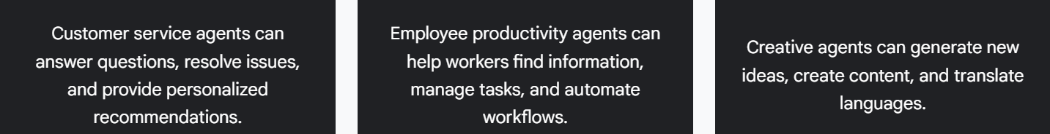
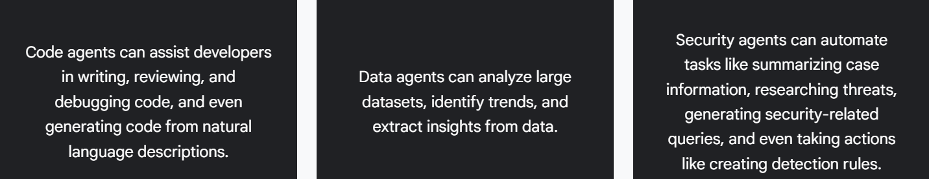
Key takeaway
Generative AI agents are primarily categorized into two types: conversational agents, which interact with users to answer questions and engage in dialogue, and workflow agents, which automate complex, multi-step tasks.
Whether it's a conversational agent providing seamless customer service or a workflow agent streamlining operations, understanding their potential is crucial for leaders looking to drive innovation and efficiency within their organizations.

Slide 78
Gen AI agents: Beyond just models

Slide 79
AI agents are designed to observe, act, and achieve goals. While AI agents utilize models, they represent a significant leap beyond their capabilities.
Agents incorporate two key elements that distinguish them from standalone models: a reasoning loop and tools.
  The reasoning loop is the agent's "thinking process." It's a continuous cycle of observing, interpreting, planning, and acting. This iterative process enables agents to analyze situations, plan actions, and adapt based on outcomes.
  Tools are functionalities that allow the agent to interact with its environment. Tools can be anything from accessing and processing data to interacting with software applications or even physical robots. This empowers agents to connect with real-world information and services, much like apps on our phones.
  For example, an agent could use tools to: Access and update a company's inventory. Schedule meetings by checking calendars. Automatically order new supplies when stock is low. Or communicate with a robot’s sensors and actuators.

Slide 80
By combining reasoning and tools, AI agents transcend the limitations of large language models (LLMs). They move beyond text generation to solve complex problems, manage multi-step tasks and produce results beyond just text or media. When solving complex problems, agents analyze information, gather data using tools, and make informed decisions with minimal human intervention.
When managing multi-step tasks, agents excel at complex workflows that LLMs alone can't handle, such as: conducting in-depth research, troubleshooting code, and automating tasks across multiple systems.
The reasoning loop is the heart of an AI agent's operation. It's an iterative process where the agent:
  Observes: Gathers information about its environment and the task at hand.
  Interprets: Processes the information and assesses the current situation.
  Plans: Plans a course of action to achieve its goal.
  Acts: Executes the planned action.
  This loop continues until the agent reaches its goal or a stopping point. The complexity of the loop varies depending on the agent and its task. Some agents have simple, rule-based processes, while others use more complex logic, potentially involving additional algorithms or probabilistic reasoning.

Slide 81
Advanced prompt engineering frameworks
The reasoning loop often utilizes advanced prompt engineering frameworks to guide its decision-making process. These frameworks can include:
  Simple rule-based calculations
  Complex thought chains
  Machine learning algorithms
  Probabilistic reasoning techniques
Examples of such frameworks include ReAct or chain-of-thought (CoT) prompting, which we discuss in more detail in Course 5 of this learning path.
Key Takeaway
AI agents represent a significant leap beyond standard language models by incorporating a reasoning loop and tools that allow them to interact with their environment. This combination empowers agents to solve complex problems and manage intricate workflows, far surpassing the capabilities of standalone models.

Slide 82
The model layer

Slide 83
What is an AI model?
At the heart of every AI and machine learning system lies the model. Think of it as the brain of the operation. These aren't just any algorithms. They're sophisticated mathematical structures trained on massive amounts of data. This training process allows them to learn patterns and relationships, ultimately enabling them to perform a wide range of tasks, such as generating content, analyzing data, and classifying information.
Vertex AI: A model hub
Within the Vertex AI platform, you have multiple options for how to handle AI models for your project. You can choose to build a model from scratch or use an existing model.

Slide 84
Use models with Model Garden
For many use cases, your organization won’t need to develop a new model. There are many AI models that already exist today that you can fine-tune and leverage for so many different use cases. Model Garden on Vertex AI is a service that lets you discover, customize, and deploy existing models from Google and Google partners.
Model Garden gives you options to pick from over 160 models and offers options of Google models, third-party models, and open-source models. With Vertex AI, you can customize these models with your own data and deploy them to your custom applications. Additionally, some pre-trained models can be used out-of-the-box without tuning.

Slide 85
  First-party foundation models: Leverage state-of-the-art models from Google including Gemini models and task-specific models for image generation, speech-to-text, and more. E.g.: Gemini Pro, Flash. Imagen for text-to-image. Veo for text-to-video and image-to-video. Chirp 2.0 for speech-to-text.
  First-party pre-trained APIs: Build and deploy AI applications faster with our pre-trained APIs powered by the best Google AI research and technology. E.g.: Speech to Text, NLP, Translation specs, Vision
  Open Models: Access a variety of enterprise-ready open models. E.g.: Gemma 2, CodeGemma, PaliGemma, Meta’s Liama 3.1 & 3.2, Mistral AI, Mistral AI21, TII’s Falcon BERT, FLAN-T5, ViT, Efficient Net
  Third Party Models: Model Garden supports third-party models from partners with foundation models. E.g.: Anthropic’s Claude Model Family

Slide 86
Build models with Vertex AI
With Vertex AI, you have two options for training and using your own models. You can go fully custom and create and train models at scale using any ML framework (PyTorch, TensorFlow, scikit-learn, or XGBoost), or there are also options for using AutoML to create and train models with minimal technical knowledge and effort.
AutoML allows you to build these types of models:
Data type | Supported objectives
Image data | Classification, object detection.
Video data | Action recognition, classification, object tracking.
Tabular data | Classification/regression, forecasting.

Slide 87
Standard workflow to be followed when creating Models in Vertex AI
  Gather your data: Determine the data you need for training and testing your model based on the outcome you want to achieve.
  Prepare your data: Make sure your data is properly formatted and labeled.
  Train: Set parameters and build your model.
  Manage your model: Review model metrics to evaluate the model’s performance and monitor changes over time.
  Deploy and predict: Make your model available to use.
Key Takeaway
The model lies at the core of any AI system, acting as its "brain" and enabling a wide range of functions from content generation to data analysis. Vertex AI provides a comprehensive platform for leveraging the power of models, offering access to a vast repository of pre-built models in Model Garden and the ability to create custom models. By understanding the different types of models and the model development workflow, leaders can effectively harness AI to drive innovation and solve complex business challenges.

Slide 88
Vertex AI pipelines lets you automate, monitor & govern your machine learning (ML) systems in a serverless manner by using ML pipelines to orchestrate ML workflows

Slide 89
The Infrastructure Layer

Slide 90
The foundation of gen AI solutions
The "infrastructure layer" is the foundation upon which any AI system is built. It's the combination of hardware and software that provides the necessary computing power, storage, and networking capabilities to train, deploy, and scale AI models. This layer is crucial for handling the massive datasets and complex computations involved in modern AI, especially with the rise of large language models and generative AI.
Google has invested heavily in building a robust and cutting-edge AI infrastructure, designed to handle the most demanding AI workloads.

Slide 91
Here are some key components.
  High performance computing
    GPUs & TPUs
    These specialized processors are the workhorses of AI. They excel at parallel processing, or doing multiple things at once, which is crucial for training large neural networks quickly and efficiently. GPUs were originally designed for graphics rendering, but since they offer general-purpose parallel processing power they’ve increasingly been used in the AI domain. TPUs are Google's custom-designed chips specifically optimized for AI tasks.
    Hypercomputers
    A hypercomputer is essentially a supercomputer built by connecting many individual computers (nodes) together. These nodes contain GPUs and TPUs. By linking them with high-speed networks, they work together as one massive computing unit. They provide the massive scale necessary for training and running the most demanding generative AI models.

Slide 92
  High performance storage
  Having high-performance storage is essential when building gen AI apps. Gen AI models are data hungry because they learn by analyzing massive datasets, often petabytes in size, containing text, images, code, and other forms of data. This storage provides the capacity and speed to store and access these enormous datasets efficiently. Without it, training would be incredibly slow or even impossible.
    Large scale Storage Systems
    Google Cloud's storage infrastructure is optimized for AI workloads, offering high throughput (the amount of work done within a specific period of time), scalability, and the ability to create dense compute clusters for faster training and inference. As AI models and datasets grow, the system can scale seamlessly to accommodate the increasing demands. Losing data due to storage failures can be catastrophic, so the storage is highly reliable to ensure data durability.
    Fast Storage Access
    The storage systems also need to provide fast read and write speeds to keep up with the demands of the training process. Otherwise, if storage access is slow, it can significantly hinder the training process.

Slide 93
  Networking
  Fast and efficient communication is essential for coordinating the work all of the processors in a high performance computing cluster are undertaking. Google's global fiber network provides high-bandwidth, low-latency connectivity, ensuring smooth data flow and efficient communication between different parts of the AI infrastructure.
  Using Google Cloud infrastructure can benefit teams in several ways, particularly with respect to scalability, performance, and cost-effectiveness.
Key Takeaway
Google Cloud's robust infrastructure, with its high-performance computing, storage, and networking capabilities, provides the foundation for handling the massive datasets and complex computations required by today's advanced AI models. As leaders, understanding the critical role of infrastructure in AI initiatives is crucial for making informed decisions about resource allocation, scalability, and ultimately, the successful implementation of generative AI solutions within your organizations.

Slide 94
AI on the edge
Edge computing runs AI on devices or servers closer to the data source or point of need.
Imagine a drone navigating a complex environment. It needs to react instantly to obstacles, making cloud processing too slow. Running AI locally on the drone ensures real-time responsiveness. Other benefits include increased data privacy and reduced reliance on internet connectivity.
To run powerful AI models on edge devices and mobile phones, Google provides tools like Lite Runtime (LiteRT). Think of LiteRT as a platform that helps machine learning models work efficiently on your device.

Slide 95
Gemini Nano is Google's most efficient and compact AI model, specifically designed to run on the edge on devices like smartphones and embedded systems. It's part of the larger Gemini family of models. Think of Gemini Nano as a miniature version of the powerful AI that usually lives in Google's data centers. This "on-device" or edge approach offers several benefits.
  Privacy: Your data stays on your device, enhancing your privacy.
  Speed: You get fast responses since there's no need to send data to the cloud.
  Offline Access: Gemini Nano can work even without an internet connection.
Gemini Nano brings the power of AI directly to your devices, making them smarter, more helpful, and more privacy-focused. It is currently being integrated into various Google products and services, including:
  Pixel phones: Gemini Nano powers features like Call Notes, which summarizes phone conversations and Pixel Recorder, which summarizes voice recordings.
  Android: Gemini Nano is available to Android developers through the AI Edge SDK, enabling them to build innovative AI experiences into their apps.

Slide 96
Even when your goal is to deploy on the edge, Vertex AI provides a powerful platform for building, training, and refining your models. You can leverage Vertex AI's capabilities for tasks like data preparation, model training, tuning, model evaluation, collaboration, and MLOps. Once your model is ready for the edge, Vertex AI offers tools to streamline the deployment process.
You can:
Convert models: Convert your models to Lite Runtime (LiteRT) for optimal performance on edge devices.
Package and deploy: Package your models and dependencies into containers for deployment on various edge hardware.
Manage and monitor: Manage your edge deployments, track their performance, and gather insights to improve your models over time.
Google provides the tools to deploy your AI models in these different locations, giving you more control and flexibility.
Key Takeaway
Edge computing allows AI to run locally on devices or servers closer to the data source, ensuring real-time responsiveness and increasing data control. Google provides tools like Lite Runtime (LiteRT) and Gemini Nano that are specifically designed for edge computing. Even when deploying on the edge, Vertex AI provides a powerful platform for building, training, and refining AI models.

Slide 97
Gen AI project resources: People, cost, and time

Slide 98
Roles and responsibilities
The AI stack is designed to support different roles with specific needs. Before jumping into building out a solution, ensure you have the proper expertise and talent for what you want to build. Business users can improve their tasks, developers can build custom AI solutions, and AI practitioners can develop and deploy advanced AI models responsibly and securely. This collaborative ecosystem allows your organization to leverage the full potential of AI across various business functions.
Business Leaders: Business leaders typically interact with pre-built gen AI solutions to enhance daily operations and improve customer experiences. For example, Google Workspace with Gemini can be used for content creation, data analysis, and document summarization.
Developers: Developers in your organization are responsible for building and deploying custom AI agents and integrating AI capabilities into existing applications. They can use AI Applications for custom agent creation, AI code generation, and AI-driven data processing. Developers can also leverage pre-trained APIs to rapidly integrate AI into applications, or they can use the Vertex AI platform which is designed to help developers build and deploy AI agents with tools for orchestration, grounding, and action.
AI practitioners: AI practitioners play a valuable role in customizing, deploying, and optimizing generative AI models. They leverage tools within Vertex AI to accelerate development and ensure responsible AI practices. Their expertise extends to scaling AI workloads, integrating models with BigQuery, and implementing responsible AI measures such as bias detection and adversarial testing.

Slide 99
Cost
The pricing model of gen AI can vary based on which part of the gen AI landscape you are looking at or even which specific product or company you are using. It is important to have a realistic budget and understanding of the cost for your project.
When building gen AI solutions, you pay for three primary activities:
  Training the model.
  Deploying the model to an endpoint.
  Using the model to make predictions.
Training and deploying models often involve paying for the compute time used as well as the storage for the training data and model outputs.

Slide 100
Pricing for using models
Usage-based: You pay for the amount you use, often measured in tokens or characters processed. This is common for APIs like Google’s PaLM & Gemini APIs.
Subscription-based: You pay a recurring fee for access to the model, often with tiers based on usage limits or features.
Licensing fees: One-time or recurring fees for using a model, especially for commercial purposes or embedding in products.
Free tiers: Some providers offer free access with limited usage for experimentation or non-commercial purposes.

Slide 101
Pricing metrics for using models
Here are some metrics you may see for usage-based pricing models.
  Tokens: A token represents a piece of text, like a word or part of a word.
  Characters: Some providers, like Google, charge based on the number of characters processed.
  Requests: Sometimes you can be charged per request, regardless of the complexity or volume of the task.
  Compute time: The time taken to process your requests can also factor into the cost, especially for resource-intensive tasks.
Factors affecting Cost
  Model size and complexity: Larger, more capable models generally cost more.
  Context window: A larger context window (the amount of text the model can consider) can increase costs.
  Features: Specialized features like fine-tuning or embedding can have separate pricing.
  Deployment: Depending on where you deploy your model and application, you may have compute based costs.

Slide 102
Time
It probably won’t surprise you to learn that the more custom your solution is, the more time and resources it takes to build. Using a prebuilt gen AI application takes seconds. Building your own custom solution with a custom AI model, can take months. Choosing to build a custom agent with AI Applications takes much less time.
Think about your project timelines and evaluate them against your needs and requirements. Determine if the timeline is realistic based on your requirements.
Key takeaway
Successful generative AI initiatives require leaders to strategically allocate resources, including the right mix of business users, developers, and AI practitioners.
Understanding the costs associated with different generative AI solutions, from pre-built applications to custom models, is crucial for effective budgeting. Aligning project timelines with the complexity of the chosen solution ensures realistic expectations and successful outcomes.

Slide 103
Gen AI solution needs

Slide 104
Gen AI solution needs
Before diving headfirst into your generative AI project, it's crucial to take a step back and assess your needs. Aligning your ambitions with your capabilities is key to setting realistic expectations and ensuring a successful outcome. Let's explore the key factors to consider when evaluating the scope and feasibility of your generative AI initiatives.
Scale: Is this for individual use, a small team, a large company, or millions of customers?
  Small scale: As an individual user or small team, you can go very far with pre-built tools. Try to leverage existing gen AI powered applications.
  Large scale: When building out solutions for millions of customers, you'll likely need a more robust and customized solution. Pick solutions that offer scalability and security. Factor in details to your decision like infrastructure costs, data storage, and potential latency challenges.

Slide 105
Customization
How specialized does your solution need to be? Powerful foundation models are constantly improving, making custom model development less necessary in many cases.
  Start with existing models: Explore pre-trained models available through APIs or open-source libraries. Fine-tune these models on your specific data to achieve better performance for your tasks.
  Identify your unique needs: What sets your project apart? Does it require specialized knowledge, handle complex tasks, or demand a unique user experience? This will help you determine the level of customization needed.
  Consider data specificity: If your project deals with specialized domains like law or medicine, consider fine-tuning with domain-specific datasets or exploring models specifically trained for those areas.
  Consider task complexity: Think about the complexity of the task itself. Are you aiming for simple tasks like text summarization or more intricate ones like code generation or creative writing? This influences model choice and training approaches.

Slide 106
User interaction
Think about how users will interact with your AI and design an intuitive and engaging experience.
User Interface (UI): Seamlessly integrate the AI into your existing workflows. This might involve a dedicated interface (e.g., a chatbot widget on your website) or embedding AI capabilities within your current applications.
User experience (UX): Aim for a user-friendly experience. Is it conversational, informative, or task-oriented? Consider the level of guidance and feedback users might need.

Slide 107
Privacy
How sensitive is the data you are working with?
  Data security
  What measures will you implement to protect data during processing and storage? Implement robust security measures to protect data during processing and storage. Consider encryption, access controls, and secure data centers.
  Compliance
  Are there specific regulations (GDPR, HIPAA, etc.) that your project needs to adhere to?

Slide 108
Other considerations
How specialized does your solution need to be? Powerful foundation models are constantly improving, making custom model development less necessary in many cases
Latency: What are the acceptable response time limits?
Tip: Consider real-time requirements. Do you need instantaneous responses, or can you tolerate some delay? If real-time interaction isn't critical, you have more flexibility in choosing models and infrastructure.
Connectivity: Will the solution always have internet access?
Tip: Consider offline functionality. Are there scenarios where the solution needs to function without internet access?
Accuracy: How crucial is the accuracy of the AI's output? What are the acceptable error tolerances?
Tip: Define acceptable tolerances. Determine the level of accuracy required for your AI's output. This will influence model selection, training data, and evaluation metrics.
Explainability: Do you need to understand the reasoning behind the AI's decisions?
Tip: Transparency is key. In certain domains, understanding the AI's reasoning is crucial. Consider using models or techniques that offer explainability features, especially in healthcare or finance.

Slide 109
Choosing and maintaining your gen AI solution

Slide 110
Choosing and maintaining your gen AI solution
Once the needs and resources are assessed, it’s time to make decisions such as what model we will use. By carefully considering the factors covered below and conducting thorough research, we can make informed decisions about gen AI pricing and choose the most cost-effective solution for our needs.
Comparing different companies and models
Evaluate model capabilities: Look for benchmarks and comparisons to assess the quality and performance of different models.
Compare pricing structures: Consider your expected usage and calculate the costs based on the pricing models and metrics of each provider.
Factor in additional costs: Account for potential costs like data storage, API calls, and fine-tuning.
Read the fine print: Pay attention to usage limits, data privacy policies, and other terms of service.

Slide 111
Key resources for comparison
Provider websites: Check the pricing pages of different companies.
Research papers and benchmarks: Look for independent evaluations and comparisons of different models.
Community forums and discussions: Engage with other users and experts to learn about their experiences and pricing insights.
Maintenance
Building a generative AI solution is a journey, not a destination. To maximize your long-term success, it's essential to consider the ongoing maintenance and evolution of your project from the beginning.
How will your project be maintained?
Do you have the resources in place to maintain the project over time?
What specific maintenance needs will your project have?

Slide 112
Key maintenance considerations
By proactively planning for maintenance, you'll ensure the long-term success and sustainability of your generative AI solution. Google Cloud provides a fully managed environment, which allows developers to focus on agent development rather than infrastructure and maintenance. With the platform handling deployment and model improvement, developers can maximize their return on investment and avoid costly issues down the road.
Model monitoring & retraining: Establish a system to continuously monitor your model's performance and retrain it periodically with updated data.
Data updates: Plan for regular data updates to keep your model fresh and relevant. This might involve adding new data sources, cleaning existing data, or adapting to evolving data formats.
Software updates & Bug fixes: Stay informed about updates to your chosen AI platform, libraries, or frameworks, and implement them promptly to ensure optimal performance and security.
Hardware & Infrastructure: Consider the maintenance needs of your hardware and infrastructure. This includes server maintenance, security updates, and capacity planning to accommodate growing data and user demands.
Security & Compliance: Maintain a vigilant approach to security. Regularly review and update your security measures to protect against evolving threats. Ensure ongoing compliance with data privacy regulations as they change.

Slide 113
Introduction to Gen AI Apps: Transform Your Work

Slide 114
Using gen AI for workplace productivity
Google Workspace is a collection of cloud-based productivity and collaboration tools that help people create, communicate, and collaborate, such as Gmail, Google Docs, Google Sheets, Google Meet, and Google Slides.
Gemini is a gen AI model that is then used in many other applications. Some of those applications were built in Google Workspace, so you can access Gemini directly within your Workspace apps through Google Workspace with Gemini.
Google Workspace business and enterprise licenses come with extra enterprise-grade data protection for your organization. These protections extend to the Google Workspace with Gemini features and the Gemini app (with Gemini Advanced). The licenses also come with administrative features for managing your organization's usage and access.

Slide 115
Google Workspace with Gemini features
Below Google Workspace with Gemini features allow you to use AI-enhanced workflows in your daily work to become more productive and effective.
Gemini side panel
One way to access Google Workspace with Gemini is through the Gemini side panel, which is present on the side of many Workspace apps. With the side panel, Gemini can assist you with summarizing, analyzing, and generating content by utilizing insights gathered from your emails, documents, and more—all without switching applications or tabs.
Gemini in Gmail
Gemini in Gmail uses generative AI to help users write and refine emails more efficiently.
Gemini in Google Docs
Gemini in Google Docs helps you streamline the process of content creation, refining, and proofreading right within your document as you write.
Gemini in Google Slides
Gemini in Google Slides can help you and your team work more effectively by using AI to generate photorealistic images that enhance your presentations.
Gemini in Google Sheets
Gemini in Google Sheets helps you generate formulas using AI.
Gemini in Google Meet
Gemini in Google Meet can help your global team communicate by providing real-time transcription and translation, facilitating seamless communication in multilingual meetings. It could also automate meeting summaries and action item extraction, saving time and increasing productivity for participants.

Slide 116
Taking enterprise Workspace farther
Gemini's capabilities also extend to other powerful applications within the Google Workspace ecosystem, like Google Vids and AppSheet.
Google Vids: Google Vids is an online video creation and editing app available to Google Workspace users through your organization. With Help me Create in Vids, you can use Gemini to generate a first draft of your video. As a project manager, you can use Vids to share project updates, timelines, and key insights with your stakeholders to more effectively communicate information than an email or lengthy report can.
AppSheet: AppSheet is a no-code app development tool included with Google Workspace enterprise editions. With Gemini in AppSheet, you can quickly create apps using AI by describing your needs in a prompt using natural language. Gemini can create an app structure with tables, columns, and links based on your description, such as "Manage inspections of my facility." You can then review and edit the app structure before creating the app in the AppSheet app editor.

Slide 117
Prompting techniques
As you continue experimenting with different gen AI applications, you'll quickly discover the crucial role of prompting. Developing your prompting skills is essential for achieving optimal results and tailoring generative AI to your specific needs.
Using examples in your prompts
When it comes to prompting techniques, there are a few different approaches.
  Zero-shot prompting is like asking a foundation model to complete a task with no prior examples, relying solely on its existing knowledge.
  One-shot prompting involves showing the foundation model just one example, allowing it to learn and apply that knowledge to similar situations.
  Few-shot prompting, on the other hand, provides the foundation model with multiple examples to learn from, which helps it better understand the task and improve its performance.

Slide 118
Role prompting
Role prompting is a technique used to guide the behavior of LLMs by assigning them a specific role or persona. This can be anything from a business analyst or Shakespearean actor to a helpful customer service agent. By instructing the model to adopt a particular role, you influence the style, tone, and focus of its responses.
Key takeaway
By assigning a specific role or persona to a model, role prompting allows you to precisely influence the tone, style, and focus of its responses. This powerful technique effectively guides the AI to act as an expert or a character, helping you generate tailored content that perfectly matches your needs.

Slide 119
Prompt chaining
Prompt chaining is a powerful technique for getting more complex and nuanced results from large language models like Gemini. It's like having a conversation with the AI where each response builds upon the previous one, leading to a more sophisticated and refined outcome.
This is where the concept of a chatbot comes in. You can have a back and forth with Gemini.
It lets you continue your conversation in the same chatbot so the chatbot knows your history before continuing on with the new prompt. Well, if you don’t want to keep repeating the same history, you can use the same conversation thread and keep working there. In Gemini, you can even name your chats and pin them for easy access.
Key takeaway
Prompt chaining is a technique for refining AI outputs by building on previous prompts. Instead of trying to achieve the final result in a single request, start with a broad, initial prompt. Then, use subsequent prompts to ask clarifying questions, provide more specific information, or request a different format to refine the AI's output incrementally until it meets the desired goal.

Slide 120
Reusing prompts with Gemini and Gems
You may already find yourself reusing prompts or parts of prompts in your day-to-day workflow. As a start, you can save these prompts as templates in a document somewhere like a Google Doc and a Google Sheet.
Gemini Advanced is an upgraded version of Gemini with extra features, making it far more capable at highly complex tasks, like coding, logical reasoning, following nuanced instructions, and creative collaboration. You can adjust your data retention settings to determine how long information is stored and delete your conversation history at any time.
Saved info
Using the same prompts in a chain won’t always work because, sometimes, you just want the gen AI tool to remember the context but not everything in your whole conversation history. For example, maybe you're a sales rep preparing for calls with potential clients. You might want to practice different sales pitches but wouldn't want the AI's feedback to be influenced by your previous practice sessions or specific details about past clients. In these cases, you can actually save information in Gemini that it will always use.
This is done through your Settings in your Saved info. You can let Gemini know that you're a sales rep so you do not need to constantly reiterate this in every prompt conversation.

Slide 121
Gems
Even saved information won’t always work. Because that will apply to all your Gemini chats. Sometimes you need specific context for particular tasks or conversations. This is where Gems come in.
Gem: Creating a personalized AI assistant with specific instructions and resources.
Like agents, these AI assistants can process information and reason over complex ideas within the context of your chosen task. You can have Gems dedicated to:
Creative writing: This Gem could be pre-loaded with your preferred writing style, tone, and commonly used resources. It could even help you brainstorm ideas, generate different creative text formats (poems, scripts, articles), and provide feedback on your drafts.
Coding: A coding Gem could be equipped with your favorite libraries, coding conventions, and even access to relevant documentation. It could assist with debugging, suggest code optimizations, and even generate code snippets based on your instructions.
Marketing: This Gem could be pre-loaded with your target audience demographics, competitor information, and campaign performance data. It could help you brainstorm campaign ideas, generate different marketing copy (social media posts, email newsletters, website content), analyze campaign performance, and suggest optimizations.

Slide 122
How do Gems work?
Think of Gems as your personalized AI assistants within Gemini.
Personalized responses
Gems can be tailored with specific instructions and information. This allows them to provide responses that are more relevant to your needs and preferences within that particular use case.
Streamlined workflows
Gems can help you streamline repetitive tasks by providing templates, prompts, or guided interactions. This can save you time and effort when working on familiar projects or activities.
Reset context
You can set the context for a Gem, like giving it background information or specific instructions. Then, you can start multiple chats with that Gem, each with its own focus and flow. These chats remain separate, so information from one won't spill over into another. It's like having different conversations with the same expert, each tailored to a specific purpose.
You can choose to use Google’s existing Gems that were built for many different common tasks, or you can create your own gem tailored to your use case.

Slide 123
What information can you provide to a custom Gem?
When you create a custom Gem, you provide it with instructions on how to act, what to do, and more. You are essentially prompting the agent or Gem on how to act. It's time to take all that prompting practice to the next level: Prompting to build your agents.
This is a very good place to use role-prompting, where you prompt the Gem to act as though it is in a specific type of role, such as an air traffic controller.
You can also provide specific documents and resources to a Gem, giving it a focused knowledge base to draw from. Imagine a "code reviewer" Gem that has access to your project's coding style guidelines and best practices documentation. This would allow the Gem to provide feedback grounded in your specific project requirements.
Key takeaway
Gems are your personalized AI assistants within Gemini, allowing you to create custom tools for any task. By using role-prompting and a focused knowledge base, you can give them clear and specific instructions, turning your well-crafted prompts into powerful, reusable assistants that streamline your workflows and save time.

Slide 124
Grounding and RAG
Grounding refers to the ability of the AI model to connect its output to verifiable and specific sources of information.
You can also attach documents and resources in your prompts in the Gemini app with Gemini Advanced. This is called grounding.
This is a critical aspect of building trust and reliability in AI systems. This is something you can already do in a Gem or Gemini prompt with no coding at all to improve accuracy and relevance to the task you need your agent to solve. By grounding with this additional information, you provide the AI model with a richer context. This can lead to more accurate and insightful results.

Slide 125
RAG
One powerful grounding technique is retrieval-ed generation (RAG). It involves:
Retrieving relevant information: The AI model first retrieves relevant information from a vast knowledge base (like a database, a set of documents, or even the entire web). This retrieval process is often powered by sophisticated techniques, like semantic search or vector databases.
Generating output: The model then uses this retrieved information to generate the final output. This could be anything from answering a question to writing a creative story.

Slide 126
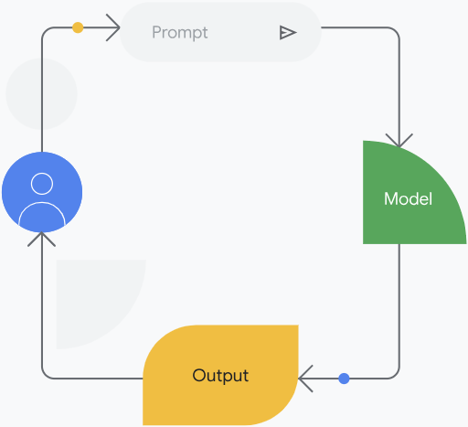
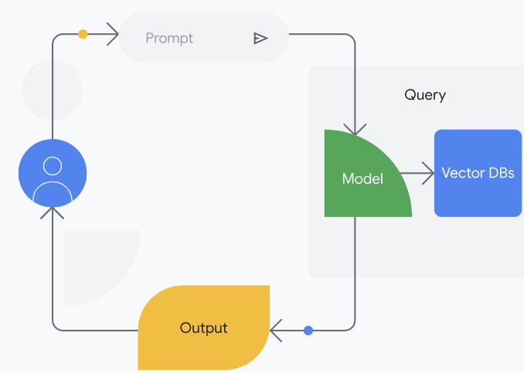
Model only (without RAG)
  The user inputs a prompt.
  The model provides output without external knowledge. The output might be outdated, and is more likely to have hallucinations.
Model only (without RAG)
  The user inputs a prompt.
  A query is sent to a backend retrieval system such as a vector database or search engine to find the most relevant information, and embed it as a part of the prompt.
  The model provides the output with the latest external knowledge. The output is much less likely to have hallucinations.

Slide 127
Key takeaways
RAG empowers AI models to go beyond simply memorizing information and instead learn to effectively access and utilize external knowledge sources to generate more insightful and reliable outputs.
  Improved accuracy and relevance: By accessing and utilizing relevant information directly, RAG models can produce more accurate and informative outputs.
  Improved explainability and transparency: RAG can increase transparency and trust in the AI system by showing the specific sources used to generate the output, ensuring that claims can be checked for accuracy.
  Extending LLM capabilities: RAG can constrain the output from an LLM so that it only generates a response based on the specific context it was provided.
One way to start using a RAG system without any coding or database development is with a tool called NotebookLM.

Slide 128
NotebookLM
NotebookLM is an AI-first notebook, grounded in your own documents, designed to help you gain insights faster.
It’s a unique tool that is built using Gemini models and is designed to help you learn and understand information better by acting as a virtual research assistant. You can "ground" NotebookLM in specific sources like documents, presentations, or even audio and video files. This means your AI assistant will only use information from those sources to answer your questions and generate summaries.
NotebookLM Plus
For users who want to take their research to the next level, there's NotebookLM Plus, a subscription plan that offers benefits like increased capacity, customization of response length and style, and usage analytics.
NotebookLM Enterprise
NotebookLM Enterprise takes NotebookLM Plus to the next level by adding compliance and administrative features necessary for enterprise environments. This includes extra privacy and security features to give you enhanced control over your data. Your notebook information is only shared with your chosen collaborators, and you can manage access using predefined identity and access management (IAM) roles. To learn more, see the documentation for What is NotebookLM Enterprise?.

Slide 129
Here's how it works
NotebookLM operates on the concept of "notebooks" to help you organize and interact with your information. Here's a breakdown:
  Creating a notebook
    Think of a notebook as a container for a specific project, topic, or area of interest.
    You start by giving your notebook a title and then uploading the relevant source materials (documents, PDFs, even audio or video files) that you want it to learn from.
  The chat interface
    Within each notebook, you have a single, ongoing chat with the NotebookLM AI.
    You can ask questions, request summaries, or give instructions, just like you would in a regular chat.
    NotebookLM will respond using only the information from the sources you've uploaded to that specific notebook.
  Saving insights as notes
    When the AI provides a response you find valuable, you can save it as a note within the notebook.
    These notes become an organized collection of key takeaways, summaries, or important points.
  Sharing and collaboration
    You can create "shared notebooks" to collaborate with others.
    In a shared notebook, everyone can access the same sources, ask questions, and contribute to the notes.
    This fosters collaborative learning and knowledge sharing.

Slide 130
How is NotebookLM different from Gemini and Gems?​
While Gems excel at general tasks and workflows, NotebookLM is designed to help you deeply understand and learn from specific sets of information. It's like having a dedicated expert who has thoroughly analyzed your chosen materials and is ready to answer any question you have.
Hyper-focused knowledge: Instead of drawing from a broad knowledge base, NotebookLM focuses solely on the sources you provide. This could be anything from research papers and articles to meeting notes and presentations.
Interactive learning: NotebookLM goes beyond simply summarizing information. It encourages active learning by allowing you to ask questions, generate different types of summaries, and even create quizzes to test your understanding.
Source-based answers: Every answer and insight provided by NotebookLM is directly grounded in your uploaded sources. This ensures accuracy and allows you to easily trace back to the original information. If you ask NotebookLM a question that isn't covered in the materials you've provided, it will honestly tell you that it can't answer. It won't invent information or speculate. This ensures that the information you get is always grounded in your sources and reliable.
Key Takeaway
NotebookLM is an AI-powered notebook designed to help you quickly gain insights from your documents. It acts as a virtual research assistant, able to summarize information, answer your questions, and even create different types of summaries based on your uploaded documents, presentations, or audio and video files.
Unlike general AI tools that draw from a broad knowledge base, NotebookLM focuses solely on the sources you provide. This "grounding" ensures that the information it provides is accurate, relevant, and traceable back to your original materials.

Slide 131
NotebookLM in Action
By centralizing these resources in a shared NotebookLM, your team can:
  Ask questions and gain a deeper understanding of the material together.
  Generate collaborative summaries and reports that leverage everyone's insights.
  Identify connections and contradictions between different perspectives more easily.
  Stay up-to-date with the latest information and changes.
Shared NotebookLM notebooks foster a culture of collaborative learning and knowledge sharing, empowering your team to work smarter and more effectively. It's like having a collective "brain" that everyone can contribute to and benefit from.

Slide 132
Gemini for Google Cloud

Slide 133
Gemini for Google Cloud
Just like with Google Workspace, Gemini is revolutionizing how we interact with Google Cloud. From simplifying data analysis to boosting developer productivity, Gemini for Google Cloud offers a suite of AI-powered tools designed to enhance your cloud experience.

Slide 134
Always on enterprise security with Gemini for Google Cloud
Gemini for Google Cloud does not use your prompts or Gemini’s responses to train models. It comes with the standard Google Cloud enterprise protections.
Gemini Cloud Assist
Gemini Cloud Assist is like having an AI expert on your team who helps you design, manage, and optimize applications on Google Cloud. It provides personalized guidance and is integrated with your Google Cloud environment to provide application lifecycle management assistance. It analyzes your cloud environment, your resources deployed, as well as metrics and logs to deliver actionable insights tailored to your needs.
Gemini in BigQuery
Gemini in BigQuery makes data analysis easier and more accessible. It can help you write code, understand your data, and even generate insights automatically, regardless of your SQL experience. This means faster and more efficient data exploration
Gemini Code Assist
Gemini Code Assist acts as an AI pair programmer, helping developers write better code, just like when two programmers work together to solve problems. Gemini Code Assist can provide code suggestions, generate code blocks, and even offer explanations. It supports over 20 popular programming languages, code editors, and developer platforms, all of which help developers increase productivity.
Gemini in Colab Enterprise
A Colab Enterprise notebook is an interactive environment that lets you write and execute code. Gemini in Colab Enterprise can use AI to help you write Python code in your notebook by suggesting code segments as you type and generating code based on your descriptions. This streamlines your data analysis and machine learning workflows.

Slide 135
Gemini in Databases
Gemini in Databases helps developers and database administrators manage their databases more effectively. It uses AI to simplify many aspects of using a database, from building applications with natural language to managing an entire fleet of databases from a single interface.
Gemini in Looker
With Gemini in Looker, you can analyze data and gain insights faster. As an intelligent assistant, it helps you understand your data, create visualizations, and even generate reports, making data exploration more intuitive.
Gemini in Security
Gemini in Security helps security teams detect, contain, and stop threats from spreading. It provides near-instant analysis of security findings and potential attack paths. Gemini in Security also summarizes prevalent tactics, techniques, and procedures used by threat actors, giving customers around the world detailed and timely threat intelligence.

Slide 136
A brief history of agents

Slide 137
Brief history of Agents
There are generally two kinds of agents: deterministic and generative.
A deterministic agent is an agent that is based on predefined paths and actions. It is typically workflow-based and event-driven, and it offers a high degree of control and predictability.
Generative AI agents can achieve a goal by observing the world and acting upon it using the tools it has at its disposal. This wasn't always the case. Early virtual agents were limited to predefined paths and lacked true understanding. But thanks to advances like generative AI and retrieval ed generation (RAG), today's agents can understand your intent, access relevant information, and provide much more helpful and natural interactions. All due to the connections of the three components of an agent.

Slide 138
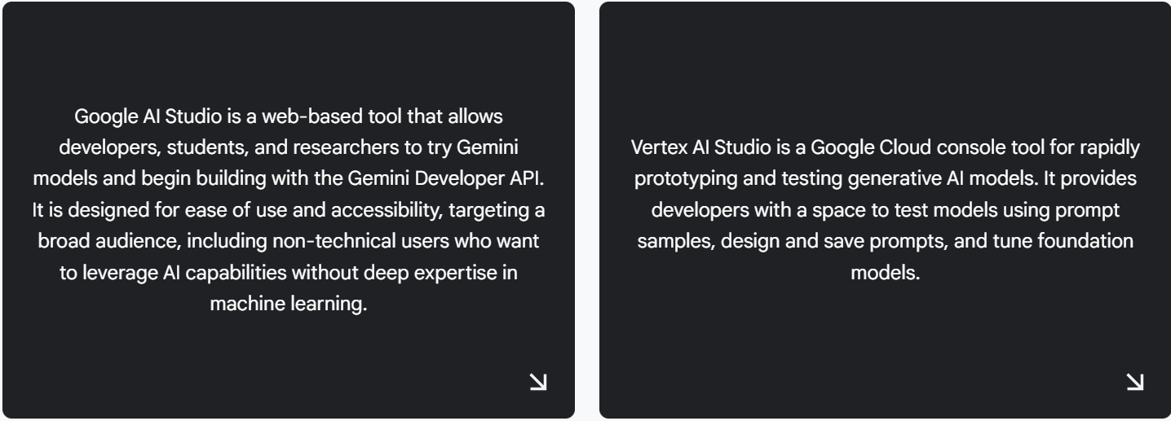
Tools provided by Google

Slide 139
Difference between Google AI Studio and Vertex AI Studio
Attributes | Google AI Studio | Vertex AI Studio
Focus | A streamlined easy-to-use interface for exploring Gemini's capabilities, experimenting with parameters, and generating different creative text formats. | A comprehensive and robust environment for building, training, and deploying machine learning models that is part of the Google Cloud Vertex AI Platform.
Users | Beginners, hobbyists, and those at the initial stages of development. | Professionals, researchers, and developers.
Access | Login with a standard Google account. | Access through Google Cloud.
Limitations | It has usage limits (queries per minute, requests per minute, tokens per minute), making it less suitable for large-scale or production-level applications. It's primarily intended for initial prototyping or small-scale model deployments | Has a service charge based on your usage.
Advantages | A simplified interface that is easy to get started and use, even for those without deep machine learning expertise. | More flexible quotas for usage, potentially increased upon request. Offers enterprise-grade security and compliance features.

Slide 140
Prompt engineering techniques
There are many different prompting techniques that one can use, but we will highlight two of the most common for this course: ReAct prompting and chain-of-thought (CoT) prompting.
  ReAct is a prompting framework that allows the language model to reason and take action on a user query, with or without in-context examples. ReAct, which stands for "reasoning and acting," is like giving an LLM a brain and a pair of hands. It allows the LLM to not only think about a problem but also take actions to solve it. This is a big step up from traditional prompting, where the LLM could only passively generate text. With ReAct, the LLM can Think, Act, Observe & Respond. This "thought-action-observation" loop allows the LLM to interact with the real world and gather information, making it much more powerful than a traditional LLM.
    Why is ReAct important?
      Dynamic problem solving: ReAct allows LLMs to tackle complex tasks that require interacting with external resources and adapting to new information.
      Reduced hallucination: By grounding the LLM's reasoning in real-world data, ReAct can help reduce the risk of generating incorrect or nonsensical information.
      Increased trustworthiness: The ability to see the LLM's reasoning process and how it interacts with external sources makes its responses more transparent and trustworthy.
    Key components of ReAct
      Think: The LLM generates a thought about the problem, similar to CoT.
      Act: The LLM decides what action to take, such as searching the web, accessing a database, or using a specific tool; the LLM specifies the input for the action, like a search query or database command.
      Observe: The LLM receives feedback from the action, such as search results or database entries.
      Respond: The LLM generates a response, which could involve providing an answer to the user, taking further actions, or formulating a new thought for the next iteration.
    ReAct in action
      ReAct has been successfully used in various applications, including:
      Question answering: LLMs can use ReAct to access external knowledge sources and answer questions more accurately.
      Fact verification: LLMs can verify claims by searching for evidence online.
      Decision making: LLMs can use ReAct to gather information and make informed decisions in interactive environments.
  The agent provides a prompt to the model, asking it to generate the next step and its corresponding output, which may include a thought, an action (including a tool choice), an action input, and an observation.

Slide 141
  Chain-of-thought prompting is a technique where you guide a language model through a problem-solving process by providing examples with intermediate reasoning steps, helping it learn to approach new problems in a more structured and logical way. CoT enables reasoning capabilities through intermediate steps. Think of CoT as a way to make LLMs even smarter by teaching them to think step-by-step, just like a human would. Instead of just giving the LLM a prompt and expecting an answer, you guide it through the reasoning process. You provide examples of how to solve similar problems, showing the steps involved. This helps the LLM learn to approach problems in a more logical and structured way. It is similar to teaching a student to think out loud. You're teaching the LLM to think out loud. By showing it the intermediate steps, you're helping it develop a "chain of thought" that leads to the correct answer.
    Why is CoT important?
    CoT is a powerful technique that helps LLMs think a bit more like humans. By guiding them through the reasoning process, we can unlock their full potential and achieve even more impressive results.
      Improved reasoning: CoT helps LLMs solve complex problems that require logical thinking.
      Better accuracy: By breaking down problems into smaller steps, CoT can lead to more accurate results.
      Enhanced explainability: CoT makes it easier to understand how the LLM arrived at an answer, which is important for building trust and transparency.
    Key components of CoT
    Just like there are different ways to solve a problem, there are different ways to implement CoT. Some popular techniques include:
      Self-consistency: Encouraging the LLM to generate multiple solutions and choose the most consistent one.
      Active-prompting: Allowing the LLM to ask clarifying questions or request additional information.
      Multimodal CoT: Combining text with other forms of data, like images or videos, to enhance reasoning.
    CoT in action
      Complex reasoning tasks: LLMs can use CoT to break down complex problems into smaller, more manageable steps, leading to more accurate solutions in tasks like math word problems or logical reasoning puzzles.
      Explanation generation: LLMs can use CoT to generate step-by-step explanations for their answers, making their reasoning process transparent and understandable, which is crucial for building trust and identifying potential errors.
      Multi-step planning: LLMs can use CoT to plan and execute complex tasks that require multiple steps, such as writing a story, planning a trip, or debugging code.

Slide 142
while both ReAct and CoT enhance LLM reasoning, they have different strengths:
  CoT focuses on internal reasoning, guiding the LLM through a chain of thought.
  ReAct focuses on external interaction, allowing the LLM to gather information and take actions in the real world.
ReAct and CoT can be combined for even more powerful results. By integrating both techniques, we can create LLMs that are capable of both deep reasoning and dynamic interaction with the world around them.

Slide 143
Types of agent tools

Slide 144
Types of agent tools
Agent tooling equips agents with the resources they need to be effective. Think of it as providing the agent with the right skills, connections, and knowledge to achieve its goals. These tools allow agents to access information, perform actions, and interact with various systems.
We can categorize agent tools into four key types.
Extensions (APIs)
Extensions bridge the gap between an agent and external APIs. APIs (application programming interfaces) are sets of rules that govern how software interacts. Extensions provide a standardized way for agents to use APIs, regardless of the API's specific design. This simplifies API interaction, making it easier for agents to access external services and data.
Example: An agent designed to book travel might use an extension to interact with a travel company’s API. The extension handles the complexities of communicating with travel company’s systems, allowing the agent to focus on the task of finding and booking flights.

Slide 145
Functions
Functions are like specialized tools within the agent's toolbox. They represent specific actions the agent can perform. An agent's reasoning system selects the appropriate function based on the task at hand. Functions can encapsulate complex logic or interactions, making them reusable and manageable.
Example: A "calculate_price" function might take flight details and passenger information as input and return the total cost. The agent can call this function whenever it needs to calculate a price.
Data stores
Data stores provide agents with access to information. This can include real-time data, historical data, or knowledge bases. Data stores ensure that the agent's responses are accurate, relevant, and up-to-date.
Example: An agent might use a data store to access current weather conditions, stock prices, or a database of customer information.

Slide 146
Plugins
Plugins extend the agent's capabilities by adding new skills or integrations. They can connect the agent to specific services, provide access to specialized tools, or enable interaction with particular platforms.
Example: A plugin could enable an agent to interact with a calendar application, allowing it to schedule appointments. Another plugin might integrate with a payment gateway, enabling the agent to process transactions.

Slide 147
How the reasoning loop works with tools
The ReAct (reasoning and acting) cycle prompting technique describes how agents use tools:
Reasoning (tool section)
The agent analyzes the task and determines which tools are needed. It considers the available extensions, functions, and data stores to choose the most appropriate resources.
Acting (execution)
The agent executes the selected tool. This might involve calling an API via an extension, invoking a function, or querying a data store. The agent provides the necessary inputs to the tool.
Observation
The agent receives the output from the tool. This output becomes the "observation" in the ReAct cycle.
Iteration (Dynamic Iteration)
Based on the observation, the agent reasons about the next steps. It might need to select different tools, refine its approach, or gather more information. This cycle repeats until the task is complete.

Slide 148
Google's agent tooling

Slide 149
Google's agent tooling
Whether building your agents inside or outside of Google Cloud, the options for tooling are extensive. You can custom-build tools, leverage third-party solutions, or, as we'll focus on here, utilize the powerful suite of tools available within Google Cloud. Note that many of these tools can be used even if you choose to build your core agent logic outside of Google Cloud.
Key Google Cloud tool for agents
Here are some of the most relevant Google Cloud services for agent tooling:
  Cloud Storage: A highly scalable and durable object storage service. Use Cloud Storage to store and retrieve data that your agent needs.
  Databases (Cloud SQL, Spanner, Firestore): Google Cloud offers a variety of database solutions to suit your needs. Your agent can use these databases to store and retrieve information, manage user data, or track its own progress.
  Cloud Run Functions: Create serverless functions that act as specialized tools for your agent. Cloud Run functions can be used to connect to databases, call external APIs, perform complex calculations, or handle other specific tasks. They are easily triggered by your agent and scale automatically.
  Cloud Run: For more complex agent tools that require containerized environments, Cloud Run provides a serverless platform for deploying and running stateless containers. This is ideal for custom tools that have specific dependencies or require more control.
  Vertex AI: Agents can use other agents as tooling. You can use Vertex AI to create models or agents that are called as tooling by other agents.

Slide 150
Pre-built AI APIs
Google Cloud also offers a wide range of pre-built APIs that provide powerful functionalities for your agent. These APIs can be used for tasks like understanding natural language, analyzing images, translating text, and more.
Speech to Text API: The Speech-to-Text API accurately converts speech into text. This is useful for transcribing meetings, customer service calls, or even video content.
Text to Speech API: The Text-to-Speech API converts text into natural-sounding speech, which is helpful for creating voice user interfaces in devices and applications, and for personalized communication.
Translation API: The Translation API can translate text, documents, websites, and even audio and video files into more than 135 languages.
Document Translation API : The Document Translation API can translate formatted documents while keeping the original layout.
Document AI API: The Document AI API allows businesses to extract data from various document formats. It can be used to automate data capture and document processing. This is useful for many kinds of documents, from invoices to contracts to medical records. Document AI can also summarize large documents using generative AI.
Cloud Vision API: The Cloud Vision API allows developers to understand the content of an image by applying powerful machine learning models. It can detect objects, faces, and landmarks, and even read text within images (OCR). This API is useful for a wide range of applications, including image tagging, content moderation, and visual search.
Cloud Video Intelligence API: The Cloud Video Intelligence API allows developers to analyze video content and extract meaningful information. It can identify objects, actions, and events within a video, and even transcribe spoken words. This API can be used for applications like content recommendation, video search, and media analysis.
Natural Language API: The Natural Language API helps derive insights from unstructured text using Google's machine learning. This API can be used to understand the sentiment of text, classify content, and extract important entities such as people, places, and events. This API can also analyze text in multiple languages.
Google Cloud also offers a vast API Library with APIs linked to many other Google products such as Google Maps, Google Workspace, YouTube, Google Photos, and more.

Slide 151
Building applications from your agents

Slide 152
Building applications from your agents
To actually use the API within your applications, you'll need to generate an API key for Google AI Studio or set up authentication and authorization for Vertex AI Studio. This process involves obtaining credentials that allow your application to securely access and communicate with the Gemini API.
  For Google AI Studio, generate an API Key by following the steps
  For Vertex AI Studio, setup authentication & authorization
  Cloud Run Functions: Small pieces of code that run in the cloud. They're triggered by specific events, like a new image being uploaded or a message being posted. You can use Cloud Run functions to automatically process these events using the Gemini API. For example, you could have a Cloud Run function that uses Gemini to automatically generate captions for uploaded images. The key benefit is that you don't have to manage any servers. Google takes care of all the infrastructure.
  A service that lets you run your applications in containers. Containers are like self-contained packages that include everything your application needs to run. Cloud Run makes it easy to deploy and scale these containerized applications. This is useful for more complex applications that might require specific software or configurations. For example, you could use Cloud Run to host a web application that uses the Gemini API to power a sophisticated chatbot.
You can integrate the Gemini API into virtually any application that can make HTTP requests. This can be a wide range of environments, including web applications, mobile apps, desktop software, and even embedded systems.

Slide 153
You can also leverage your API or code through some of Google’s no code and low code tooling, such as:
Apps Script: A cloud-based platform that lets you automate Google Workspace tasks by leveraging a combination of JavaScript code and Google's built-in services. You can use the Gemini API with Apps Script to build add-ons that enhance features in Google Workspace using generative AI.
AppSheet: AppSheet is a no-code platform for building custom business apps. You can use Apps Script to extend the capabilities of your AppSheet applications using custom logic or by integrating APIs. With the Gemini API, for example, you can automate tasks, generate content, or provide intelligent assistance directly within your AppSheet app.

Slide 154
Multi-agent applications
When leveraging agents into your application, consider situations when you may need multiple agents.
These systems utilize multiple agents, each potentially specialized for a specific task, to create more efficient and capable applications. For instance, a travel booking app might use one agent to search for flights, another to find hotels, and a third to suggest local attractions.
These agents can work independently or interact with each other to provide a seamless booking experience. This modular approach not only improves efficiency but also allows for greater flexibility and scalability. Even more interestingly, an agent itself can be a tool within another agent. A sentiment analysis agent, for example, could be used by a customer service agent to gauge user satisfaction during an interaction.
Key takeaway
Integrating generative AI models into your applications can be achieved through various methods, including leveraging APIs, Cloud Run functions, Cloud Run, and no-code tools like Apps Script and AppSheet. These methods offer flexibility for incorporating generative AI capabilities into diverse environments and applications. Multi-agent systems can further enhance efficiency and capability by utilizing multiple specialized agents.
Understanding these integration options can empower you to build and deploy generative AI solutions that meet your specific business needs.

Slide 155
RAG and tooling

Slide 156
Pre-RAG history
Pre-RAG History: Before retrieval-ed generation (RAG), models could not directly learn from tool data. They could use tools to fetch information, but lacked the ability to process and integrate that data into their knowledge. Their understanding was limited to their training data, and tool-retrieved data was used only for the immediate query, not for learning. RAG solves this by enabling models to retrieve and learn from data provided by tools.

Slide 157
How the model works with tools
Retrieval-ed generation (RAG) enhances the capabilities of large language models (LLMs) by grounding their responses in external knowledge sources. This process allows the model to access and process information beyond its training data, leading to more accurate, relevant, and up-to-date responses.
After the user submits a query or request to the LLM, here's how RAG works with tools.
Retrieval
The LLM, equipped with retrieval tools, identifies relevant information from external sources. These tools can include:
  Data stores: These can be internal databases or other sources of structured and unstructured data.
  Vector databases: These databases store embeddings (numerical representations) of text, allowing the LLM to find semantically similar information to the user's query. The LLM uses the user query to create an embedding and searches the vector database for matching documents or passages.
  Search engines: The LLM can use search engines (via extensions or APIs) to find relevant web pages, articles, or other online content.
  Knowledge graphs: These structured databases store information about entities and their relationships. The LLM can query knowledge graphs to retrieve facts and relationships relevant to the user's query.
The LLM uses these tools to retrieve a set of potentially relevant documents or passages.

Slide 158
ation
The retrieved information is then incorporated (or "ed") into the prompt that is fed to the LLM. This ed prompt now contains both the user's original query and the relevant context retrieved from external sources.
Generation
The retrieved information is then incorporated (or "ed") into the prompt that is fed to the LLM. This ed prompt now contains both the user's original query and the relevant context retrieved from external sources.
Iteration
In some RAG systems, the LLM might iterate on the retrieval process. For example, if the initial retrieval doesn't yield satisfactory results, the LLM might refine its query or use different retrieval tools to find more relevant information. It could also ask clarifying questions of the user. This iterative process allows the LLM to continuously improve the quality and relevance of its responses.
By combining the power of LLMs with the ability to access and process external knowledge, RAG systems create more powerful and reliable AI agents.

Slide 159
Data stores
RAG allows LLMs to access and process information beyond their training data, making them more accurate and relevant. A key component of this process are data stores in AI Applications. They act as structured and unstructured knowledge bases that your agent can draw upon.
You can access a variety of data store options to connect your agent to your data through AI Applications, including:
Websites: Access and process information directly from web pages, enabling your agent to stay up-to-date with current events or access publicly available information.
Structured data: Connect to information organized in tables or JSON format, such as product catalogs, customer databases, and internal knowledge bases. Vertex AI can automatically understand the structure of your data or allow you to define it.
Unstructured data: Utilize files in various formats such as HTML, PDF, and DOCX, making it possible for your agent to access information from a wide range of sources.

Slide 160
The power of search agents

Slide 161
Vertex AI Search
Vertex AI Search offers both search and recommendation solutions.
Search solutions
Search allows you to create a powerful search experience for your public website. It can index and search across a variety of data types, including structured data in BigQuery and unstructured documents stored in Google Cloud Storage. This ensures your users can easily find the information they need on your website, regardless of how it's stored.
Search also extends to include some specific forms of search such as:
  Document Search: If your primary need is to search across a large repository of unstructured documents stored in Google Cloud Storage, this is the ideal solution. It's optimized for understanding and retrieving information from text-heavy data, making it perfect for internal knowledge bases, document archives, and more.
  Media Search: For organizations dealing with rich media libraries, media search provides specialized capabilities. It's designed to understand and search within images, videos, and audio files. This allows users to find specific media assets based on their content, metadata, or even spoken words within audio or video.
  Healthcare Search: Addressing the unique needs of the healthcare industry, this option enables searching across healthcare data while supporting regulatory compliance. It allows professionals to access patient records, research articles, and medical guidelines efficiently and securely.
  Search for Commerce: Specifically designed for e-commerce, this option focuses on building a search app for your retail catalog. It optimizes for product discovery, understanding product attributes, and handling complex product queries.

Slide 162
Recommendation solutions
The general purpose recommendation engine can be used to recommend similar content within websites, documents, and other structured content. It analyzes user behavior and content attributes to provide personalized recommendations, increasing user engagement and content discovery. This also extends to include some specific forms of recommendations such as:
  Media recommendations: Tailored for consumer-focused media applications like audio/video streaming and digital publishing, this option provides specialized recommendations. It understands user preferences and consumption patterns within media content to suggest relevant audio, video, articles, and more.
  Retail recommendations: Optimized for e-commerce, this solution drives sales by providing personalized product recommendations. It leverages user browsing history, purchase data, and product attributes to suggest items that are likely to be of interest to each individual shopper.

Slide 163
How Vertex AI Search works
Regardless of the specific search or recommendation option you choose, Vertex AI Search operates on a foundation of intelligent data connection, grounding, and generative AI. It seamlessly connects to your existing data stores, whether they are structured databases, unstructured document repositories, or a combination of both. This connection is crucial as it allows Vertex AI Search to act as an agent, observing the user's query or context (the environment) and acting by retrieving relevant information or suggesting relevant items (using the data stores as tools) to achieve the goal of providing the right information or recommendation at the right time.
A key strength of Vertex AI Search lies in its ability to ground gen AI LLM responses with your first-party data, curated third-party data, and even Google's knowledge graph (Grounding with Google Search), minimizing "hallucinations" and ensuring trustworthy information.
This grounding is where the connection to RAG comes in. By using your own data sources as the foundation for LLM responses, Vertex AI Search implements a RAG approach, ensuring that the information provided is relevant, accurate, and grounded in the context of your specific data.

Slide 164
Vertex AI Search also gives you the options of adding extra generative AI features to your search functionality.
Search summaries: Vertex AI Search can generate concise and informative summaries of search results, saving users time and effort. These summaries can be tailored to different needs, providing a quick overview of a document, a comparison of multiple products, or a synthesis of key findings from a set of search results.
Answers and follow ups: Vertex AI Search can add AI generated answers to your search results. Users can ask questions in natural language to your website’s search and get AI generated answers based on the search results. Users can then follow up with further questions.
Vertex AI Search is built for enterprise and offers granular access controls to help ensure data security. It also provides advanced analytics to understand search trends and user behavior and scalable infrastructure to handle large volumes of data and search requests. It's designed to meet the demanding requirements of organizations of all sizes. Vertex AI Search is built to easily integrate with existing enterprise systems through APIs and SDKs. Whether you're building a customer-facing search experience or an internal knowledge base for employees, Vertex AI Search can be seamlessly integrated into your workflow.

Slide 165
Gen AI for customer engagement

Slide 166
Gemini Enterprise for Customer Experience
Gemini Enterprise for CX provides an agentic solution designed to bring shopping and customer service together on a single intelligent interface. The tools are built using Gemini multimodal models, enabling agents to use complex reasoning to understand intent and execute multi-step tasks. With the Gemini Enterprise for CX, you can build:
Customer Experience Agents: Customer Experience agents to act as effective chatbots communicating with your customers.
Agent Assist: Agent Assist to support your live human contact center agents.
Customer Experience Insights: Customer Experience Insights to gain insights into all your communications with customers (through chatbot agents or human agents).
All of this can be built on top of Google’s Contact Center as a Service (CCaaS), an enterprise-grade contact center solution that is native to the cloud.

Slide 167
Customer Experience agents
The Customer Experience (CX) agents you can build today have evolved significantly into proactive "digital concierges" capable of reasoning and complex problem-solving.
To build the best agents, you need your agents to be flexible and generative at points and fully structured and deterministic at other points. Customer Experience Agent Studio (CX Agent Studio) allows you to use this combination to create powerful CX agents.
This hybrid approach allows you to build agents that don’t just talk—they take action, such as processing a refund or scheduling a delivery.
With CX Agent Studio, you have flexible options for building and integrating agents with your existing tools. You can rapidly deploy agents using natural language instructions or develop sophisticated hybrid workflows with custom rules and enterprise-grade logic.
Deterministic: Deterministic is associated with rule-based, defined systems. It uses specific logic—such as "if the user selects this option, buy this product." Every action a deterministic agent takes must be explicitly defined. These agents typically require low-to-medium code to build and offer maximum predictability for sensitive transactions.
Generative: Generative is powered by Gemini multimodal models. These agents use advanced reasoning to understand intent from text, images, or voice, providing a natural, human-like conversational flow. Unlike legacy bots, these agents determine the best path forward based on your instructions and grounded data, often requiring only natural language prompting and little to no code.
Hybrid: CX Agent Studio empowers you to build hybrid agents that combine the strengths of both methodologies. This approach offers the strict control of deterministic rules for compliance and security, while leveraging the flexibility of generative AI to handle the nuances of customer needs.

Slide 168
Agent Assist
Within Gemini Enterprise for CX, this is where Agent Assist comes in. It is a tool that supports live human agents with in-the-moment assistance, generated responses, and real-time coaching to help them resolve customer issues faster and with greater accuracy. Leveraging Gemini multimodal models, Agent Assist can recommend agent responses to customers, suggest the appropriate knowledge base content to solve a customer’s issue, transcribe or translate calls in real time, and summarize conversations.

Slide 169
Customer Experience Insights (CX Insights)
CX Insights analyzes conversational data from across the customer journey to provide contact center leaders and managers with the data-driven insights to boost efficiency, improve agent performance, and create better customer experiences. This tool uses Gemini multimodal models and natural language analysis to provide you with information such as agent and caller sentiment, entity identification, and call topics. It can automatically identify interesting customer interactions in need of further review and automatically score interactions using conditional scorecards.

Slide 170
Contact center as a service (CCaaS)
CCaaS, the unified foundation of Gemini Enterprise for CX, simplifies (complex, needing to handle 24/7 communication across multiple channels (phone, text, email, etc.) while maintaining security and customer privacy) this by providing a complete contact center solution. It manages the infrastructure, integrates with CRMs, and offers omnichannel support (consistent experience across all channels, like websites, apps, phone, and text).
CCaaS handles simultaneous multichannel communication, channel switching, multimodal interactions (text, voice, images), and agent routing, freeing businesses to focus on customer experience. CCaaS seamlessly integrates with other Gemini Enterprise for CX tools, including CX agents for automated support, Agent Assist for real-time agent guidance, and CX Insights for valuable data analysis.

Slide 171
Build your own agent

Slide 172
Creating agent instructions
When building a CX agent with CX Agent Studio , you create instructions for how you want your agent to act. In the instructions, you define your agent's goal, such as providing customer support, answering user questions, or even generating creative content. You also provide details on how the agent should act and any rules you would like it to follow. You then can add tools such as data stores to your agent. As soon as your agent is defined, you are ready to go and can start testing your agent and interacting with it.
What are system instructions?
In Google AI Studio, you use system instructions to provide context, persona, and constraints to an agent before any user input is provided to guide the model's behavior and ensure its responses align with your desired outcome.
Consistency: Ensure the chatbot maintains a consistent tone and persona.
Accuracy: Ground the model in specific knowledge, reducing hallucinations.
Relevance: Keep responses focused on the intended domain (e.g., Cymbal Manufacturing).
Safety: Prevent the model from generating inappropriate or unhelpful content.

Slide 173
Gemini Enterprise

Slide 174
Gemini Enterprise
Gemini Enterprise is designed to help you and your team use your company's information more effectively. It uses AI to create customized agents that can access and understand data from various sources, regardless of where that data is stored. These agents can then be integrated into your organization’s internal websites or dashboards. Think of it as a way to give your employees their own personal research assistants, but for work.
Connect to NotebookLM Enterprise so employees can upload information to analyze, get insights, and listen to audio summaries of data.
Connect to multimodal search agents grounded in your data (structured and unstructured) across multiple systems (Google Drive, Confluence, Jira, ServiceNow, and more) so your employees can find relevant information within your company.
Add generative AI assistants that are grounded in your enterprise data and can be prompted to take actions through connectors (tools). For example, creating Google Calendar events or editing issues in Jira Cloud.
Add custom agents through CX Agent Studio.
How is Gemini Enterprise different from NotebookLM?
While Gemini Enterprise can connect to NotebookLM Enterprise, they serve different core purposes. Think of NotebookLM Enterprise as your specialized AI tool for diving deep into specific documents and web sources – asking questions, summarizing, and creating new content based only on those sources. Gemini Enterprise, on the other hand, is your comprehensive enterprise AI assistant. It uses AI agents and unified search to automate tasks and find information across all your connected business systems, not just specific documents you upload.

Slide 175
Plan for generative AI integration
Establish a clear vision: Define how gen AI integrates with your overall corporate strategy. Secure buy-in from leadership and appoint a champion to drive adoption.
Prioritize high-impact use cases: Focus on opportunities that align with business goals, considering factors like technical feasibility, data readiness, and potential for transformation.
Invest in capabilities: Develop the necessary skills within your organization through a combination of upskilling, recruitment, and training. Foster a culture of learning and experimentation to empower teams to leverage gen AI effectively.
Drive Organizational Change: Proactively manage the shifts in workflows, roles, and mindsets that accompany gen AI implementation. Encourage agile collaboration and knowledge sharing to scale best practices.
Measure & Demonstrate Value: Track, measure, and assess the impact of gen AI initiatives. Use data-driven insights to continuously improve and demonstrate the value of your efforts.
Champion Responsible AI: Develop and implement a robust framework for responsible AI, ensuring fairness, transparency, privacy, and security in all generative AI initiatives.

Slide 176
Plan for impact
We have discussed the importance of measuring and demonstrating value from gen AI projects, but until now, we haven’t really discussed how.
Define key metrics: Start by identifying the metrics most relevant to your goals. Are you aiming for a return on investment (ROI), increased revenue, reduced costs, improved efficiency, enhanced customer experience, or improved security?
The key is to select metrics that align with your overall business objectives. If it’s a return on investment (ROI) that’s important to your organization, calculate the financial benefits of your gen AI initiatives against their costs. If it’s increased revenue, measure the direct impact of gen AI on sales and profits.
Collect and analyze data: Once you've defined your key metrics, it's time to gather data. Set up tracking mechanisms, conduct surveys, or analyze existing data to understand the impact of your gen AI initiatives.
For example, if you're tracking customer experience, you might compare satisfaction scores before and after implementing a gen AI powered chatbot. Look for patterns and trends to identify areas where gen AI is making a difference.
Iterate and improve: The beauty of gen AI is its adaptability. Use the insights from your data analysis to refine your gen AI strategy and optimize performance. If you're not seeing the desired ROI, consider why you aren't seeing the desired ROI, what are the practical issues or pain points? Then adjust your approach. This may include fine-tuning your models, updating training data, improving prompting techniques, or integrating gen AI more effectively into your workflows.

Slide 177
Plan for change
Staying up-to-date requires a proactive approach to learning and development. It also entails fostering a culture of continuous learning and improvement within your organization. Here are some tips on the best ways to stay ahead of the curve with gen AI.
Regularly review and refine your strategy based on the latest advancements and your organization's specific needs.
Stay informed about new models, tools, and techniques by actively following industry news, research publications, and expert opinions.
Engage with the generative AI community through conferences, workshops, and online forums to learn from others and share your knowledge.
Invest in training and development programs to upskill your workforce and equip them with the knowledge and skills needed to thrive in the generative AI era.
Attract and retain top talent by creating a stimulating and rewarding work environment that fosters creativity and professional growth.

Slide 178
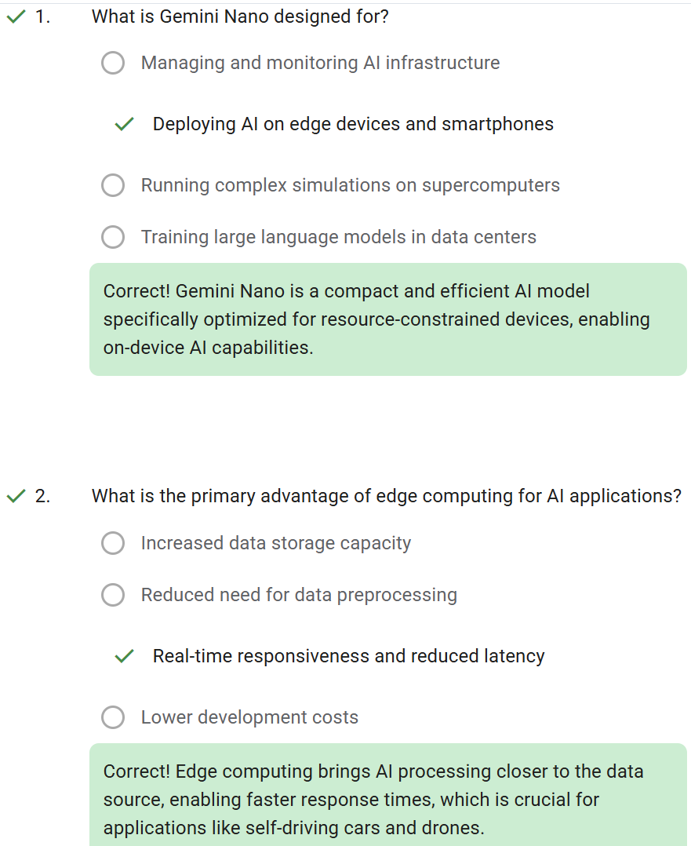
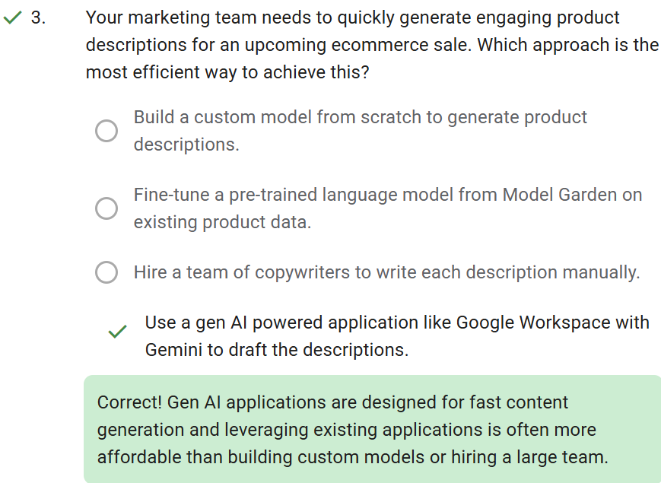
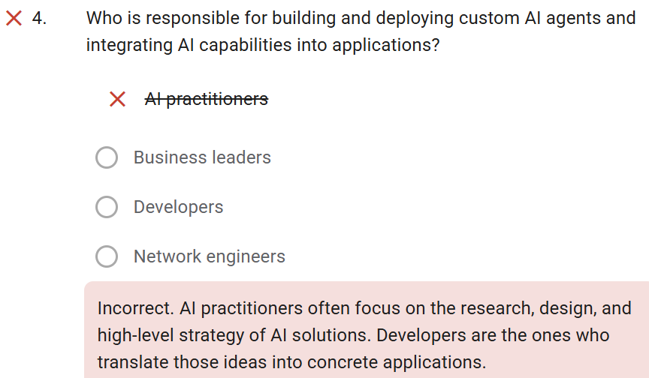

Slide 179
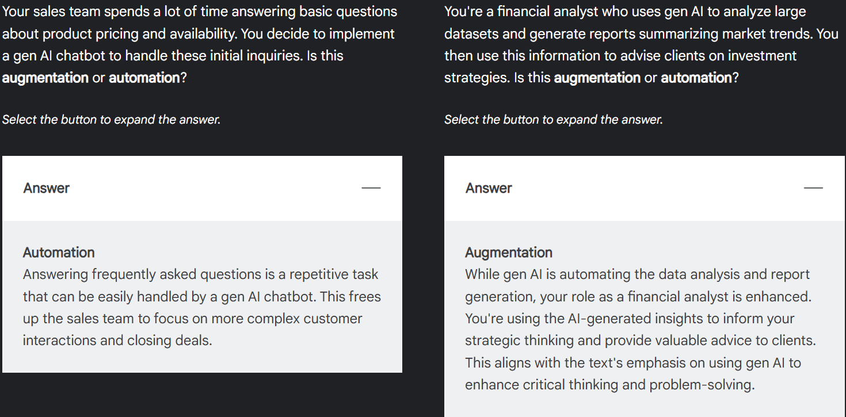

Slide 180
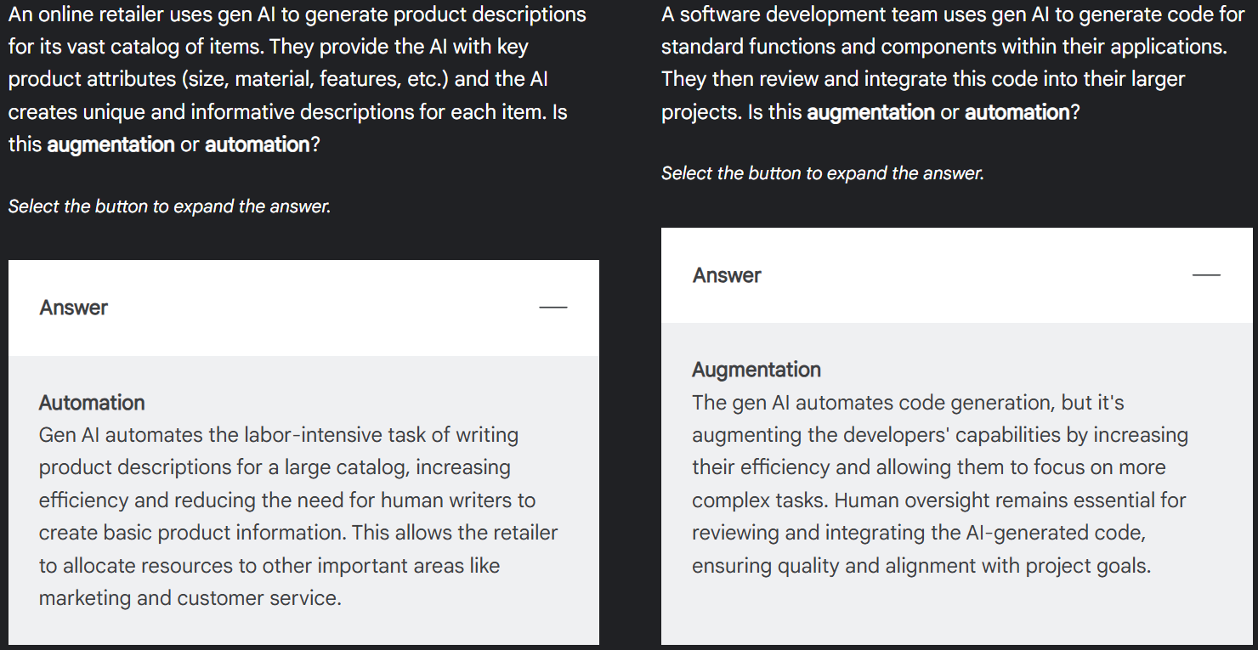

Slide 181
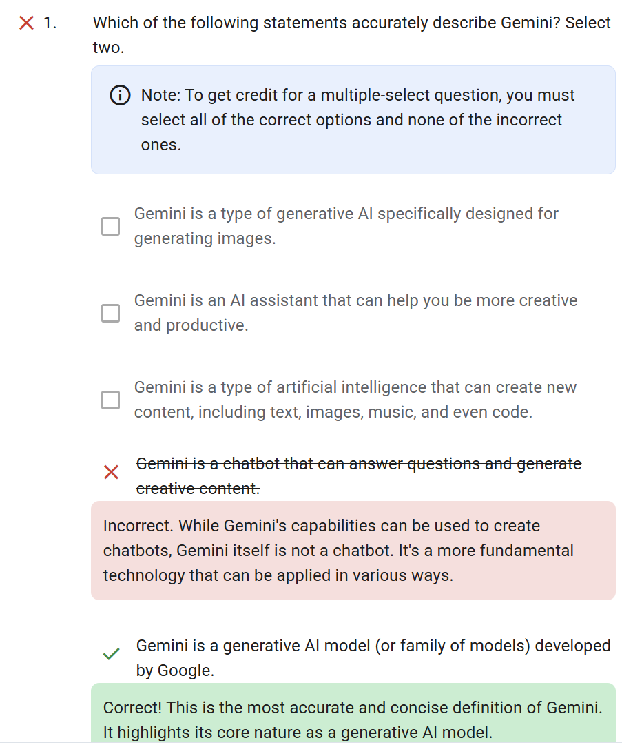
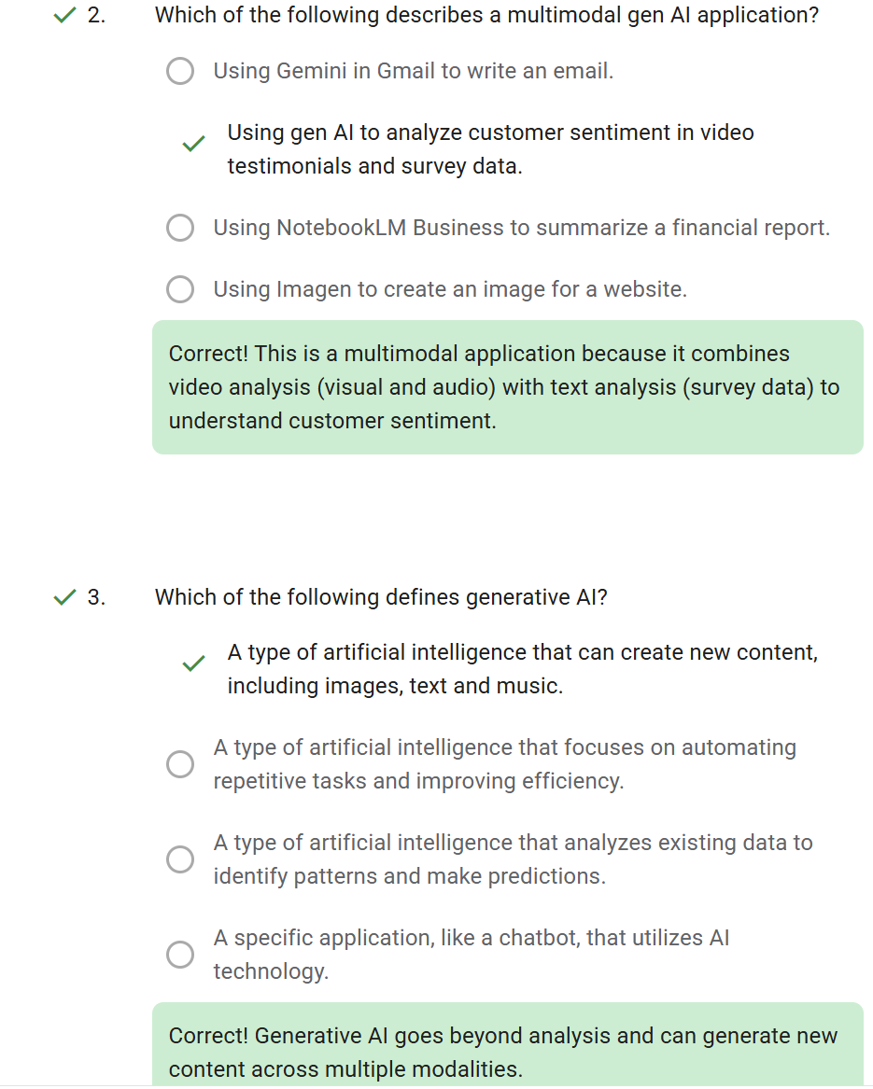
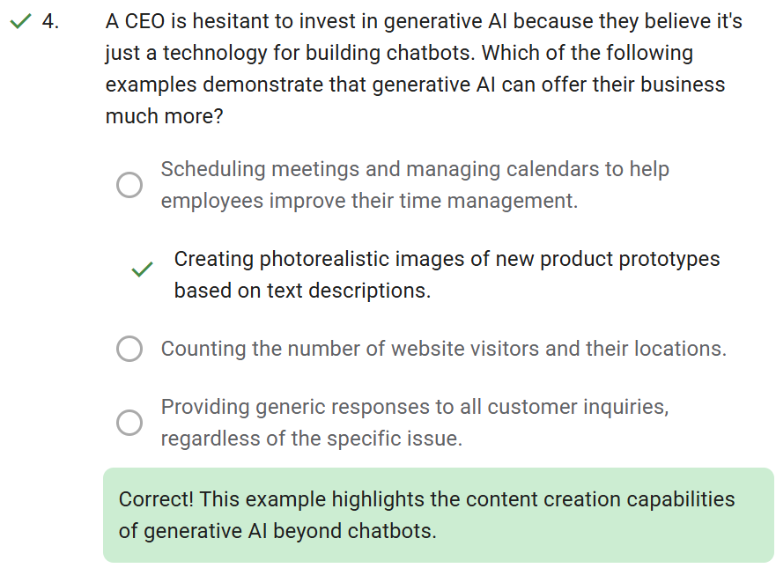

Slide 182
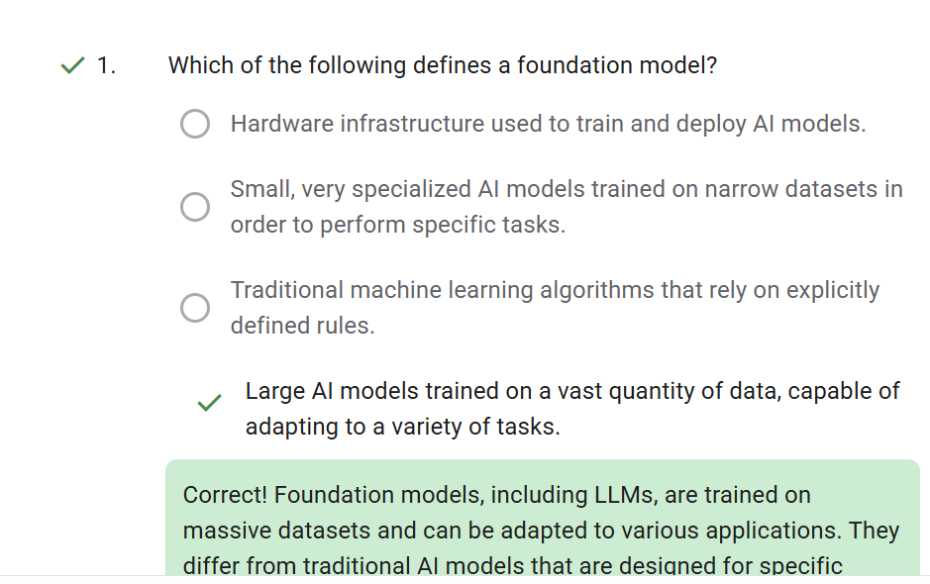
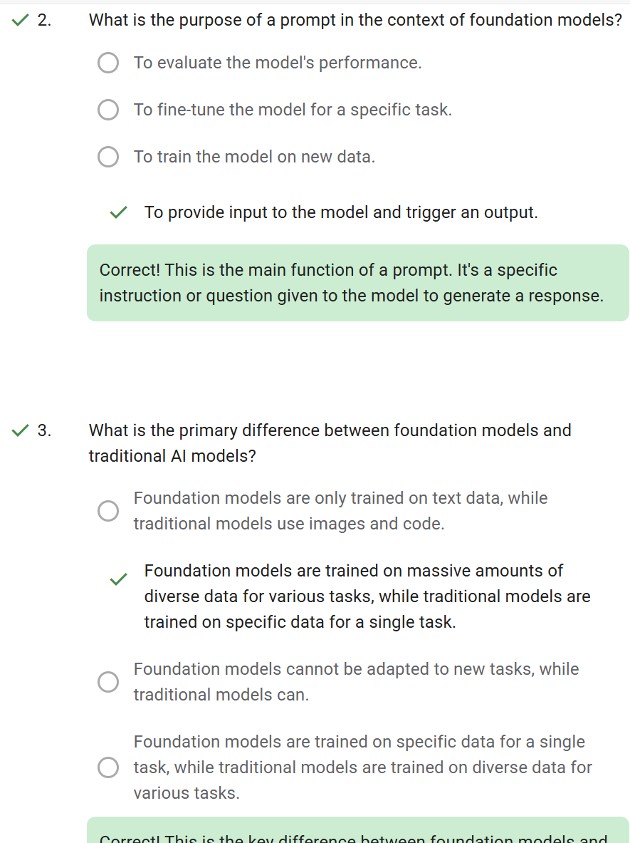
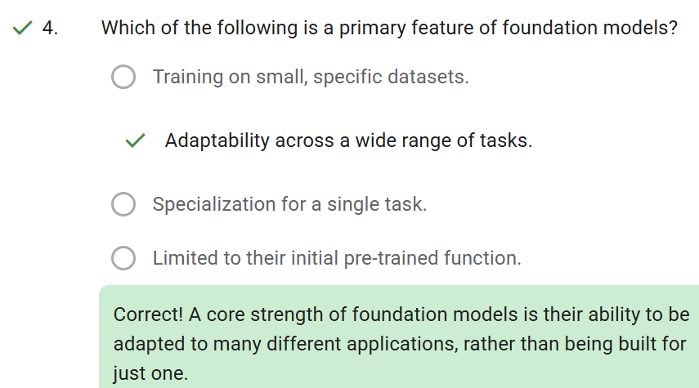
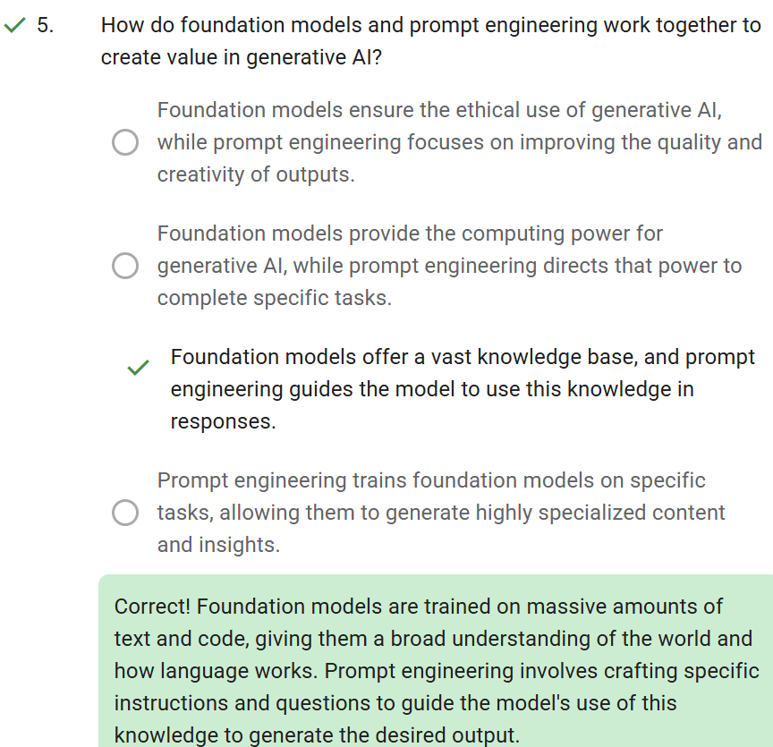

Slide 183
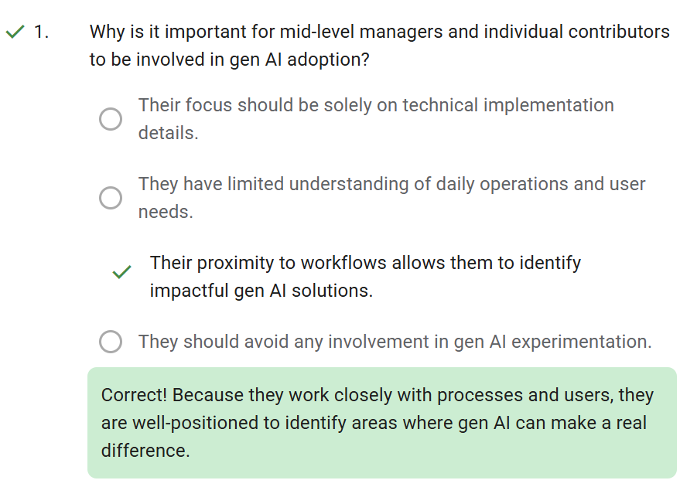
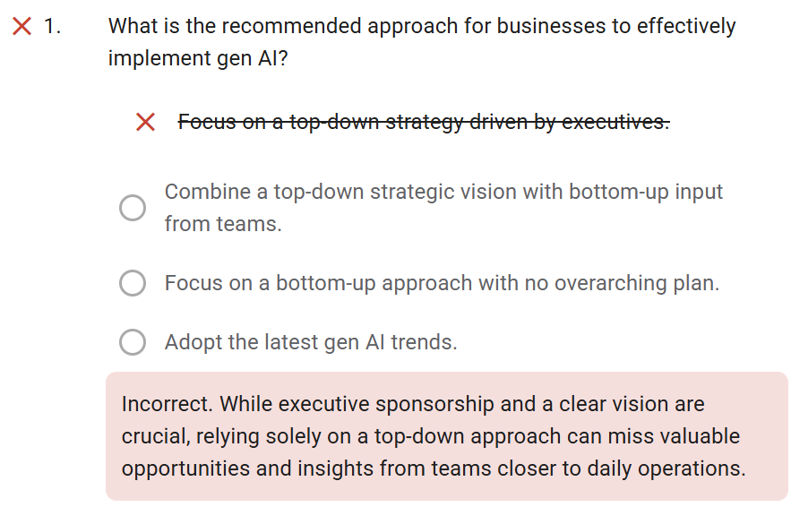
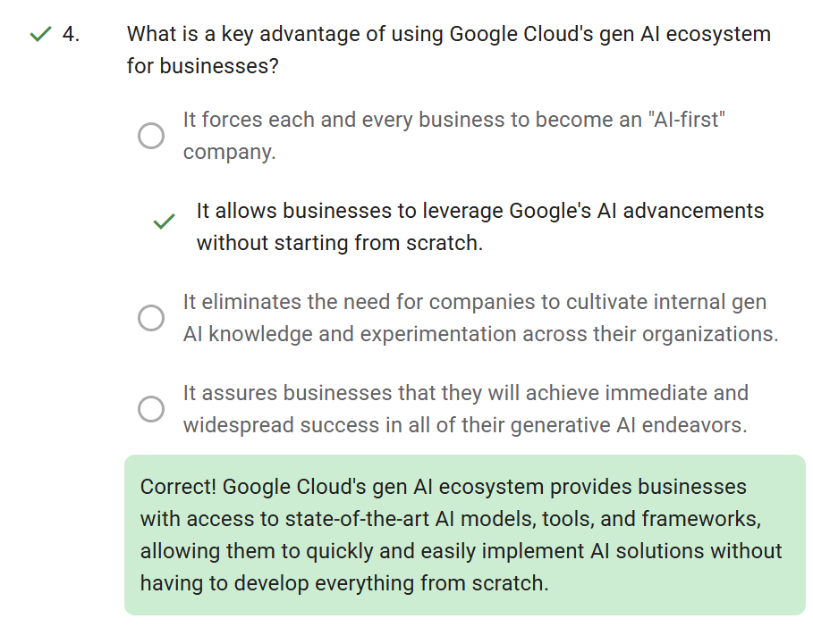
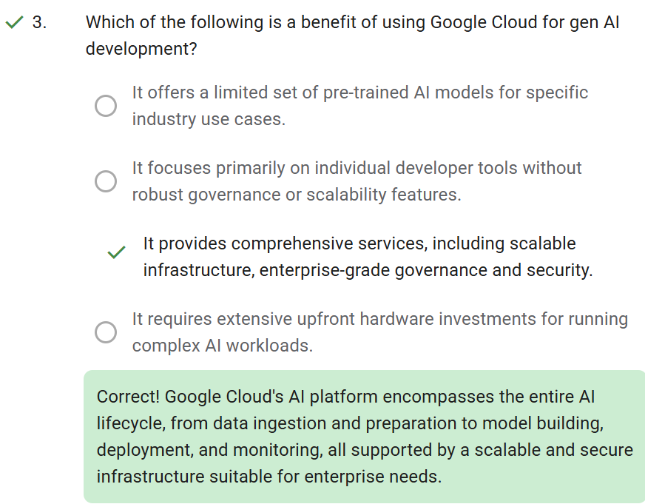
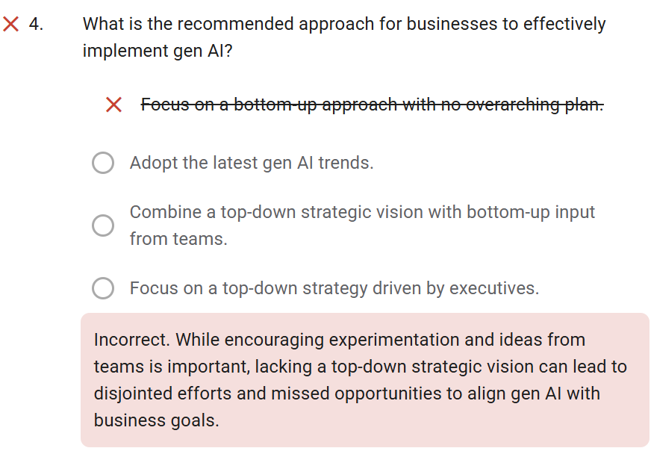

Slide 184
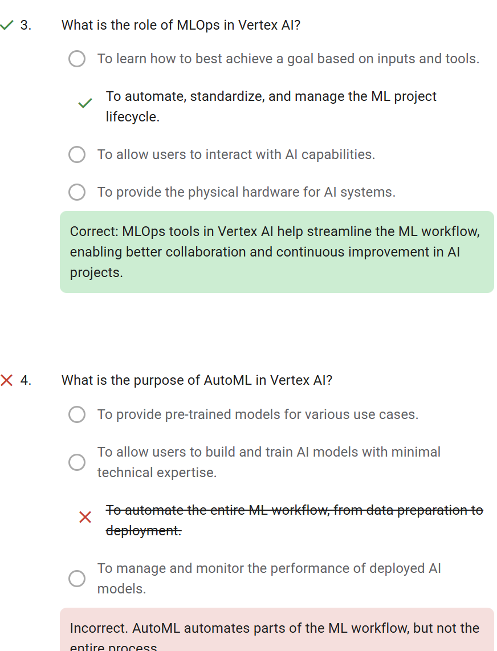
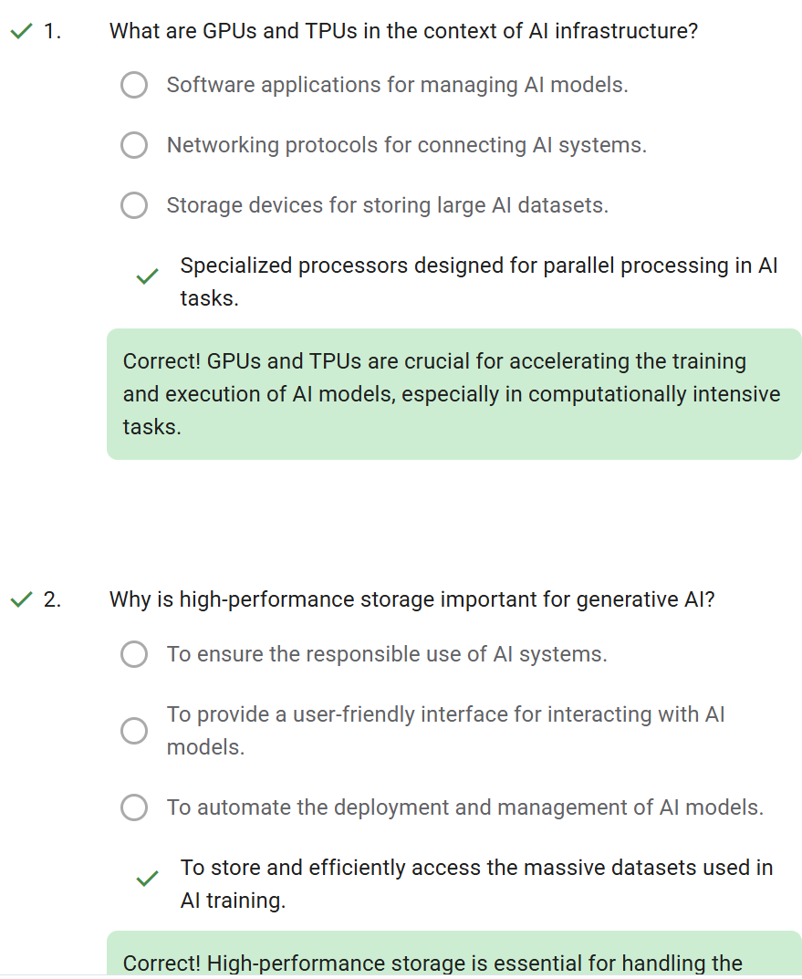
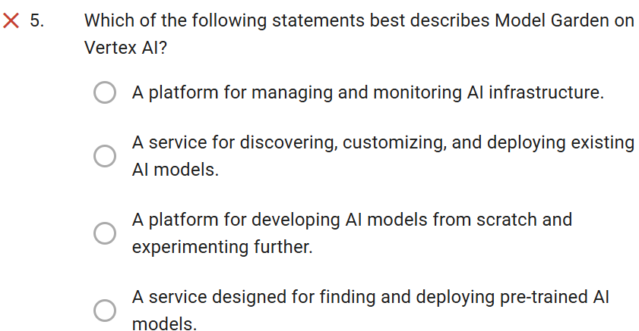
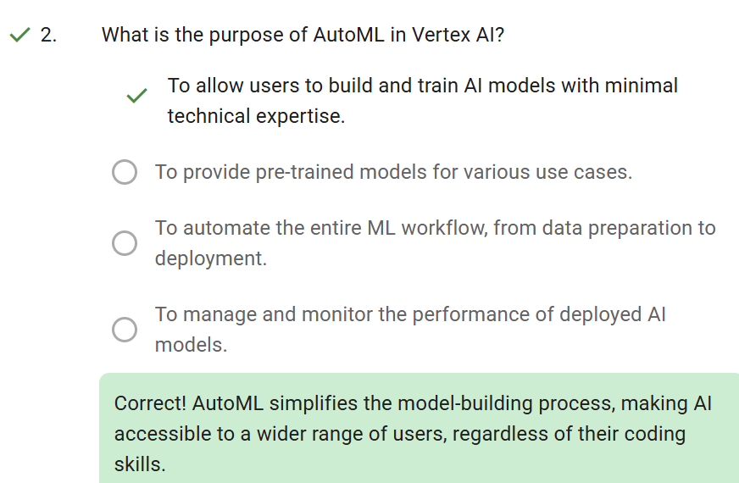

Slide 185
Foundations of Responsible AI
Transparency is key
Privacy in the Age of AI
Data Quality, bias & fairness
  Ethical Ai requires high quality data and responsible use of data itself
  AI inherits societal biases causing unfair outcomes. Fairness must be central to AI component
  Understand how your application
Accountability & explainability

Slide 186
Legal implications
Key legal areas for AI development
  Data privacy
  Non-discrimation
  Intellactual property
  Product liability

