Slide 1
Efficient implementation of image processing algorithm on ARM v8 processor

Slide 2
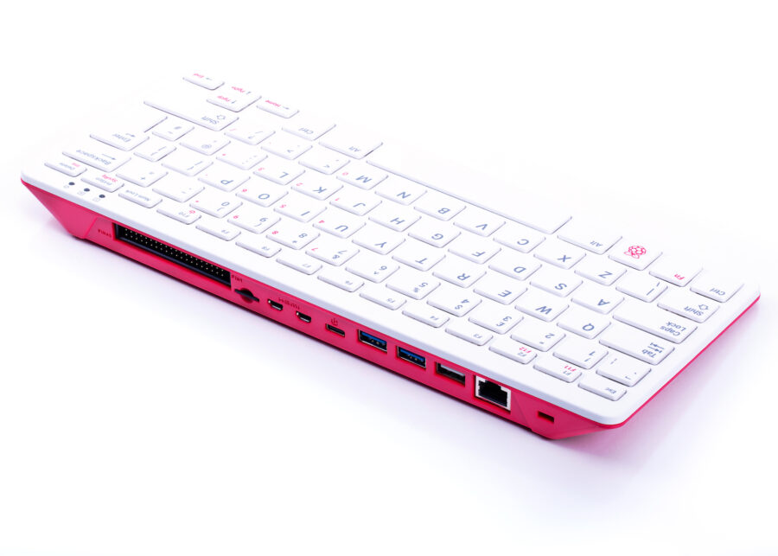
Target Device
Single board computer model - Raspberry Pi 400
SoC specifications-
Broadcom BCM2711 quad-core Cortex-A72
(ARM v8) 64-bit SoC @ 1.8GHz
Memory- 4GB LPDDR4-3200

Slide 3
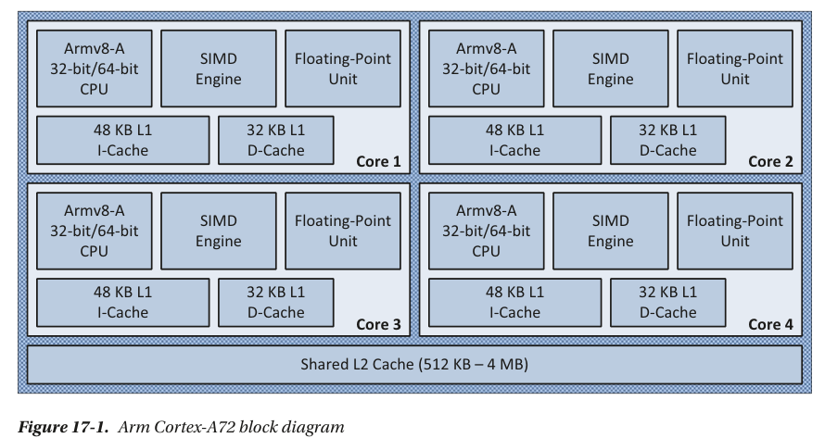
SoC Block Diagram

Slide 4
RGB to Gray conversion
Relatively simple operation
Formula
Gray value = (R *0.2126f + G *0.7152f + B *0.0722f)
R, G, B are Red, Green, and Blue Channel values.

Slide 5
Performance comparison
Maximum speed up achieved for a scalar implementation with thread level parallelism with 4 threads.

Slide 6
Implementations
Scalar implementation(Baseline)-
Simple for loop implementation running on a single core.
SIMD Implementation- Taking advantage of data parallel SIMD engine and implement data operations using AArch64 Neon assembly instructions.
OpenMP implementation- Taking advantage of multicore SoC with different no. of threads from 2 to 32.

Slide 7
Future Exploration
Using different memory map for image file planar or instead of current interleaved.
Combine data and thread level parallelism.
Take cache length and memory hierarchy into account.

Slide 8
Thank you
Umesh Deshmukh
umeshdeshmukh2024@gmail.com

