Slide 1
Filter Design for ECG signal

Slide 2
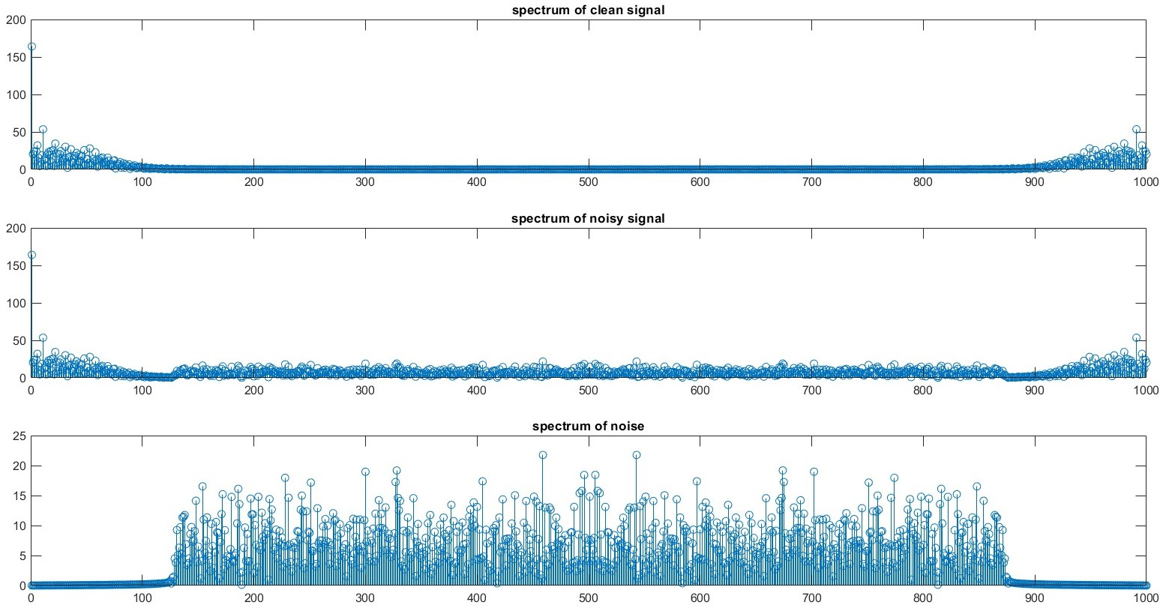
Analyzing input signal in frequency domain

Slide 3
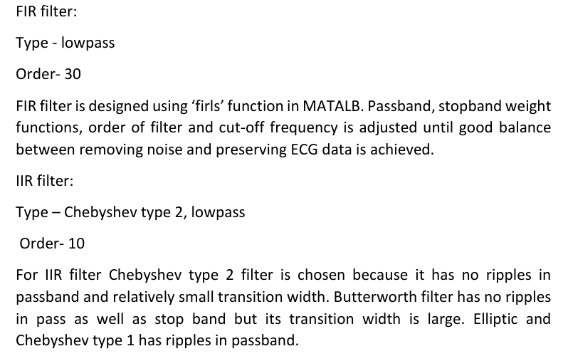
Choosing Filter parameters

Slide 4
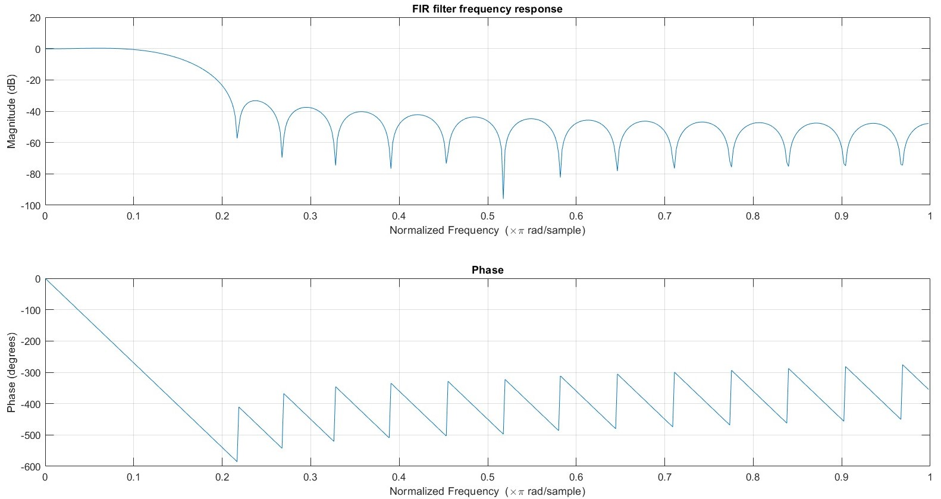
FIR Filter Frequency Response

Slide 5
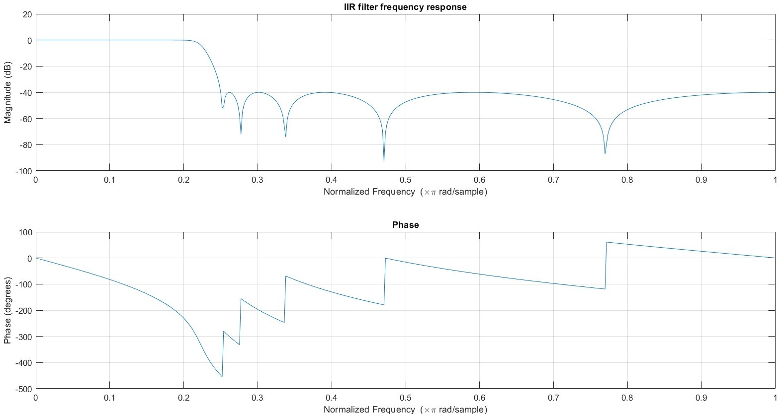
IIR Frequency Response

Slide 6
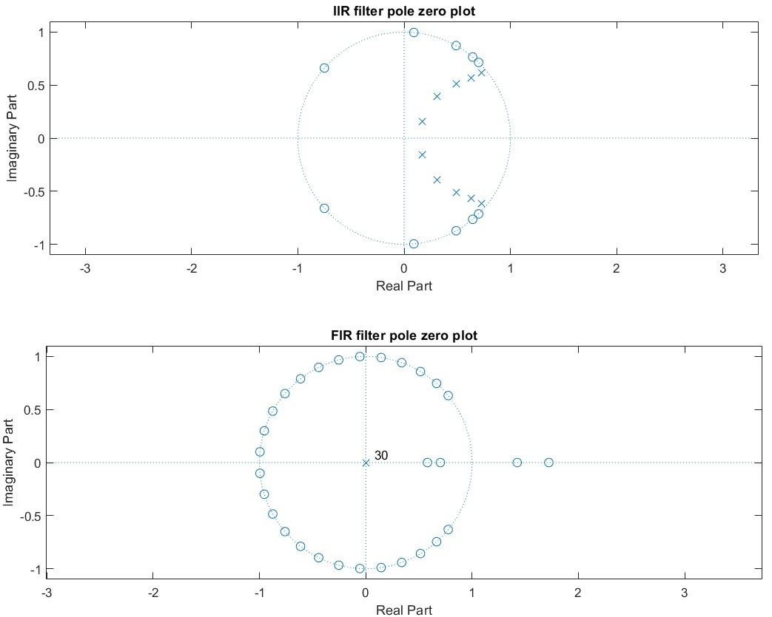
Pole-Zero Plot

Slide 7
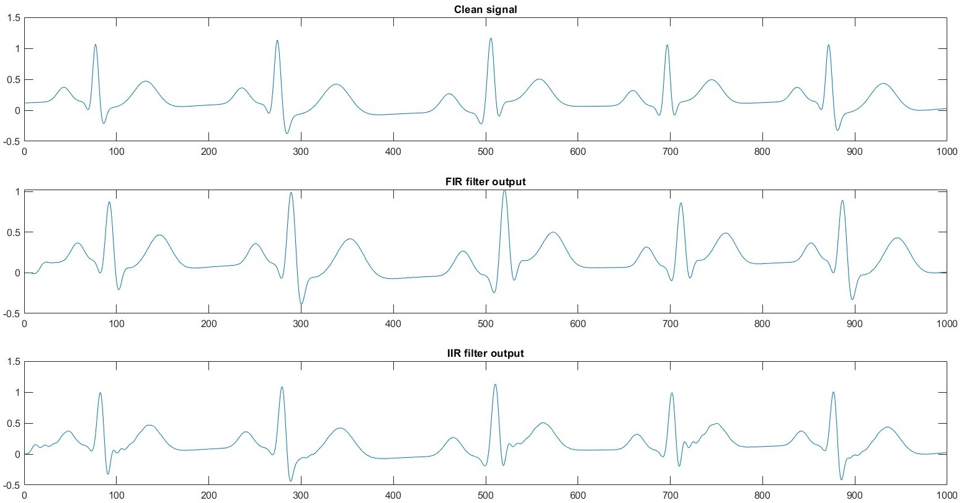
Filter Input Output

Slide 8
Efficient implementation of image processing algorithm on ARM v8 processor

Slide 9
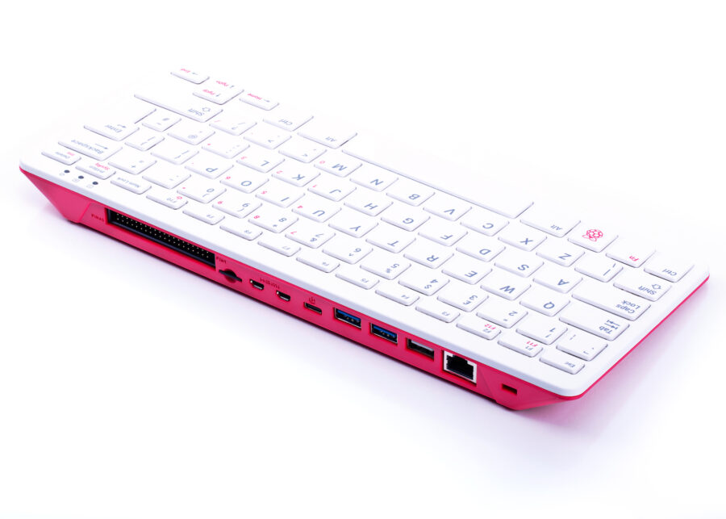
Target Device
Single board computer model - Raspberry Pi 400
SoC specifications-
Broadcom BCM2711 quad-core Cortex-A72
(ARM v8) 64-bit SoC @ 1.8GHz
Memory- 4GB LPDDR4-3200
Image source: https://www.raspberrypi.com/

Slide 10
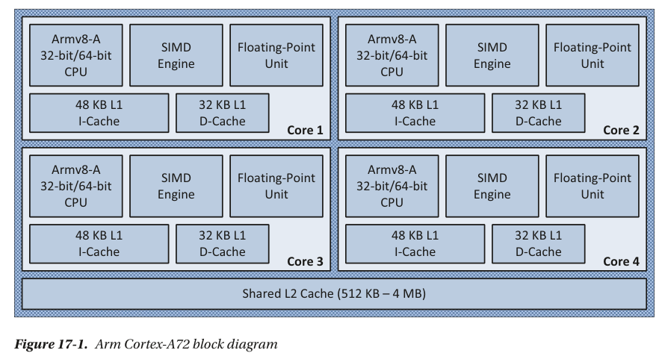
SoC Block Diagram
Image source: Modern Arm Assembly Language Programming Covers Armv8-A 32-bit, 64-bit, and SIMD

Slide 11
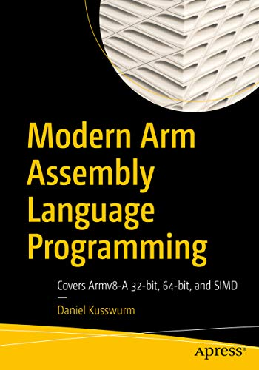
Reference Book
Book link:
https://link.springer.com/book/10.1007/978-1-4842-6267-2

Slide 12
RGB to Gray conversion
Relatively simple operation
Formula
Gray value = (R *0.2126f + G *0.7152f + B *0.0722f)
R, G, B are Red, Green, and Blue Channel values respectively.

Slide 13
Implementations
Scalar implementation(Baseline)-
Simple for loop implementation running on a single core.
SIMD Implementation- Taking advantage of data parallel SIMD engine and implement data operations using AArch64 Neon assembly instructions.
OpenMP implementation- Taking advantage of multicore SoC with different no. of thread configurations from 2 to 32.

Slide 14
Performance comparison
Maximum speed up achieved for a scalar implementation with thread level parallelism with 4 threads.

Slide 15
Future Exploration
Using different memory map for image file planar or instead of current interleaved.
Combine data and thread level parallelism.
Take cache length and memory hierarchy into account.

Slide 16
Thank you
Umesh Deshmukh
umeshdeshmukh2024@gmail.com

