Slide 1
Real-Time Object Dimension Measurement with OpenCV and Machine Learning
Project Reference No.: 48S_BE_2253
Name of the College : Jain College of Engineering and Technology, Hubballi
Branch : Computer Science and Engineering
Student(s) Name:
1. Amogh P Lokhande (2JH21CS015)
2. Shrivatsa D Desai (2JH21CS094)
3. Umesh Laxman Nayak (2JH21CS115)
4. Abhishek Burud (2JH21CS003)
Guide Name: Prof. Pydipogu Preethi B.E., MTech

Slide 2
OBJECTIVES
Develop a monocular depth estimation system to accurately measure object dimensions using a single RGB camera.
Achieve measurement accuracy within ±1–3 cm, rivaling expensive depth sensors.
Enable real-time dimension detection for applications in robotics, automation, and AR/VR.
Assist visually impaired users by recognizing and measuring objects in their surroundings.
Build educational tools for geometry learning and digital literacy enhancement.
Apply the solution in agriculture for sorting and assessing produce based on size.

Slide 3
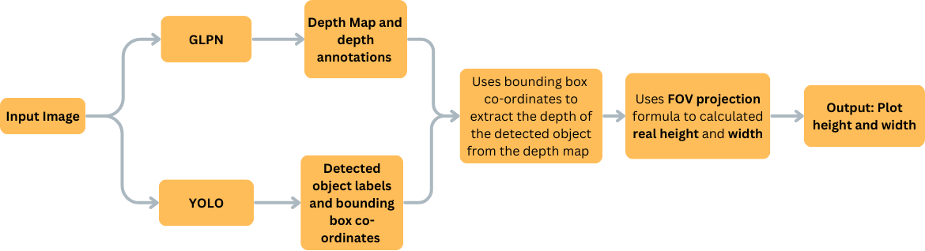
METHODOLOGY
Fig 1: System Architecture

Slide 4
METHODOLOGY contd..,
Image Capture: Captures an input image from a monocular camera.
YOLO Model: Detects objects and provides bounding box coordinates and class labels.
Depth Estimation Model (GLPN): Generates a depth map and depth annotations for the image.
Depth Extraction: Uses bounding box coordinates to extract the object's depth from the depth map.
FOV Projection Calculation: Applies the Field of View (FOV) projection formula to compute real-world height and width.
Output Generation: Plots the estimated height and width on the image for visualization.

Slide 5
WORK PLAN
Project Goal : To develop a real-time, accurate, and low-cost system to detect objects and measure their dimensions using a monocular camera, eliminating the need for expensive depth sensors.
Project Deliverables:
  • Working prototype
  • Codebase with documentation
  • Demo video
Tasks:
1. Literature survey
2. Model selection and training
3. System design and development
4. Integration and testing
5. Evaluation and documentation

Slide 6
WORK PLAN contd..,
Timeline: Oct 2024 - Mar 2025
Status: In progress (Started Oct 2024, Completion by Mar 2025)
Resources:
• Depth camera, GPU-enabled system, Python libraries
Milestones:
• Model integration
• Successful dimension detection
• Midterm evaluation
Risks: Camera calibration issues, model accuracy
Mitigation: Dataset augmentation, tuning parameters

Slide 7
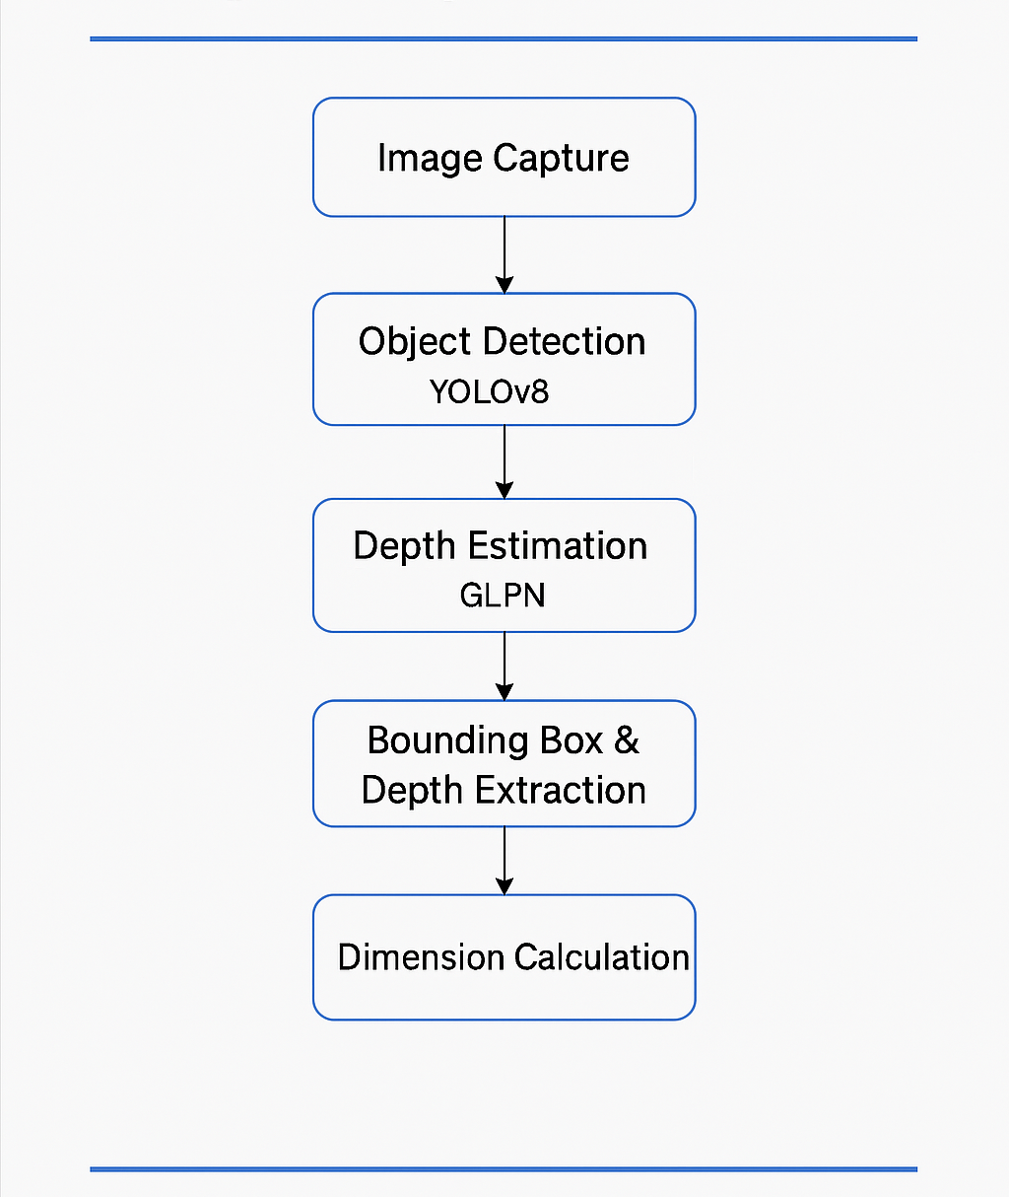
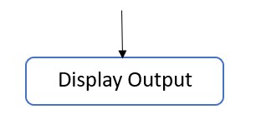
SUMMARY OF PROGRESS - DESIGN & EXPERIMENTS
Fig 2 : Flowchart of the Process

Slide 8
SUMMARY OF PROGRESS - DESIGN & EXPERIMENTS Contd..,
System uses YOLOv8 for object detection and GLPN for depth estimation.
Monocular camera captures images; models extract bounding boxes and depth maps.
Real-world dimensions calculated using FOV projection formula.
Design validated on objects like bottles, remotes, and smartphones.
Encountered challenges with lighting and calibration, improved through preprocessing.

Slide 9
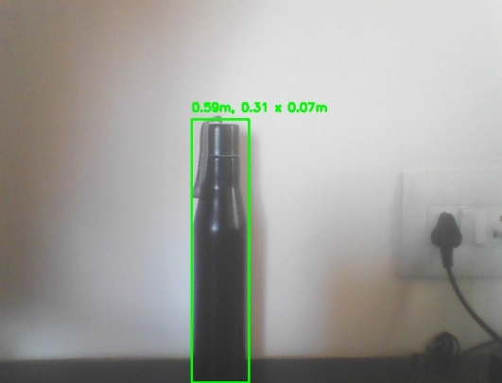
RESULTS, CONCLUSIONS
• Objects successfully detected and measured.
• Accuracy range: ±1-3 cm in most tests.
• Bottles and remotes tested with consistent results.
Fig 3 : Bottle
Conclusion:
The system effectively measures object dimensions using a monocular camera and deep learning models without requiring expensive sensors
• Accurate, low-cost alternative to expensive depth sensors.
• Feasible for real-time applications in various domains.

Slide 10
Project Innovation & Technological Advancement
Uses YOLOv8 and GLPN with a single camera setup.
Avoids expensive LiDAR/stereo cameras.
Achieves real-time performance using lightweight models.
Potential for robotics, e-commerce, and assistive technologies.
Improves accessibility of object measurement tools.

Slide 11
Project Outcome & Industry Relevance:
Provides practical solutions in dimension estimation.
Relevant for industries: robotics, automation, logistics, e-commerce.
Demonstrates real-time feasibility with basic hardware.
Learnings: Depth estimation, model integration, OpenCV applications.

Slide 12
Future Development & Industry Collaboration
• Future Directions:
- Improve accuracy with fine-tuning and more data.
- Develop user interface and backend database.
- Enable multi-object measurement and angle estimation.
• Prototype Development:
- Current version semi-tested.
- Plan for full demo and real-world object integration.
• Industry Collaboration:
- Seek partnerships in smart manufacturing and logistics.
- Explore potential for IPR filing based on model
optimization.

Slide 13
Thank You

