Slide 1
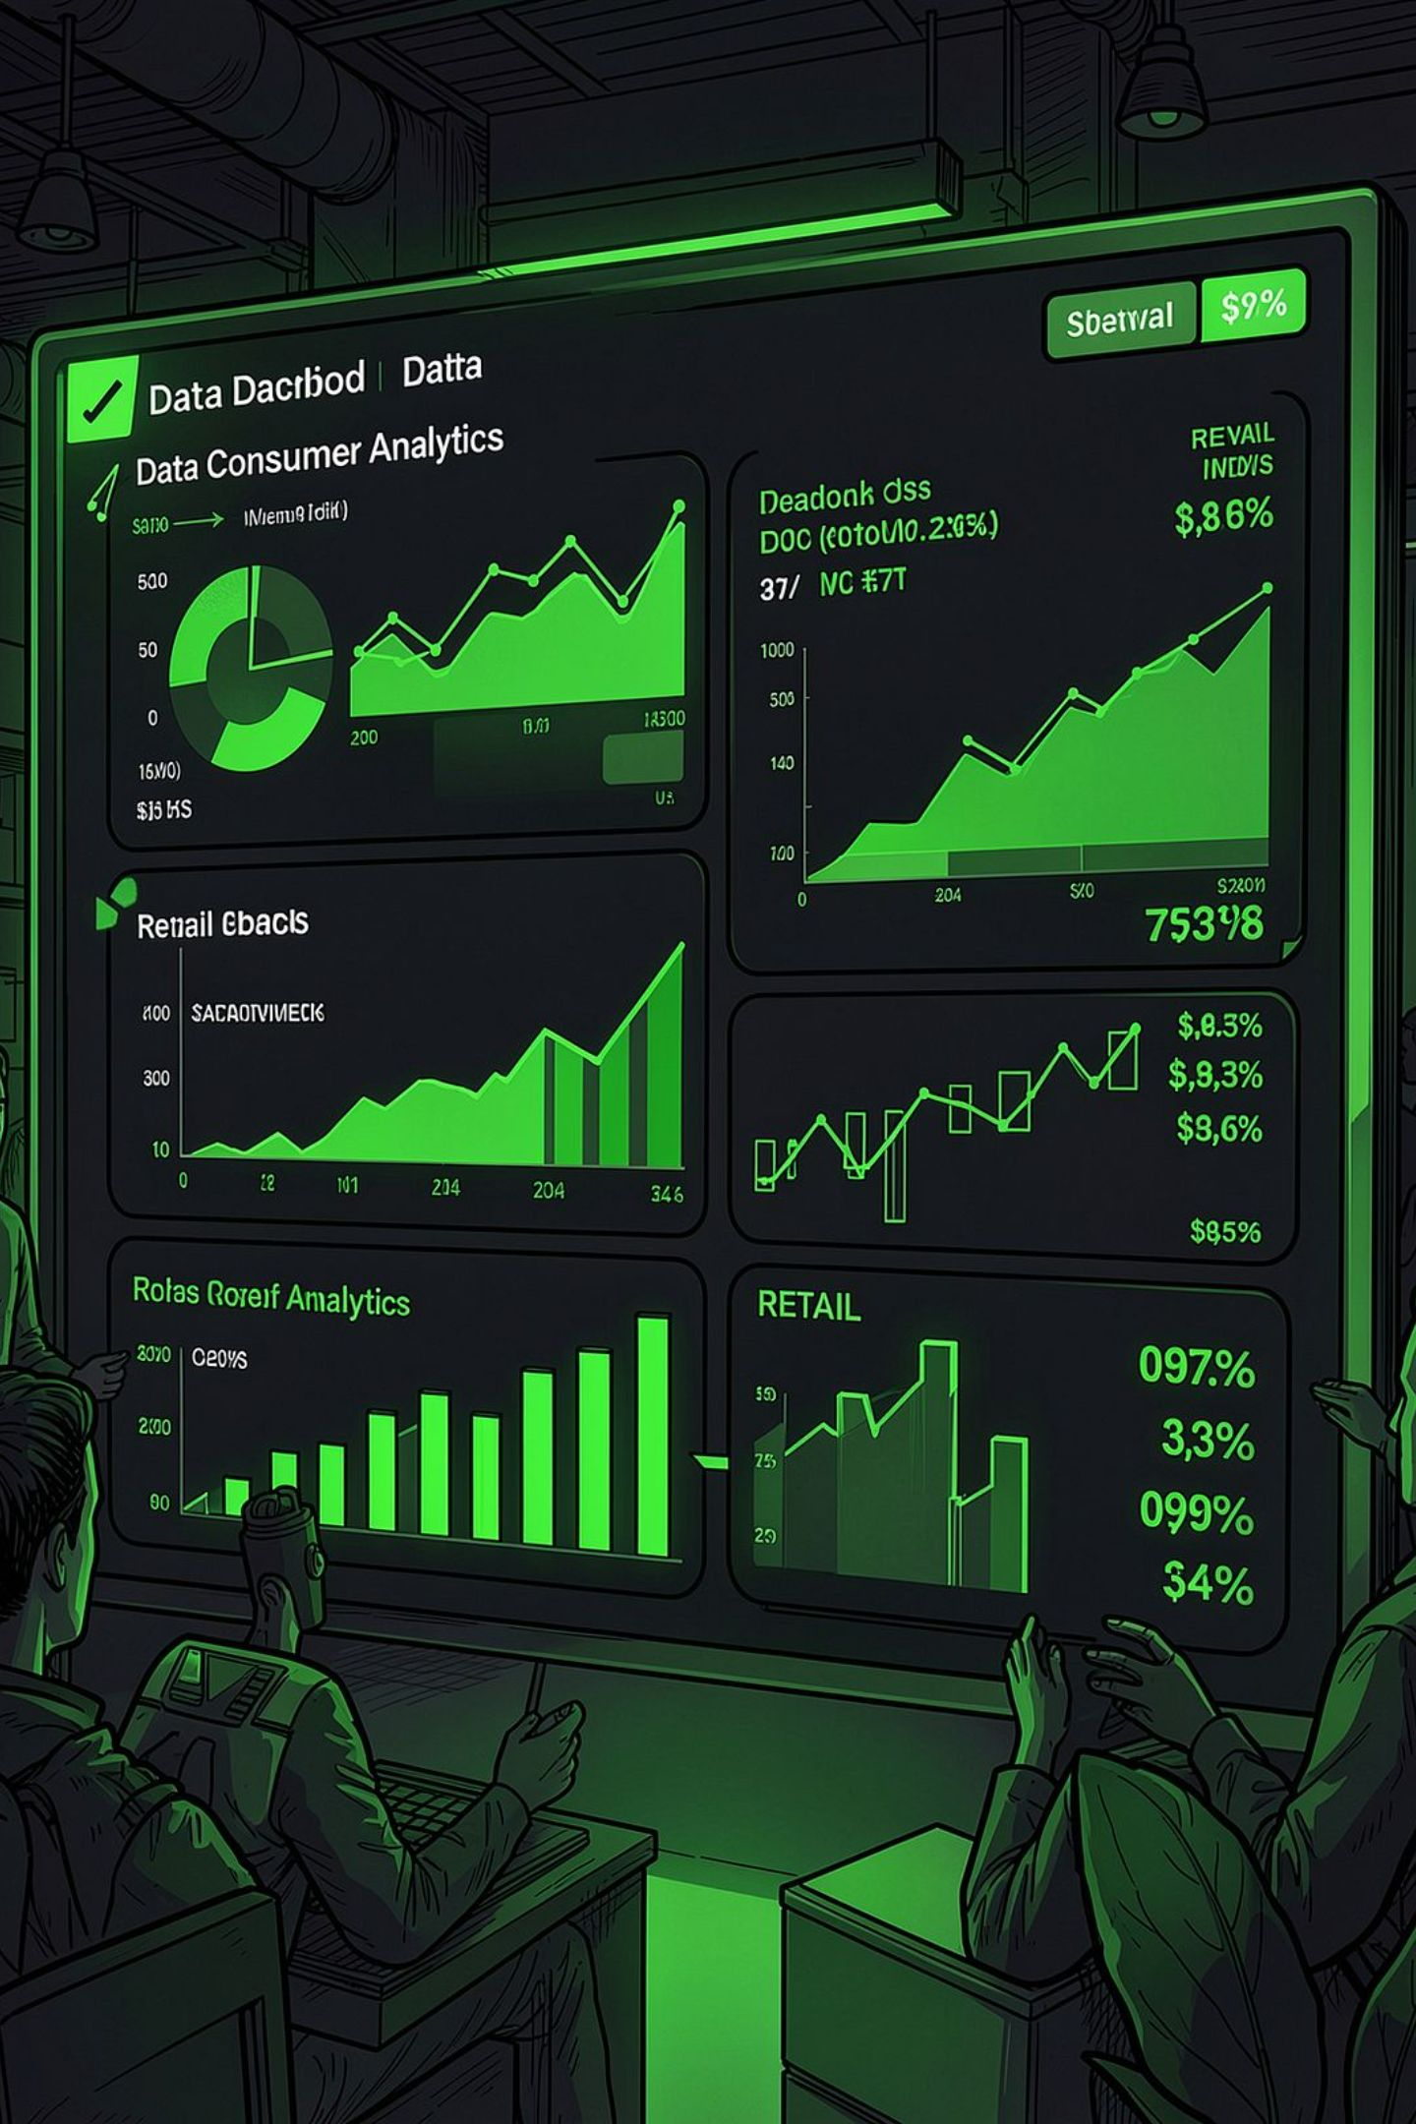
ConsumerIQ
AI-Powered Consumer Purchase Behavior Analytics
BATCH – 19
2420030500 - P Aashish
2420030027 – P Umesh
CONSUMER ANALYTICS
RETAIL ANALYTICS
E-COMMERCE ANALYTICS

Slide 2
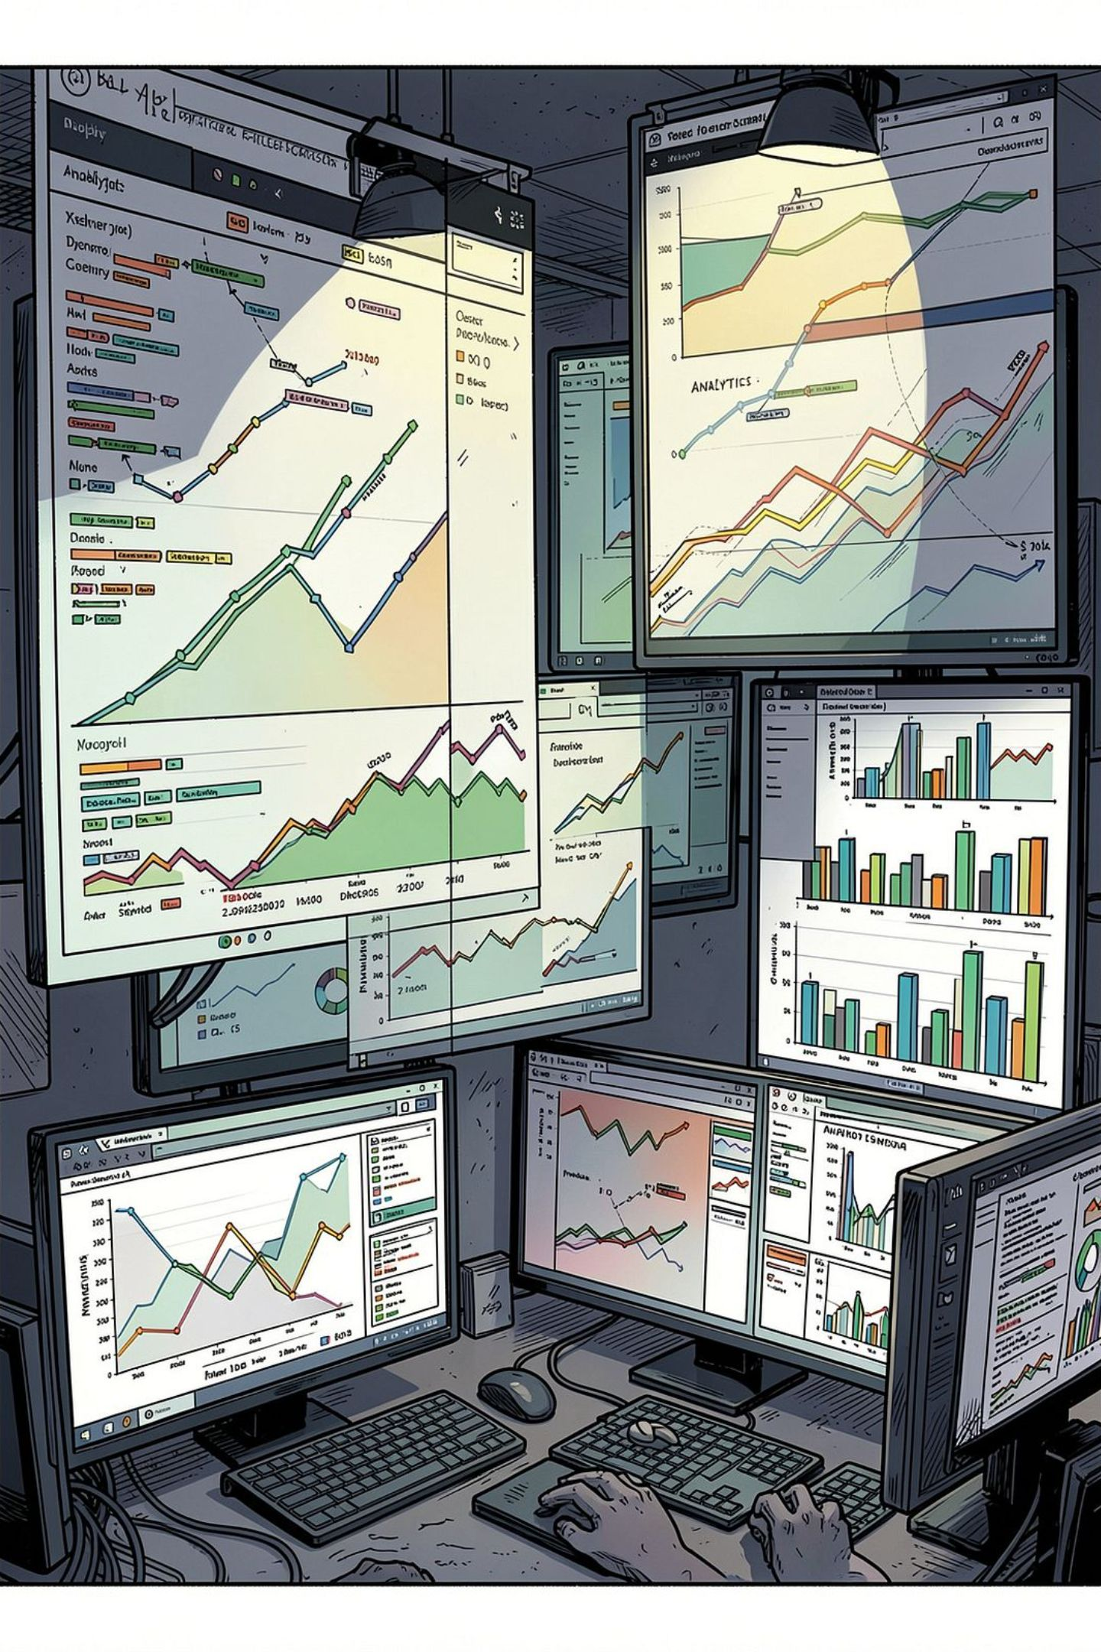
The Problem: Fragmented Consumer Analytics
Siloed Data Sources
Retail and e-commerce platforms generate vast transaction, demographic, product, and behavioral data — but organizations analyze these sources independently.
Task-Specific Approaches
Existing research addresses segmentation, churn, CLV, or purchase prediction separately — rarely as an integrated framework.
Lack of Actionable Output
Insights are often buried in model metrics rather than presented through understandable, interactive visualizations for business decision-makers.

Slide 3
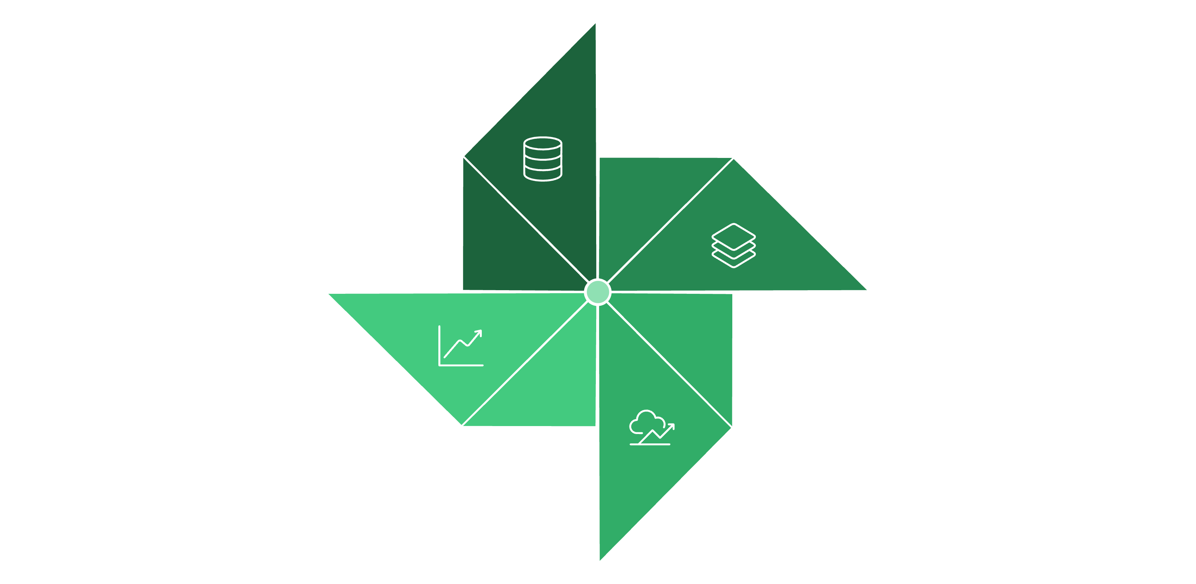
ConsumerIQ: The Solution
ConsumerIQ addresses the research gap by integrating consumer transaction and behavioral data with AI/ML techniques and interactive visualization to generate actionable consumer insights.
Segmentation
Data Integration
Behavior Prediction
Explainable Viz
A unified framework combining multiple consumer datasets, customer segmentation, purchasing pattern identification, behavior prediction, and interactive dashboards.

Slide 4
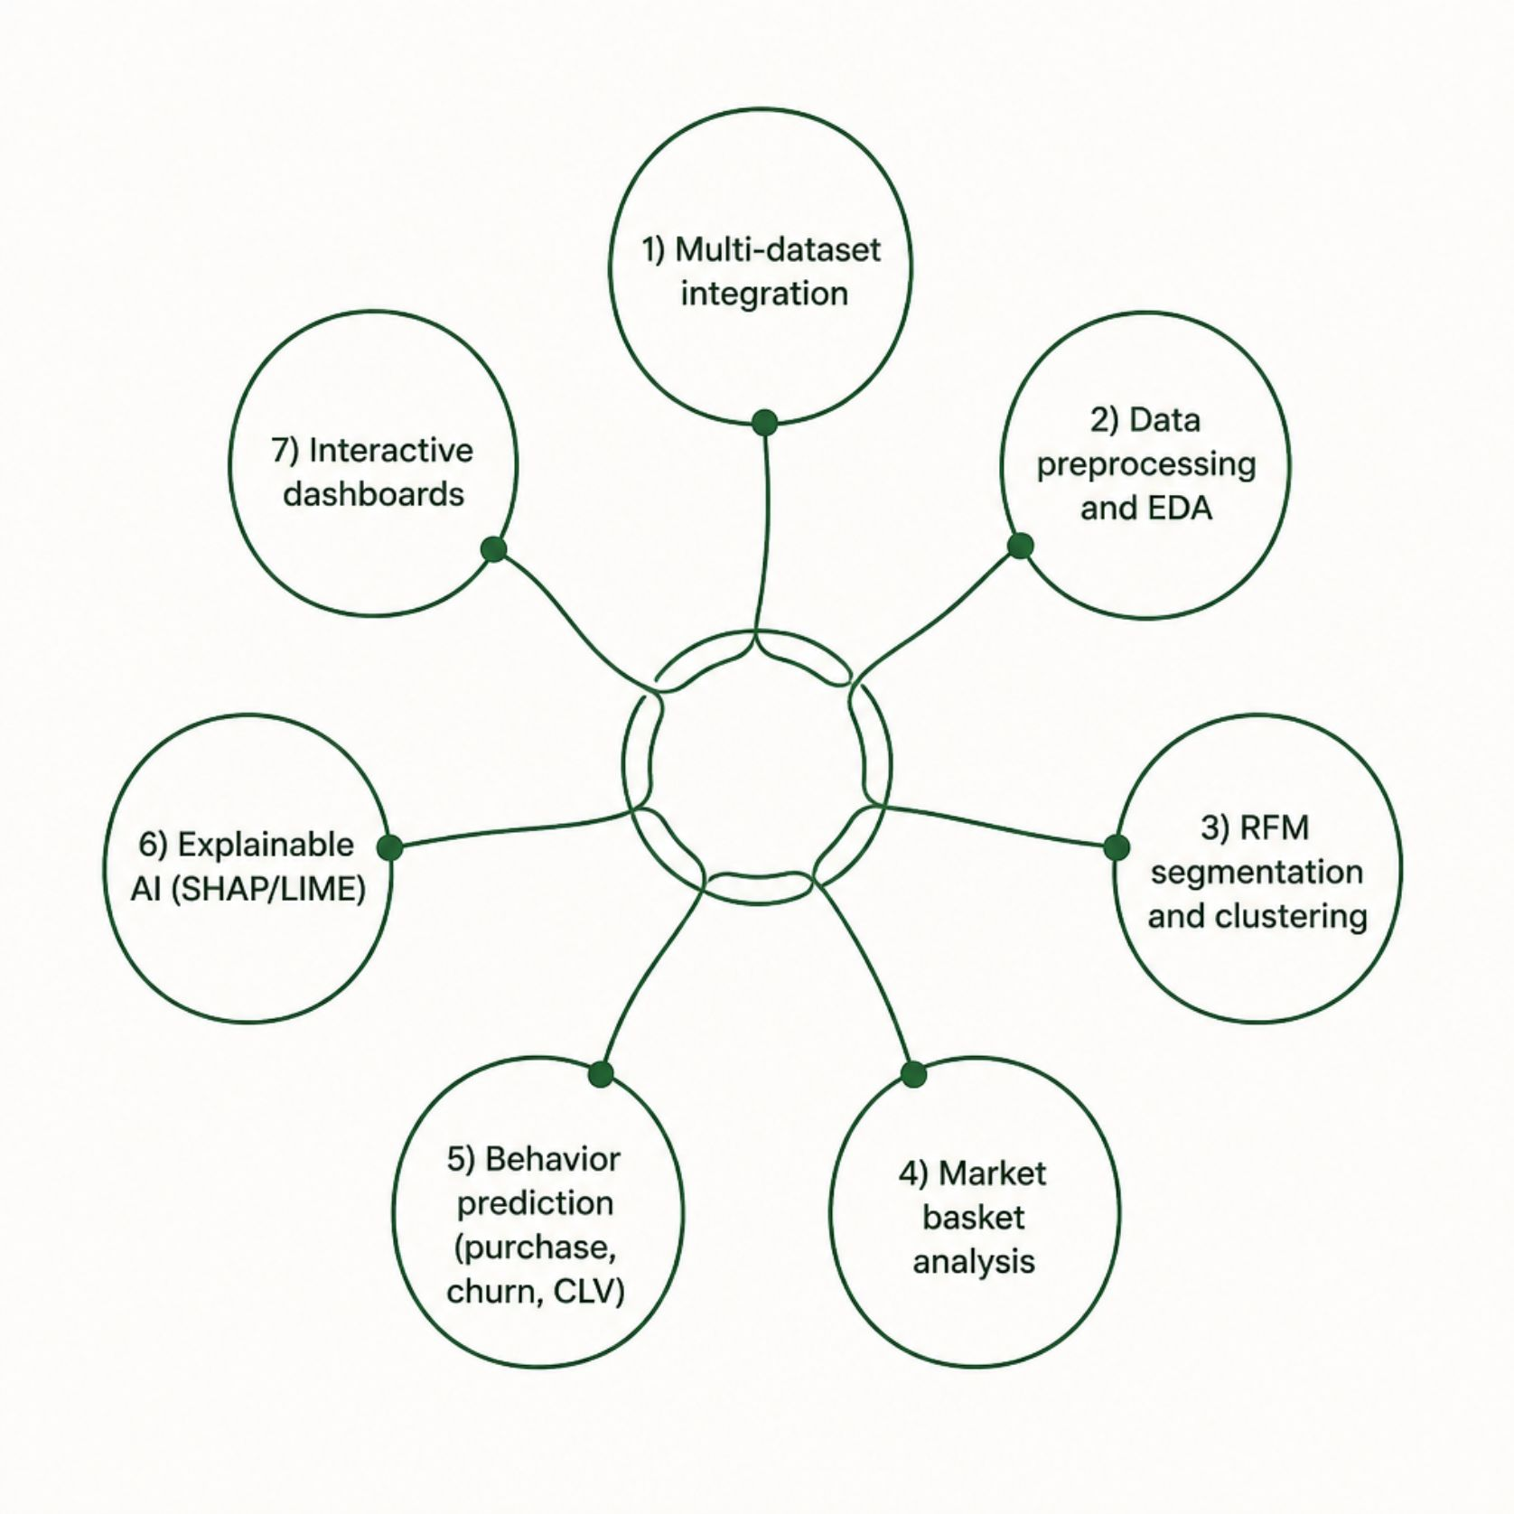
Research Objectives
Primary Objective
Develop an AI-powered analytics framework for analyzing, predicting, and visualizing consumer purchase behavior using machine learning techniques.
Key Specific Objectives
Integrate transaction, demographic, product, and behavioral datasets
Segment customers via RFM analysis and clustering
Identify product associations through market basket analysis
Predict purchase likelihood, churn risk, and customer lifetime value
Apply explainable AI (SHAP/LIME) to interpret predictions
Build interactive dashboards for consumer insights
Compare and evaluate multiple ML approaches

Slide 5
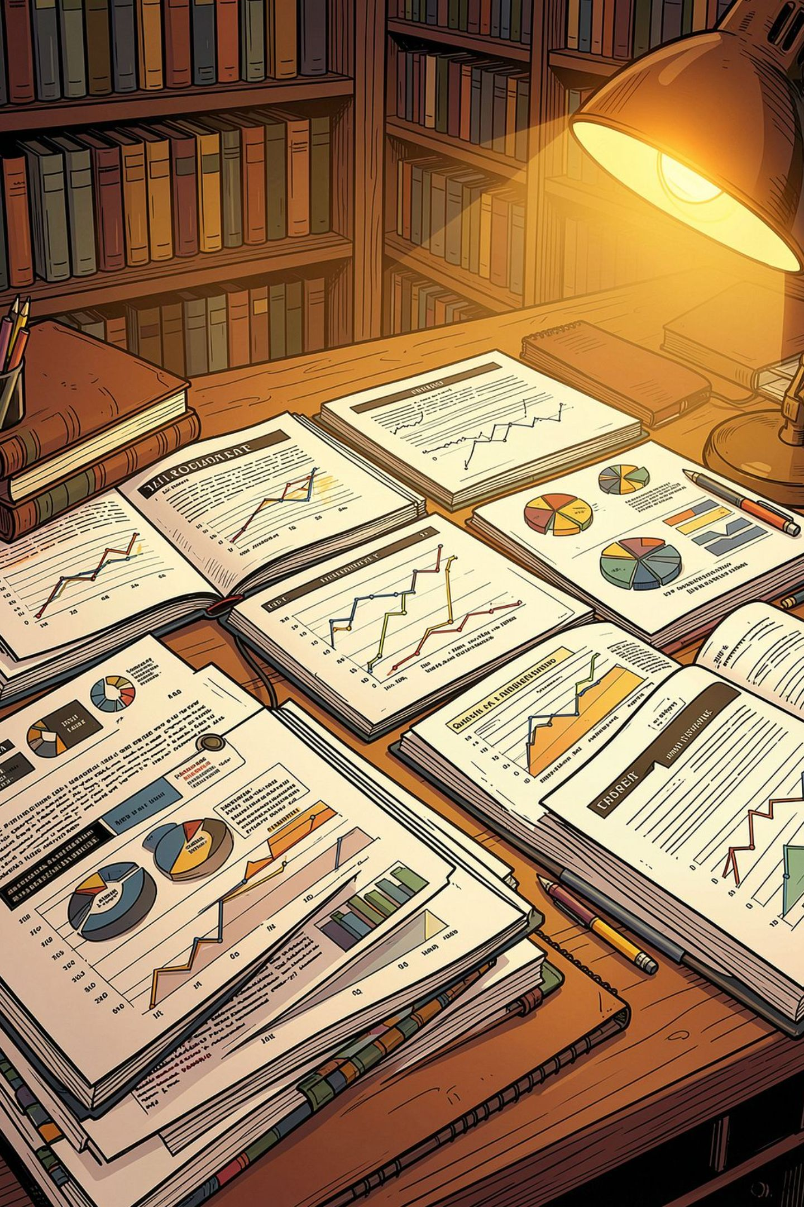
Literature Survey: Segmentation & Profiling
Salminen et al., 2023
Gomes & Meisen, 2023
Reviewed 172 articles; K-means most used. Gap: Focuses on segmentation only, not integrated analytics.
Four-stage targeting: data collection → representation → analysis → targeting. RFM + K-means widely used. Gap: Limited integration of behavioral representation, prediction, and explainability.
Kasem et al., 2024
Combines RFM, K-means, and AI for customer profiling and sales prediction. Gap: No broader multi-dataset analytics pipeline.

Slide 6
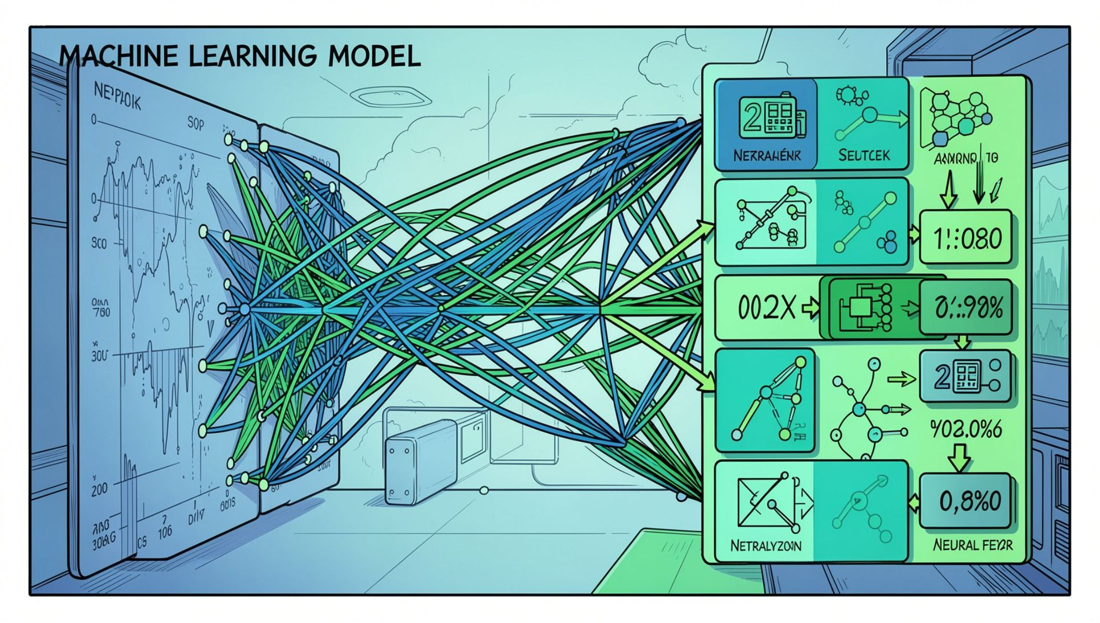
Literature Survey: Prediction & CLV
Yan & Resnick, 2024
1
Scalable CLV system across 12 retail brands using embeddings, Random Forest, and ensemble learning. Gap: CLV-only focus.
Kvíčala et al., 2024/26
2
Online behavior impact on CLV; identifies targeting variables. Gap: Limited predictive/visual integration.
Ehsani & Hosseini, 2024
3
Purchase prediction from clickstream using Oracle meta-classifier. Gap: Prediction-only, no segmentation.
Mena et al., 2024
4
Time-varying RFM + deep neural networks for churn. Gap: Churn-centric, no integrated framework.

Slide 7
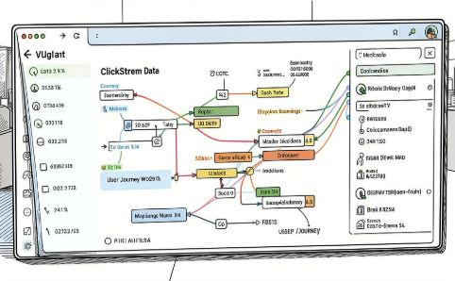
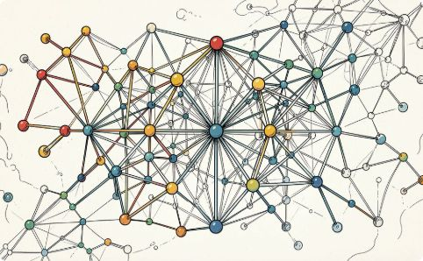
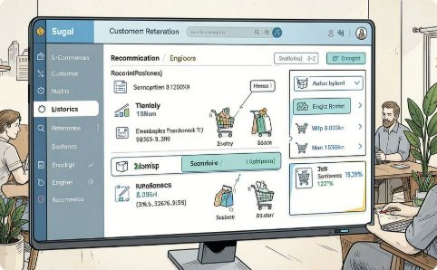
Literature Survey: Behavior, Churn & Retention
Liu et al., 2024
Sagming et al., 2024
Jahan & Sanam, 2024/26
ML vs. deep learning (RNN/LSTM) for purchase prediction. Gap: No segmentation or visual analytics lifecycle.
Topological data analysis + ML for churn; barcode stats improve accuracy. Gap: Specialized to churn only.
Combines churn prediction, segmentation, and recommendation in one framework. Most relevant prior work. Gap: Limited explainability and multi-dataset integration.

Slide 8
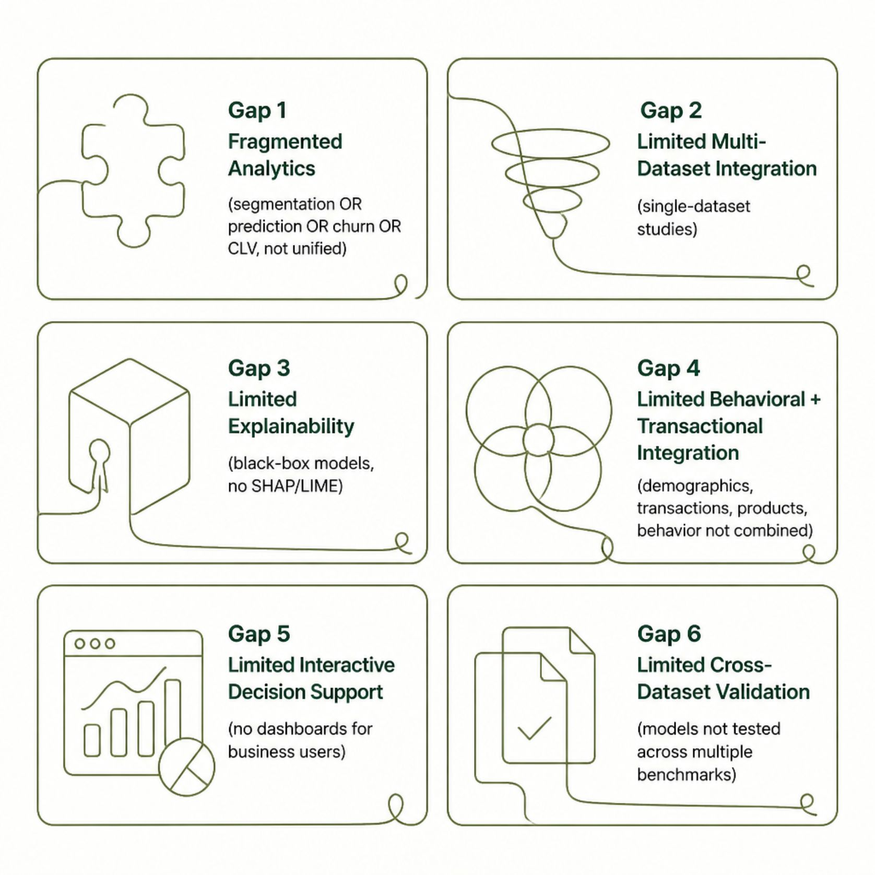
Research Gaps Identified
The Core Opportunity
Recent literature points toward separate methodological approaches for segmentation, targeting, prediction, and CLV. ConsumerIQ addresses this by unifying these tasks in a single, explainable, multi-dataset analytics pipeline with interactive decision support.

Slide 9
ConsumerIQ Innovations
Multi-Dataset Analytics
Unified Pipeline
Explainable Intelligence
Integrates multiple benchmark datasets capturing demographics, transactions, products, and behavior.
EDA → RFM → Segmentation → Market Basket → Prediction → Explainability → Visualization in one framework.
SHAP/LIME explains why a customer is high-value, likely to purchase, or at churn risk.
Action-Oriented Insights
Interactive Visualization
Translates predictions into business guidance — e.g., "High-frequency, high-value customers should receive loyalty campaigns."
Dashboard to explore segments, spending patterns, product associations, trends, CLV, and model explanations.

Slide 10
ConsumerIQ: What Sets It Apart
From Fragmented to Unified
Where prior work isolates segmentation, churn, CLV, or prediction, ConsumerIQ delivers a single integrated framework — combining multi-dataset integration, explainable AI, and interactive dashboards.
Key Differentiators
Multi-dataset consumer behavior integration
End-to-end analytics lifecycle in one system
SHAP/LIME explainability for business users
Interactive dashboard for exploration and decisions
Cross-dataset validation for consistent insights
10
6
5
Papers Reviewed
Research Gaps
Core Innovations
Springer-published studies across segmentation, CLV, churn, and prediction
Fragmented analytics, limited explainability, no unified pipeline
Multi-dataset, unified pipeline, XAI, actionable insights, interactive dashboard

