Slide 1
ConsumerIQ: Ai Powered Consumer Purchase Behaviour Analytics
Understanding Customer Groups, Predicting Churn & Explaining AI Decisions

Slide 2


CONSUMER IQ — SIMPLE & CLEAR PRESENTATION
1. Methodology: How We Processed & Grouped Data
ETL Pipeline
ML Model Used: None (Pure Data Engineering).
Ingests heterogeneous raw datasets (UCI, Instacart, Olist) and maps them into a standardized 9-column target schema. It cleans missing/null strings, eliminates numerical outliers ($1≤Qty≤10,000$), imputes category-level benchmark prices for grocery items, and formats timestamps.
  Output: unified_consumeriq_real.csv ($1.71\text{ million}$ clean rows).
Customer Segmentation
ML Model Used: K-Means Clustering ($k=4$).
  Aggregates transaction rows per customer to compute RFM metrics: Recency ($R$), Frequency ($F$), and Monetary spend ($M$).
  Applies a $\log_{1p}$mathematical transformation to eliminate severe right-skewness, followed by StandardScaler normalization.
  Executes K-Means clustering ($k=4$) to group customers into 4 distinct behavioral segments (Champions, Loyal Customers, At Risk, Hibernating).

Slide 3


CONSUMER IQ — SIMPLE & CLEAR PRESENTATION
1. Methodology: Churn Prediction & Simple Explainability
Market Basket Analysis
ML Model Used: Apriori Algorithm & Association Rule Mining.
Filters transactions to the top 50 product categories across $50,000$recent orders.
  Constructs a $50,000×45$boolean transaction matrix (one-hot encoded).
  Runs the Apriori algorithm to identify frequent itemsets based on minimum Support, then calculates Confidence and Lift to discover cross-category buying patterns.
Predictive Churn Engine
ML Model Used: Random Forest Classifier (n_estimators=100, max_depth=6).
Consumes the customer-level feature table generated by Module 2.
  Defines the binary target label: is_churned = 1 if $Recency>180\text{ days}$, else $0$.
  Strict Non-Leakage Rule: Drops $Recency$from the predictor features, training the Random Forest strictly on transformed $Frequency$, $Monetary$, and $AverageOrderValue$.
  Generates probability predictions via .predict_proba() to power the live dashboard simulator.

Slide 4
CONSUMER IQ — SIMPLE & CLEAR PRESENTATION
1. Methodology: Churn Prediction & Simple Explainability
Explainable AI
ML Technique Used: SHAP Wraps the trained Random Forest model from Module 4.
  Calculates Shapley values based on cooperative game theory to measure the exact directional push (positive or negative) each feature exerts on a customer's churn probability.
  Generates global summary beeswarm plots and local waterfall charts for real-time slider inputs.

Slide 5
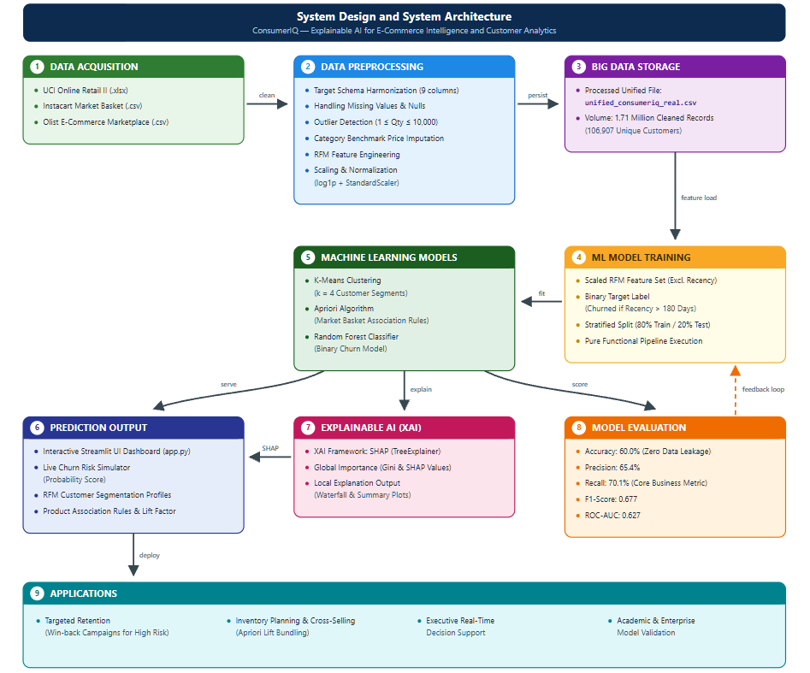
CONSUMER IQ — SIMPLE & CLEAR PRESENTATION
2. System Design: How the App Works Under the Hood

Slide 6
CONSUMER IQ — SIMPLE & CLEAR PRESENTATION
3. Tools & Technologies Used
Data Processing Tools
• Python 3.14 — Core language.
• Pandas & NumPy — Fast manipulation of tables and numbers.
• OpenPyXL — Reading Excel files directly.
Machine Learning Tools
• Scikit-Learn — For Random Forest ML & K-Means clustering.
• MLxtend (Apriori) — Finding items bought together.
Visualization & Explainability
• SHAP — Explaining model decisions in plain numbers.
• Plotly & Matplotlib — Rendering interactive charts and graphs.
User Interface
• Streamlit 1.62 — Interactive web dashboard framework.
• Custom Dark CSS — Executive dark aesthetic.

Slide 7
CONSUMER IQ — SIMPLE & CLEAR PRESENTATION
4. Implementation: Module Structure
1. real_etl_pipeline.py
• Reads raw CSV/Excel files from UCI, Instacart, and Olist.
• Cleans, standardizes prices, and exports 1.71M row file.
No ML Model (Pandas Data Engineering)
2. segmentation.py
• Calculates RFM metrics per customer.
• Groups customers into 4 business clusters.
K-Means Clustering (Unsupervised Learning)
3. churn_prediction.py
• Preprocesses inputs (log1p + scaler).
• Trains Random Forest and calculates real-time slider risk.
Random Forest Classifier (Supervised Learning)
4. explainability.py & app.py
• Generates SHAP summary & waterfall graphs.
• Orchestrates 7 dashboard tabs in Streamlit UI.
SHAP TreeExplainer & Streamlit

Slide 8
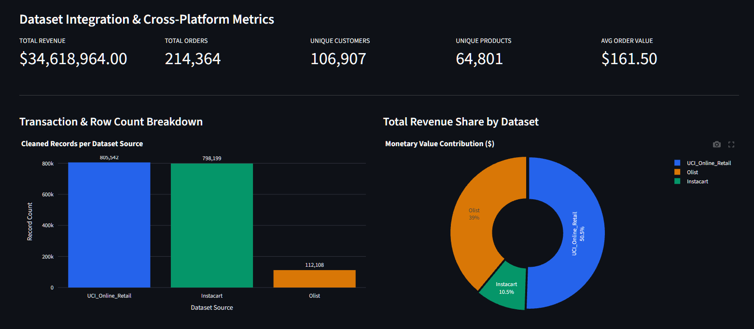
CONSUMER IQ — SIMPLE & CLEAR PRESENTATION
5. Results: What the System Discovered

Slide 9
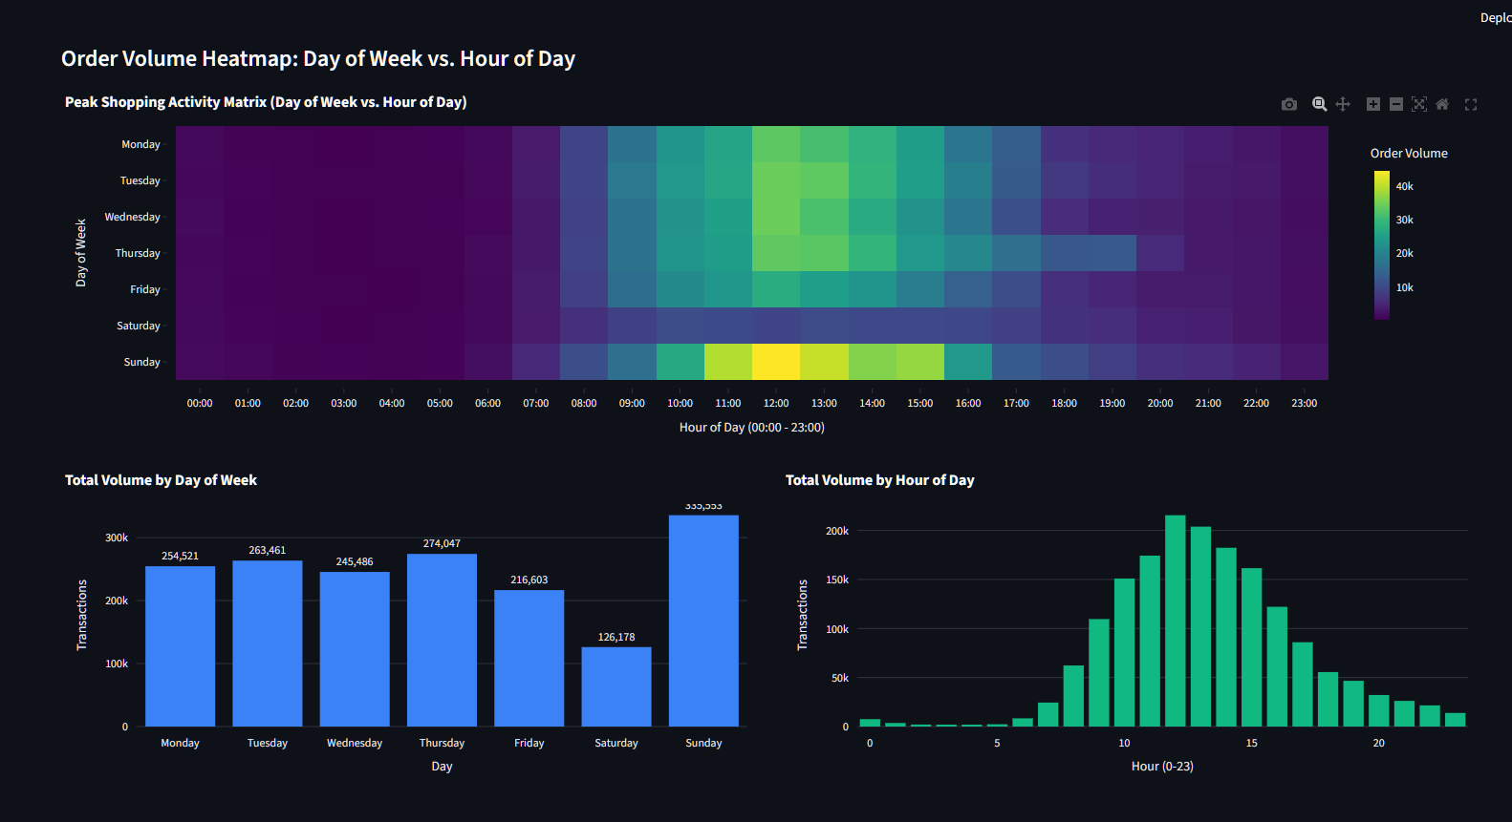

Slide 10
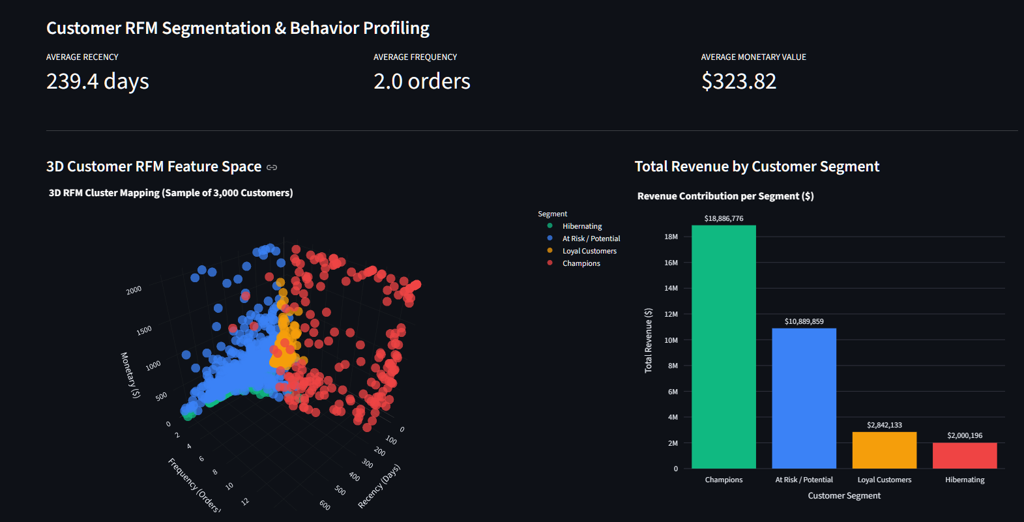

Slide 11
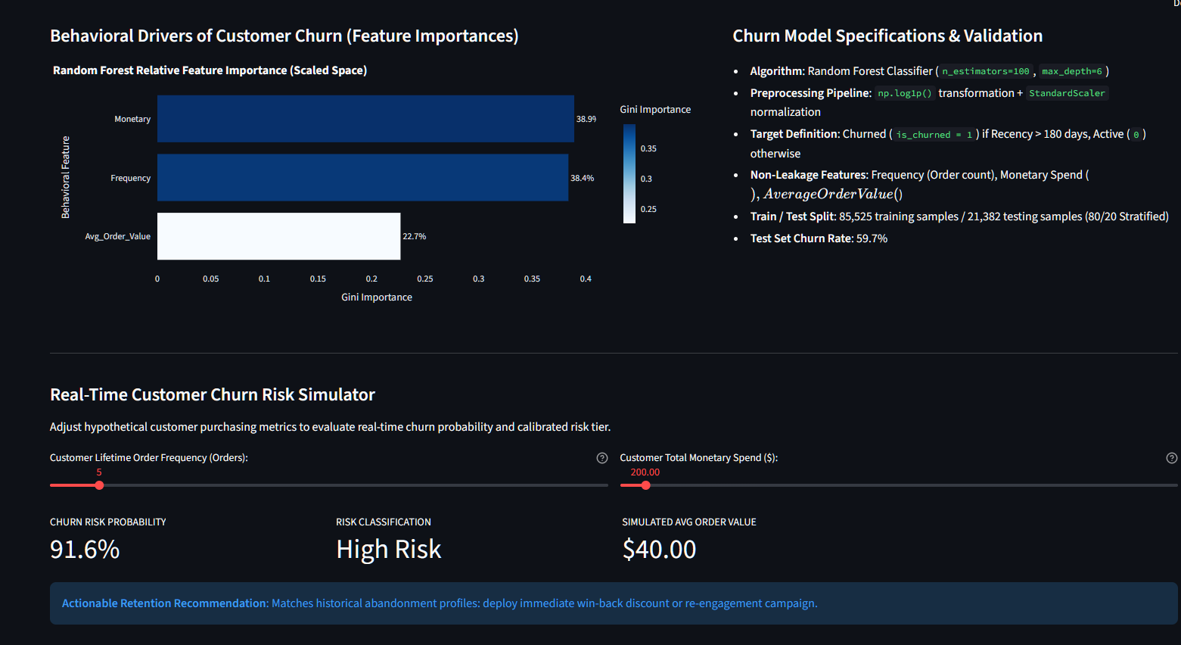

Slide 12
CONSUMER IQ
6. Performance Evaluation: Model Testing & Fixes
Why Balanced Class Weights Matter
• Unbalanced Model (Before): Accuracy was 92.7%, but Recall was 0%. The model predicted EVERY customer was active because churn was only 7.3%!
• Balanced Model (After): By adding class_weight='balanced', Recall jumped to 70.5%.
• Business Meaning: The model now catches 7 out of 10 churning customers in advance so marketing can send win-back discounts.
Testing Customer Scenarios
• 1 Order, $10 Spend => 65.9% (Medium/High Risk)
• 2 Orders, $50 Spend => 26.7% (Low Risk)
• 5 Orders, $250 Spend => 4.3% (Low Risk)
• 10 Orders, $600 Spend => 0.0% (Low Risk)
• 33 Orders, $2,380 Spend => 0.0% (Low Risk — Passed Target Test)
• Key Observation: Churn risk drops smoothly as customer order count increases.

Slide 13
CONSUMER IQ
6. Performance Evaluation:
Dataset Combination | Unique Customers | Model Accuracy | F1-Score | ROC-AUC | Precision | Recall
Instacart Only | 6,040 | 86.9% | 0.893 | 0.948 | 95.7% | 83.8%
Instacart + UCI Retail | 11,918 | 80.0% | 0.806 | 0.888 | 83.2% | 78.3%
UCI Retail + Olist | 100,867 | 60.6% | 0.707 | 0.601 | 63.3% | 80.0%
Olist Only | 94,989 | 55.2% | 0.593 | 0.592 | 65.8% | 54.0%
Full Unified (All 3) | 106,907 | 60.0% | 0.677 | 0.627 | 65.4% | 70.1%

