Slide 1

ChatGPT-Based Adaptive Service Composition for Natural Language-Driven Distributed Retail Microservices
SOA Project Review-1
 | Under the Guidance of K. Venkateswari Professor, Department of Computer Science and Engineering, KLH CSE Bowrampet Campus
Team Members 2420030251 - M Rakesh 2420030576 – E Hitesh 2420030027 – P Umesh

Slide 2
Outline of Project Work
Problem Statemen
Objectives
Literature Survey
Gap Identification
Innovation, Creativity And Novelity
Feasibility
Project Plan

Slide 3
Problem Statement
Modern e-commerce systems provide multiple services such as product search, inventory, cart, and order management.
Users often need to perform several separate operations to complete a single shopping requirement.
Existing microservice architectures do not inherently understand complex natural-language requests.
There is a need for an intelligent mechanism to interpret user intent and coordinate the required services.
The proposed system addresses this using ChatGPT-based adaptive service composition across distributed retail microservices.

Slide 4
Problem Statement
Modern e-commerce systems provide multiple services such as product search, inventory, cart, and order management.
Users often need to perform several separate operations to complete a single shopping requirement.
Existing microservice architectures do not inherently understand complex natural-language requests.
There is a need for an intelligent mechanism to interpret user intent and coordinate the required services.
The proposed system addresses this using ChatGPT-based adaptive service composition across distributed retail microservices.

Slide 5
Objectives
Develop a distributed retail microservice architecture for Product, Inventory, Cart, Order, Payment and related services.
Integrate ChatGPT for natural-language intent and constraint extraction from customer requests.
Develop an adaptive service-composition layer that maps user intent to the required retail microservices.
Implement backend validation and controlled execution so that AI-generated actions cannot directly bypass business rules or databases.

Slide 6
Literature Survey
Authors | Title of the Paper | Methodology | Inferences | Limitation/Future work
Samoylenko H.T. & Selivanova A.V. (2024) | Microservice Architecture of the E-Commerce System | • Decomposes e-commerce functionality into independent microservices • Defines functional and non-functional requirements • Uses client-server and microservice architecture • Supports independent deployment and scaling | • Microservices improve modularity, flexibility and scalability of e-commerce systems • Different business functions can be implemented as independent services • Provides a structured architecture for distributed retail applications | • Focuses mainly on architectural design of e-commerce microservices • Does not address natural-language interaction or AI-based service selection/composition
Wang et al. (Gorilla, 2023/2024) | Gorilla: Teaching LLMs to Use Tools | • Fine-tunes an LLM for API/tool usage • Introduces APIBench for evaluating API calls • Uses document retrieval to handle changing API documentation • Focuses on accurate API generation and tool selection | • LLMs can interact with external APIs and tools • Retrieval improves adaptation to changing APIs • Demonstrates the potential of LLMs for converting natural-language requirements into executable API calls | • Primarily focuses on generating API calls rather than complete multi-service retail workflows • Reliability, validation and orchestration across multiple business services remain important challenges
Qin et al. (2023) | ToolLLM: Facilitating Large Language Models to Master 16,000+ Real-World APIs | • Develops a general tool-use framework for LLMs • Creates the ToolBench dataset using ChatGPT-generated instructions • Trains and evaluates models for selecting and using real-world APIs | • LLMs can learn to identify and invoke large numbers of external APIs to satisfy user instructions • Demonstrates the feasibility of tool-based natural-language interaction | • Primarily addresses general API/tool usage rather than domain-specific retail service composition • Coordinating multiple dependent APIs and enforcing business constraints requires additional system-level orchestration

Slide 7
Problem Gap Identification
Gap 1 — No intelligent retail-specific service composition
Existing e-commerce microservice research establishes modular and scalable service architectures, but does not provide an AI-driven mechanism for dynamically composing services from natural-language shopping requirements.
Gap 2 — API-use research is not focused on retail transactions
LLM API-use studies demonstrate API selection and invocation, but they do not sufficiently address domain-specific constraints such as inventory validation, cart operations, order consistency, and payment workflows.
Gap 3 — Service composition requires validation and orchestration
Research on ChatGPT-based service composition shows that LLMs can help generate multi-service workflows, but reliable execution still requires backend validation, dependency management, and controlled orchestration.

Slide 8
Innovation, Creativity, and Novelty
Innovation
Integration of ChatGPT with a distributed retail microservice architecture.
Enables customers to interact with the shopping system using natural-language queries.
Converts user requirements into structured intent, entities, constraints, and actions.
Creativity
Introduces adaptive service composition, where the required microservices are selected according to the customer's request.
A single natural-language request can trigger a sequence of services such as Product → Inventory → Cart → Order.
Provides conversational responses instead of requiring users to manually perform every individual operation.
Novelty
The key novelty is an AI-assisted service composition layer that bridges natural-language customer requirements and distributed retail microservices, while keeping transaction validation and execution under backend control.

Slide 9
Feasibility and Project Plan
Technical Feasibility
The proposed system is technically feasible using widely available development technologies and frameworks. The backend can be implemented using Java and Spring Boot, with independent microservices for retail operations. Spring Cloud Eureka can provide service discovery, while Spring Cloud Gateway can manage API routing. MySQL can be used for persistent data storage, and the ChatGPT/OpenAI API can provide natural-language understanding and intent extraction. Postman, Git, and IntelliJ IDEA/VS Code can be used for testing and development.
Operational Feasibility
The system is designed around commonly used online shopping workflows such as product search, inventory checking, cart management, and order processing. Users can interact through a simple web interface and natural-language queries, making the system easy to use without requiring knowledge of individual APIs.
Economic Feasibility
The project can be developed using mostly open-source tools such as Java, Spring Boot, Spring Cloud, MySQL, Maven, Git, and Postman. The main external cost is associated with OpenAI API usage, which can be controlled during development through limited testing and predefined queries.
Project Feasibility
The project can be developed incrementally by first implementing the individual microservices, followed by service discovery, API Gateway, inter-service communication, and finally ChatGPT integration and adaptive service composition.

Slide 10
Feasibility and Project Plan
Phase 1 – Requirement Analysis & Architecture
Identify system requirements
Define retail services
Design overall system architecture
Define database structure
Phase 2 – Core Microservices
Develop User Service
Develop Product Service
Develop Inventory Service
Develop Cart Service
Phase 3 – Transaction Services
Develop Order Service
Develop Payment Service
Develop Notification Service
Integrate databases
Phase 4 – Microservice Infrastructure
Implement Eureka Service Discovery
Implement API Gateway
Configure inter-service communication
Implement centralized configuration

Slide 11
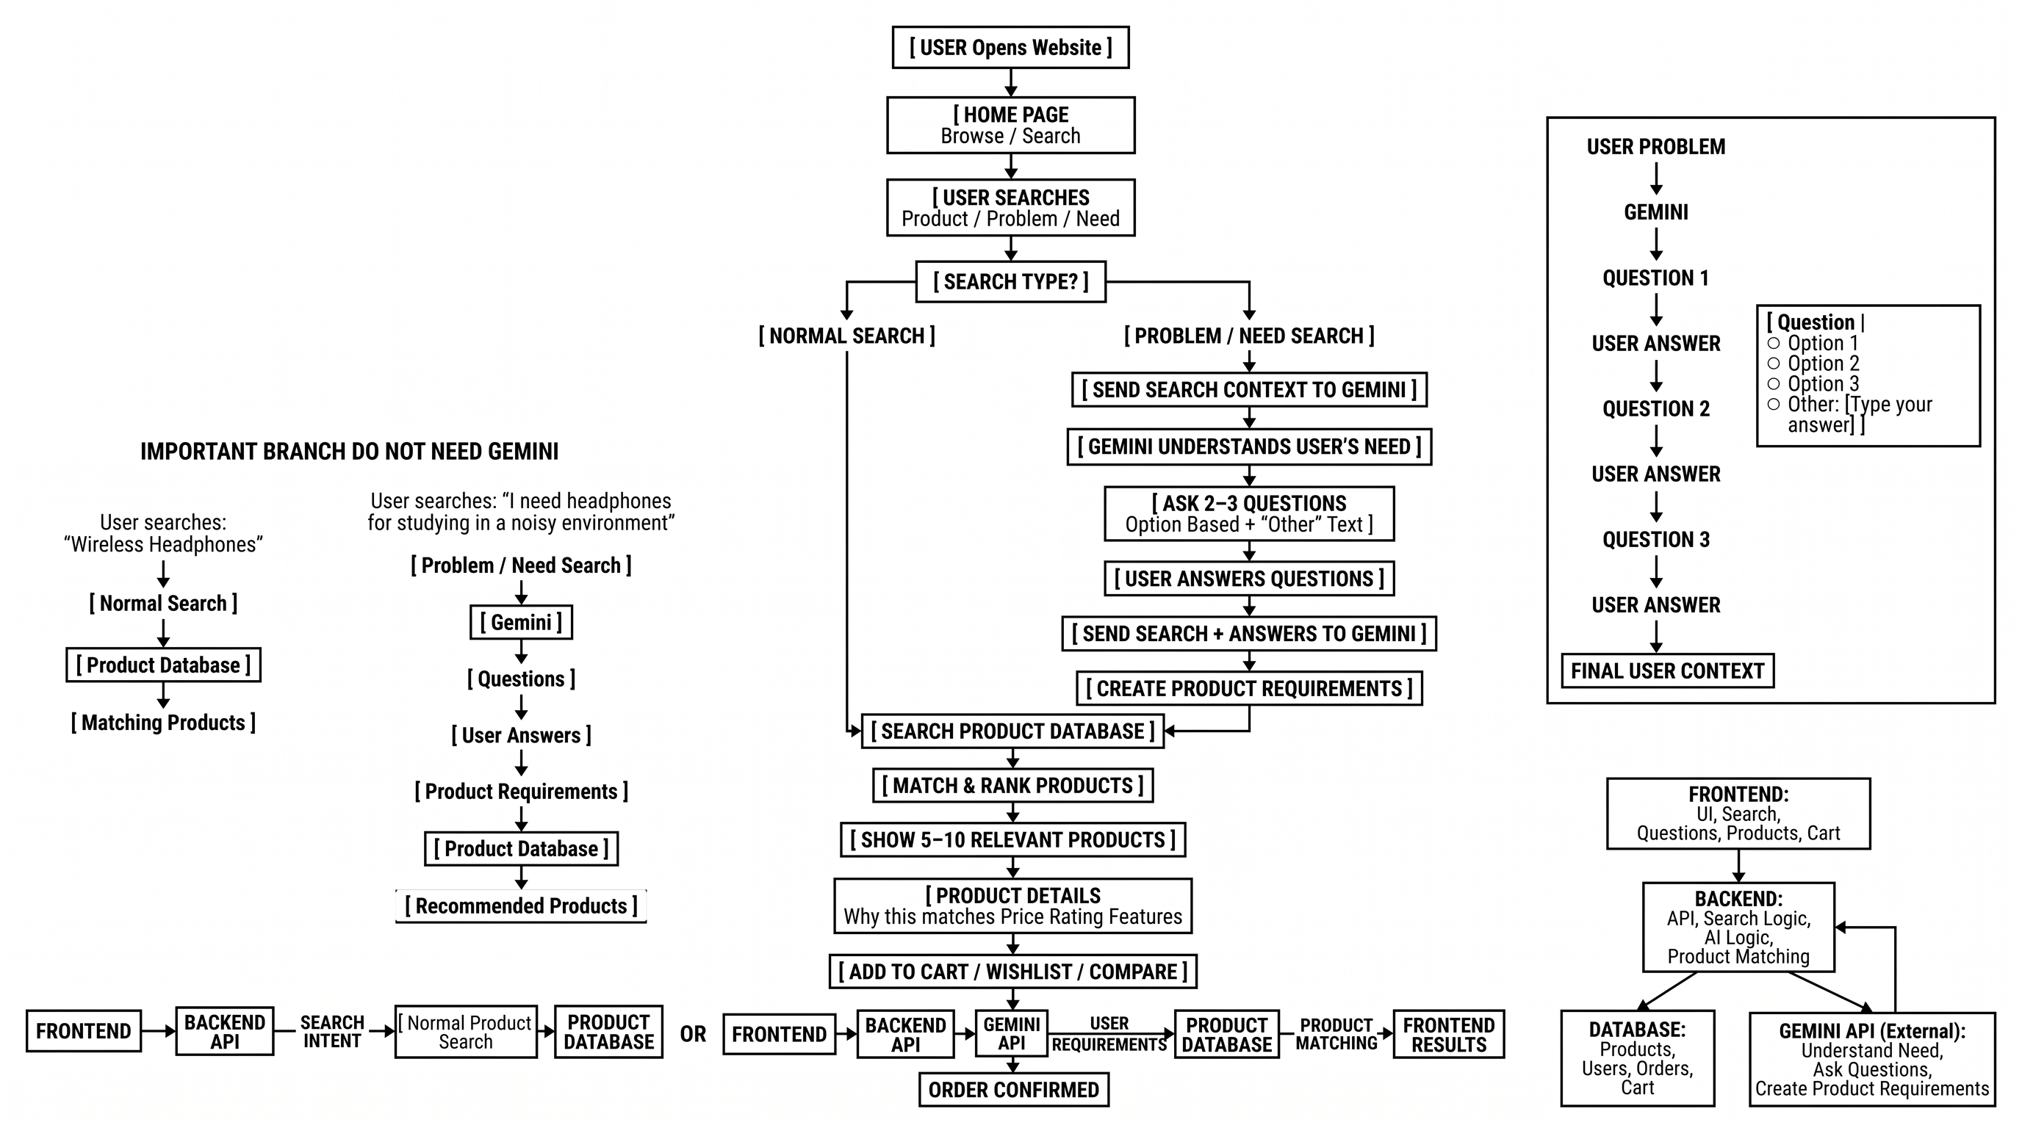
Project WorkFlow

Slide 12
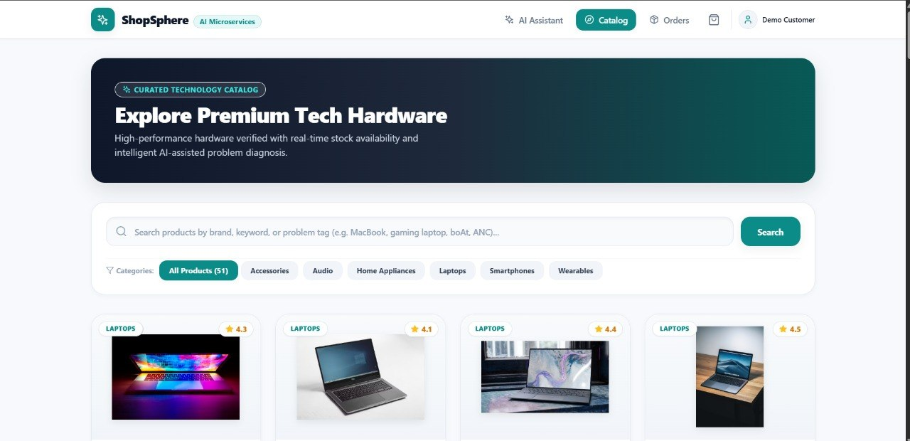
FrontEnd Implementation

