Slide 1

AI-Powered Deep Fake Detection
Team_10666
Samartapu Umesh
Merugu Bharath
Rendla Abhinay

Slide 2

Project Objectives
• Problem Statement
• Project Overview – Introduction
• End Users
• Wow Factor in Project
• General System Overview
• Modelling
• Result
• Conclusion
• Future Perspective

Slide 3
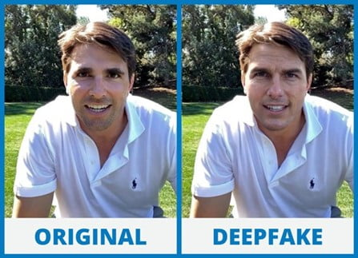
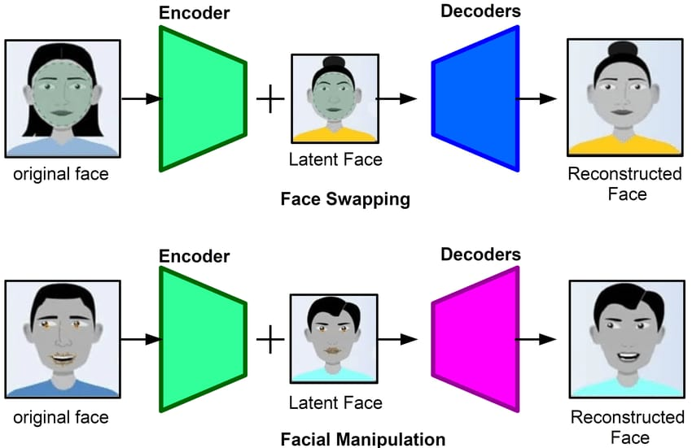
Problem Statement
Deepfake technology uses AI to generate hyper-realistic fake videos that can be weaponized to spread dangerous misinformation, facilitate identity theft
While these threats grow, existing detection tools often suffer from slow processing speeds, complex interfaces , or opaque decision-making.
To combat this, there is an urgent demand for a user-friendly web application that offers: Real-time analysis , Intuitive design.

Slide 4
Project Overview – Introduction
This Django-based web application detects deepfakes in uploaded videos using a hybrid approach:
Computer Vision: Analyzes facial inconsistencies via OpenCV and face_recognition.
Deep Learning: Employs PyTorch models trained on
User-Friendly Interface: Allows non-technical users to upload media, and receive instant results with visual explanations (confidence scores).

Slide 5
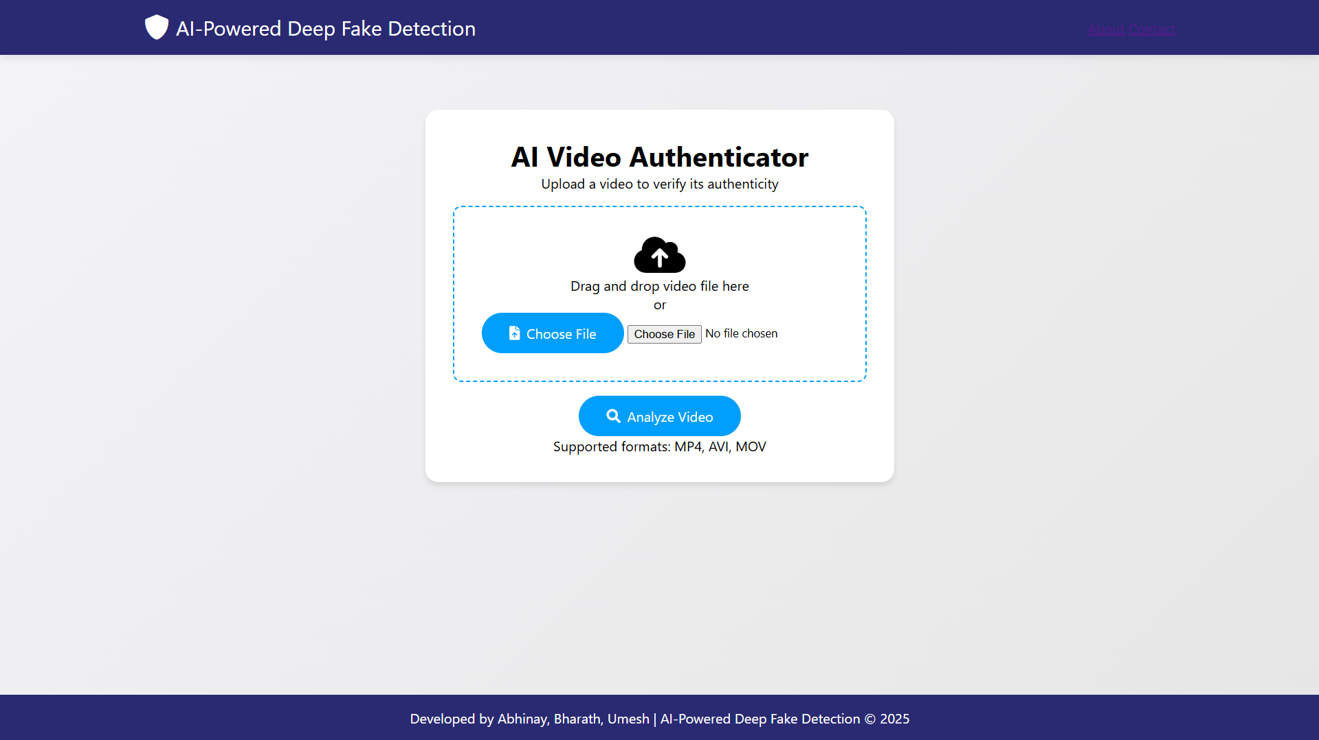
Project Overview

Slide 6
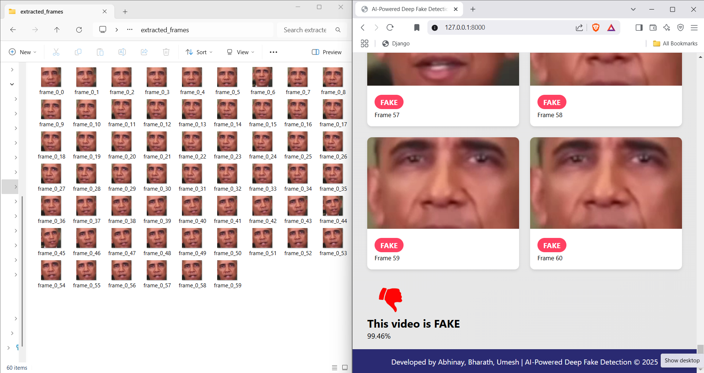
Project Overview

Slide 7
Wow Factor in Project
Hybrid Detection:
Combines facial landmark analysis (via face_recognition) with temporal consistency checks (OpenCV) and deep learning (PyTorch).
User-Friendly Interface:
Allows non-technical users to upload media, and receive instant results with visual explanations (confidence scores).

Slide 8





Wow Factor in Project
Hybrid Detection: Combines facial landmark analysis (via face_recognition) with temporal consistency checks (OpenCV) and deep learning (PyTorch).

Slide 9

Wow Factor in Project
User-Friendly Interface:
Allows non-technical users to upload media, and receive instant results with visual explanations (confidence scores).

Slide 10



End Users
Journalists/Media: Verify authenticity of viral content.
Legal Teams: Analyze evidence for forensic investigations.
General public: Check personal media credibility.
Social Media Platforms: Automatically flag Check personal media credibility, deepfakes.

Slide 11





General System Overview
User Upload: Accepts videos/images via a Django frontend (HTML/CSS/JS).
Preprocessing: Extracts frames (OpenCV), detects faces (face_recognition), and normalizes data (NumPy).
Model Inference: PyTorch-based CNN model predicts deepfake likelihood.
Result Delivery: Displays confidence scores.
User Upload
preprocessing
Model
Accuracy prediction

Slide 12
Modelling
Input: Video files
Preprocessing: Frame extraction (OpenCV) → Data organization (Pandas)
Feature Extraction: Transfer Learning with ResNet50/EfficientNet (PyTorch)
Custom Layers: Temporal 3D Convolutions for video sequence learning
Training: Using FaceForensics++ & Celeb-DF datasets
Evaluation: AUC-ROC, Precision-Recall, F1-score (scikit-learn)
Output: Deepfake detection probability

Slide 13
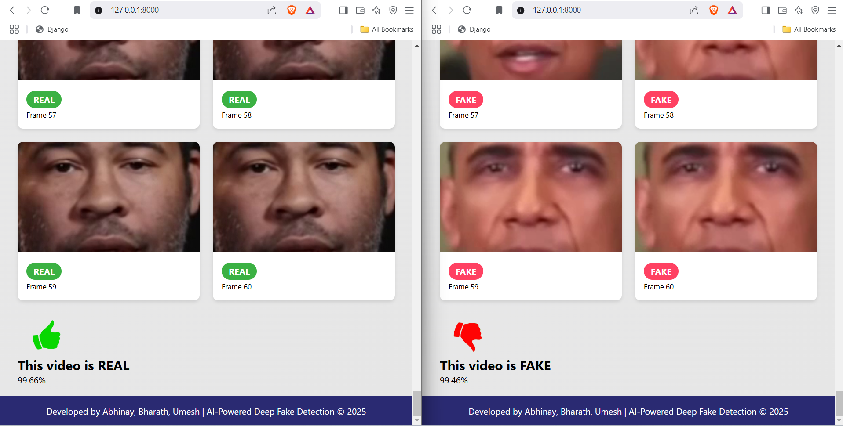
Result

Slide 14
Result
Expected >90% accuracy on benchmark datasets.
Real-time processing (<30 seconds for a 15-second video).
Interactive dashboard showing detection and visual explanations.

Slide 15
Conclusion
This project bridges the gap between advanced AI research and practical tools by combining Django’s scalability, PyTorch’s deep learning capabilities, and OpenCV’s real-time processing. Key achievements include:
A hybrid detection system for robust deepfake identification.
A user-friendly interface democratizing access to AI-powered verification.

Slide 16
Future Perspective
Mobile Integration: Develop a lightweight app using ONNX/TensorRT.
Adversarial Training: Improve model resilience against evolving deepfake techniques.
Blockchain Verification: Store hashed results for tamper-proof audits.
Browser Extension: Real-time detection for social media platforms.

Slide 17
Thank You !

