Slide 1

Welcome…

Slide 2

Name of Project:- Book Publication Management System
Serial No. | Name of Group Members | Class | Branch | Divison
1. | Umesh Vikas Sathe | T.Y.BTech. | CSE | A
2. | Sanket Sambhaji Kondubhairy | T.Y.BTech. | CSE | A
3. | Gorakshnath Balkrushna Shejal | T.Y.BTech. | CSE | A
4. | Pratik Gorakh Mali | T.Y.BTech. | CSE | A

Slide 3
Introduction of the Project
A Book Publication Management System keeps track of all books those are published.
It is an important piece of software which will help us to maintain record of all books.This software is most useful at schools ,colleges and libraries.
Tkinter is the standard GUI library for Python.We will build a Book Publication Management System using Tkinter Library to make it interactive.
Book Publication Management System is a software which stores whole information of published books in a local database.
We can easily add, delete, update a book information in the database.

Slide 4
Requirements
Software Requirements:
Python Interpreter
IDE- Visual Studio Code
Windows OS 7/8/10
MySQL Server

Slide 5

E-R Diagram
Name
ID
Year
Book Publication Management System
Company
Edition
Author

Slide 6

Program in Python

Slide 7
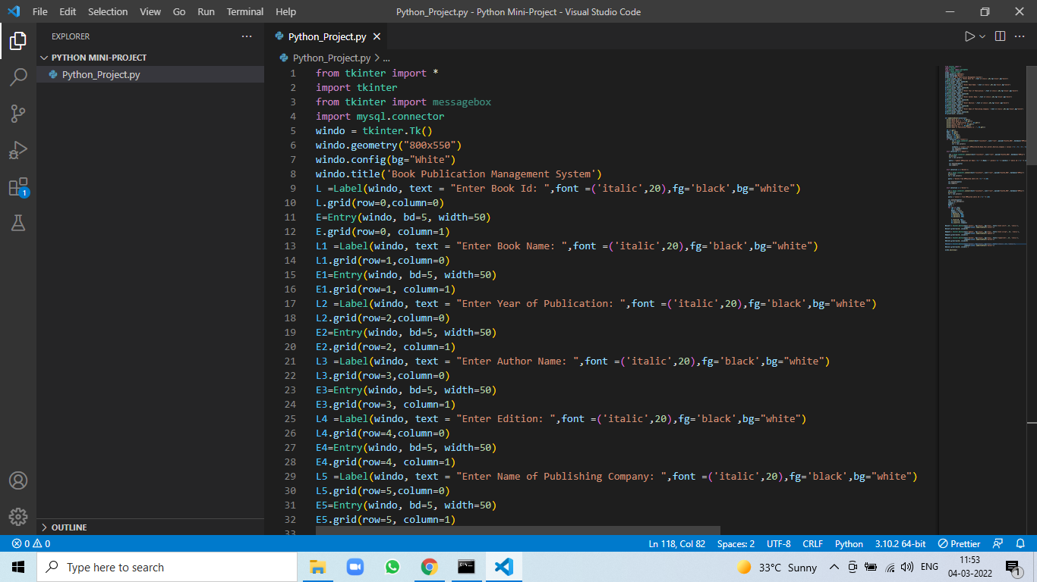

Slide 8
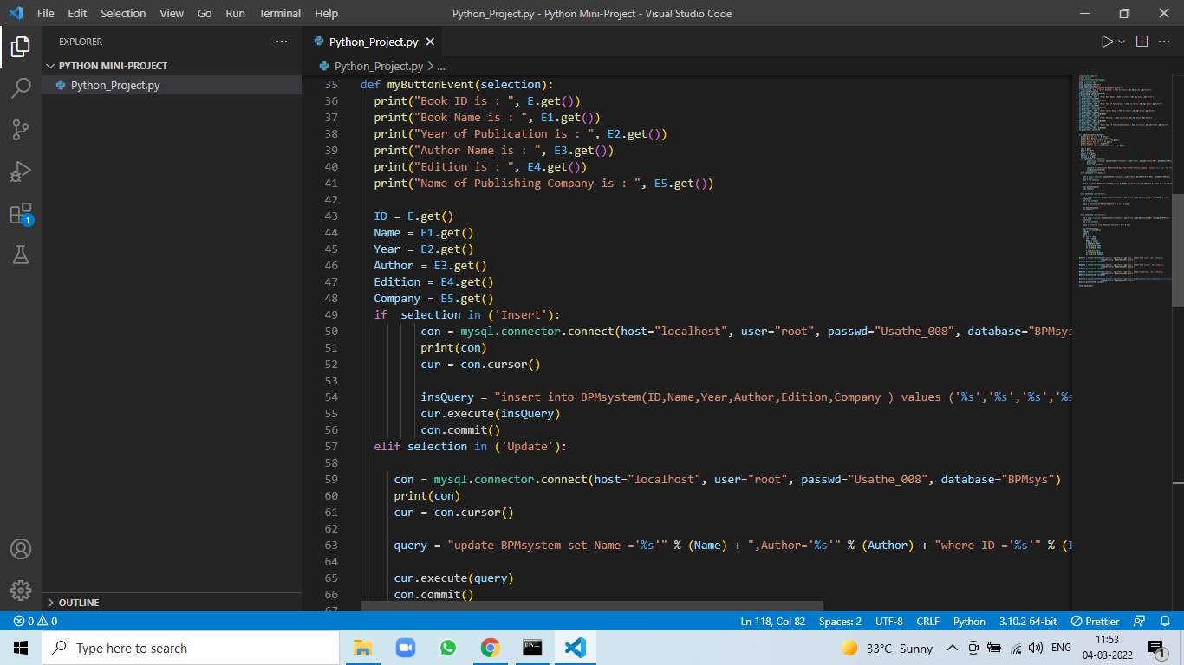

Slide 9
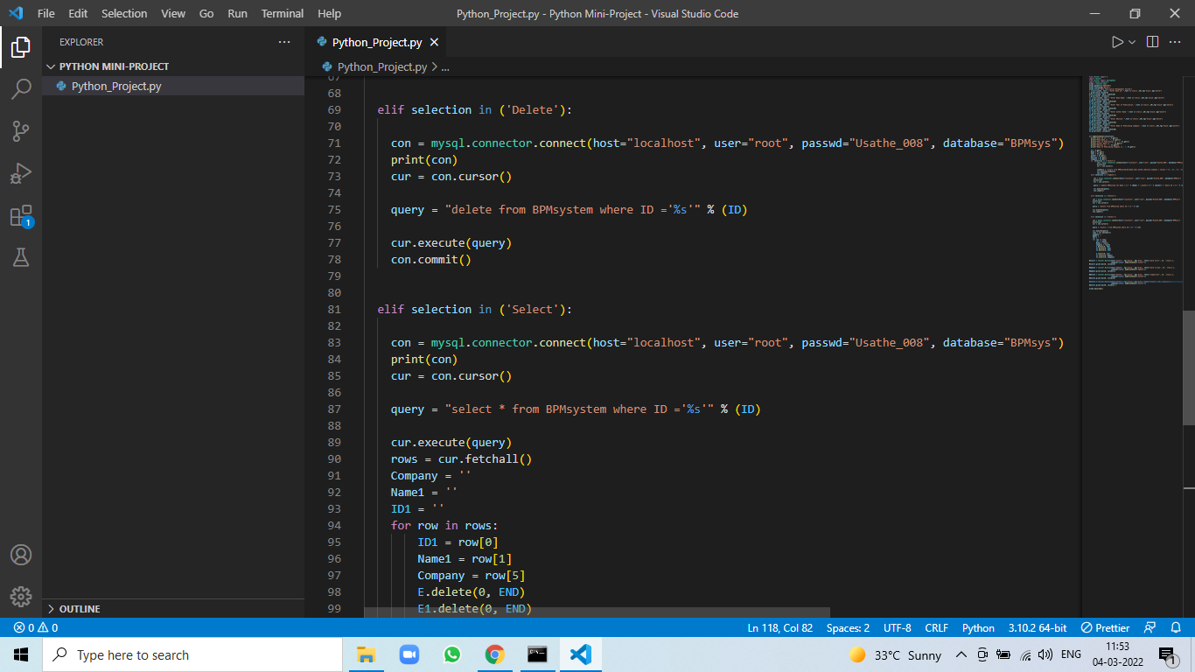

Slide 10
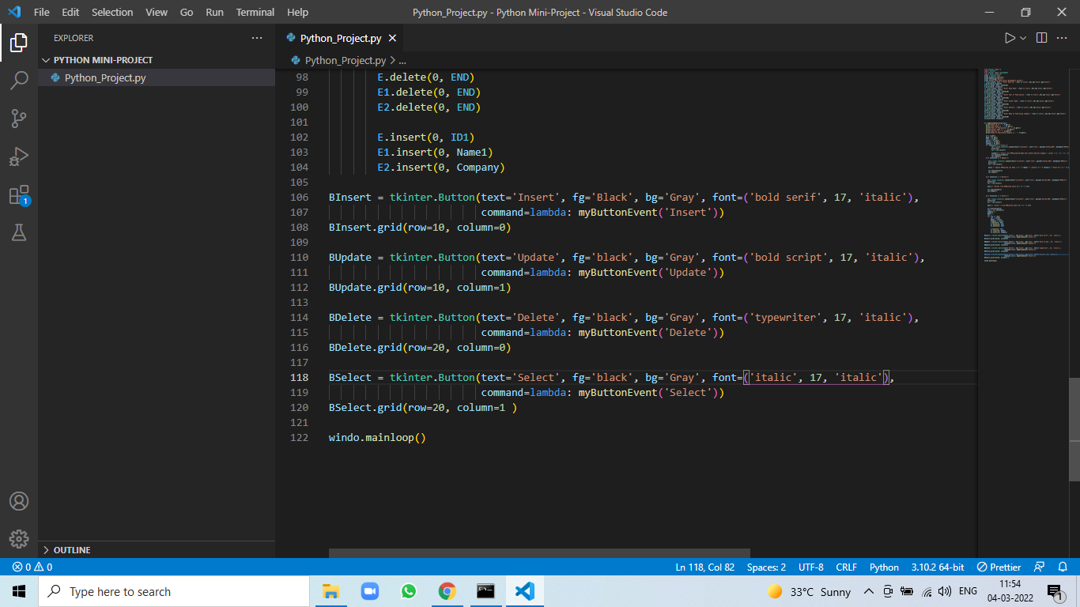

Slide 11

Output of Program

Slide 12
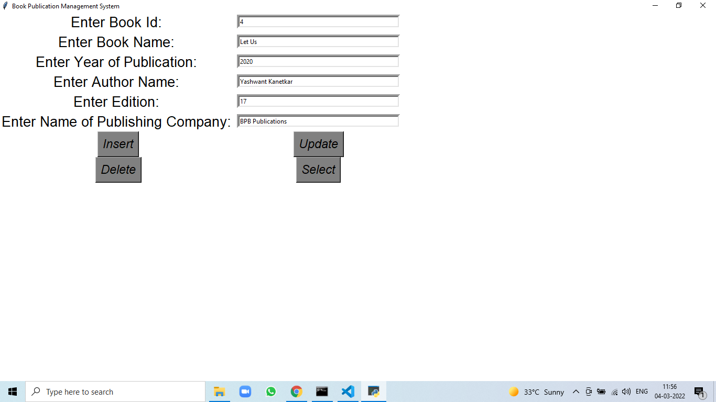

Slide 13

Database

Slide 14
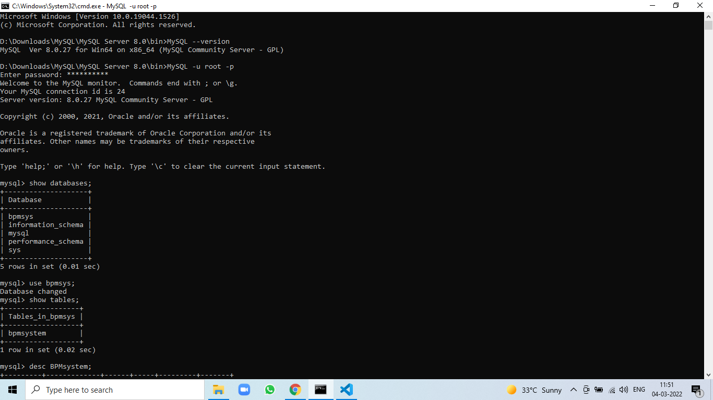

Slide 15
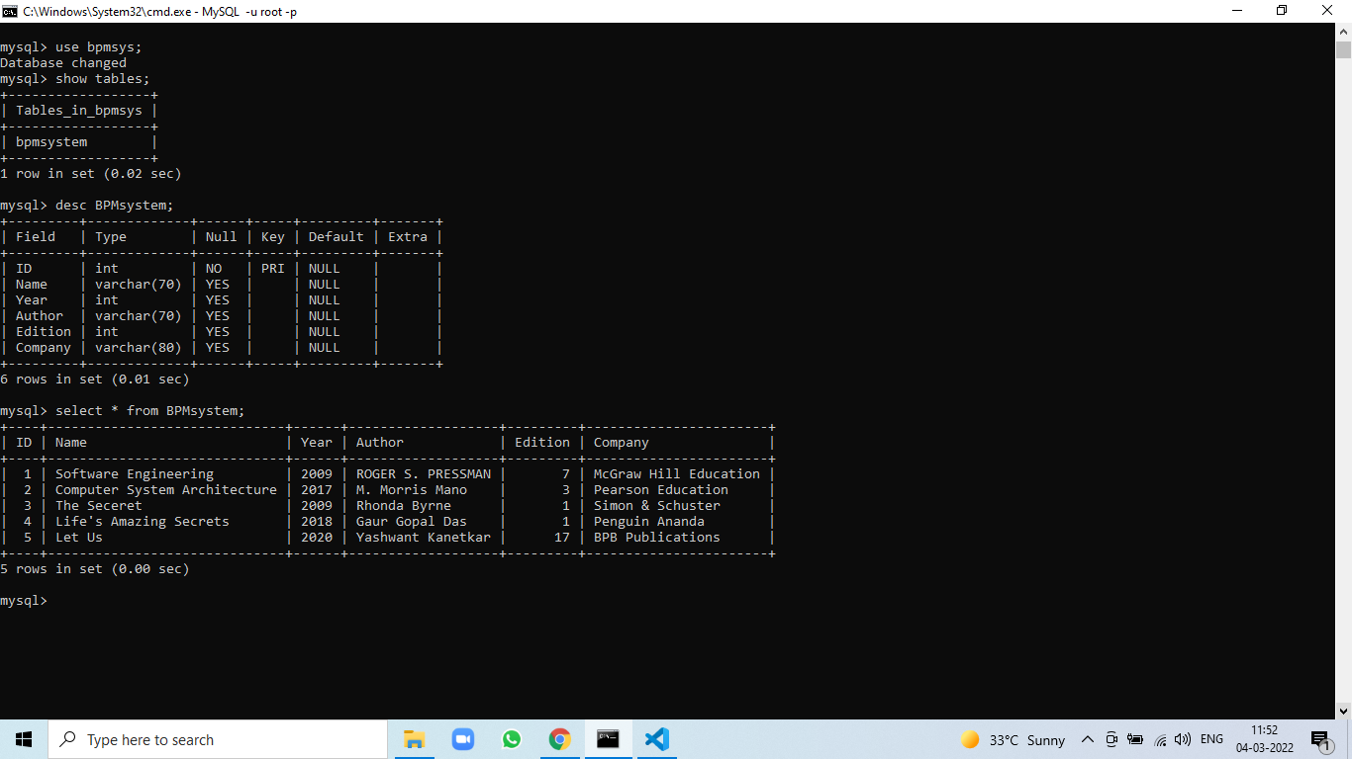

Slide 16
Conclusion & Future scope
The Book Publication Management System will helps us to keep track of all books those are published. This Piece of software mostly helpful for staff of college library as well as students. By using this software students as well as staff of college library can easily take information of all books that are present in the library.

Slide 17
Thank You …!

