Slide 1

Welcome…

Slide 2

Name of Project:- Book Publication Management System

Slide 3
Introduction of the Project
A Book Publication Management System is an important piece of software which will help us to maintain record of all published books.
This software is most useful in schools as well as college libraries. Also in a organization which publishes different books.
Tkinter is the standard GUI library for Python.We have built a Book Publication Management System using Tkinter Library to make it interactive.
Book Publication Management System is a software which stores whole information of published books in the local database.
We can easily add, delete, update book information in the local database.

Slide 4
Requirements
Software Requirements:
Python Interpreter
IDE- Visual Studio Code
Windows OS 7/8/10
MySQL Server

Slide 5

E-R Diagram
Name
ID
Year
Book Publication Management System
Company
Edition
Author

Slide 6

Program in Python

Slide 7
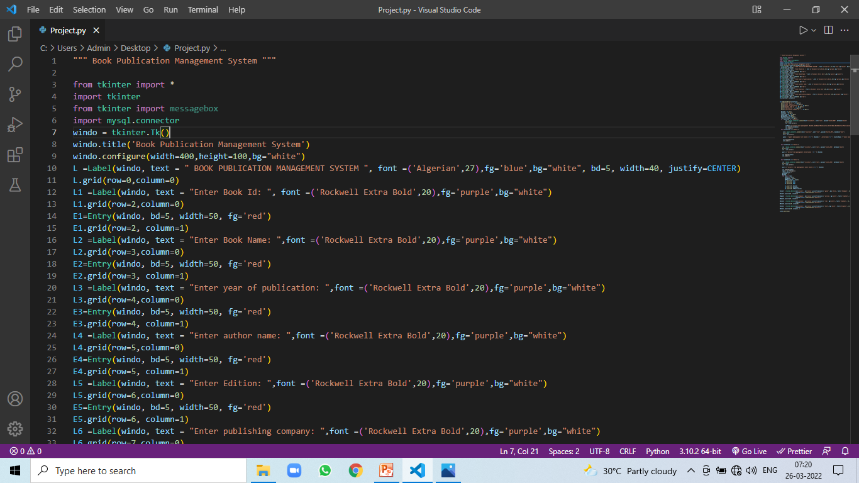

Slide 8
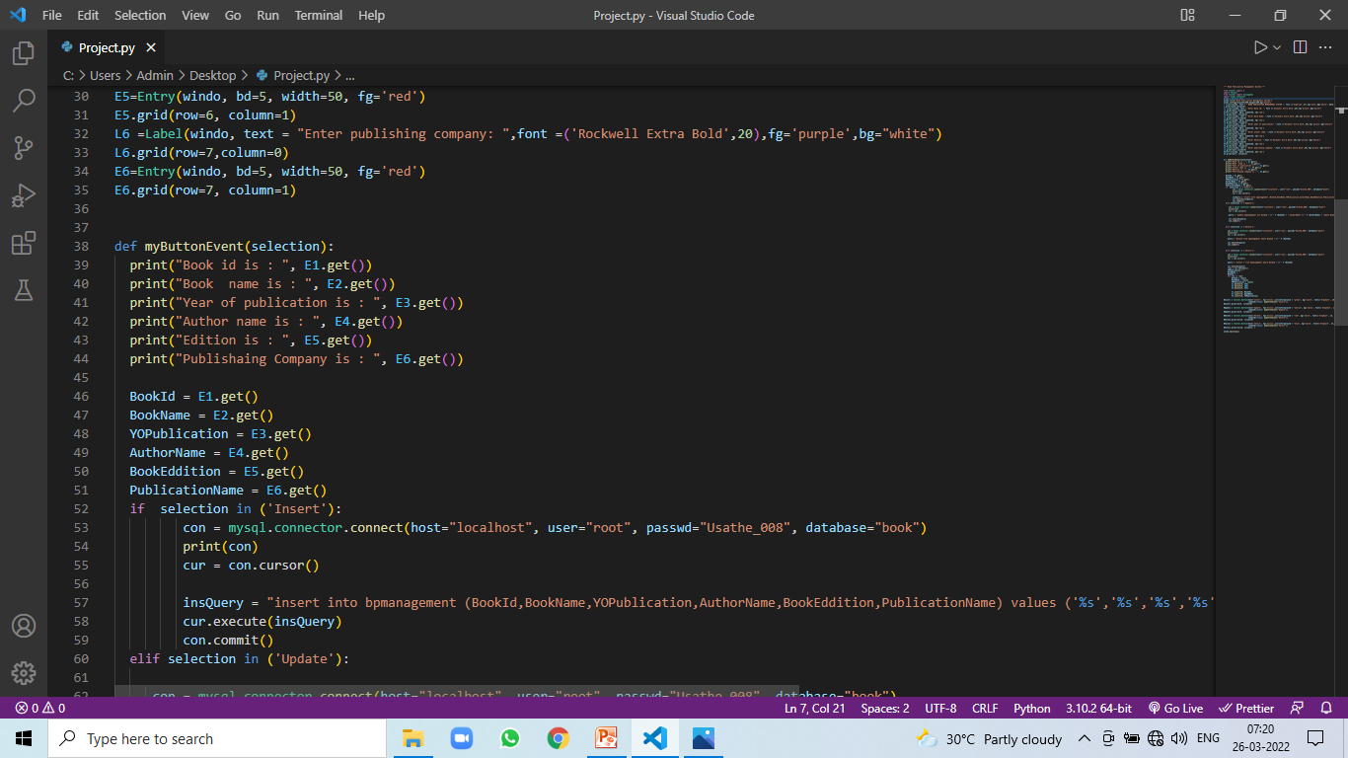

Slide 9
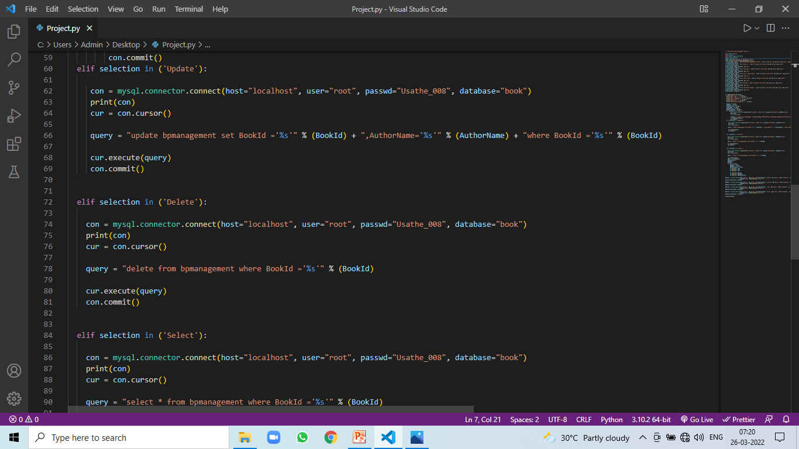

Slide 10
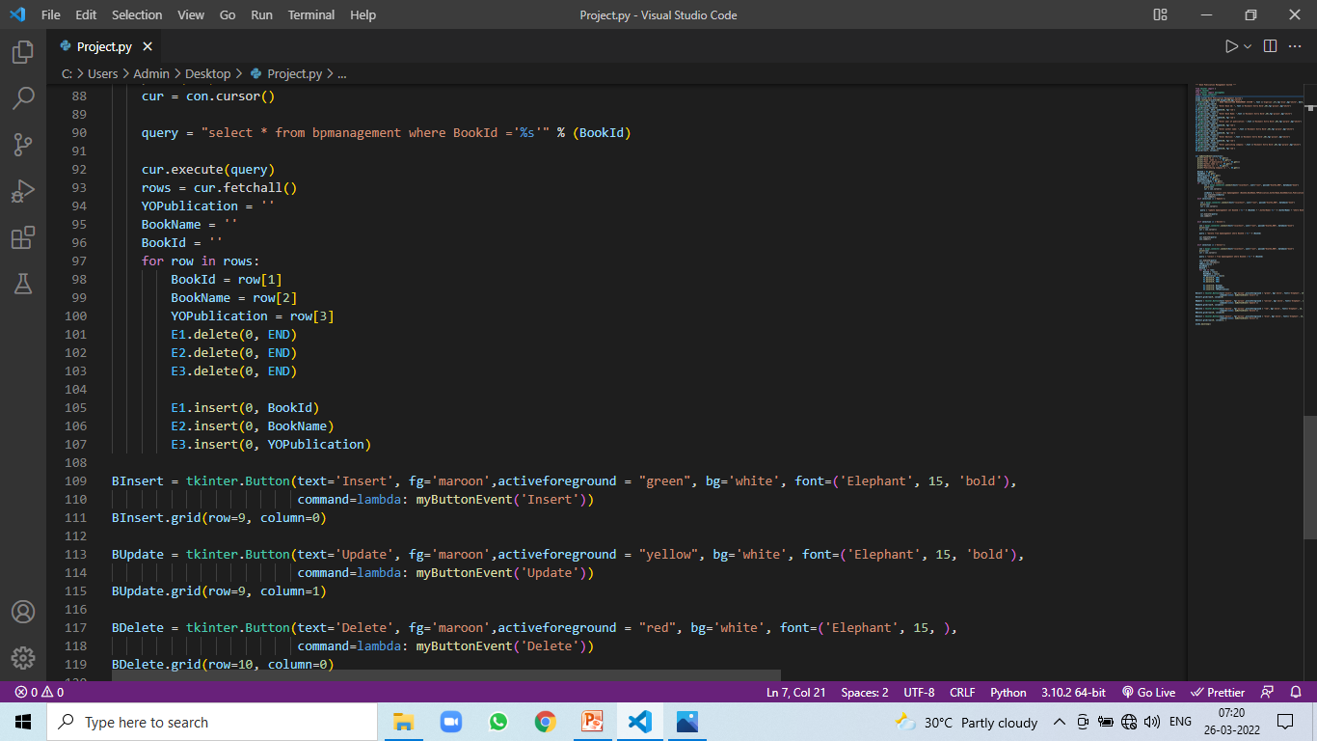

Slide 11
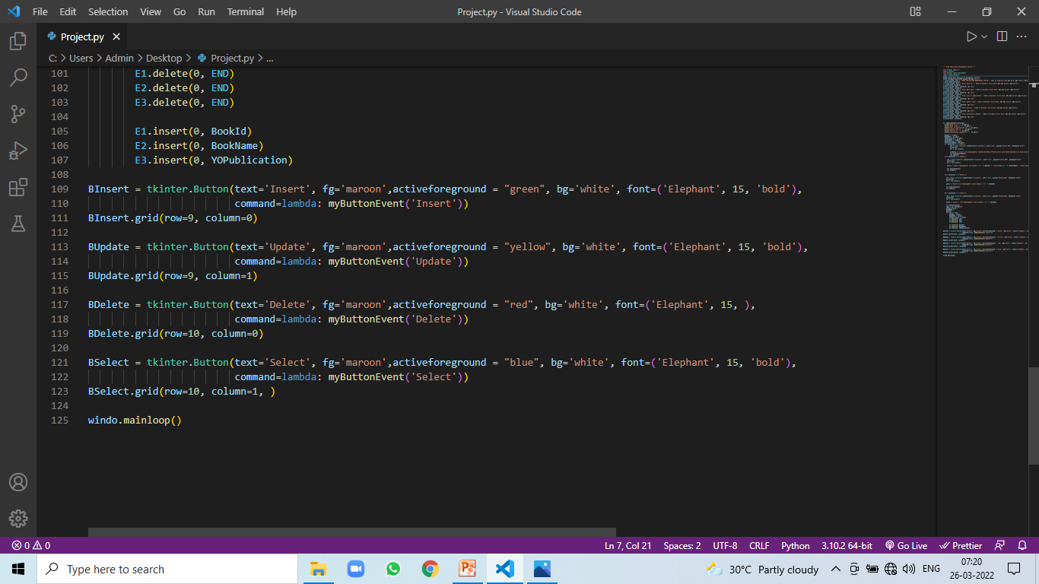

Slide 12
Output of Program

Slide 13
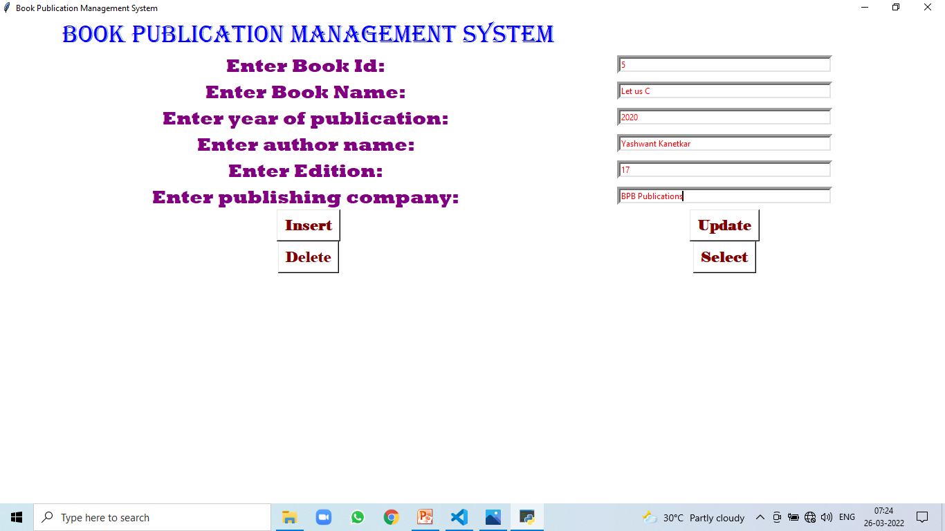

Slide 14

Database

Slide 15
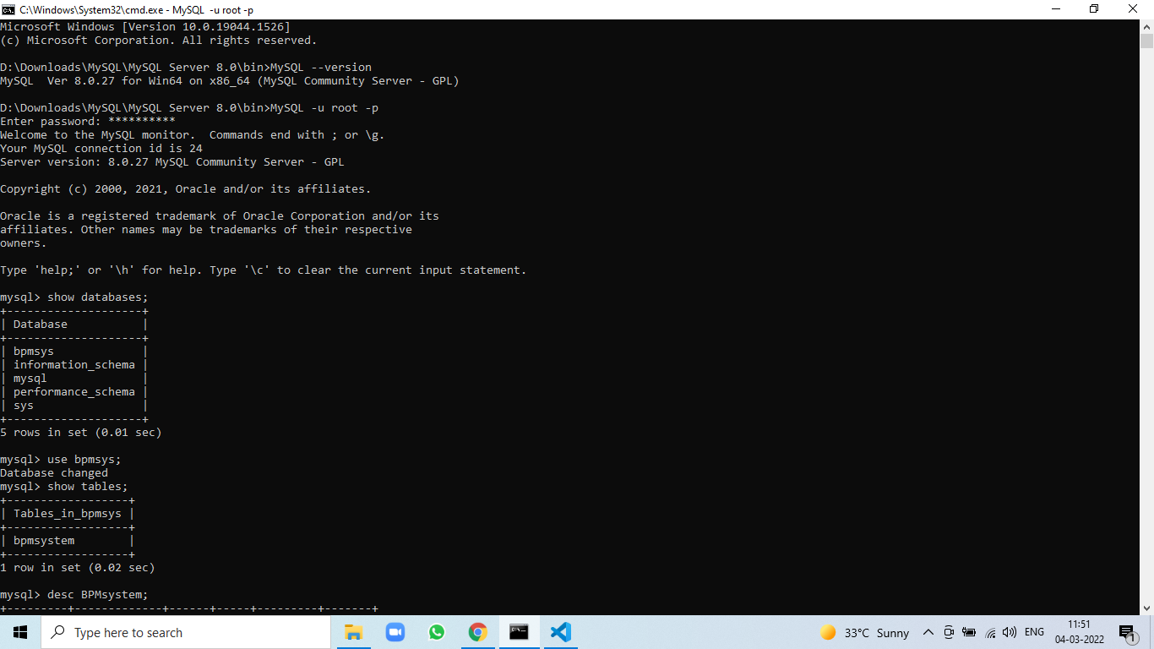

Slide 16
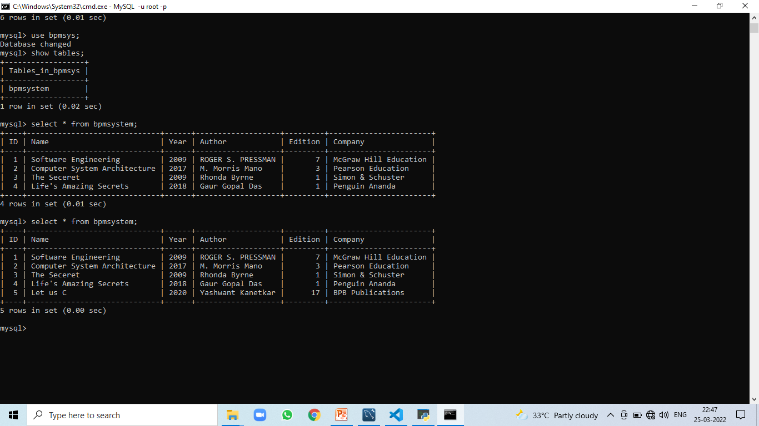

Slide 17
Conclusion & Future scope
The Book Publication Management System will helps us to keep track of all published books . This piece of software mostly helpful in a organization which publishes books. By using this software different users can easily take information of any published book.

Slide 18
Thank You …!

